Slide 1
RESILIENCE INDEX (RI)
Dan Wismer
Conservation Data Specialist
Last major edit: Aug 16th, 2023

Slide 2
RI OVERVIEW
The goal of the RI is to:
Capture National Conservation data into a single metric
Enhance Where To Work site selection outputs
Drive What To Do management action optimizations
Guide Project Management Plans and Securement
RI provides a “catch-all” Landscape Level metric that aids in comparing the relationship between location and conservation impact.

Slide 3
RI INPUT DATA
Conservation data has been captured into 8 broad Themes.
Biodiversity
Carbon
Climate
Connectivity
Environmental Services
Habitat
Protection
Threats
Features (layers) that make up each theme have been weighted by importance.

Slide 4
RI FEATURES & RELATIVE WEIGHTS
POSITIVE FEATURES
THEMES | FEATURES | SIGN | WEIGHTS | RANKS
Biodiversity | Key Biodiversity Areas | + | 15 | 1
Connectivity | Connectivity | + | 13 | 2
Protection | Existing Conservation | + | 12 | 3
Biodiversity | Critical Habitat | + | 9 | 4
Biodiversity | Endangered | + | 8 | 5
Biodiversity | Threatened | + | 7 | 6
Biodiversity | Special Concern | + | 6 | 7
Climate | Refugia | + | 6 | 7
Climate | Velocity | + | 6 | 7
Carbon | Potential | + | 5 | 8
Carbon | Storage | + | 5 | 8
Habitat | Forest Landcover | + | 2 | 9
Habitat | Grassland | + | 2 | 9
Habitat | Wetland | + | 2 | 9
eServices | Freshwater Provision | + | 1 | 10
eServices | Recreation | + | 1 | 10
NEGATIVE FEATURES
THEMES | FEATURES | SIGN | WEIGHTS | RANKS
Threats | Human Footprint Index | - | 38 | 1
Climate | Extremes | - | 12 | 2
Ranks are rationalized using the
Connectivity. Adequacy. Representativeness. Efficiency principle.
Positive weights tally up to 100
Negative weights tally up to -50

Slide 5
RI PREP DETAILS
Each feature is scaled between 0 and 1 before the RI equation is executed. This step is required in order to combine features that have different units of measurement.
Scaling equation:
Normalized feature = (feature – min value) / ( max value – min value)

Slide 6
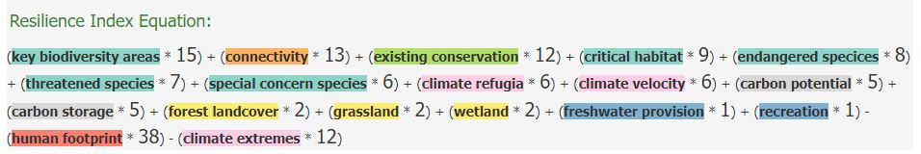
RI EQUATION
RI = (feature * weight) + (feature * weight) - (feature * weight) etc.
CP&P has provided an RI recommendation for review.

Slide 7
RI BUILDER
Designed as an engagement tool that shows transparency in the make-up of the index.
Users can change weights and update the RI in real time. This provides a means to reason with the relative importance of layers that comprise the index
Main App Features:
RI map display
RI equation display
RI point extractions and pop-up
RI download

Slide 8
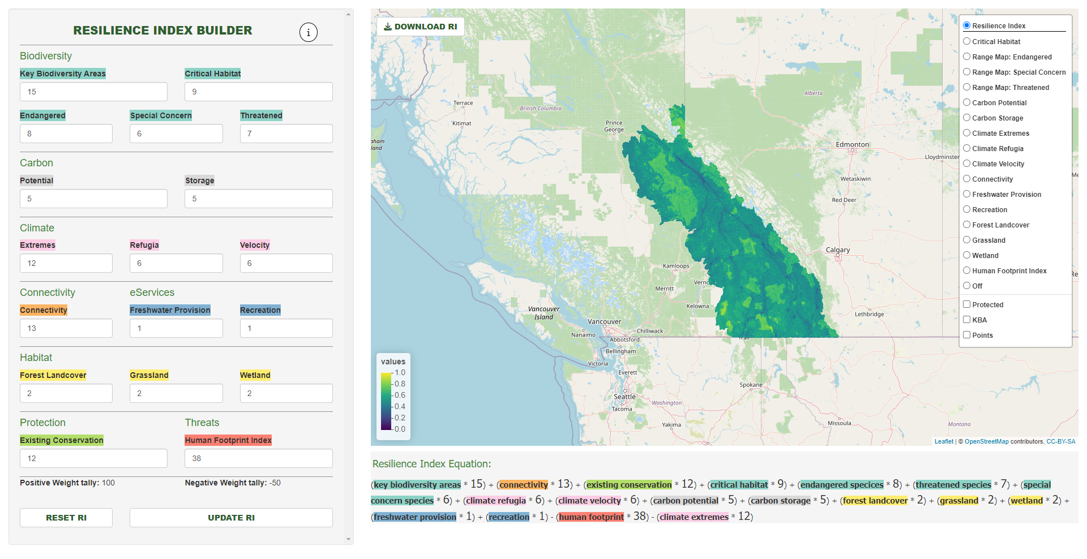
RI BUILDER UI
Download updated RI raster (.tif) and weights (.xlsx)
View PowerPoint
View layers one at a time
Update weights
Toggle overlays
Reset weights to CP&P Recommendation
Update RI on map
Tally of total weights
RI Equation
Click on mapped points to view RI cell value

Slide 9
RI BUILDER
As you increase the weight, the feature
Users can change weights and update the RI in real time. This provides a means to reason with the relative importance of layers that comprise the index
Main App Features:
RI map display
RI equation display
RI point extractions and pop-up
RI download

Slide 10
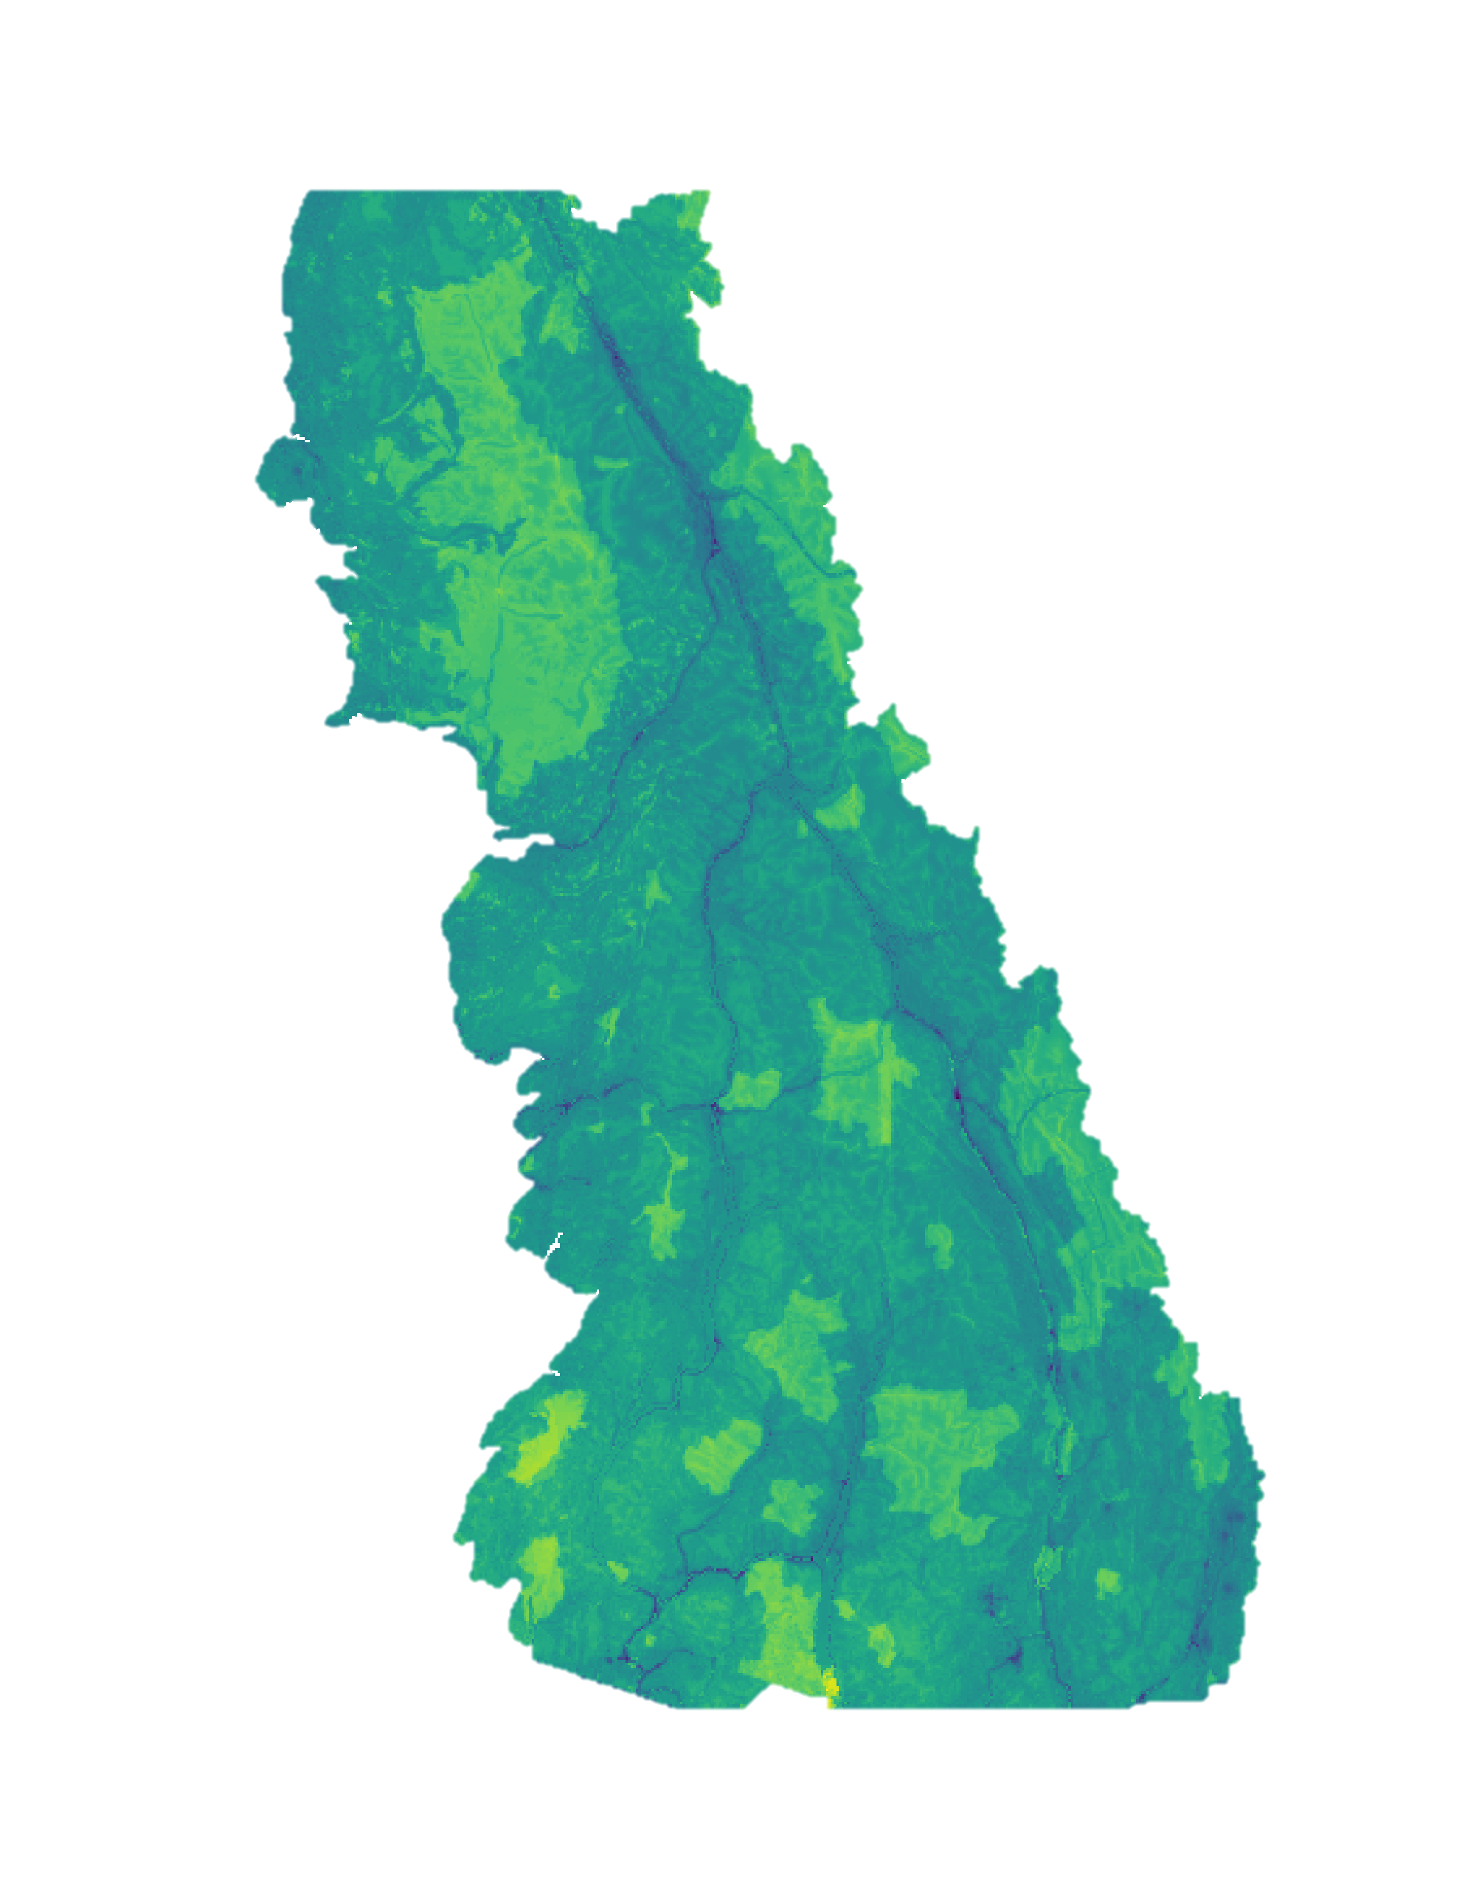
NEXT STEPS
Low RI Value
Finding agreement on RI definition
Finding agreement on the RI inputs
Finding agreement on RI weights
Communicating what RI is good at explaining and where it falls short (limitations)
High RI Value

