Slide 1
RESILEINCE INDEX (RI)
Dan Wismer
Conservation Data Specialist
Last major edit: Aug 16th, 2023

Slide 2
RI OVERVIEW
The goal of the RI is to:
Capture National Conservation data into a single metric
Enhance Where To Work site selection outputs
Drive What To Do management action optimizations
Guide Project Management Plans and Securement
RI provides a “catch-all” Landscape Level metric that aids in comparing the relationship between location and conservation impact.

Slide 3
RI INPUT DATA
Conservation data has been captured into 8 broad Themes.
Biodiversity
Carbon
Climate
Connectivity
Environmental Services
Habitat
Protection
Threats
Features (layers) that make up each theme have been weighted by importance.

Slide 4
RI FEATURES & RELATIVE WEIGHTS
POSITIVE FEATURES
THEMES | FEATURES | SIGN | WEIGHTS | RANKS
Biodiversity | Key Biodiversity Areas | + | 15 | 1
Connectivity | Connectivity | + | 13 | 2
Protection | Existing Conservation | + | 12 | 3
Biodiversity | Critical Habitat | + | 9 | 4
Biodiversity | Endangered | + | 8 | 5
Biodiversity | Threatened | + | 7 | 6
Biodiversity | Special Concern | + | 6 | 7
Climate | Refugia | + | 6 | 7
Climate | Velocity | + | 6 | 7
Carbon | Potential | + | 5 | 8
Carbon | Storage | + | 5 | 8
Habitat | Forest Landcover | + | 2 | 9
Habitat | Grassland | + | 2 | 9
Habitat | Wetland | + | 2 | 9
eServices | Freshwater Provision | + | 1 | 10
eServices | Recreation | + | 1 | 10
NEGATIVE FEATURES
THEMES | FEATURES | SIGN | WEIGHTS | RANKS
Threats | Human Footprint Index | - | 38 | 1
Climate | Extremes | - | 12 | 2
Ranks are rationalized using the
Connectivity. Adequacy. Representativeness. Efficiency principle.
Positive weights tally up to 100
Negative weights tally up to -50

Slide 5
RI PREP DETAILS
Each feature is scaled between 0 and 1 before the RI equation is executed. This step is required in order to combine features that have different units of measurement.
Scaling equation:
Normalized feature = (feature – min value) / ( max value – min value)

Slide 6
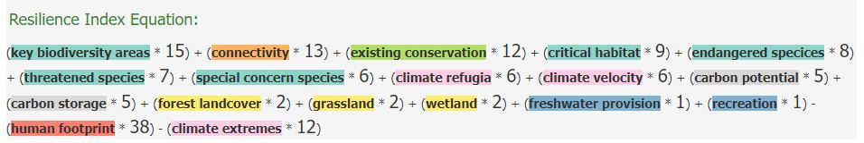
RI EQUATION
RI = (feature * weight) + (feature * weight) - (feature * weight) etc.
CP&P has provided an RI recommendation for review.

Slide 7
RI BUILDER
Designed as an engagement tool that shows transparency in the make-up of the index.
Users can change weights and update the RI in real time. This provides a means to reason with the relative importance of layers that comprise the index
Main App Features:
RI map display
RI equation display
RI point extractions and pop-up
RI download

Slide 8
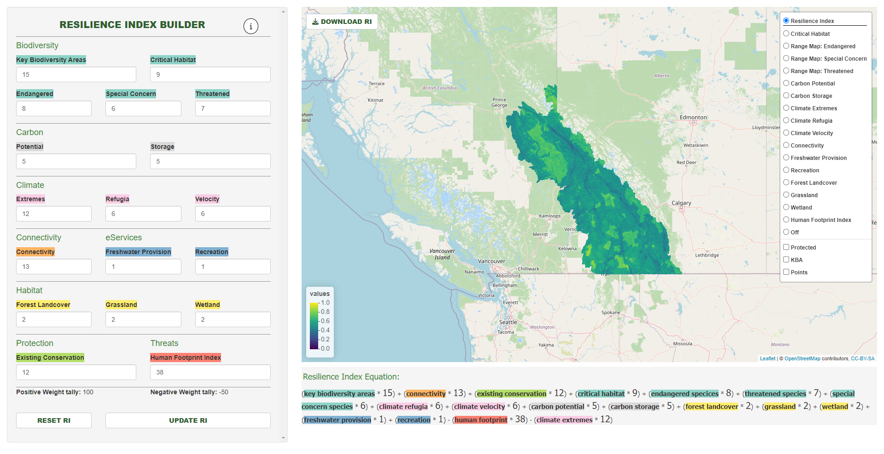
RI BUILDER
Download updated RI raster (.tif) and weights (.xlsx)
View PowerPoint
View layers one at a time
Update weights
Toggle overlays
Reset weights to CP&P Recommendation
Update RI on map
Tally of total weights
RI Equation
Click on mapped points to view RI cell value

