Slide 1
LANDSCAPE RESILIENCE CONCEPTS & SCORE THIS IS NOT AN OVERVIEW OF THE LANSCAPE RESILIENCE TOOL
Dan Wismer
Conservation Data Specialist
Last major edit: Sep 14th, 2023

Slide 2
What is Landscape Resilience?
NCC infers the term Landscape Resilience as the capacity for biodiversity to recover from local losses and persist at the landscape scale.
For a landscape to be resilient, it must be able to adapt to pressures over time in a way that supports the long-term survival of biodiversity and ecosystems.
Landscape Resilience within this context considers ecological variables and aligns more closely with Ecological Resilience defined in the academic literature.
NCC’s Landscape scale is 1km x 1km square pixel

Slide 3
How can NCC Contribute to Landscape Resilience?
Addressing the existing protected area gaps to better represent ecosystems, increase connectivity and promote species persistence within intact landscapes.
By building a system of protected areas with a diverse ecological portfolio to help mitigate the risk of biodiversity loss.
Adding redundancy of species and their habitat through protection ensures persistence of biodiversity at the landscape level (Peterson, Allen & Holling, 1998).

Slide 4
Why is a Score Needed?
To operationalize the concept of Landscape Resilience.
To consolidate conservation variables that support the definition of Landscape Resilience into a single composite metric.
To assess a project’s contribution to Landscape Resilience and validate securement.
Provide basis for directing limited resources to those areas on the landscape where they are likely to have the greatest benefit.

Slide 5
How will the Score be used?
Enhance Where To Work site selection outputs
Extracting the Landscape Resilience Score to Where To Work outputs provides a continuous variable to assess Landscape Resilience between planning units.
Guide Project Management Plans and validate Securement
Extracting the Landscape Resilience Score to parcel boundaries provides a means to assess a projects contribution to Landscape Resilience.
Landscape Resilience Tool is the interface to extract the score

Slide 6
What makes up the Score?
NCC valued conservation themes that capture concepts of Landscape Resilience impacts and risks:
Protection: existing conservation
Biodiversity: richness, adequacy, key biodiversity areas, critical habitat
Connectivity: current density
Climate: centrality, refugia
Habitat: forest, wetland, grassland, rivers, shoreline
Threats: human disturbance, climate extremes

Slide 7
Landscape Resilience Score Inputs
Protection
Protected areas contribute to Landscape Resilience by safeguarding species from threats of biodiversity loss.
Protected areas that intersect other themes of Biodiversity, Connectivity and Climate with less influence of Threats are more resilient.
Variable(s) that capture Protection:
Existing conservation from Canadian Protected and Conserved Areas Database
NCC fee simple and conservation agreement achievements
All classes of protections is considered equal

Slide 8
Landscape Resilience Score Inputs
Biodiversity
Biodiversity theme is captured by mapping species data and calculating cumulative adequacy goals for each individual species.
The adequacy goal explains the required protection needed to ensure species persistence throughout time; where some species need more conservation than others.
Variable(s) that capture Biodiversity:
Species at risk: richness & cumulative adequacy goal (ECCC)
Endemic species: richness & cumulative adequacy goal (NSC)
Common species: richness & cumulative adequacy goal (IUCN & NSC)
Key biodiversity areas (IBA Canada)
Critical habitat for species at risk (ECCC)

Slide 9
Landscape Resilience Score Inputs
Connectivity
Landscapes that are connected promote the movement of species among habitat patches
High connectivity values favor biological flows and represent movement and dispersal patterns of species.
Variable(s) that capture Connectivity:
Current density (Pither et al, 2023)
Considered anthropogenic and natural features and their know effects on the movement of terrestrial non-volant fauna to predict connectivity.

Slide 10
Landscape Resilience Score Inputs
Climate
Related to connectivity, it is important to adjust for the effects of climate change and give species the opportunity to move as climate conditions change.
Areas that provide climate resiliency increase the Landscape Resilience Score
Variable(s) that capture Climate:
Climate refugia (Stralberg et al. 2021; AdaptWest)
Locations with rare climatic conditions that are likely to facilitate species persistence under climate change
Climate centrality (Carroll et al. 2018; AdaptWest)
Represents connectivity between current and future climate analogs

Slide 11
Landscape Resilience Score Inputs
Habitat
By securing a diverse portfolio of habitat types ensures redundancy is built into the protected area network.
Habitat types reflect NCC impact metrics.
Variable(s) that capture Habitat:
Forest landcover hectares (VLCE2 and AFFC LUTS)
Wetland hectares (CanVec)
Grassland hectares (AAFC LU)
River kilometers (NRCan)
Shoreline kilometers (CanVec)

Slide 12
Landscape Resilience Score Inputs
Threats
Habitat pressures pose a negative impact on Landscape Resilience.
Protected areas decreases the threat of biodiversity loss from anthropogenic pressures.
Variable(s) that capture Threats:
Human footprint index (UNBC)
considers built environments, population density, nighttime lights, crop lands, pasture lands, forestry, railways, roads dams, reservoirs, navigable waterways, mining and oil and gas disturbances.
Climate extremes (La Sorte et al. 2021)
Useful way to capture extreme stressors on biodiversity

Slide 13
Landscape Resilience Score Details
Each variable is scaled between 0 and 1 before the score is executed. This step is required to combine features that have different units of measurement.
For variables that have extreme concentration of high or low values, a log transformation is applied before scaling.
Scaling equation:
Normalized feature = (feature – min value) / ( max value – min value)

Slide 14
Landscape Resilience Score Details
Landscape Resilience Score =
(protection * value) +
(key biodiversity area * value) + (critical habitat * value) + (SAR richness * value) + (END richness * value) +
(common richness * value) + (SAR goal * value) + (END goal * value) + (common goal * value) +
(connectivity * value) +
(climate centrality * value) + (climate refugia * value) +
(forest landcover * value) + (wetland * value) + (grassland * value) + (rivers * value) + (shoreline * value)
- (human footprint index * value) - (climate extremes * value)
Where value represents the relative importance in rank with other variables in the equation.
Each unique 1km x 1km pixel has a score

Slide 15
Landscape Resilience Score Details
For now, each variable gets an equal weight of 1.
Eventually, we will need to decide IF variables should or should not be influenced by a “relative importance value”.
This decision should align with what NCC infers as Landscape Resilience.
There is no right or wrong approach, as argument could be made for many different combinations.
Example of importance broken down by Impact and Risk:
Impacts = Protection > Biodiversity > Connectivity > Climate > Habitat
Risks = Threats

Slide 16
LANDSCAPE RESILIENCE BUILDER THIS IS NOT THE LANSCAPE RESILIENCE TOOL
Dan Wismer
Conservation Data Specialist
Last major edit: Sep 14th, 2023

Slide 17
Landscape Resilience Builder
Designed as an engagement tool that shows transparency in the make-up of the Landscape Resilience (LR) Score.
Provides a proto-type of Landscape Resilience, where each pixel has a score
Users can change values and update the LR score in real time. This provides a means to reason with the relative importance of layers that comprise the score.

Slide 18
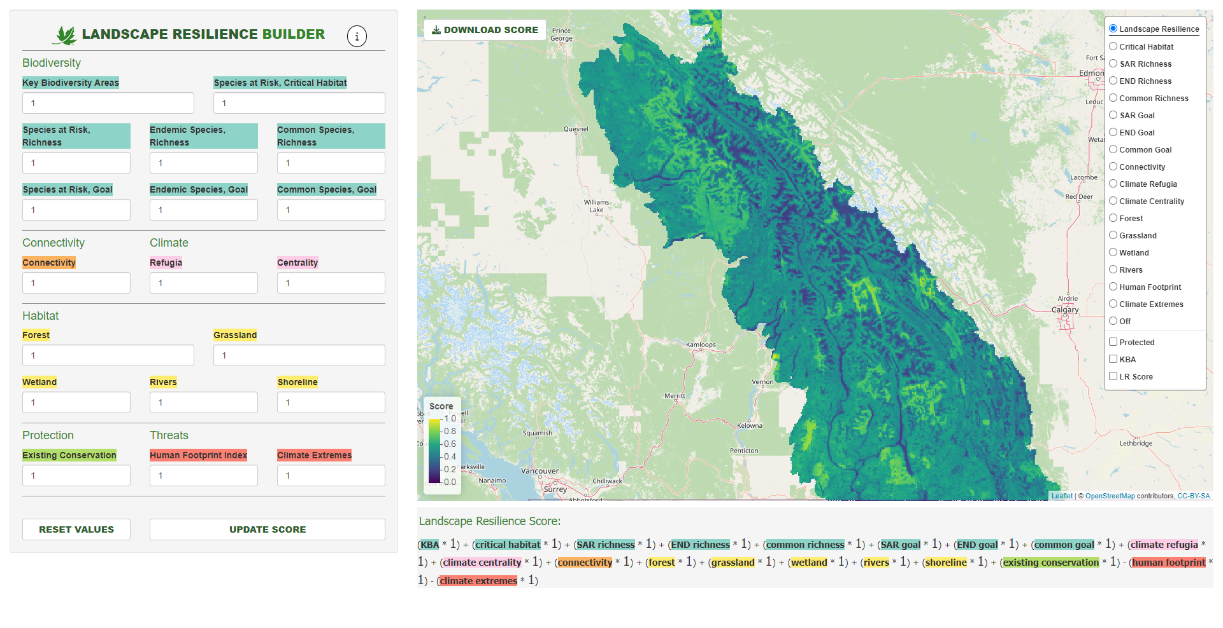
Landscape Resilience Builder
Download score (.tif) and values (.xlsx)
PowerPoint
Web link
View layers one at a time
Update values
Toggle overlays
Legend
Click points to view LR Score
Landscape Resilience Equation
Reset values
Update score on map

Slide 19
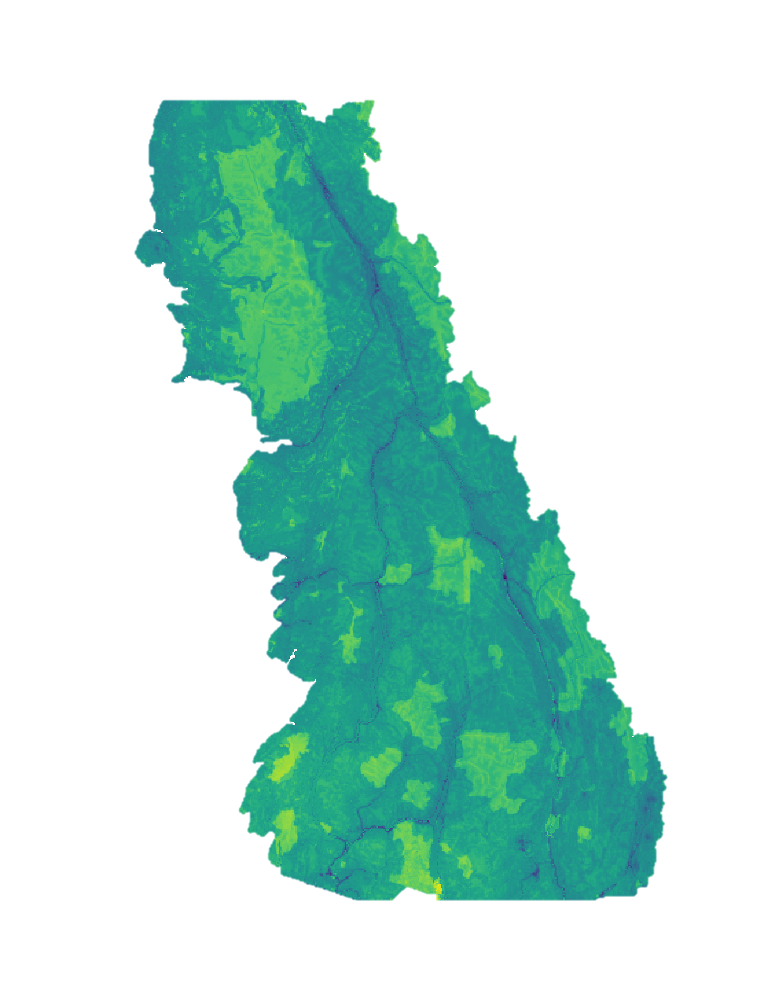
NEXT STEPS
Low LR Score
Finding agreement on Landscape Resilience definition
Finding agreement on Landscape Resilience inputs
Finding agreement on Landscape Resilience values
Communicating the difference between Landscape Resilience concept, score and tool
High LR Score

Slide 20
References
Ecological Resilience, Biodiversity and Scale
https://link.springer.com/article/10.1007/s100219900002
Resilience and stability of ecological systems:
https://www.annualreviews.org/doi/abs/10.1146/annurev.es.04.110173.000245
Metrics and Models for Quantifying Ecological Resilience at Landscape Scales:
https://www.frontiersin.org/articles/10.3389/fevo.2019.00440/full
Wild, connected, and diverse: building a more resilient system of protected areas:
https://esajournals.onlinelibrary.wiley.com/doi/full/10.1002/eap.1527
Understanding protected area resilience: a multi-scale, social-ecological approach:
https://esajournals.onlinelibrary.wiley.com/doi/abs/10.1890/13-2113.1?casa_token=a5GUcC01mnsAAAAA:dsV4tSiXnHfhPwnCutvAEmA-FGFrxO40JND730ft-nI6Oq_Eqe6GlarmzasTqznSmhyP1B2BW-0UNNg5
Landscape ecological concepts in planning: review of recent developments:
https://link.springer.com/article/10.1007/s10980-021-01193-y
Managing Rather Than Avoiding “Difficulties” in Building Landscape Resilience:
https://www.mdpi.com/2071-1050/13/5/2629
Quantifying spatial resilience:
https://besjournals.onlinelibrary.wiley.com/doi/full/10.1111/1365-2664.12634
Resilience in the Studies of Biodiversity-Ecosystem Functioning:
https://www.cell.com/trends/ecology-evolution/fulltext/S0169-5347(15)00321-3
Perspectives for ecosystem management based on ecosystem resilience and ecological thresholds against multiple and stochastic disturbances:
https://www.sciencedirect.com/science/article/pii/S1470160X15002411
A riparian conservation network for ecological resilience:
https://www.sciencedirect.com/science/article/pii/S0006320715002529#bb0155
A resilient and connected network of sites to sustain biodiversity under a changing climate
https://www.pnas.org/doi/10.1073/pnas.2204434119
Biodiversity, ecosystem function, and resilience: ten guiding principles for commodity production landscapes
https://esajournals.onlinelibrary.wiley.com/doi/full/10.1890/1540-9295%282006%29004%5B0080%3ABEFART%5D2.0.CO%3B2?casa_token=iSM4aLrMYhcAAAAA%3A7vbR7SrZmxu_f3k5FDiNeRWU9icdsIW24OMs6uA9QyAp6uCxU-JiKypg2ox7W9UpNIh2NCDROQtxkV4l

