Slide 1
RESILEINCE INDEX (RI)
Dan Wismer
Conservation Data Specialist

Slide 2
RI OVERVIEW
The goal of the RI is to:
Capture National Conservation data into a single metric
Enhance Where To Work site selection outputs
Drive What To Do management action optimizations
Guide Project Management Plans
RI provides a “catch-all” metric that aids in comparing the relationship between location and conservation impact.

Slide 3
RI INPUT DATA
Conservation data has been captured into 8 broad Themes.
Biodiversity
Carbon
Climate
Connectivity
Environmental Services
Habitat
Protection
Threats
Features (layers) that make up each theme have been weighted by importance.

Slide 4
RI FEATURES & RANKS
ADDITOINS
SUBTRACTIONS
Key Biodiversity Areas
Connectivity
Climate Refugia, Climate Velocity
Existing Conservation
Critical Habitat Area
Endangered Species Ranges
Threatened Species Ranges
Special Concern Species Ranges
Carbon Potential, Carbon Storage
Forest, Grassland, Wetland
Freshwater provision, Recreation
Climate Extremes
Human Footprint Index

Slide 5
RI PREP DETAILS
Each feature is scaled between 0 and 1 before the RI equation is executed. This step is required in order to combine features that have different units of measurement.
Scaling equation:
Normalized feature = (feature – min value) / ( max value – min value)

Slide 6
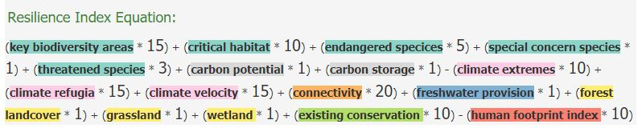
RI EQUATION
RI = (feature * weight) + (feature * weight) - (feature * weight) etc.
CP&P has provided an RI recommendation for review.

Slide 7
RI BUILDER
Designed as an engagement tool that shows transparency in the make-up of the index.
Users can change weights and update the RI in real time. This provides a means to reason with the relative importance of layers the comprise the index
Main App Features:
Display
RI point extractions and pop-up
RI Download

Slide 8
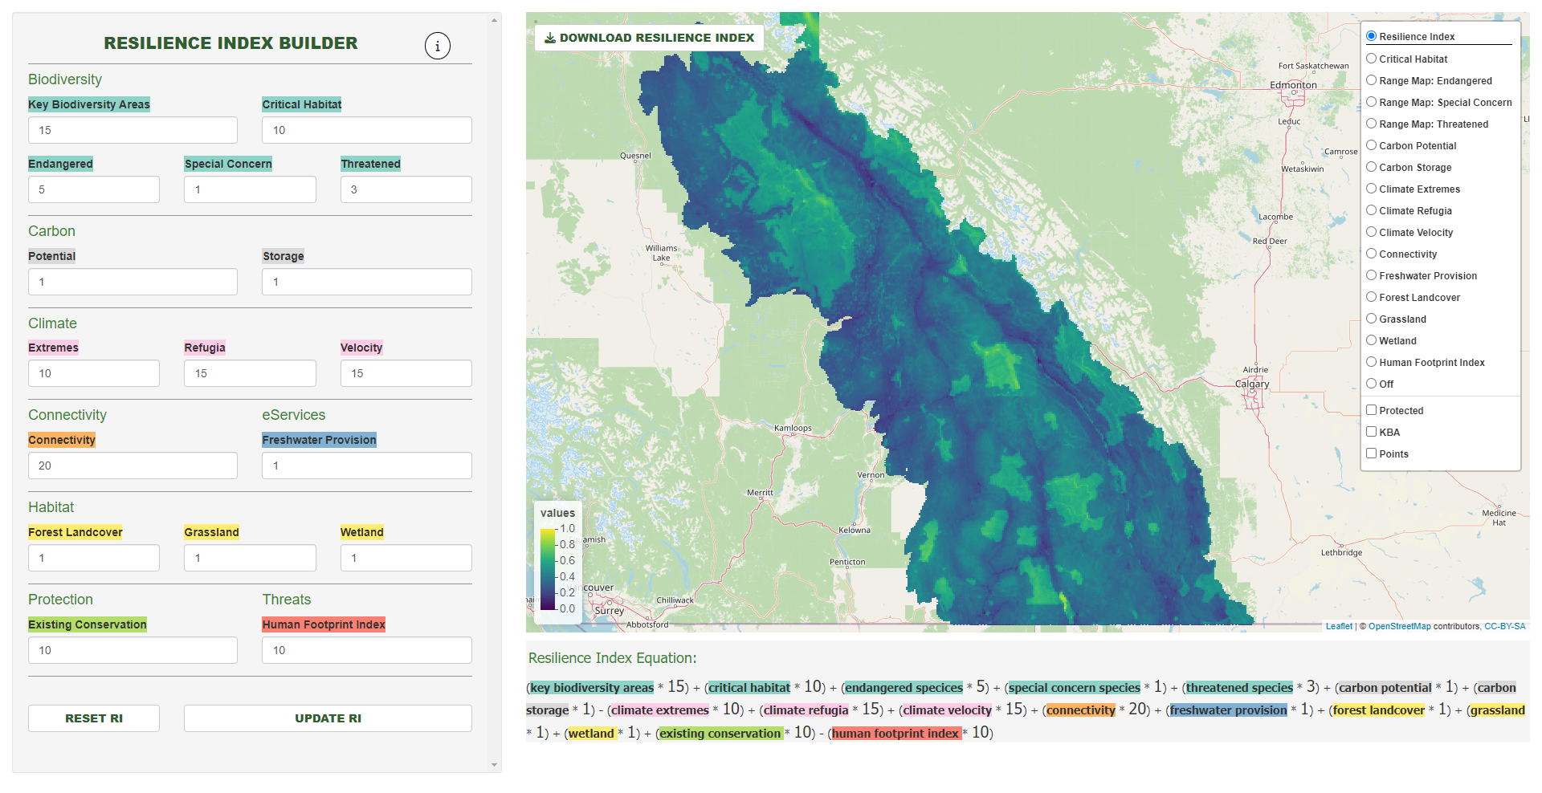
RI BUILDER

