Slide 1


ncca RenderFarm Tool
Houdini: Mantra \ HBatch
Constantinos Glynos
Michail Agoulas

Slide 2
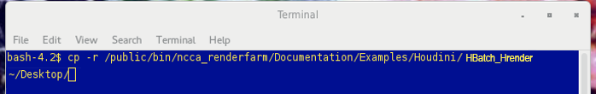
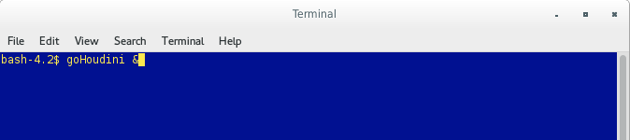
Copy the example scene
run the copy (cp) command with the recursive flag (-r)
cp –r /public/bin/ncca_renderfarm/Documentation/Examples/Houdini/HBatch_HRender ~/Desktop
Open Houdini
goHoudini &

Slide 3
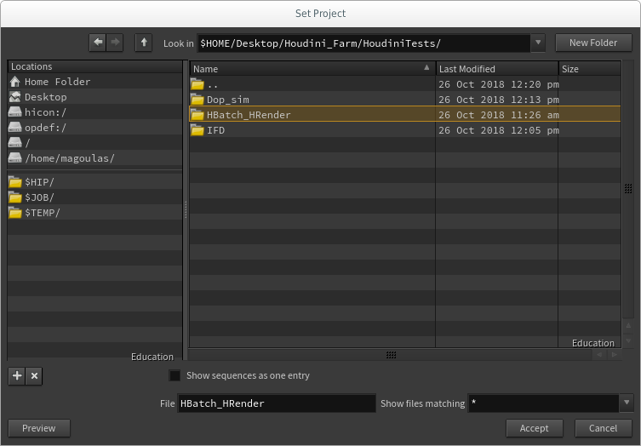
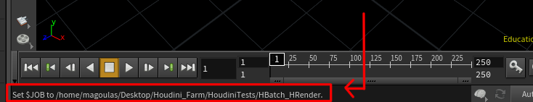
Set project directory
File -> Set Project...
Select the directory which is parent to all the project data files and folders and click Accept.
Do not dive in the directory that you
plan to store your .hip projects and
project files.
Click Accept
Now Houdini has set the folder of your project
as the root folder.

Slide 4
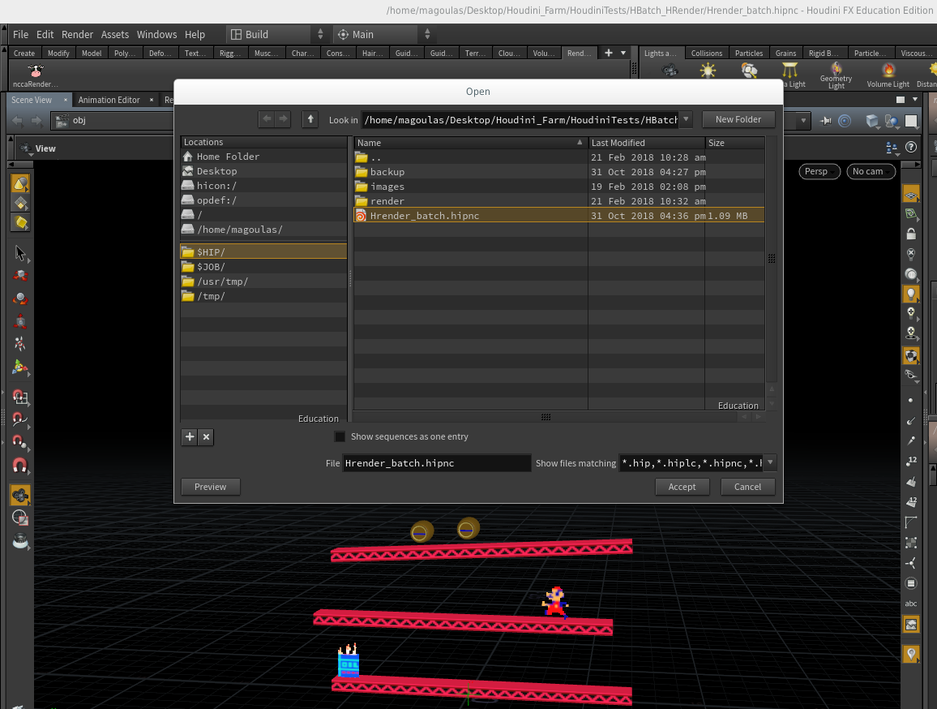
Open the example scene
File -> Open -> Hrender_batch.hipnc

Slide 5
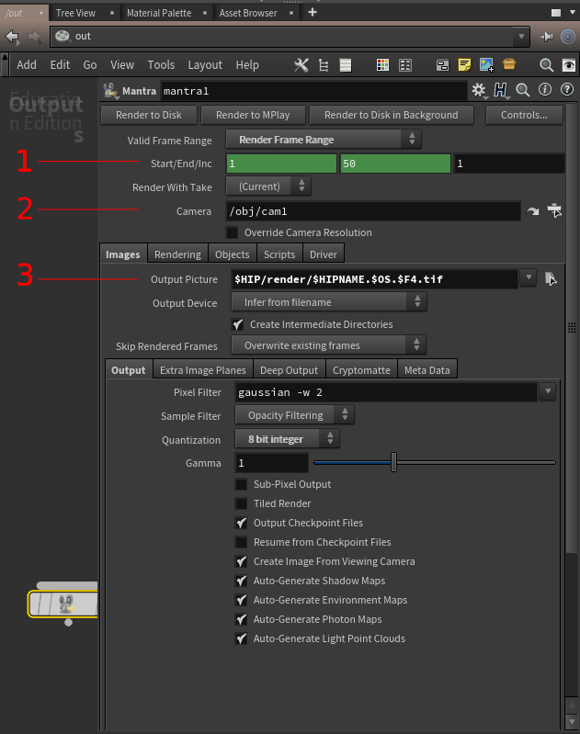
Check Mantra Settings
Check that your render settings are correct:
Select the desirable frame range
Select the take and the camera that you want to render from. (If you don't have a camera the render script will ask you to create one)
Select the render output folder and file name (make sure that the path starts with $HIP

Slide 6
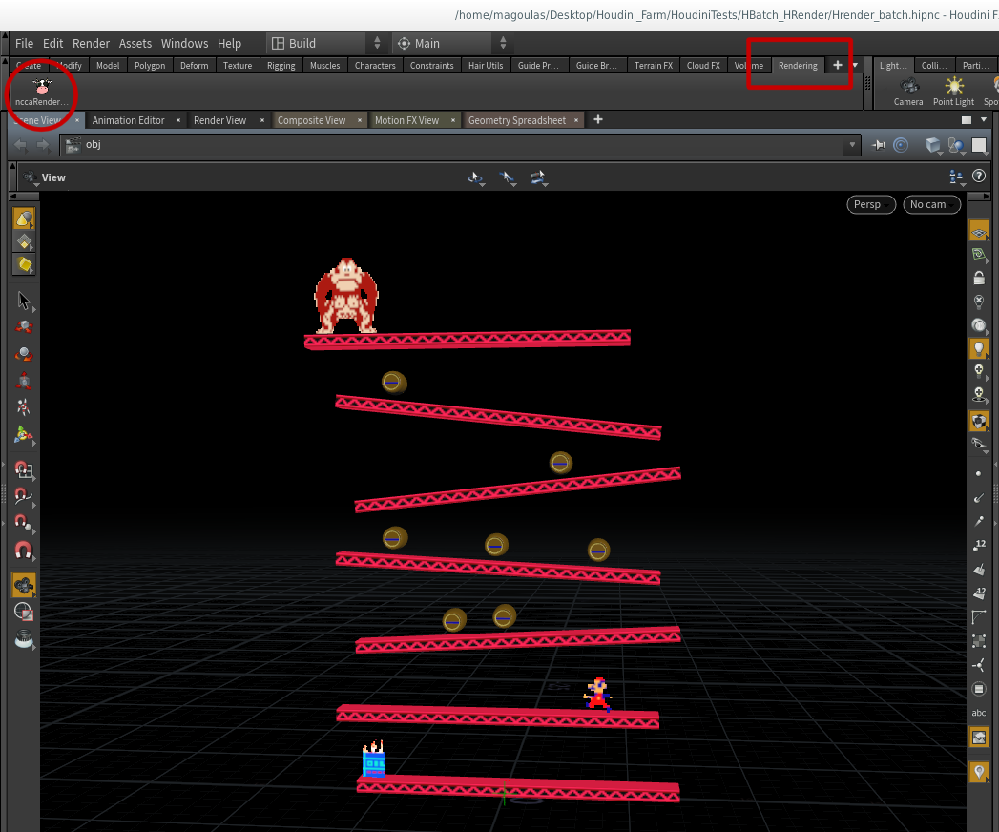
Let's render
Press Ctrl + S to save the scene
Go to the rendering shelf
Hit the cow!

Slide 7
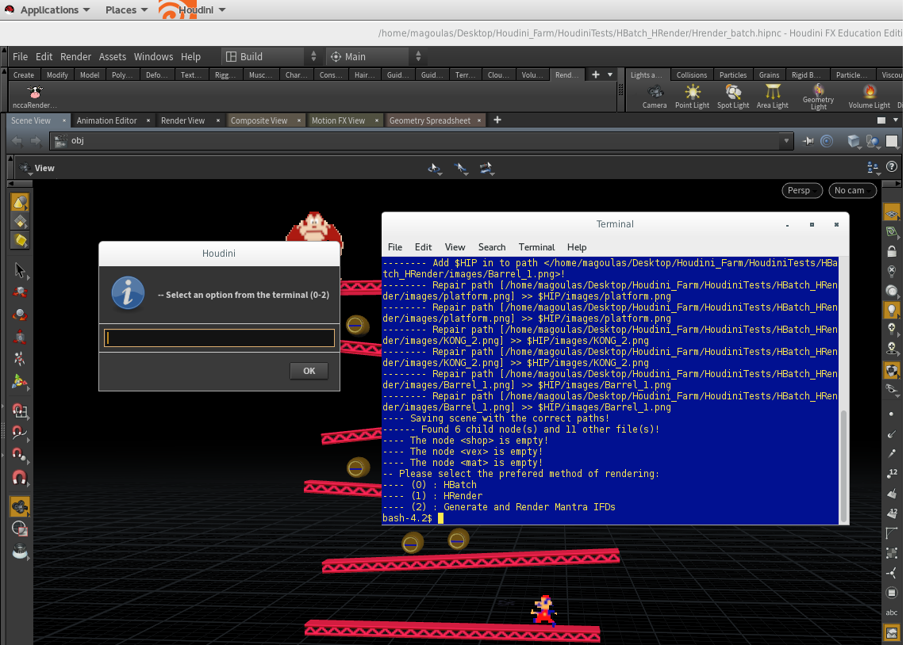
Using the tool
Check your local disk space (quota), or skip if not needed.
Check the terminal for any warnings about the version of the tool you are using.
We will choose the HBatch method by entering 0 in the window.

Slide 8
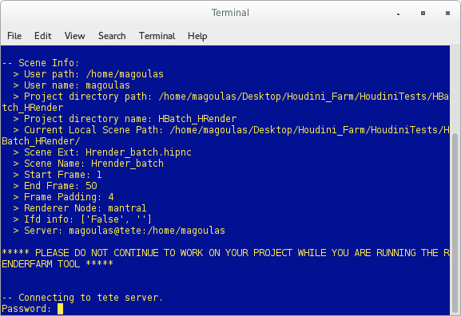
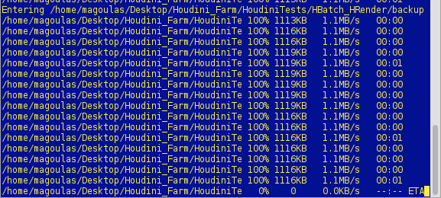
Using the tool
Now the tool will ask you to enter your user password in order to connect to the tete server. It is the same as your student account.
Once you enter your password the tool will start uploading the project files.
Do not interrupt this process nor continue working on your project.

Slide 9
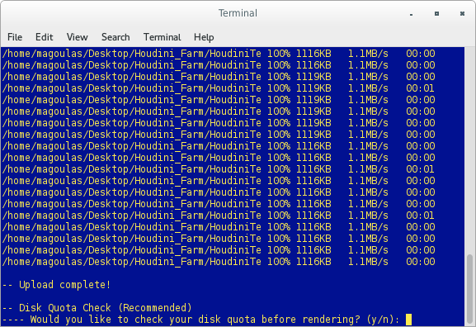
Using the tool
Once the files are uploaded, the tool will prompt for a quota check on the server.
If you do not have enough disk space (quota) available on the server, your renders will not be saved anywhere.
Skip online quota check if you are sure you have enough space available.

Slide 10
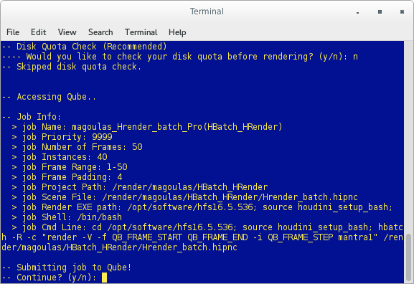
Using the tool
The output images directory is set from within your Mantra Settings.
Check the Job info data before submitting the job to Qube.
Type y and Enter to continue.

Slide 11
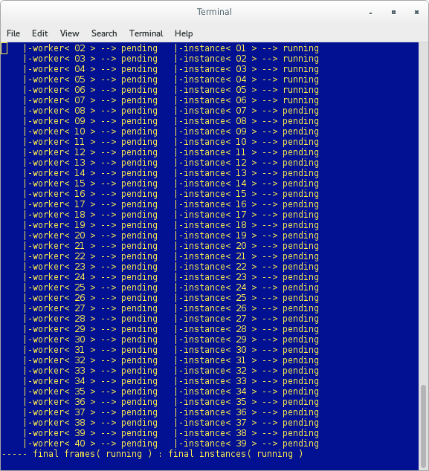
Using the tool
Wrangle your renders from the terminal.
At this point you can safely close the terminal and wrangle your renders from Qube. But it's advised that you leave the terminal open.
Now we wait for it to finish.
You can now continue to work on your scene.

Slide 12
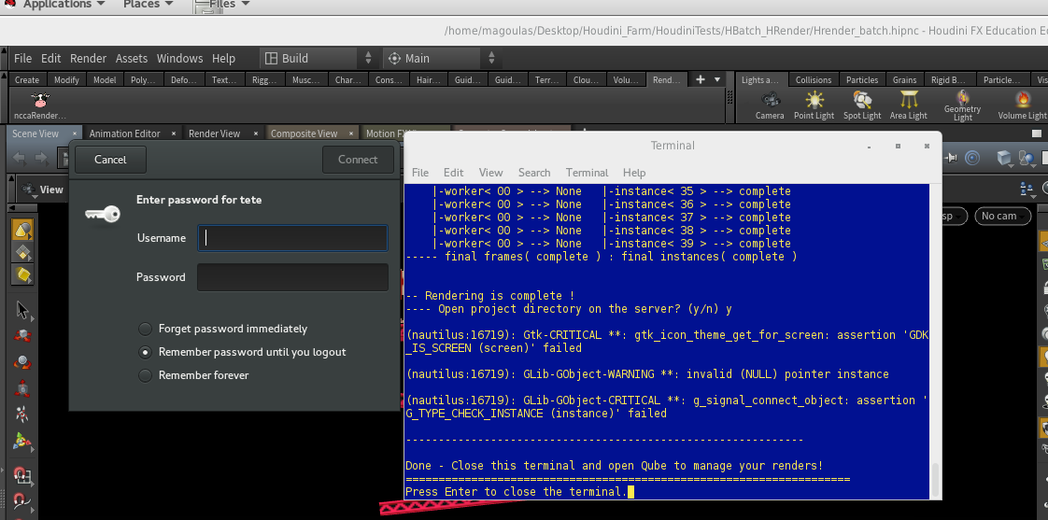
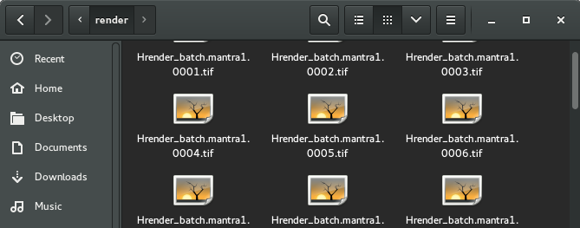
Finishing off
Once the renders are complete, the tool will prompt you to open the project directory on the server.
Type y and Enter so that the tool can open your project directory on the server. Otherwise, type n and Enter.
You might get asked to enter your student account credentials. Enter them so you can get access to the server.
Navigate in the render folder or wherever you have told mantra to save the files and copy them to your computer.

