Slide 1


ncca RenderFarm Tool
Install – Update - Uninstall
Constantinos Glynos
Michail Agoulas

Slide 2
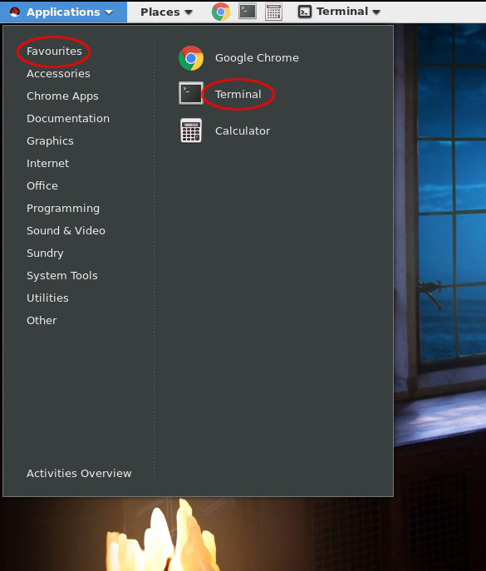
Opening a new terminal

Slide 3
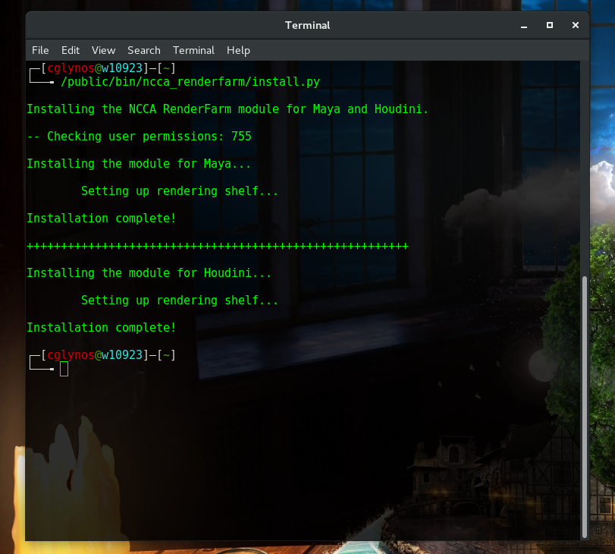
Install
Close Maya and Houdini if opened.
Open a new terminal.
Run the command:
/public/bin/ncca_renderfarm/install.py
Done!

Slide 4
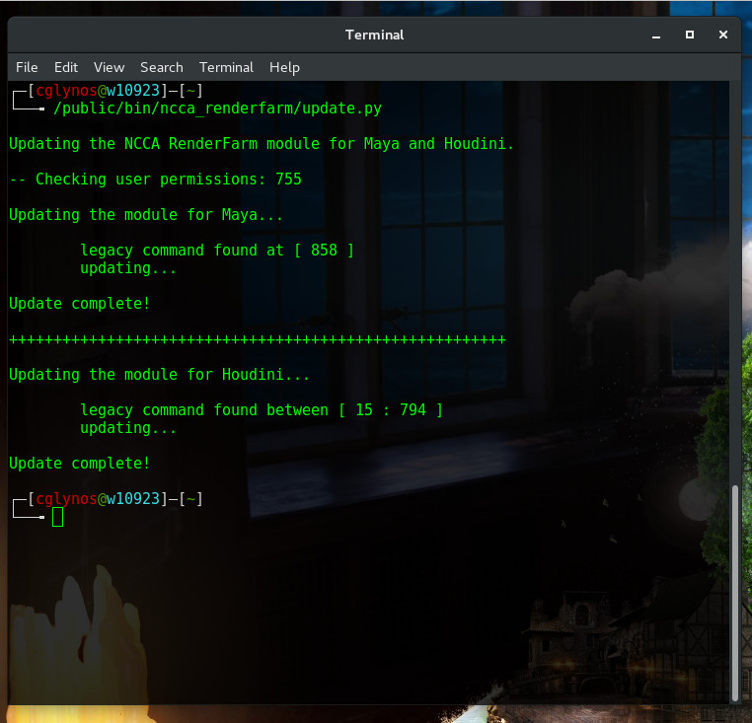
Update
The tool will prompt for an update.
Close Maya and Houdini if opened.
Open a new terminal.
Run the command:
/public/bin/ncca_renderfarm/update.py
Done!

Slide 5
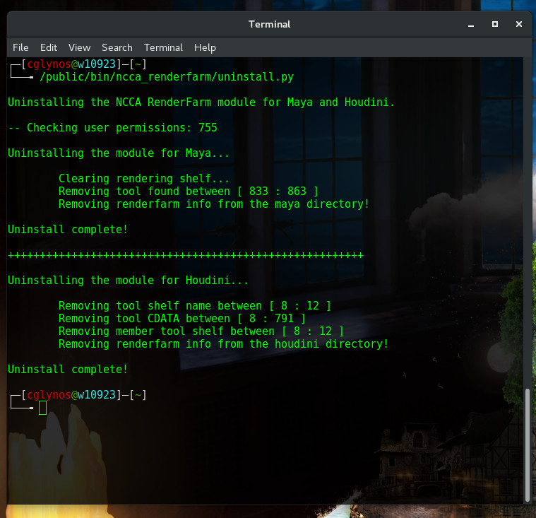
Uninstall
Close Maya and Houdini if opened.
Open a new terminal.
Run the command:
/public/bin/ncca_renderfarm/uninstall.py
Done!

Slide 6
FAQ
Q: The tool doesn't install! It says something about permissions.
A: To change your permissions, open a new terminal and run:
chmod –R 755 /home/<your student login number>
Q: I installed the tool but I cannot see the icon in the rendering shelf.
or
The tool cannot be installed because it says the rendering shelf is not there.
A: This is a bug with Maya mostly. Do the following:
Close down Maya
Uninstall the tool
Open Maya and click on the rendering shelf - This will generate the shelf_Rendering.mel script
Close Maya again without saving the scene
Re-install the tool
If the error is not one of the above and you cannot install the tool, then delete your
preferences from Maya and / or Houdini and re-install the tool.

