Slide 1


ncca RenderFarm Tool
Install – Update – Uninstall
Constantinos Glynos
Gordon Dunn

Slide 2

Before we install the tool we need to launch our programs from Apps Anywhere.

Slide 3
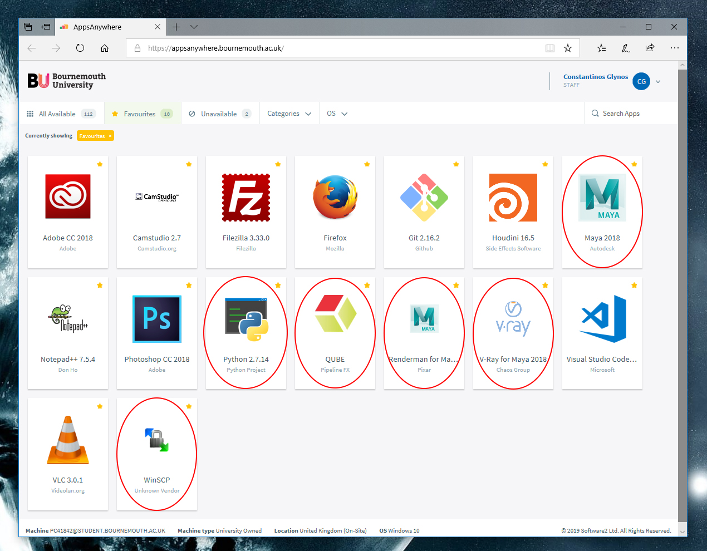
Launch the following:
Python 2.7.14
Maya 2019
Vray for Maya 2019
Renderman for Maya 2019
QUBE
WinSCP
Once opened, close all the above apart from Maya 2019

Slide 4
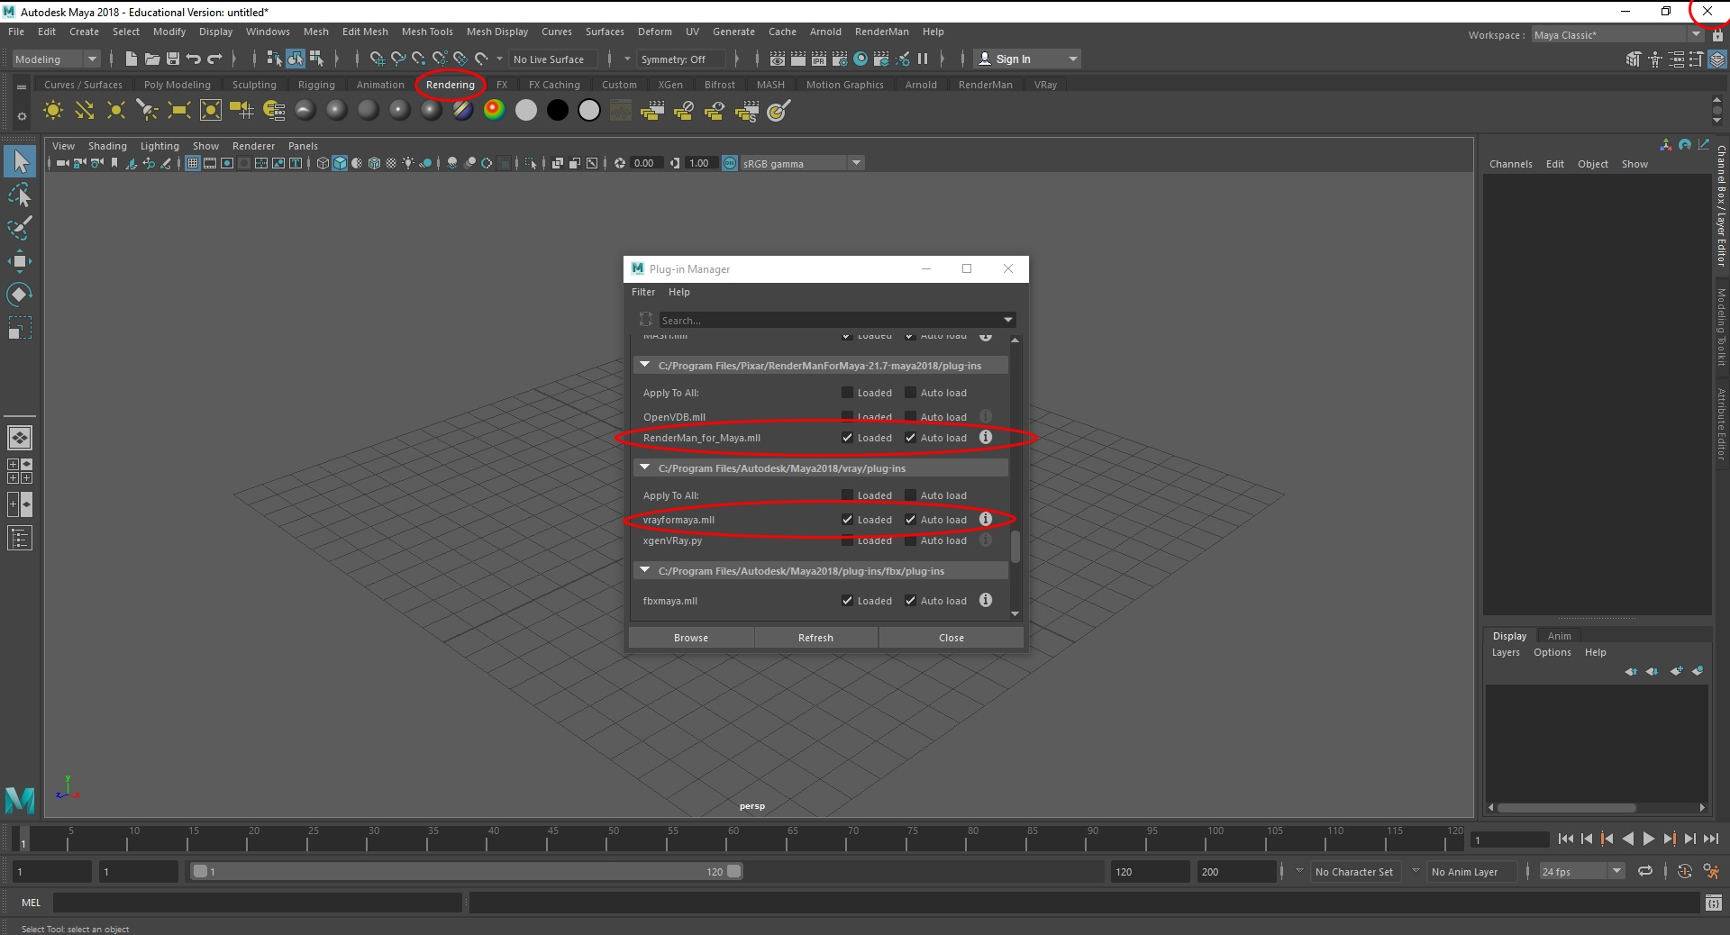
Setup Maya
With Maya 2019 opened
Click on the rendering shelf
Go to Windows -> Settings/Preferences -> Plugin Manager and enable Arnold, Vray and Renderman
Do not save the scene.
Close Maya.

Slide 5
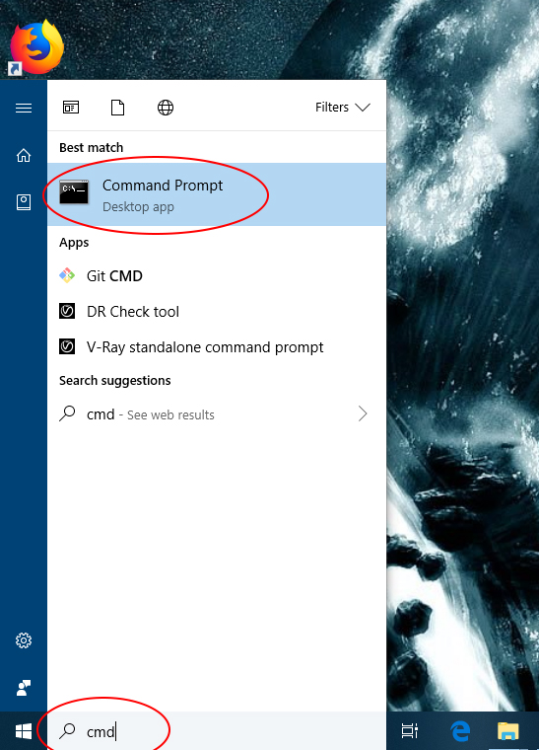
Open a new command prompt (cmd)

Slide 6
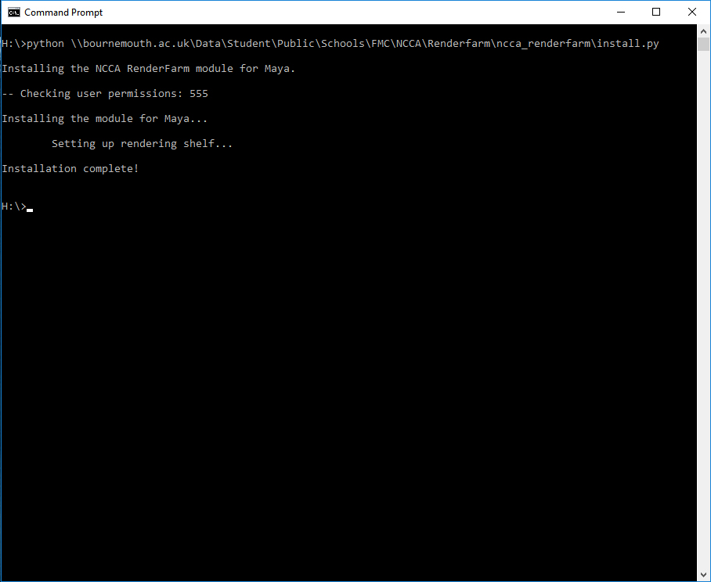
Install
Close Maya if opened.
Open a new cmd.
Run the command:
python \\bournemouth.ac.uk\Data\Student\Public\Schools\FMC\NCCA\Renderfarm\ncca_renderfarm\install.py
Done!

Slide 7
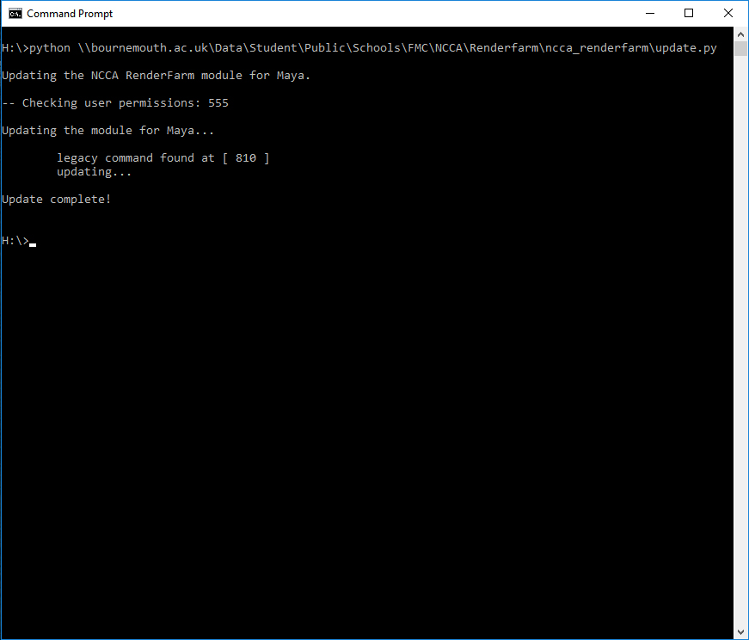
Update
The tool will prompt for an update.
Close Maya if opened.
Open a new cmd.
Run the command:
python \\bournemouth.ac.uk\Data\Student\Public\Schools\FMC\NCCA\Renderfarm\ncca_renderfarm\update.py
Done!

Slide 8
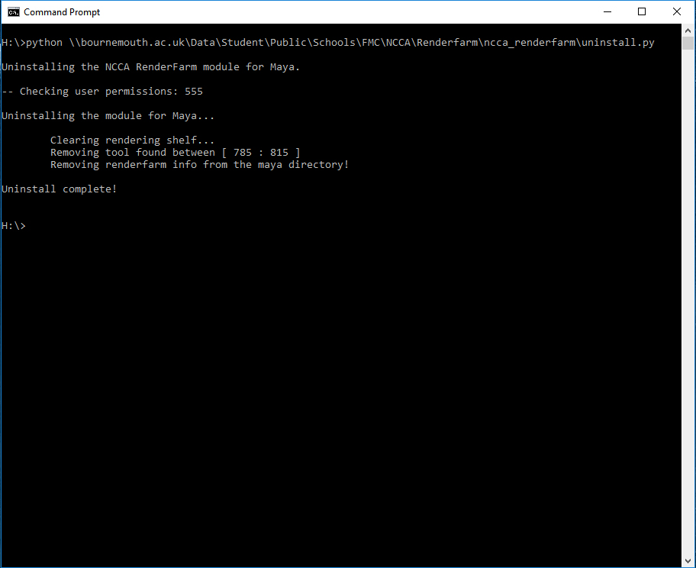
Uninstall
Close Maya if opened.
Open a new cmd.
Run the command:
python \\bournemouth.ac.uk\Data\Student\Public\Schools\FMC\NCCA\Renderfarm\ncca_renderfarm\uninstall.py
Done!

Slide 9
FAQ
Q: The tool doesn't install! It says something about permissions.
A: On Windows you cannot change your permissions manually. You need to contact IT for this matter.
Q: I installed the tool but I cannot see the icon in the rendering shelf.
or
The tool cannot be installed because it says the rendering shelf is not there.
A: This is a bug with Maya mostly. Do the following:
Close down Maya
Uninstall the tool
Open Maya and click on the rendering shelf - This will generate the shelf_Rendering.mel script
Close Maya again without saving the scene
Re-install the tool
If the error is not one of the above and you cannot install the tool, then delete your
preferences from Maya and re-install the tool.

