Slide 1
Welcome to the dual task experiment!
This task consists of a combination of the two tasks you have just run. Just as before we will present you with sequences of sounds and images.
Your task will be to discriminate the high and low pitch sounds and to detect the target images. Importantly, you should first respond to the sounds and second to the visual task!
Press the right ring finger button to proceed

Slide 2
As before, you will hear a sound. The sound will be either high or low pitch sounds. You should determine whether the sound you have heard was high or low pitch.
Press the left index finger button when you hear a low pitch sound and the right index finger button when you hear a high pitch sound.
Press the right ring finger button to proceed or the left ring finger button to return to the previous slide

Slide 3
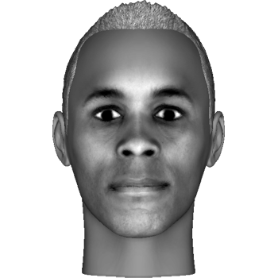
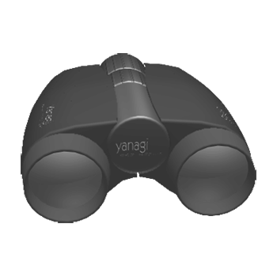


In addition, you will see images. Each image will be a particular face, object, letter or meaningless symbol, like these:
At the beginning of each sequence, we will show you two specific “target” images that you will need to be on the lookout for.
When the target image is presented, you should press the right middle finger button
Press the right ring finger button to proceed or the left ring finger button to return to the previous slide

Slide 4
Each block contains 4 sequences and will last about 15 minutes. You will be able to rest between every two blocks.
Please do your best to remain focused and alert during the experiment, and keep your eyes fixed on the center of the screen.
Remember: it is important to process first the sound stimulus and second the image one!
Good luck!
Press the right ring finger button to proceed or the left ring finger button to return to the previous slide

