Slide 1
Welcome to the auditory experiment!
In this task, we will play sounds that can be high pitch or low pitch. Your task is to discriminate between the two.
You should press the left index finger button when you hear a low pitch sound and the right index finger button when you hear a high pitch sound!
Press the right ring finger button to proceed

Slide 2
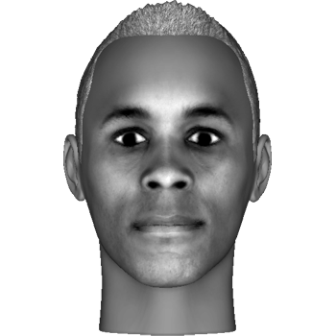
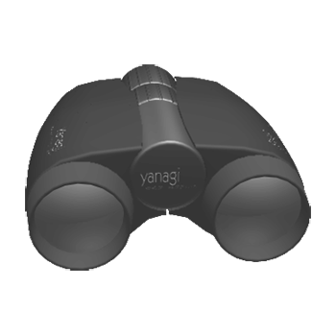


In addition, you will see images. Each image will be a particular face, object, letter or meaningless symbol, like these:
You can ignore them in this task!
Press the right ring finger button to proceed or the left ring finger button to return to the previous slide

Slide 3
This task is organized in blocks, each block contains 4 sequences and will last about 10 minutes. You will be able to rest between every block.
Please do your best to remain focused and alert during the experiment, and keep your eyes fixed on the center of the screen.
Good luck!
Press the right ring finger button to proceed or the left ring finger button to return to the previous slide

