Slide 1
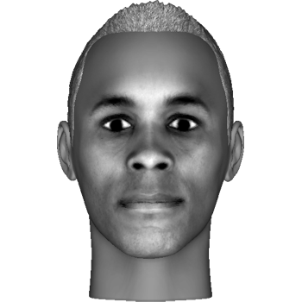
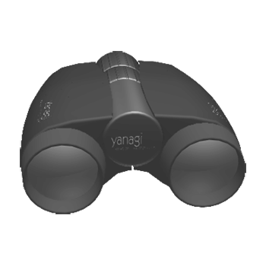


Welcome to the visual experiment!
We will present you with sequences of images. Each image will be a particular face, object, letter or meaningless symbol, like these:
At the beginning of each sequence, we will show you two specific “target” images that you will need to be on the
lookout for.
When the target image is presented, you should press the right middle finger button
Press the right ring finger button to proceed

Slide 2
In addition, you will hear sounds that can either low pitch or high pitch. You can ignore them in this task!
Press the right ring finger button to proceed or the left ring finger button to return to the previous slide

Slide 3
This task is organized in blocks, each block contains 4 sequences and will last about 10 minutes. You will be able to rest between every block.
Please do your best to remain focused and alert during the experiment, and keep your eyes fixed on the center of the screen.
Good luck!
Press the right ring finger button to proceed or the left ring finger button to return to the previous slide

