Slide 1
Dynamic, implicit vs. discrete, explicit measures of statistical learning

Slide 2
Acoustic Stream
tupirobidakugolabupadotibidakutupiro
Saffran et al. 1996

Slide 3
Acoustic Stream
tupirobidakugolabupadotibidakutupiro
Saffran et al. 1996

Slide 4
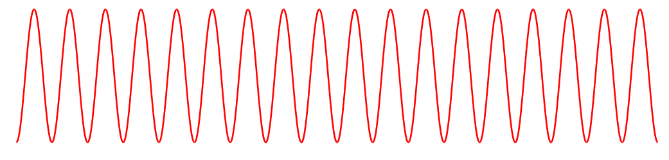
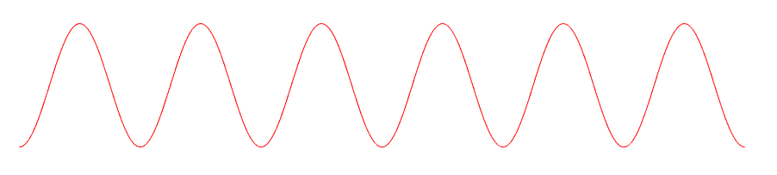
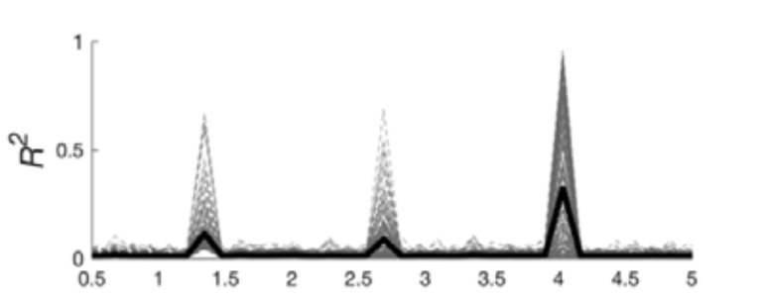
Acoustic Stream
tupirobidakugolabupadotibidakutupiro
Observed Neural Response
4 Hz
1.33 Hz
Henin et al. bioRxiv

Slide 5

measures of statistical learning
do
tupirobidakugolabupadotibidakutupiro
go la bu bi da ku
golabu pirobi
golabu bidaku

Slide 6
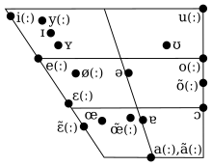
stimuli
CV syllables equated for co-occurrence frequency in spoken German
12 unique consonants
5 vowels, maximally separated in place and manner
Set:
nugadi rokise mipola zabetu

Slide 7
1.
3.
exp 1: online vs. offline SL
+
…zabetumipolarokisenugadi…
+
…tularogazamirobekinusedi…
Pre-Test:
2AFC Tempo Judgment
Post-Test:
2AFC Tempo Judgment
+
Which was faster?
2.
4.
po
Incidental learning
+
2AFC Word Recognition
laroki
+
+
zabetu
…zabetumipolarokisenugadi…
+
Which was a
word?
Hit the spacebar when you hear the target.

Slide 8
questions
Statistical Learning
1a. Do participants show online (implicit) statistical learning?
1b. Do participants show offline (explicit) statistical learning?
1c. How these measures related?
Rate Perception
2a. Are judgments of perceived tempo modulated by learning?
2b. If (2a), are they predicted by/correlate with one or both measures of SL?

Slide 9
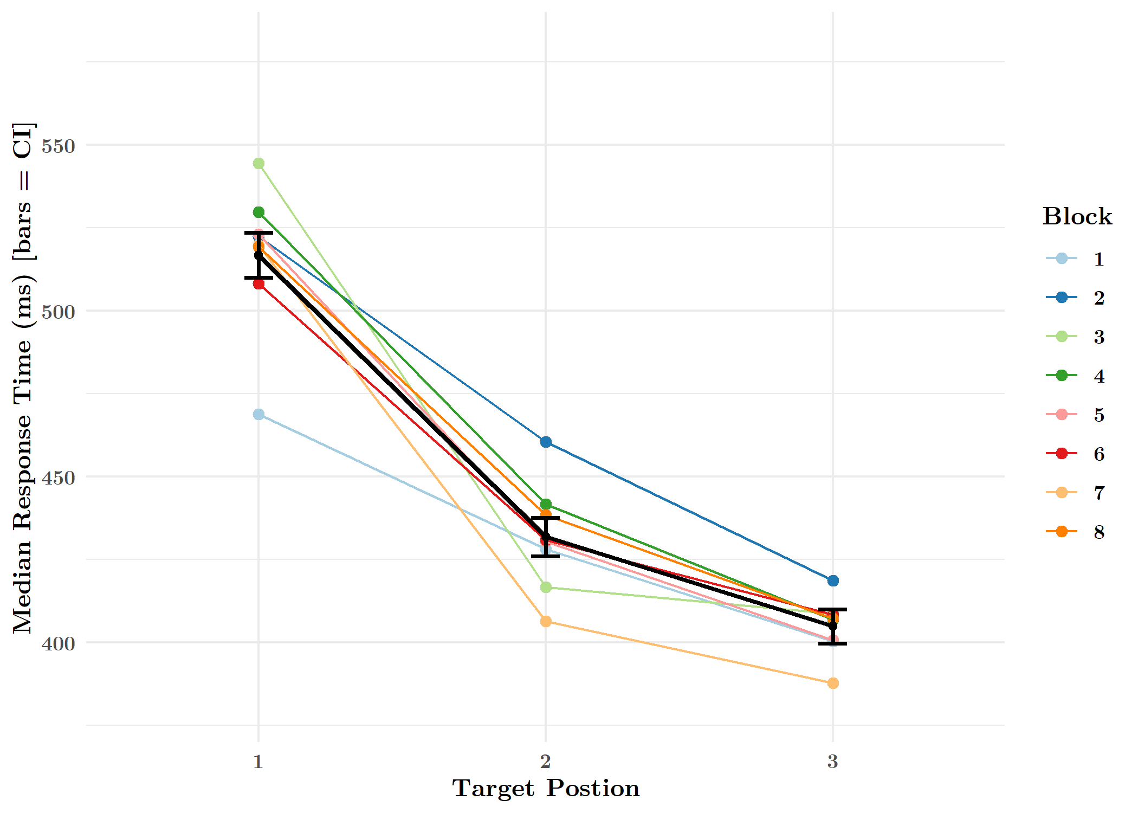
online statistical learning
RTs to target syllables reflect transitional probabilities
1st position syllables discriminated from 2nd/3rd in 1st block (in 3 minutes)
All target position contrasts significant.

Slide 10
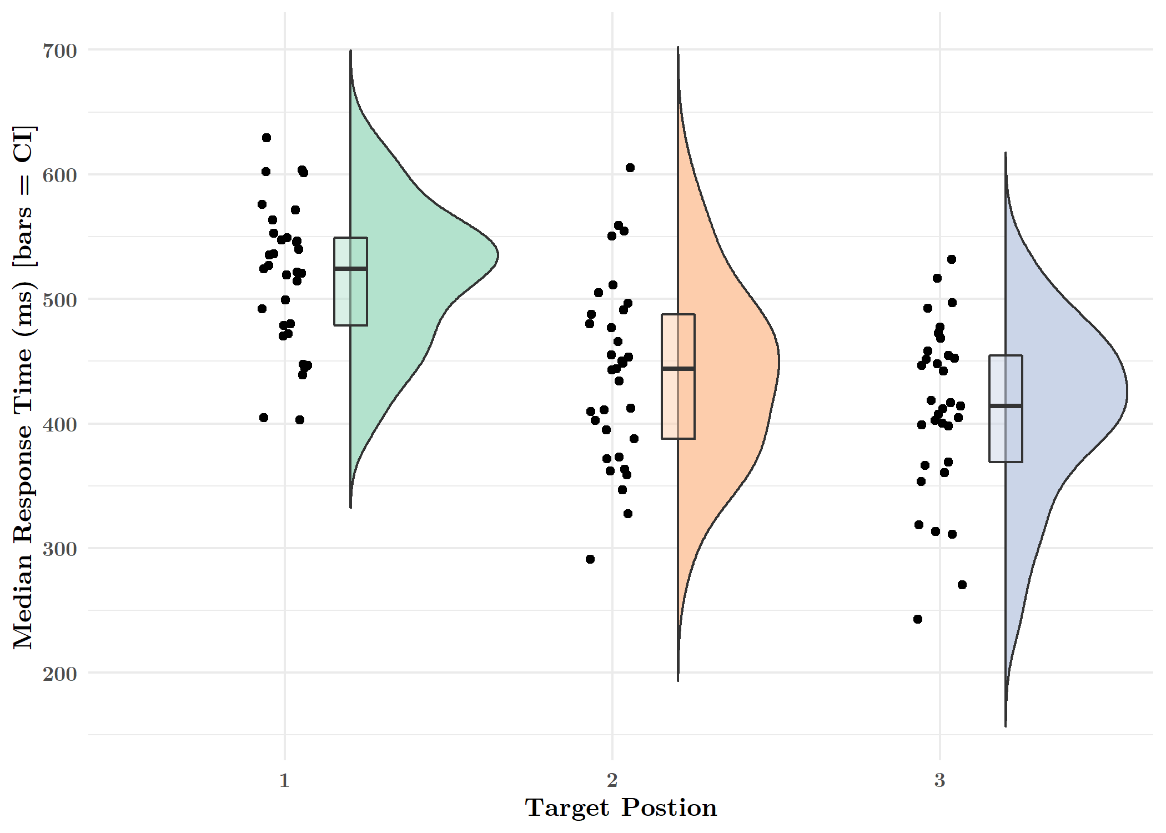
online statistical learning
RTs to target syllables reflect transitional probabilities
1st position syllables discriminated from 2nd/3rd in 1st block (in 3 minutes)
All target position contrasts significant.

Slide 11
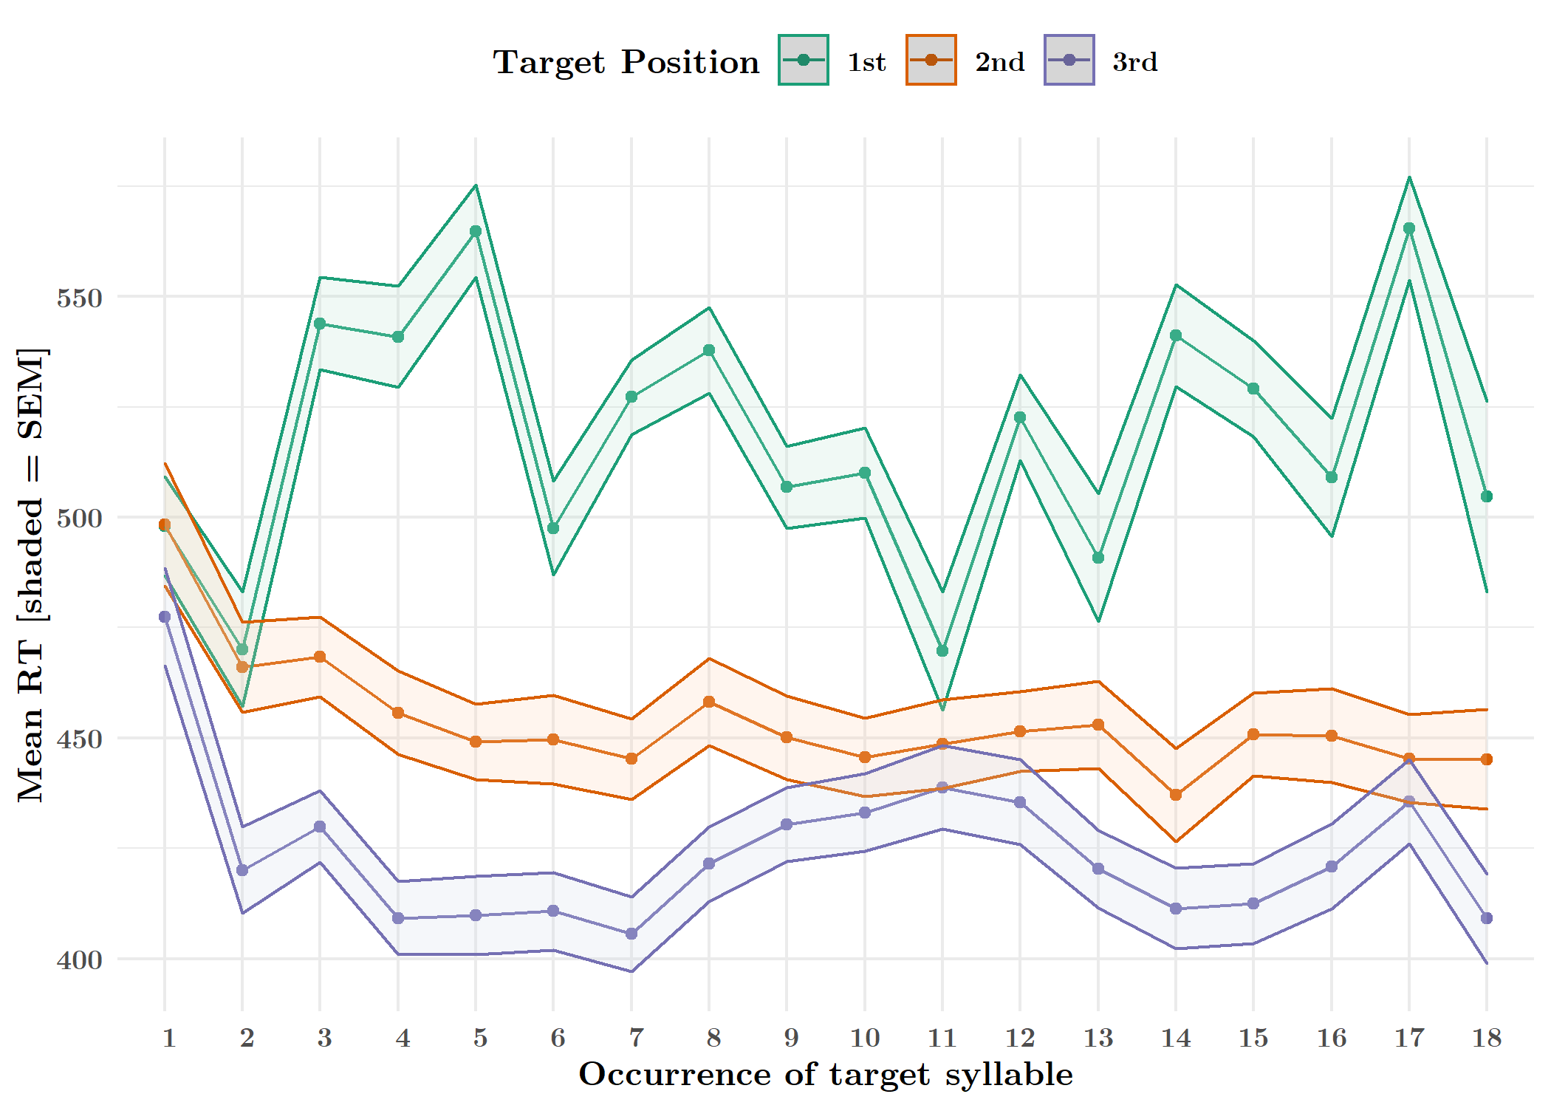
online statistical learning: moving average
RTs to targets, averaged over participants, shows discrimination after 2 exposures to the word featuring the target syllable
Main effect of target position
Notes:
Sd and show 1st block only

Slide 12
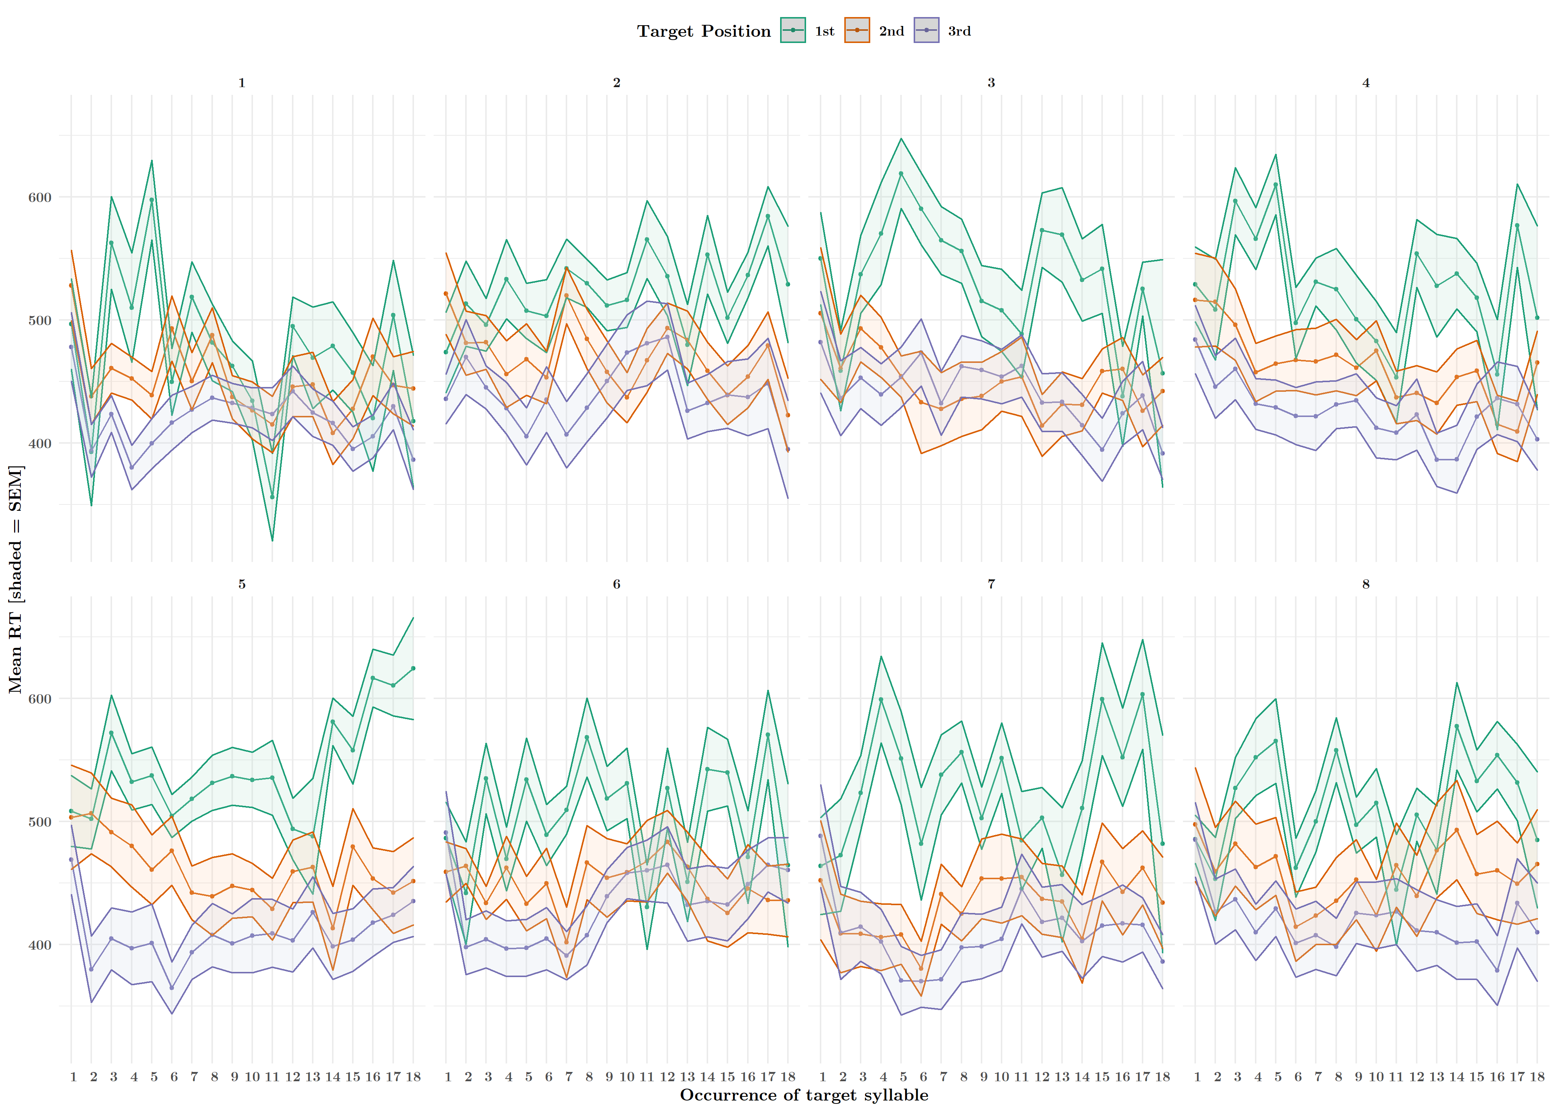
online statistical learning: moving average
RTs to targets, averaged over participants, shows discrimination after a single exposure to the word featuring the target syllable
Main effect of target position

Slide 13
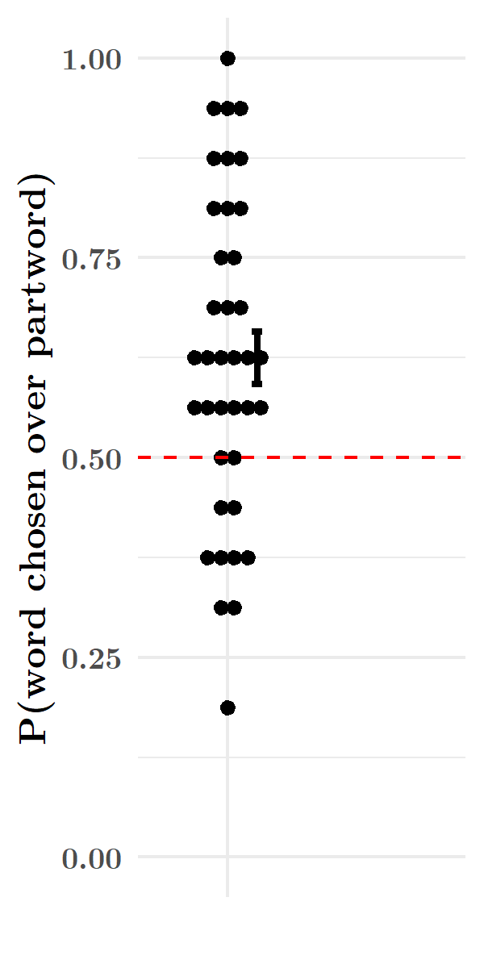
offline statistical learning
Explicit recognition of words from partwords sig. above 50% chance level

Slide 14
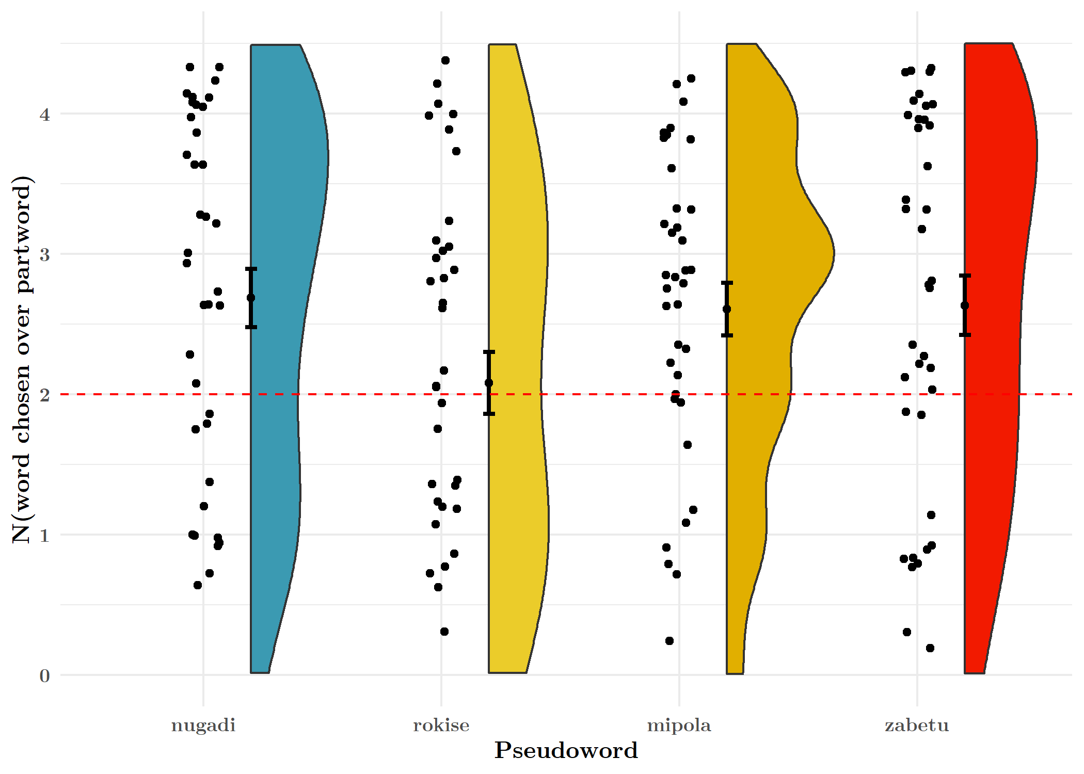
offline statistical learning
Explicit recognition of words from partwords sig. above 50% chance level

Slide 15
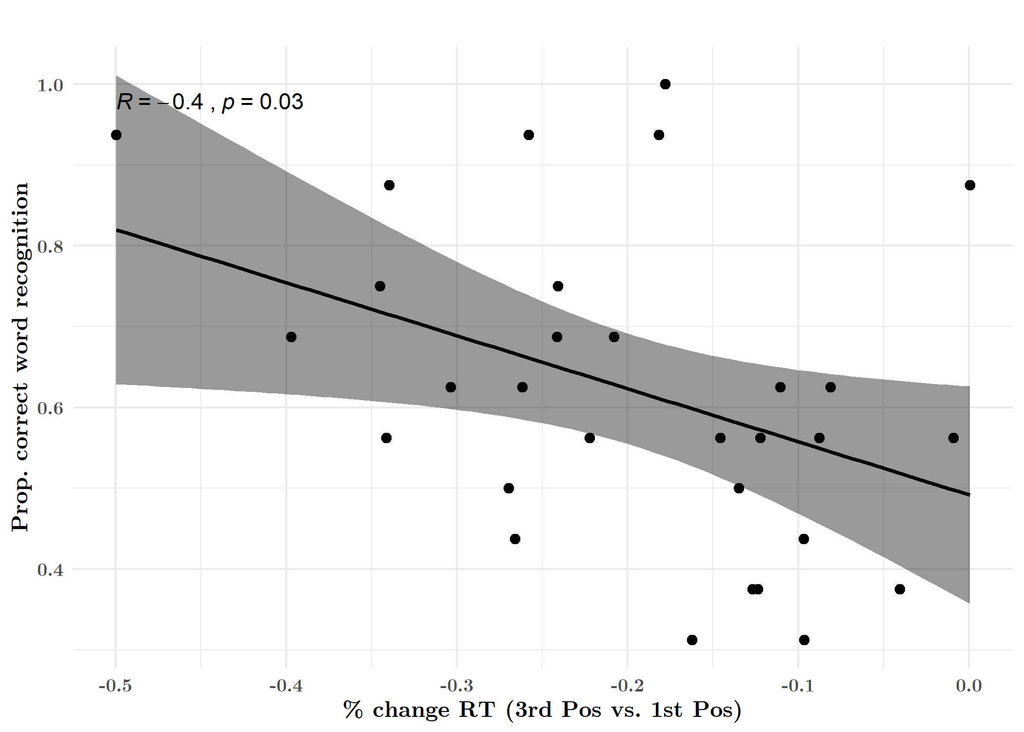
online & offline SL
Participants who showed greater change in RTs to 3rd vs. 1st position syllables also performed better on the word recognition task

Slide 16
interim conclusions
Statistical Learning
1a. Do participants show online (implicit) statistical learning? Yes.
1b. Do participants show offline (explicit) statistical learning? Yes.
1c. {How} Are these measures related? Online SL appears to reflect learning that is lost in the offline task.
So, what might the online task tell us about what participants are learning?
E.g. association of pairs (AB, BC, etc.) not triplet (ABC), transitional probabilities, ordinal position…

Slide 17


exp 2: random vs. structured online SL
+
2. Test_{struct}
4. Test_{rand}
test
… za be tumi po laro ki se…
b.
a.
1. Exposure_{struct}
3. Exposure_{rand}
po
cue
+
…zabetumipolarokisenugadi… 10 mins
Hit the spacebar when you hear the target.

Slide 18
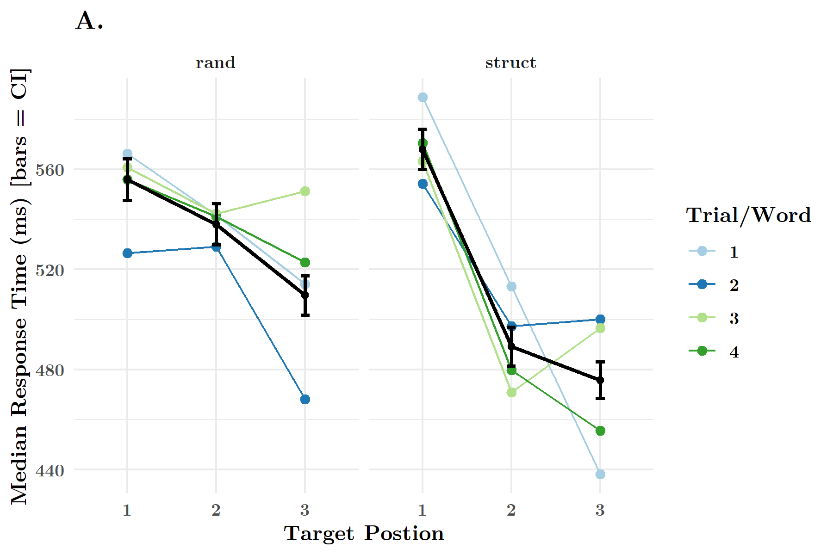
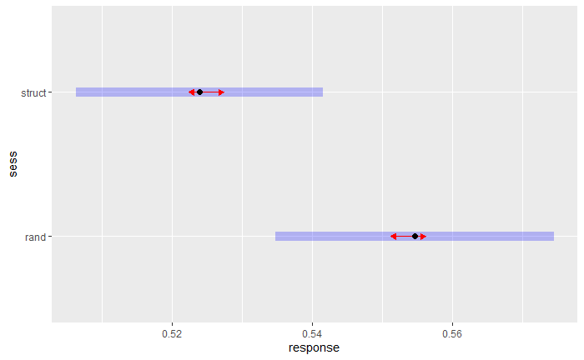
rt: rand vs. struct
Target Detection
Main effect of session
rt_secs ~ sess + (1 |cond_order/subject)

Slide 19
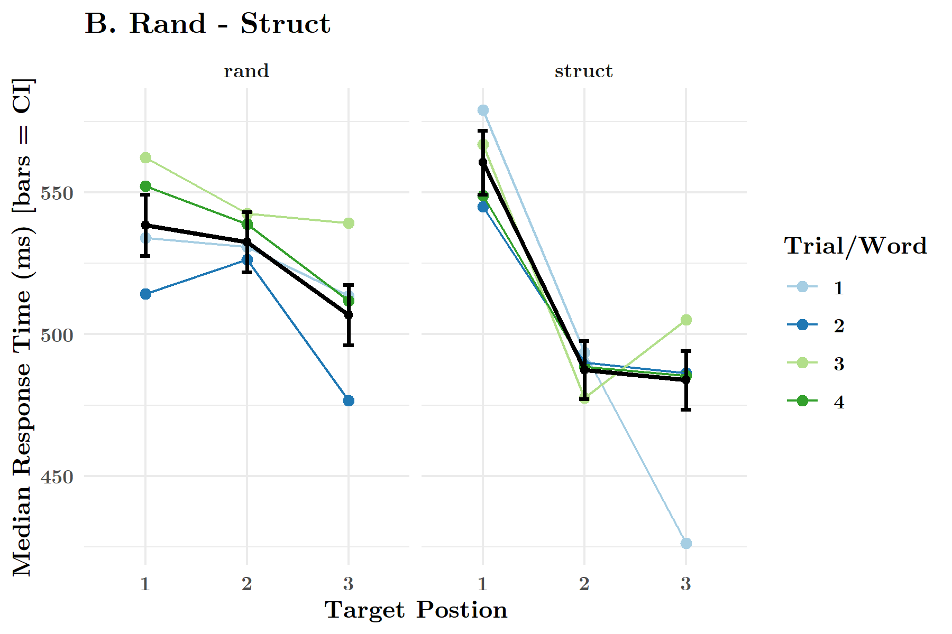
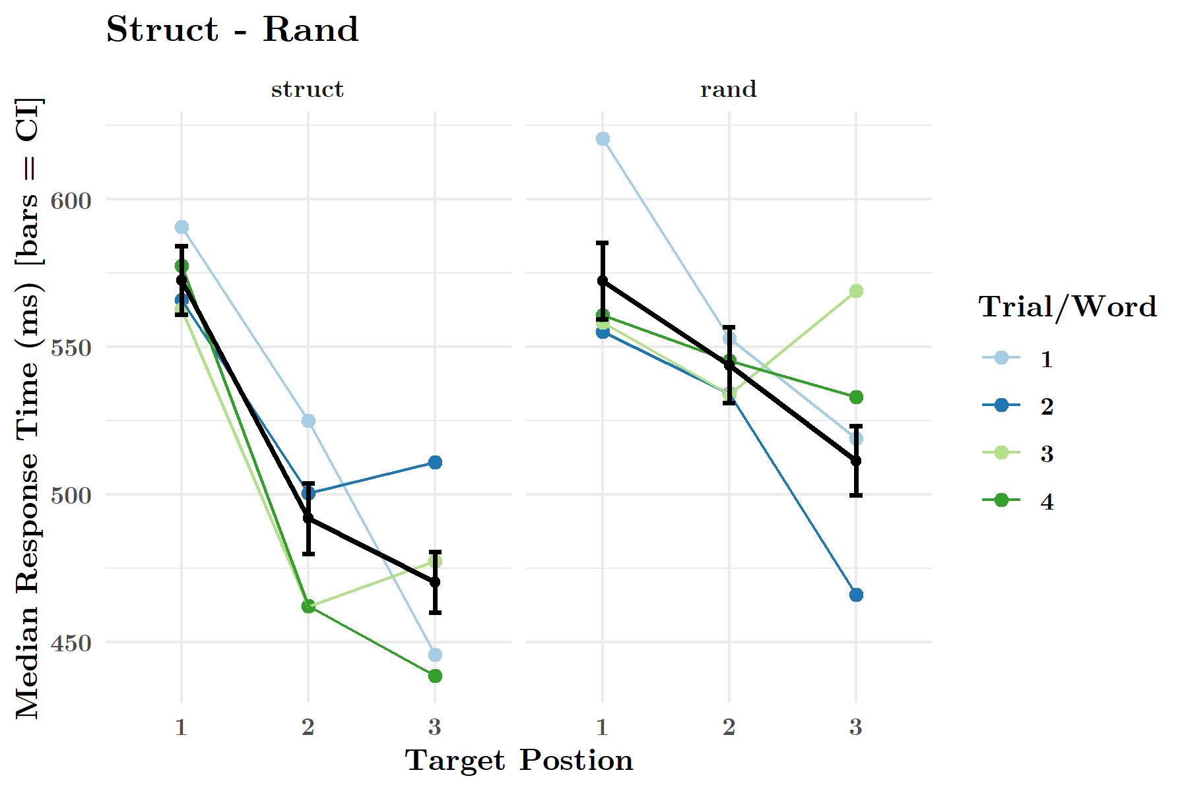
rt: rand vs. struct x order
Target Detection
No main or interaction effect for condition order
rt_secs ~ sess * cond_order + (1 | cond_order/subject)

Slide 20
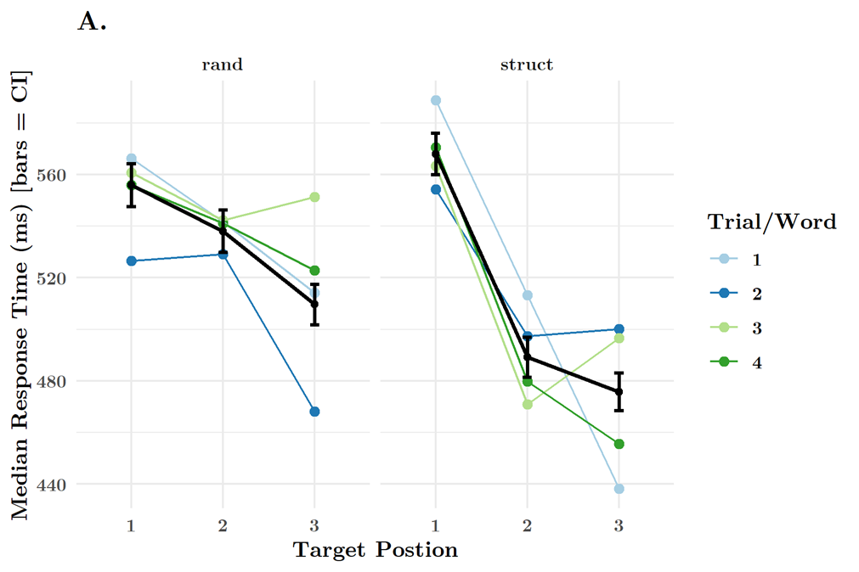
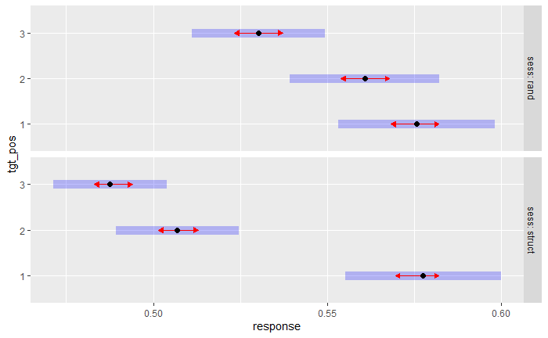
rt: session x target position
Target Detection
Sig. main & interaction effect of sess*target position
rt_secs ~ sess * tgt_pos + (1 | cond_order/subject)
Positions are distinct within both rand & struct
Rand: 2-3 & 1-3
Struct: 1-2 & 2-3

Slide 21
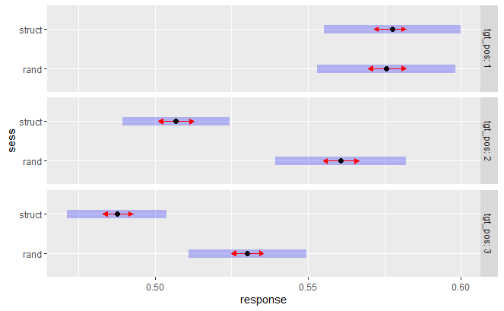
rt: session x target position
Target Detection
Sig. main & interaction effect of sess*target position
rt_secs ~ sess * tgt_pos + (1 | cond_order/subject)
Positions are distinct within both rand & struct
Rand: 2-3 & 1-3
Struct: 1-2 & 2-3
Between rand & struct, Pos 1 is the same, Pos 2 & 3 diverge

Slide 22
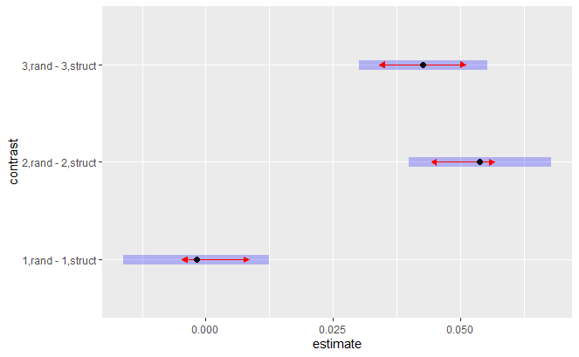
rt: session x target position
Target Detection
Sig. main & interaction effects with target position
rt_secs ~ sess * tgt_pos + (1 | cond_order/subject)
Positions are distinct within both rand & struct
Rand: 2-3 & 1-3
Struct: 1-2 & 2-3
Between rand & struct, Pos 1 is the same, Pos 2 & 3 diverge
Rand1-Struct1 distinct from Rand2-Struct2 (or 3)

Slide 23
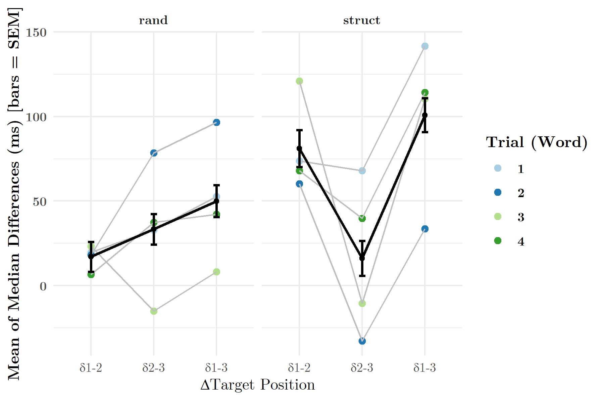
rt deltas*: deltas x session
Target Detection
The largest change in median RTs occurs between Pos 1 & 3 in structured.
Differences in median RTs between positions in random are at 0, but are also not stepwise sig. different from one another.

Slide 24
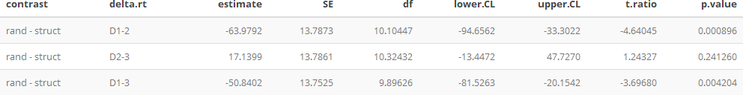
rt deltas*: deltas x session
Target Detection
*D1-2 (Pos1-Pos2); D2-3 (Pos2-Pos3); D1-3 (Pos1-Pos3)
Delta1-2 and Delta 1-3 diverge significantly between structured and random conditions

Slide 25
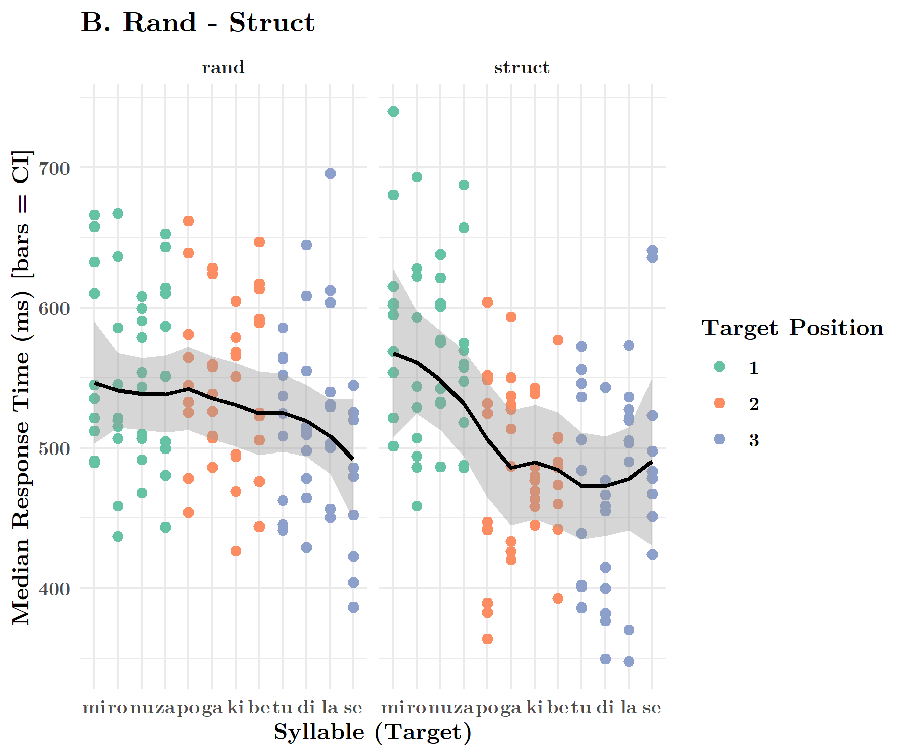
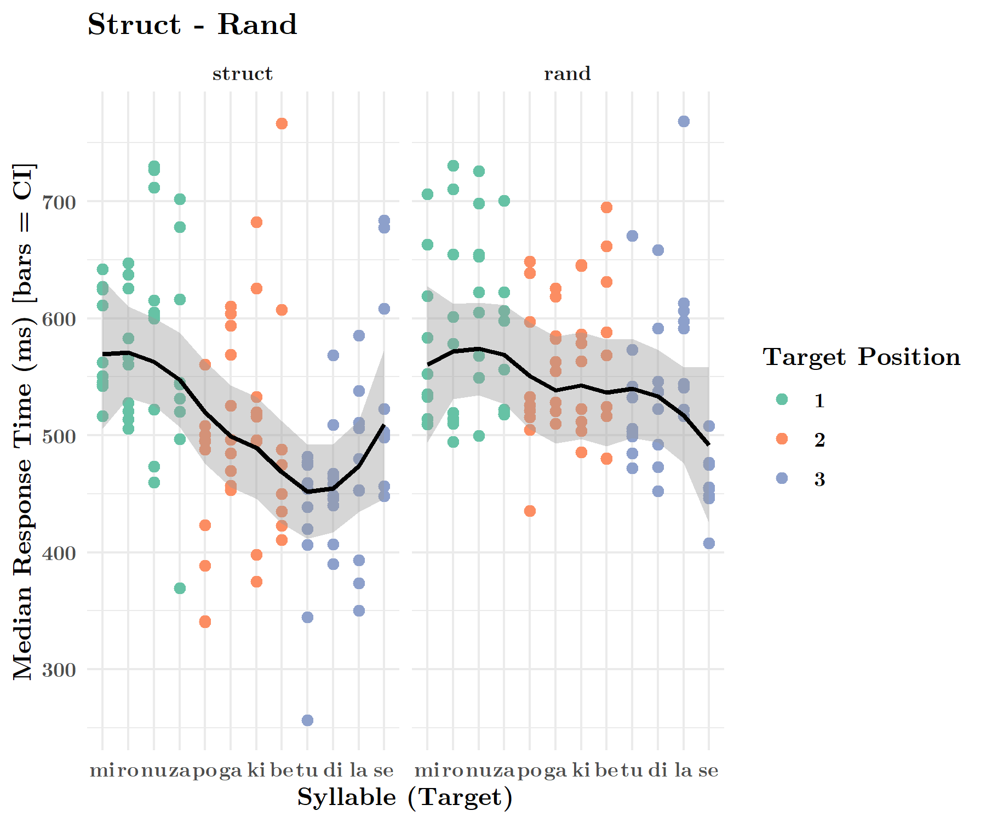
rt: syllable x session x order
Target Detection

Slide 26
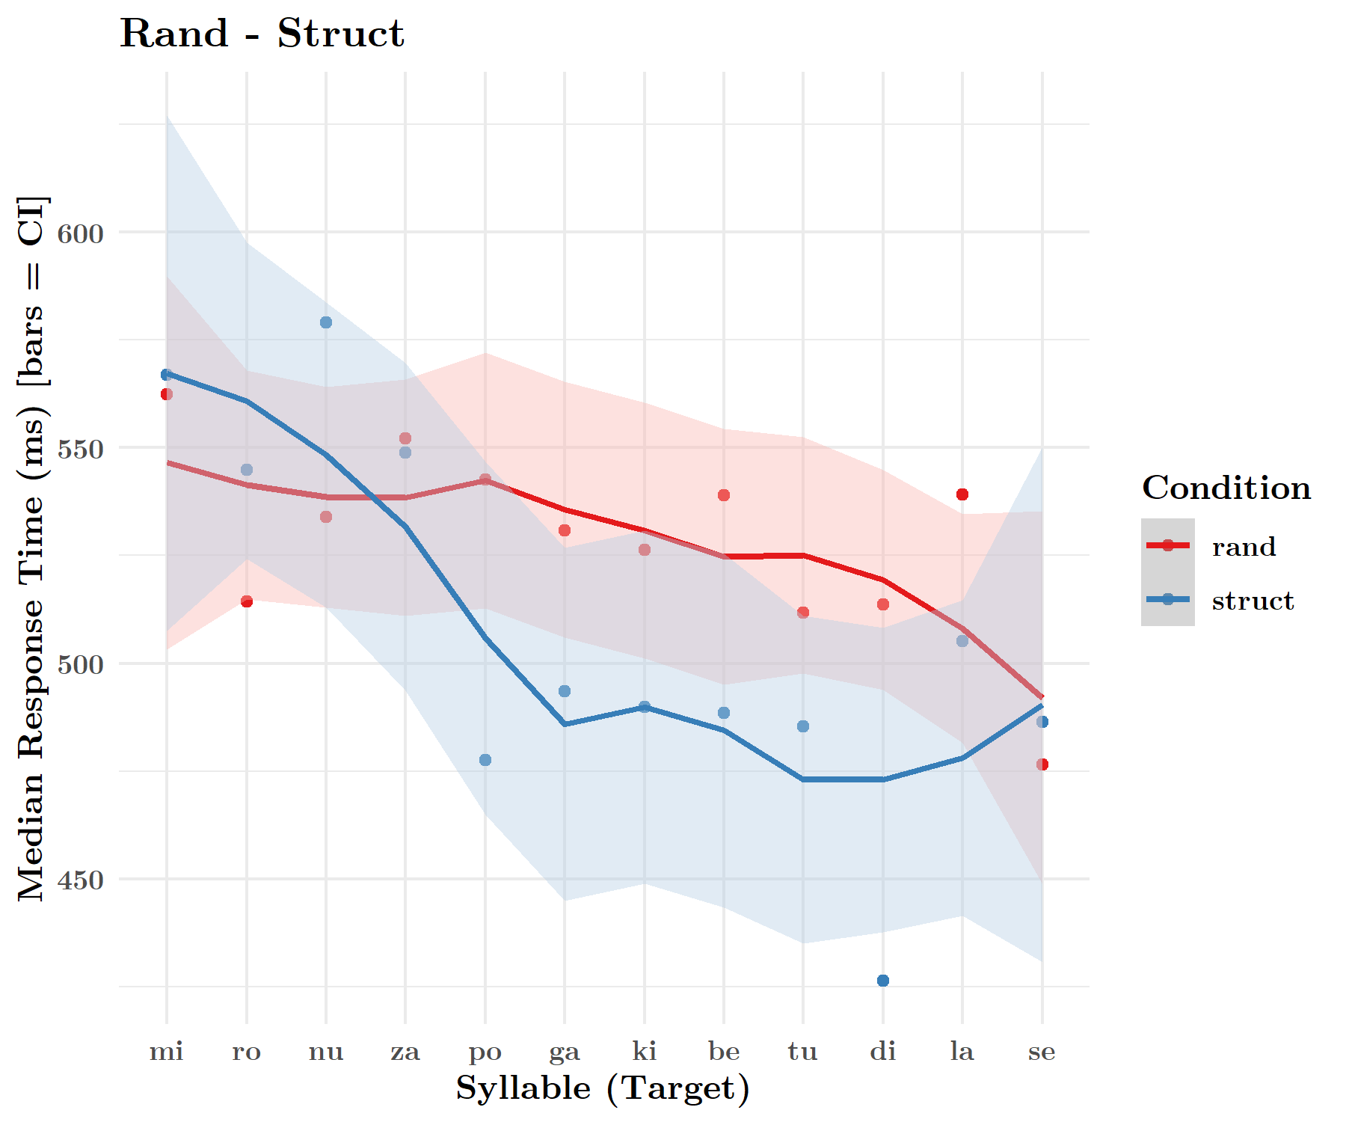
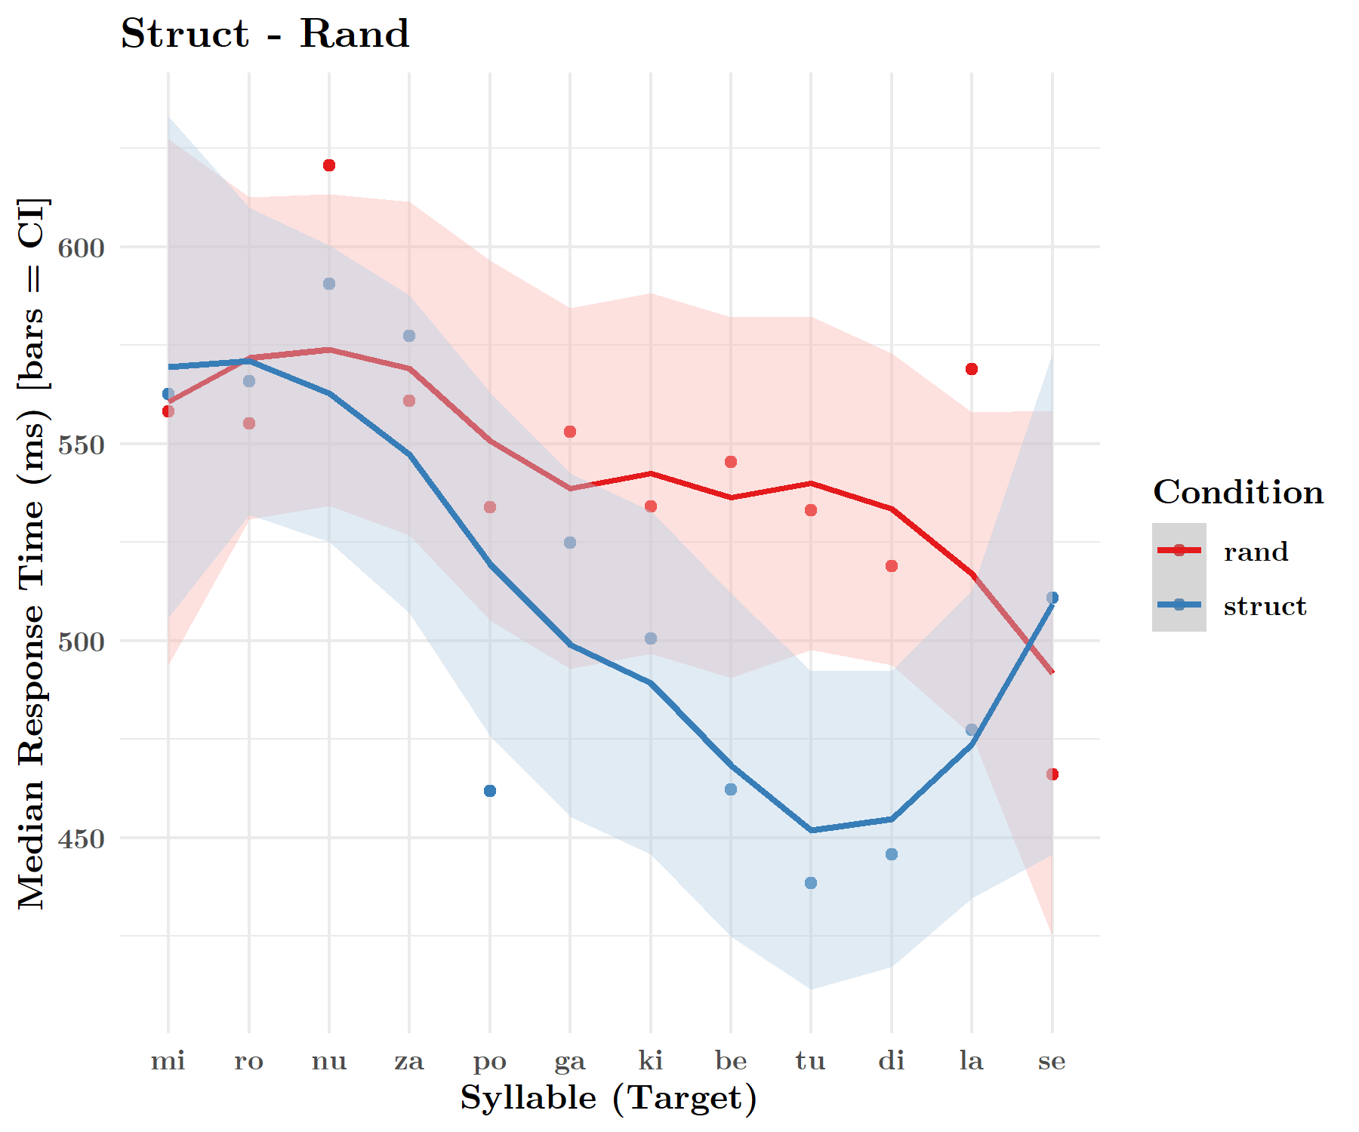
rt: syllable x session x order
Target Detection

Slide 27
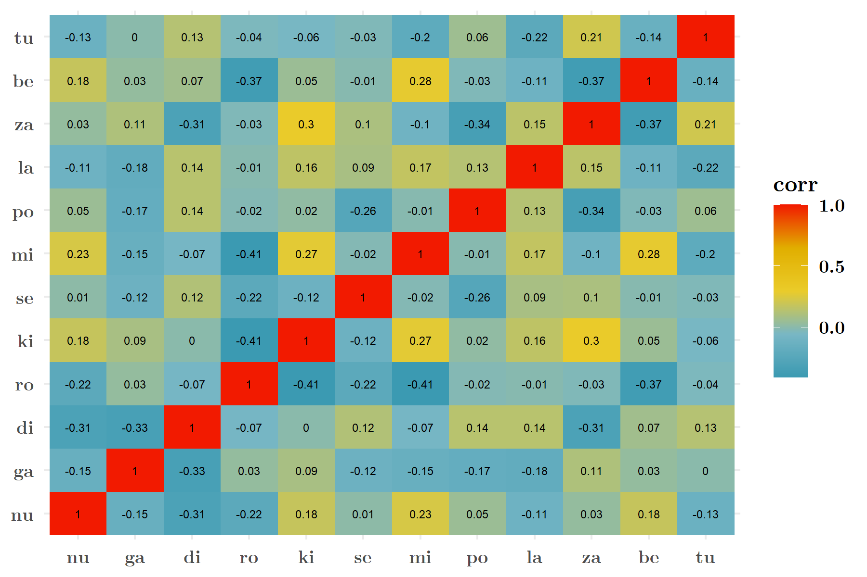
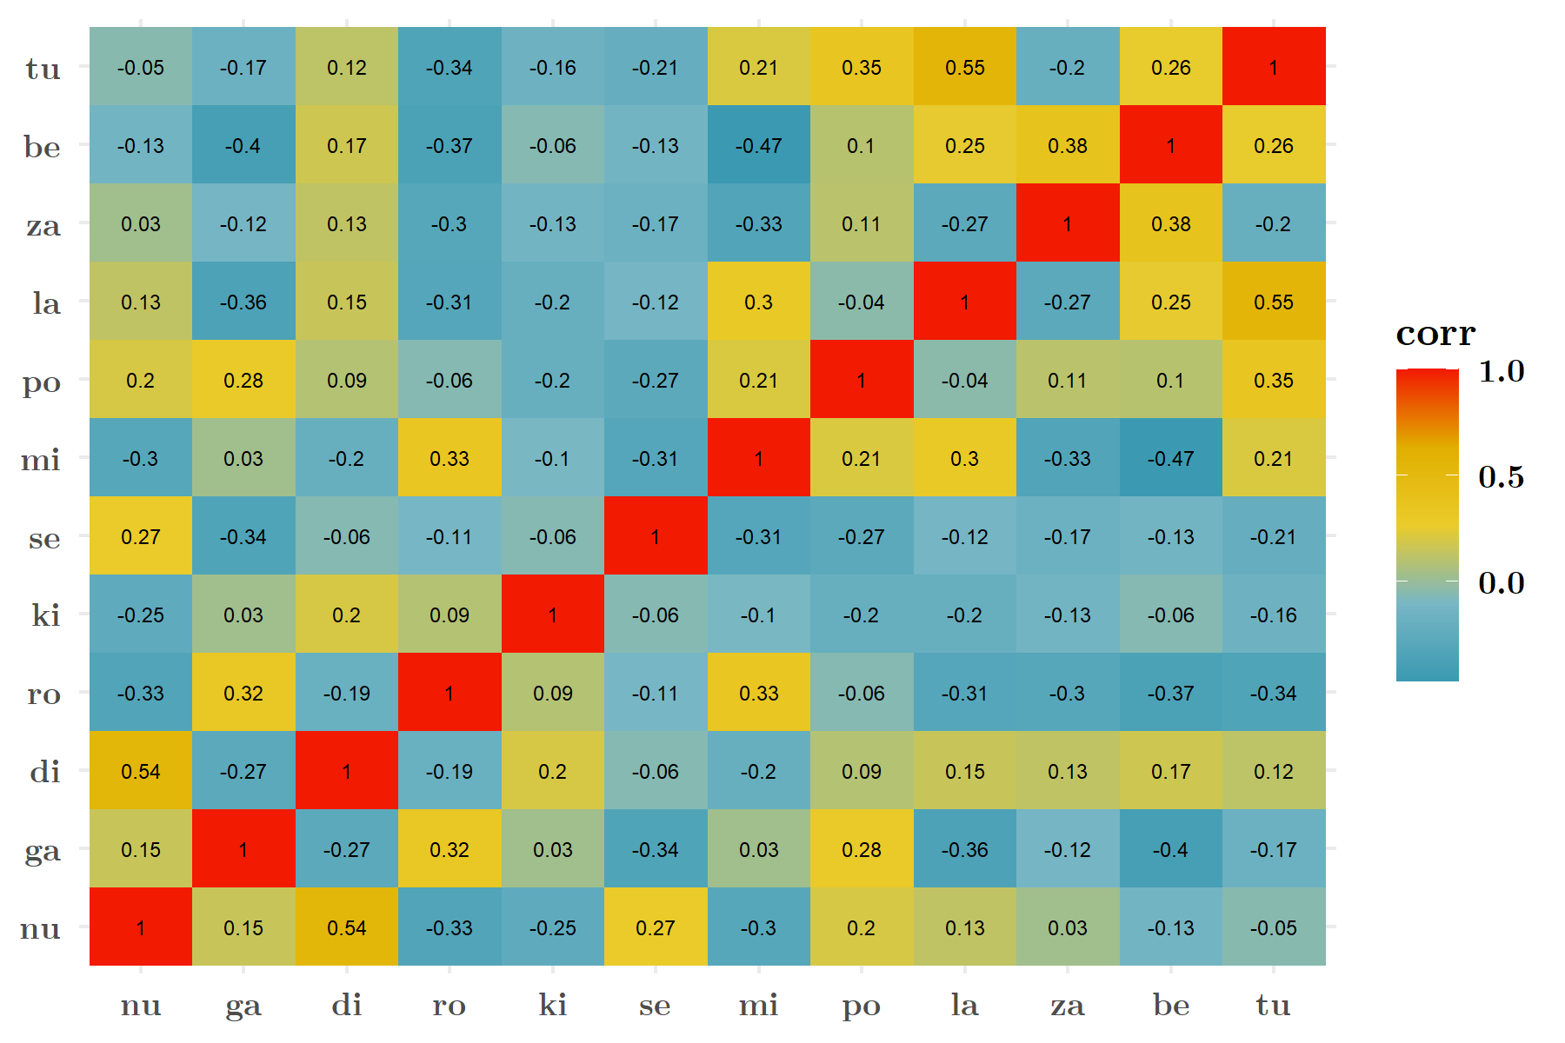
correlation heatmaps for RT to sylls
Exp 3
Exp 4
Notes:
Relevant questions:
Are words learned? (Triplets)
Are positions learned? (1 vs. 2 vs. 3)
Are duplets learned? (1-2 or 2-3)
Recall these are response times, so they tell us principally about how predictable or easy to recognize a syllable was. While some differences may exist in the latter, the former we were able to show is present in the data.

Slide 28
statistical comp. of corrmats()
Ordinal position (1st pos vs. 2nd pos. vs. 3rd pos.)
Transitional Probability (1st pos vs. 2nd + 3rd pos.)
Word (nugadi, rokise, mipola, zabetu)
Identity (each syll.)
cor() → FisherZ() → Wilcoxon Rank Test()
! I no longer have arrays…
rt_1 rt_2 rt_3
rt_1 -Inf 0.8621912 0.9071126
rt_2 0.8621912 -Inf 0.9078270
rt_3 0.9071126 0.9078270 -Inf
rt_1 rt_2 rt_3 rt_4
rt_1 -Inf 0.8877505 0.9266855 0.9239165
rt_2 0.8877505 -Inf 0.8864135 0.8781094
rt_3 0.9266855 0.8864135 -Inf 0.9331248
rt_4 0.9239165 0.8781094 0.9331248 -Inf
rt_1 rt_33
rt_1 -Inf 0.8872528
rt_33 0.8872528 -Inf

Slide 29
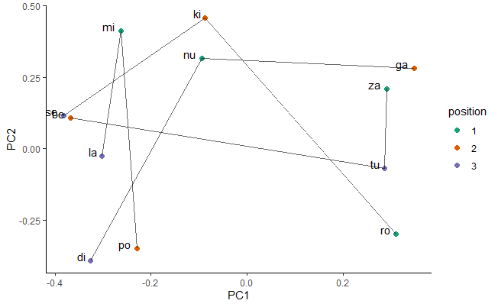
pca on corrmat() for combined data set

Slide 30
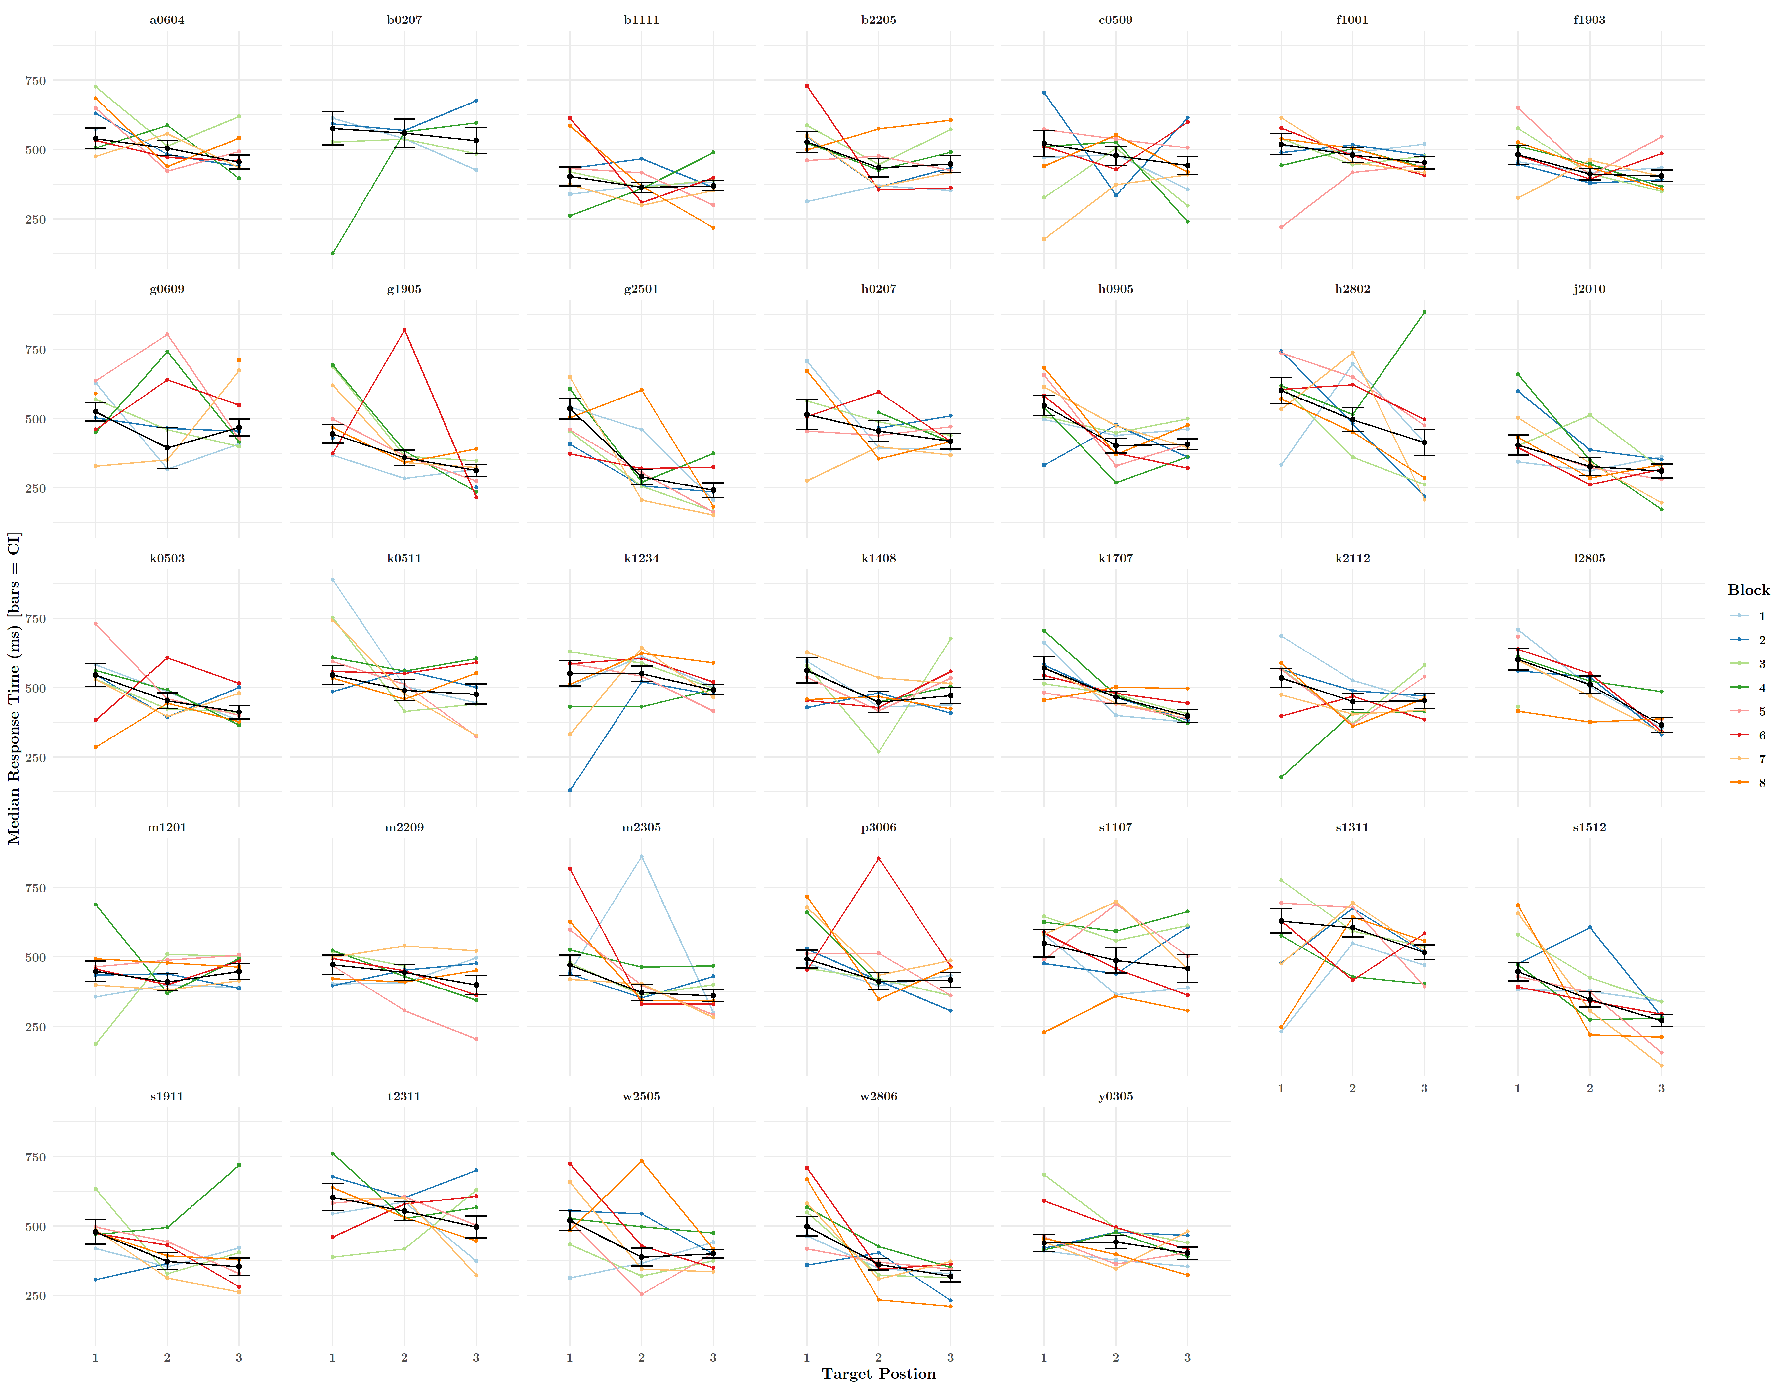
exp 1

Slide 31
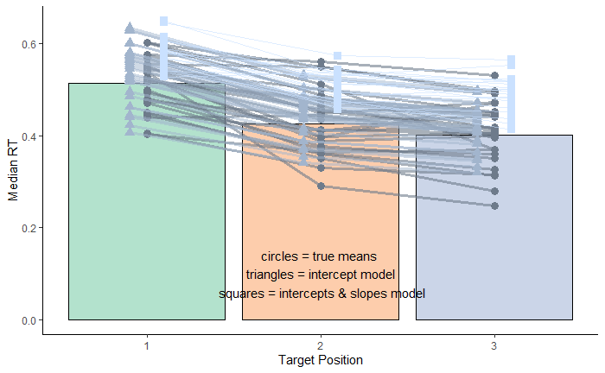
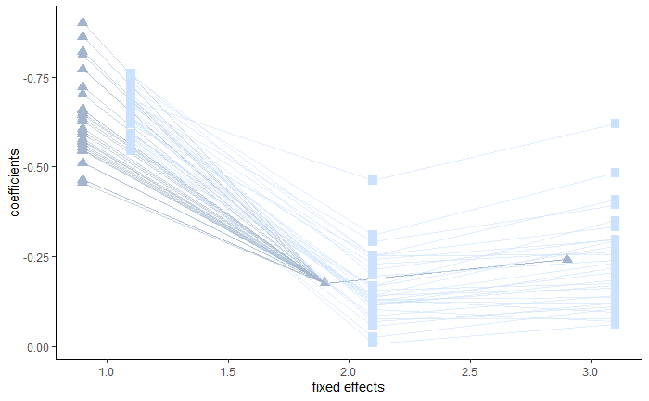
random intercepts, random slopes
glmer(rt_secs ~ tgt_pos + (1| subject), data = exp_3_data, family = Gamma(link = "log")
glmer(rt_secs ~ tgt_pos + (tgt_pos | subject), data = exp_3_data, family = Gamma(link = "log")
Notes:
The slopes model is penalized and it appears the random slopes plot does not account for the data better than the random intercept plot. This suggests that subjects did not behave differently on the task, and that one slope is sufficient to account for the variance between participants.

Slide 32
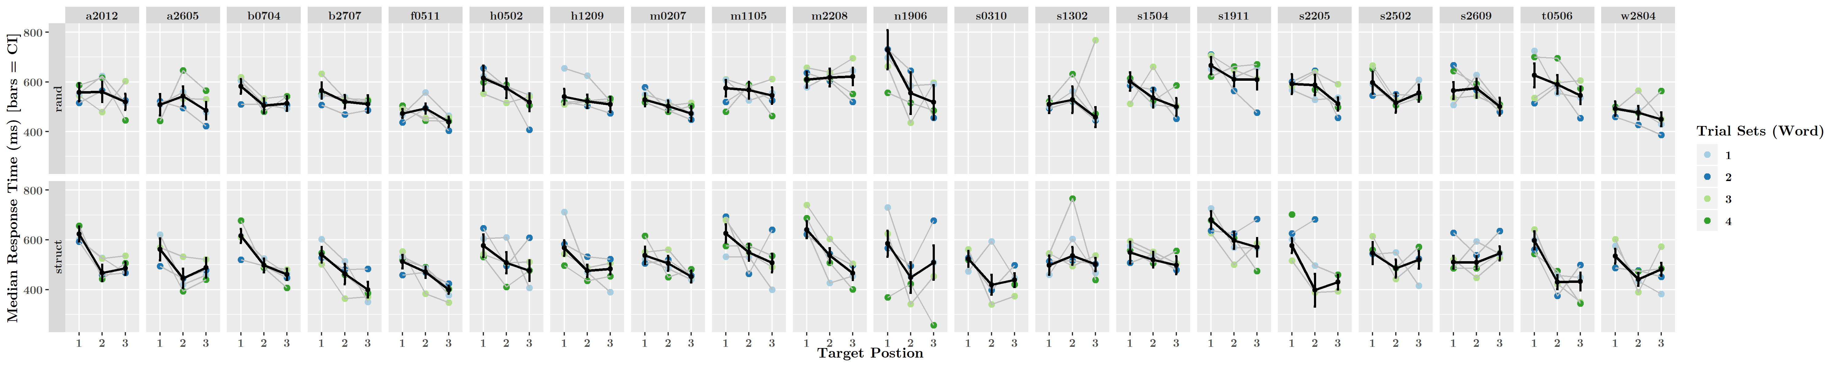
exp 2

Slide 33
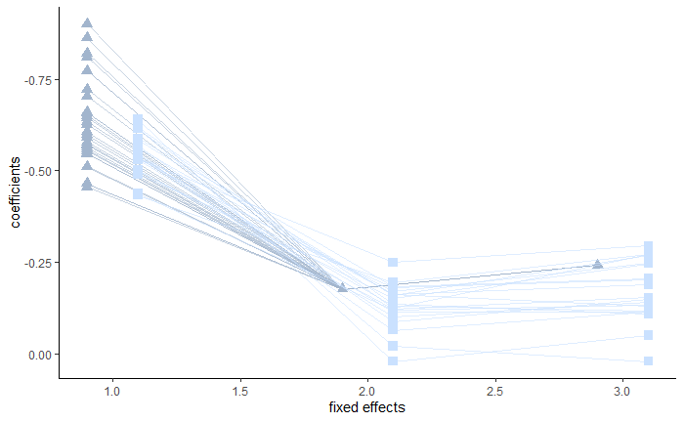
random intercepts, random slopes
glmer(rt_secs ~ tgt_pos + (1| subject), data = exp_4_data_s, family = Gamma(link = "log")
glmer(rt_secs ~ tgt_pos + (tgt_pos | subject), data = exp_4_data_s, family = Gamma(link = "log")
Notes:
The slopes model is penalized and it appears the random slopes plot does not account for the data better than the random intercept plot. This suggests that subjects did not behave differently on the task, and that one slope is sufficient to account for the variance between participants.

Slide 35
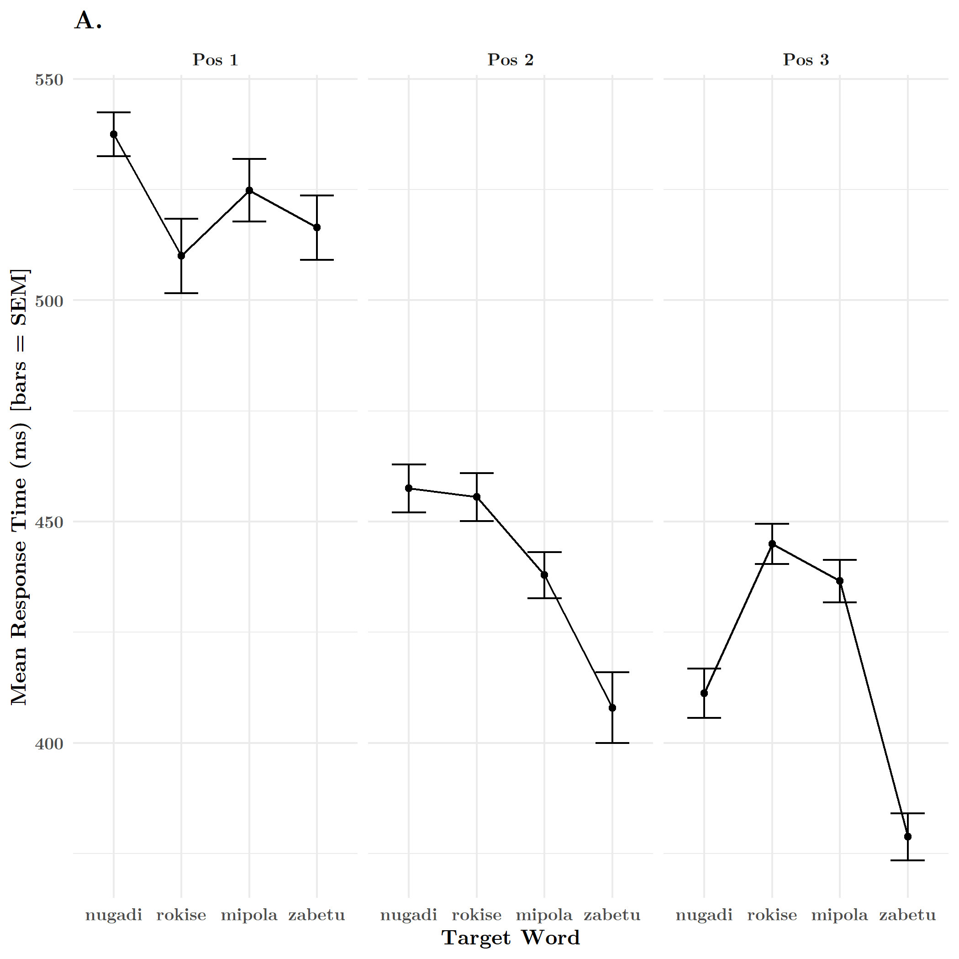
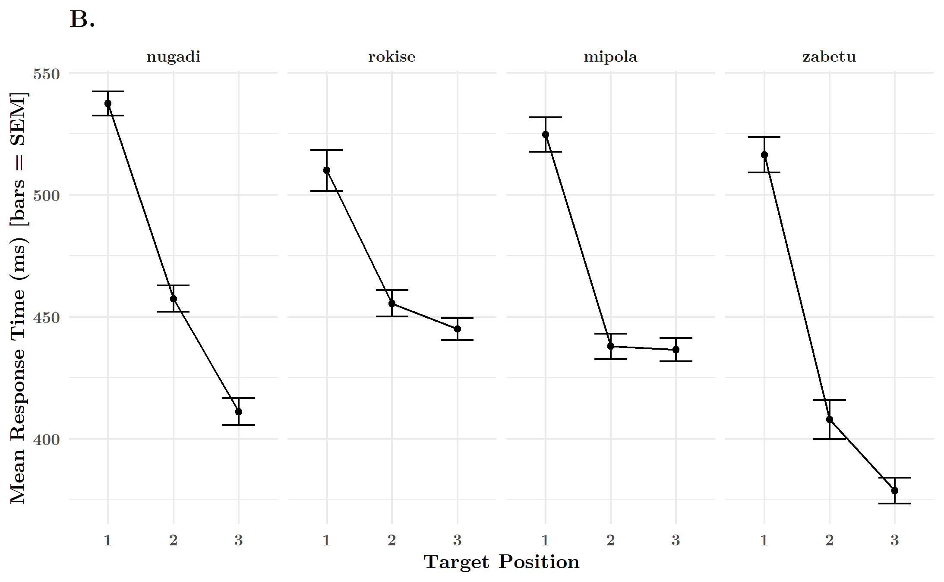
online statistical learning: word effects
1st position targets were detected equally fast among all words
However, differences arose between words for 2nd and 3rd position targets
Notably faster for “zabetu” – I believe this to be due to accidental patterns in stimuli, that could be controlled for by a “Language B”

Slide 36
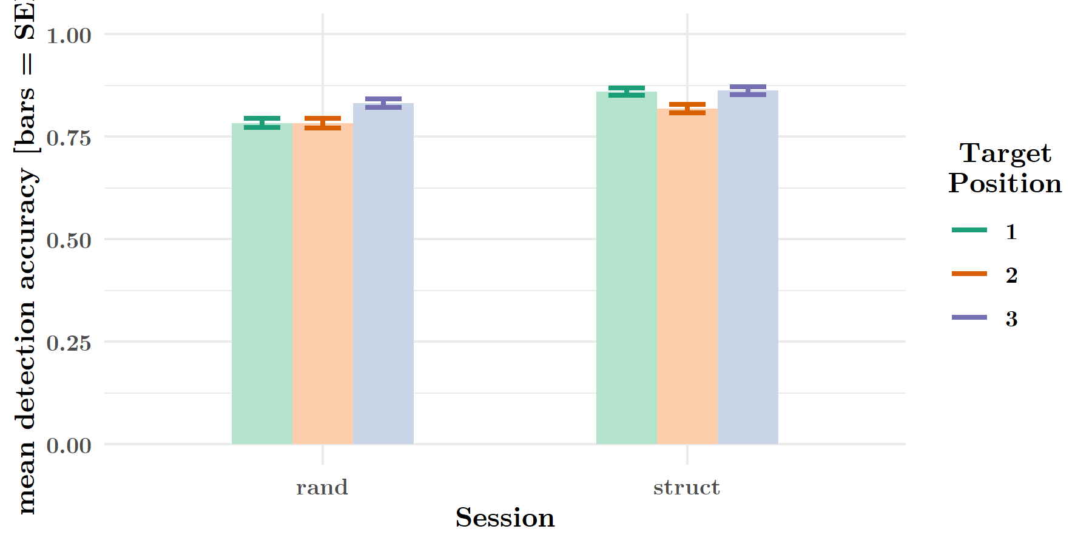
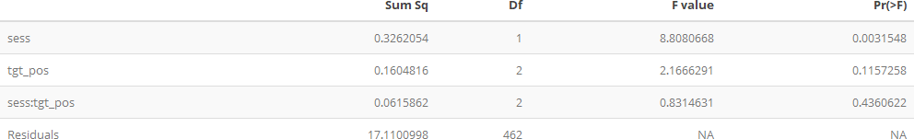
accuracy: session x position
Target Detection
**
Accuracy sig. higher in struct vs. rand condition, but not differences between tgt positions, nor interaction.

Slide 37
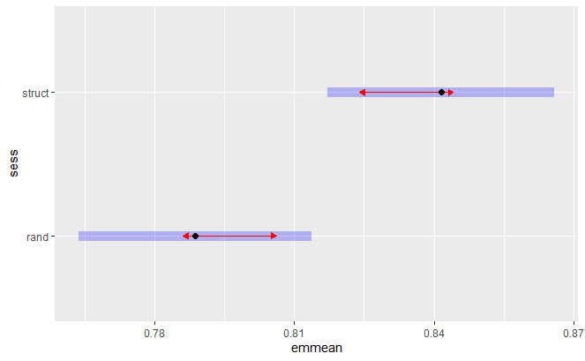
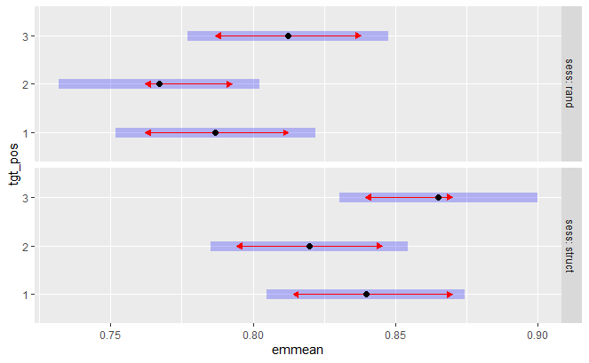
accuracy: session x position
Target Detection
Accuracy sig. higher in struct vs. rand condition, but no differences between tgt positions, nor interaction.
Confirmed by contrasts, see est. marginal means:

Slide 38
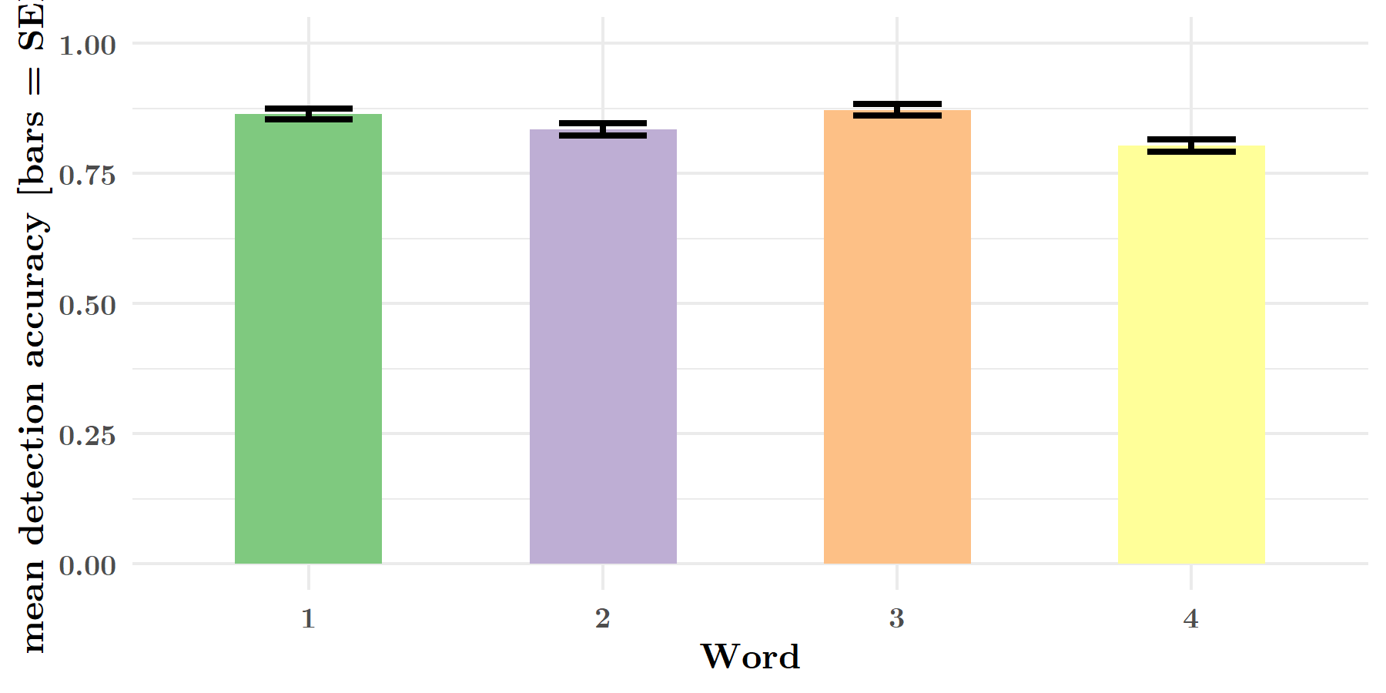
accuracy: word
Target Detection
No effect of word (in struct.)

Slide 39
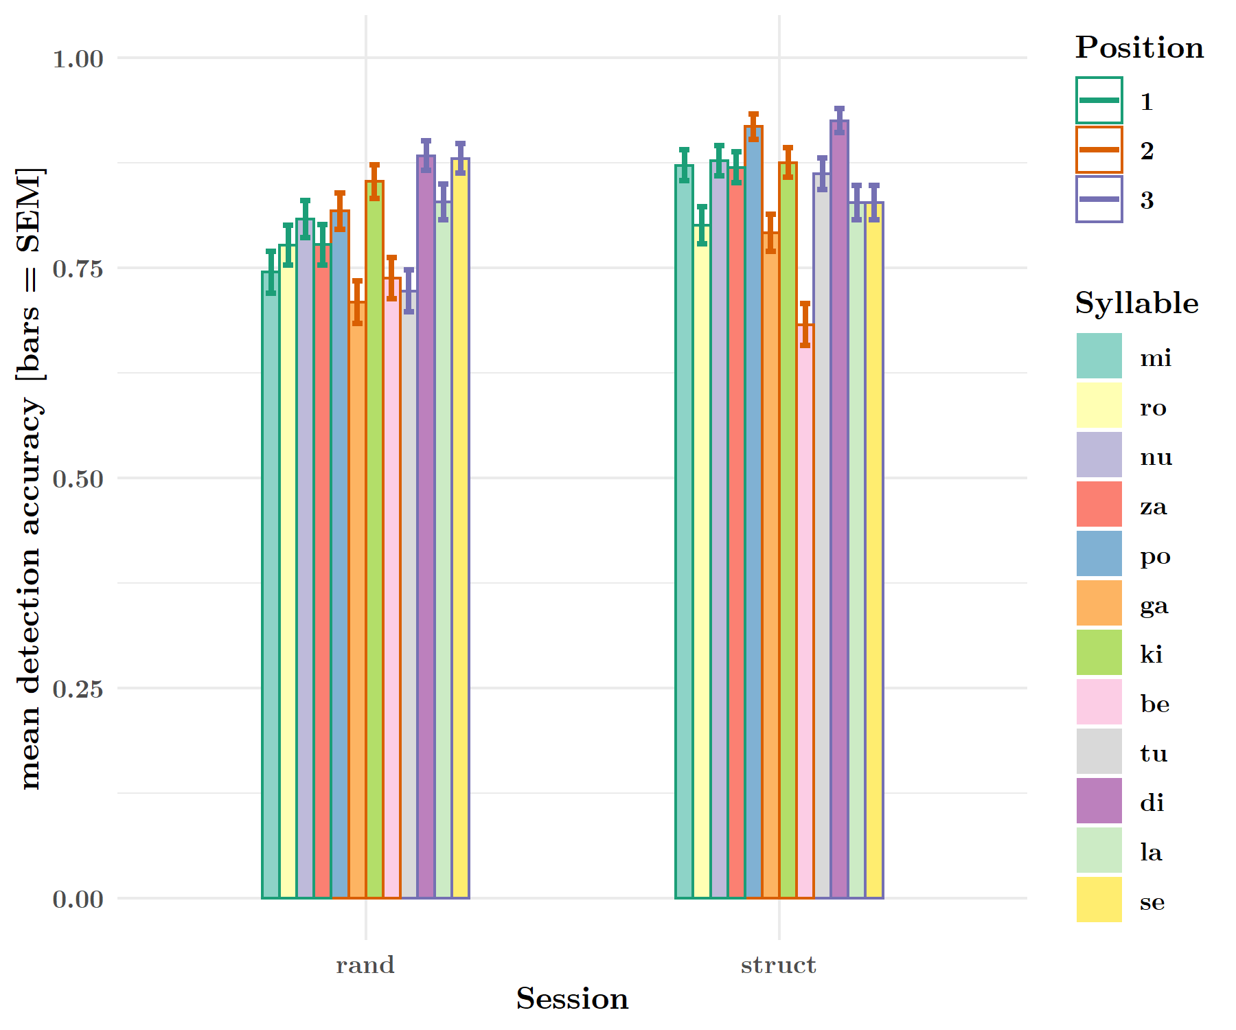
accuracy: session x syllable
Target Detection
Main effect of both target and session (session is explained by earlier graph), but we want to know if any individual items elicited strange behavior

Slide 40
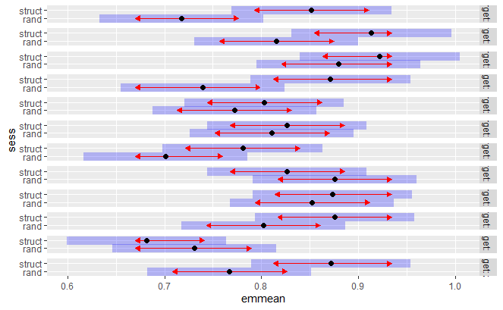
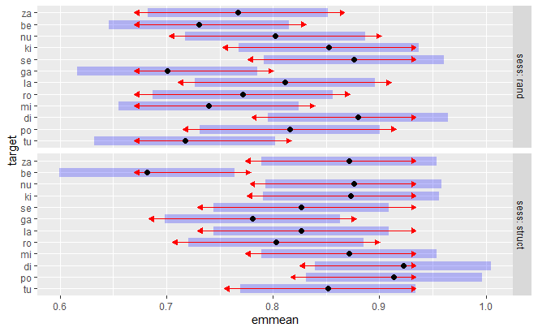
accuracy: session x syllable
Target Detection
Within sessions, only syllable “be” was sig. detectable than others (in struct.)
Between sessions, only “tu” and “mi” showed marked differences.
tu po di mi ro la ga se ki nu be za
… we have some variability in syllable detectability, although most are clustered in the same region…

Slide 41
analyses review
Questions
Were participants able to perform the task?
Did RTs reflect predictability (and provide evidence for learning)?
Can we see a more nuanced picture of learning onset?
Yes.

Slide 42
analyses review
Questions
Were participants able to perform the task?
Did RTs reflect predictability (and provide evidence for learning)?
Can we see a more nuanced picture of learning onset?
Yes.
Yes.

Slide 43
analyses review
Questions
Were participants able to perform the task?
Did RTs reflect predictability (and provide evidence for learning)?
Can we see a more nuanced picture of learning onset?
Yes.
Yes.
…

