Slide 1
Getting NC Produce to People in Need
Big question: How do people in unstable food situations have access to fresh produce?

Slide 2
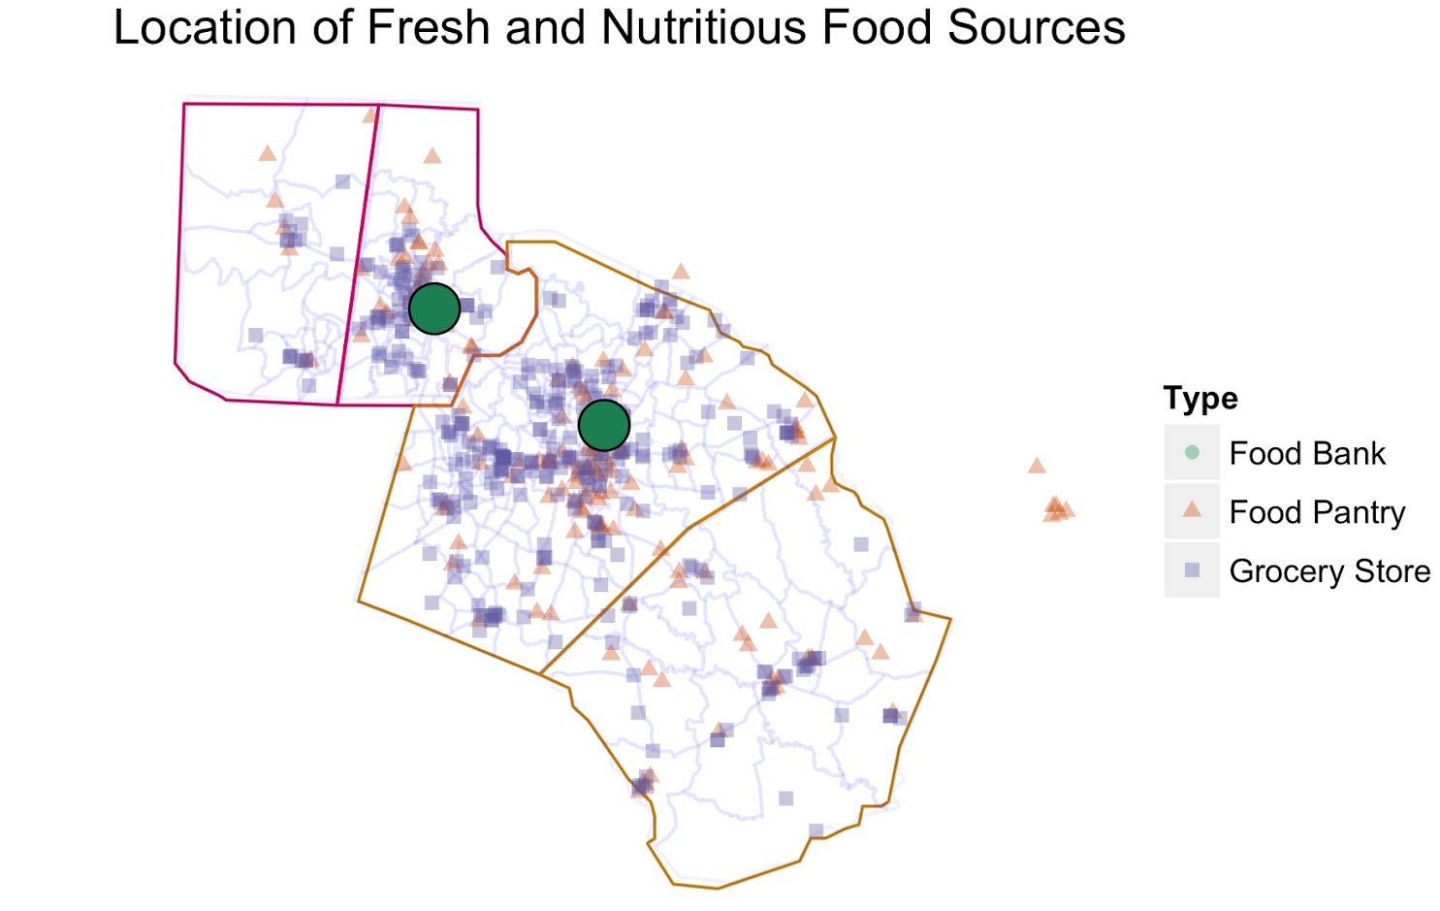
Fresh and Nutritious Food Sources
-Where are panties, banks and grocery stores?
-Which counties each food bank is serving?

Slide 3
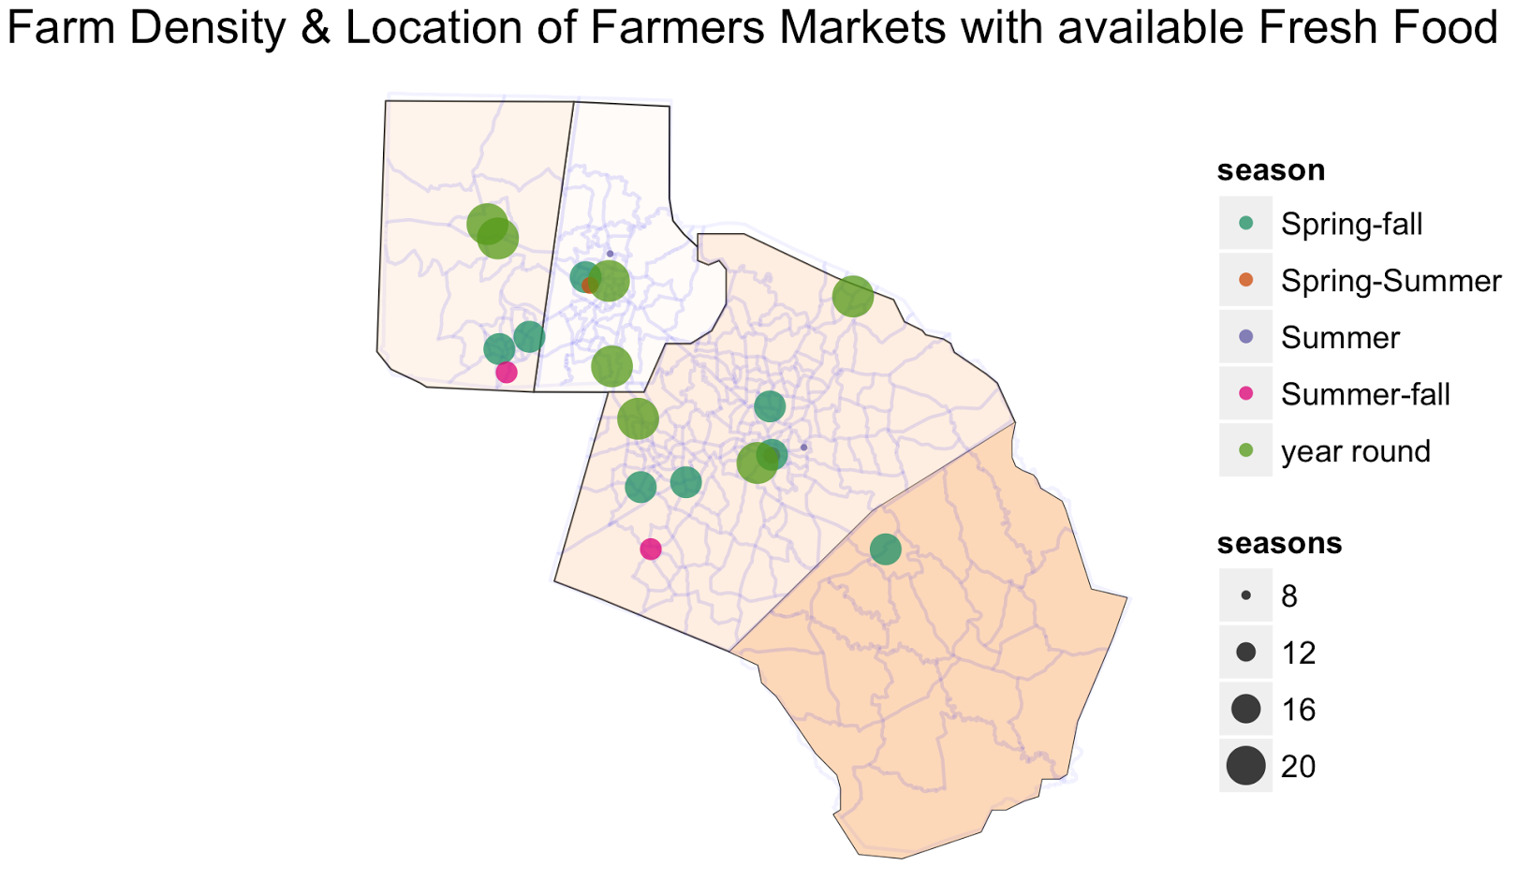

Farm Density and Farmers Markets
*Dot size indicates diversity in availability
-We looked at NCDA what’s in season: Selections were used for what was available
Farms = potential source for banks/pantries.
Where are foods grown and where are they available?

Slide 4
Insights and Future Work
-We have a lot of opportunities to gather more data around crops and agriculture
-inventory information from banks/pantries
-Does poverty always indicate food insecurity?
Bigger question: Since we have a strong agricultural sector in NC, can we use our produce to feed our people?

