Slide 1

35th ADA Anniversary Series
Ground Transportation for People with Mobility Disabilities: 35 Years after the ADA
Presenters: Anne Sommers McIntosh, Director of Legislative Affairs Kimie Eacobacci, Legislative Affairs Specialist

Slide 2

Opening Remarks
Jim Langevin
Former Congressman Rhode Island
35th ADA Anniversary Series

Slide 3
Real life example….
“A few weeks ago, I got a call from my personal assistant telling me that my wheelchair accessible van was not working due to a muffler problem, and I would need to find another way home from work…”
35th ADA Anniversary Series

Slide 4
Americans with Disabilities Act
Congress identified transportation as a “critical area” where discrimination persisted and kept people shut out of full and equal participation in all aspects of life
However, the ADA does not explicitly require taxis or Ubers or Lyfts to have a percentage of wheelchair-accessible vehicles.
35th ADA Anniversary Series

Slide 5
On-Demand Transportation Options
People who use motorized wheelchairs and scooters | People without mobility disabilities
Personal vehicle – only if able to afford a modification or purchase for $50-100k | Personal vehicle
Transportation Network Companies (Uber, Lyft) – only if in one of a very small handful of cities with modest WAV-inclusion in fleet | Transportation Network Companies (Uber, Lyft) – on demand
Taxis – dwindling likelihood of securing a WAV taxi in most cities | Taxis – on demand
Can only get a ride from others if they own a WAV | Get a ride from family or friend
No accessible robotaxis, no autonomous WAVs poised for market | Select cities offer “robotaxis,” autonomous vehicles poised for market
35th ADA Anniversary Series

Slide 6
Other Ground Transportation Options
Paratransit
No on-demand option; must schedule in advance
Ridesharing so often lengthy trips for even short distances
Inconsistency with pickups and policies often leads to missed rides
Public bus systems
Fixed-route
Walkways to bus stops and bus stops themselves often inaccessible
Transfers and frequent stops add considerable time to trip
35th ADA Anniversary Series

Slide 7
Who does this topic affect?
People with “ambulatory disabilities”
2022 U.S. Census – 21 million
People with “mobility disabilities”
2022 CDC – 35 million
People with “travel-limiting disabilities”
“A temporary or permanent condition or handicap that makes it difficult to travel outside of the home.”
24.6 million in 2017; 17.7 million in 2022*
U.S. Dept. of Transportation, National Household Travel Surveys
Their families, friends, employers, schools, communities
*As a preface, we note that the 2022 NHTS surveyed only 27,290 households, the smallest sample size in its history.
35th ADA Anniversary Series

Slide 8
Impacts of a lack of transportation options
NHTS measures trip-making patterns among groups surveyed
In 2017 and 2022 surveys, people with travel-limiting disabilities took fewer trips, of shorter distances, that took longer than their nondisabled peers
2017 survey: 34.1% of PWD took no trips vs. 13.4% of PWOD
37.3% of rural PWD stayed home
16% of rural PWOD stayed home
In 2017, a total of 3.6 million people with travel-limiting disabilities reported they didn’t travel b/c of their disabilities or that they were housebound.
35th ADA Anniversary Series

Slide 9
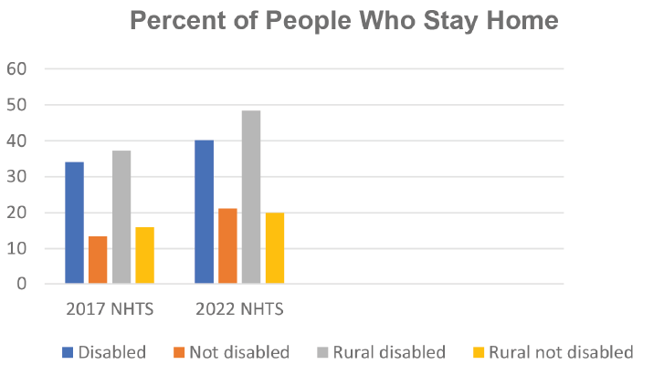
Impacts of a lack of transportation options
2022 survey – 40.2 % of PWD ages 18-64 took no trips vs. 21.2% of PWOD
48.3% of rural PWD stayed home
20% of rural PWOD stayed home
35th ADA Anniversary Series

Slide 10
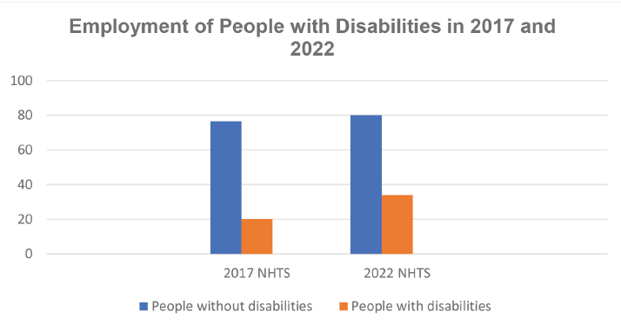
Determinants of travel behavior
2017 survey – 20.2% w/ a travel-limiting disability (TLD) ages 18-64 worked, vs. 76.6% without a disability
2022 survey – 33.9% w/ a TLD worked, vs 80% without a disability
35th ADA Anniversary Series

Slide 11
Determinants of travel behavior
2017 survey – 34.7% of people w/ a travel-limiting disability (TLD) ages 18-64 lived in a zero-vehicle household vs. 13.4% without a disability
People w/ TLDs ages 18-64 also less likely to drive if they had vehicles
91% people w/o a disability drove if had a vehicle, vs. 60.4% PWTLD
2022 survey – 14.3% of people w/ a TLD lived in a zero-vehicle household vs. 4.9% of people w/o a disability
93.4% people w/o a disability drove if they had a vehicle, vs. 66% PWTLD
35th ADA Anniversary Series

Slide 12
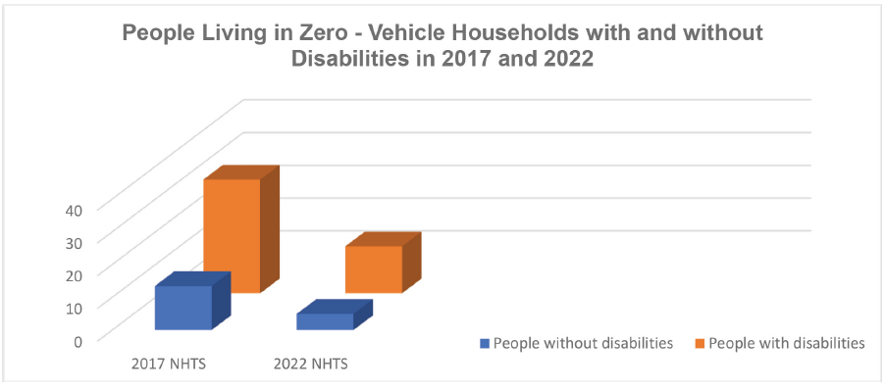
Determinants of travel behavior
35th ADA Anniversary Series

Slide 13
Determinants of travel behavior
[Non-NHTS data], 2017 – 29.6% of people with disabilities aged 18 to 64 years living in the community were living in poverty, more than double the percent of people in the same age group without disabilities (13.2%).
[Non-NHTS data], 2022: 25% of people with disabilities aged 18 to 64 years living in the community were living in poverty, more than double the percent of people in the same age group without disabilities (10%).
Those w/ ambulatory disabilities living in poverty was even higher at 29.6%
35th ADA Anniversary Series

Slide 14
Cost of Personal WAVs, Missing Data
Modifications to a van include:
Raised roof
Lowered floor
Ramp
Modified air bags
Modified steering wheel
Wheelchair securement
Cost of modifications can range from $50k - $100k
NHTS surveys do not inquire about which people with travel-limiting disabilities require vehicle modifications, how reliable the modifications are, or how they were paid for.
35th ADA Anniversary Series

Slide 15
Compensation Strategies Used by People with Travel-Limiting Disabilities
In 2017 and in 2022, people with travel-limiting disabilities ages 18 to 64 compensated for transportation barriers in the following ways:
Asking others for rides (44.3% in 2017; 34.7% in 2022)
Limiting travel to the daytime (22.6% in 2017; 17.6% in 2022)
Paratransit / Dial-a-Ride or reduced-fare taxis (12.3% in 2017; 8.1% in 2022)
Using ride hail (4.6% in 2017; 10.1% in 2022)
60.3% of people with travel-limiting disabilities reduced day-to-day travel; and 13% gave up driving altogether.
35th ADA Anniversary Series

Slide 16
Misleading Data
People who use motorized wheelchairs and scooters cannot simply hitch a ride with any friend or family member, which is noted as the number one compensation strategy for people with travel-limiting disabilities (TLDs).
And though some statistics suggest people with TLDs use rideshare at the same rates as people without disabilities, wheelchair-accessible options for rideshares are few and far between in only approximately 10 U.S. cities and are thus misleading absent further disaggregation.
35th ADA Anniversary Series

Slide 17
Literature Review
Interconnection of transportation disadvantage and social exclusion
In a National Network of ADA Centers study of approximately 1,700 people with disabilities, of those reporting mobility disabilities, approximately one third “always or usually had difficulty accessing transportation” for:
Spontaneous events;
Recreation and socializing;
Running errands; and
For healthcare.
And nearly a quarter of those with mobility disabilities always or usually had difficulty accessing transportation for school or work.
35th ADA Anniversary Series

Slide 18
Literature Review
In another National Network of ADA Centers Study of over 4,000 individuals with disabilities who use public transportation, top barriers cited included:
Problems with lifts (34%)
Inaccessible bus stops and stations (26.9%)
Gaps or steps to reach vehicles (28.8%)
Inability to secure wheelchairs (15.4%)
Scheduling problems with paratransit (59.3%)
Long wait times with paratransit (51%)
35th ADA Anniversary Series

Slide 19
Public Comment Input
Key problems with ground transportation for people with mobility disabilities identified through NCD public comment:
Limited availability or lack of wheelchair-accessible taxis (and limited hours);
Largely inaccessible rideshare services;
Paratransit is not demand-responsive and takes too much time;
Hotel and rental car shuttles are frequently inaccessible;
Inadequate infrastructure – a lack of accessible sidewalks and bus stops, especially in suburban and rural locations.
35th ADA Anniversary Series

Slide 20
Public Comment Input
Negative emotions evoked by experiences with inaccessible transportation:
Stress and anxiety – unreliability and uncertainty of whether rides will show up on time if at all, and whether appointments will be made or missed.
Isolation and exclusion – wheelchair users often find themselves unable to participate in social activities or travel freely
Fear and vulnerability – experiences of being stranded lead can lead to feeling fearful for one’s safety, especially at night and in unfamiliar locations.
Hopelessness – ongoing challenges and lack of progress make one feel their needs are being ignored.
Frustration
35th ADA Anniversary Series

Slide 21
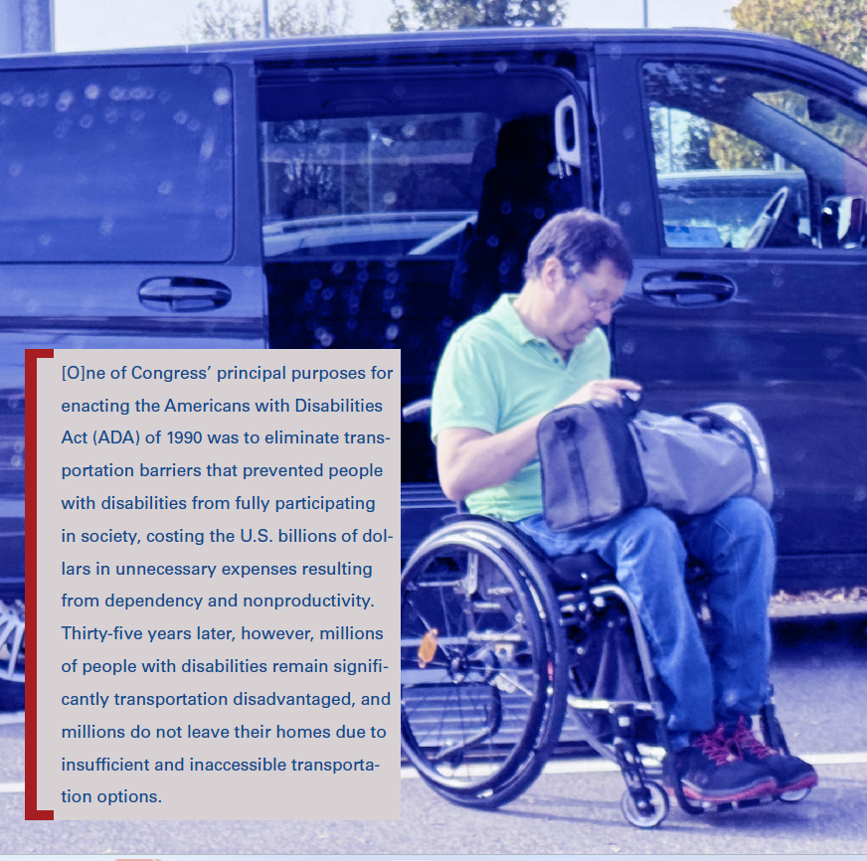
Conclusion
Ground Transportation for People with Mobility Disabilities 2025: Challenges and Progress
www.ncd.gov
35th ADA Anniversary Series

Slide 22
Next Briefing
Transportation Network Company Services (Uber, Lyft)
Wednesday, July 30, 2025
2:00 PM EDT
35th ADA Anniversary Series

