Slide 1
Pillars for Building a Disability Middle Class
A policy framework for wealth, opportunity, and economic security
August 19, 2026
Thomas Foley, Executive Director and Elizabeth Jennings, Deputy Director

Slide 2
The Shift: From Poverty Prevention to Prosperity
The historic middle class was built through intentional public policy and investment.
People with disabilities face structural barriers to building assets and advancing economically.
The goal is not simply to reduce poverty; it is to create pathways into and through the middle class.
Shift: Income maintenance → Asset accumulation → Wealth building → Financial capability

Slide 3
The Five Pillars of a Disability Middle Class
Introduce the framework:
Asset Building & Wealth
High-Paid Employment & Upward Mobility
Physical & Digital Infrastructure
Health Security
The AI Dividend

Slide 4
Pillar 1 | Structured Asset-Building
Goal: Give people with disabilities meaningful opportunities to save, own assets, and build wealth without losing essential supports.
Strengthen ABLE accounts as long-term wealth-building tools
Protect retirement savings
Expand pathways to homeownership and home equity
Remove policies that penalize saving and asset accumulation

Slide 5
Pillar 2 | High-Paid Employment & Upward Mobility
Goal: Move beyond employment access toward career advancement and middle-class earnings.
Make government a model employer
Create accessible career ladders and professional advancement
Expand paid apprenticeships and training pathways
Incentivize retention, professional development, and workplace accessibility
Expand opportunities for disabled-owned businesses through procurement

Slide 6
Pillar 3 | Physical & Digital Infrastructure
Goal: Build the infrastructure people need to fully participate in the economy.
Accessible public transportation
Accessible autonomous vehicles and mobility technology
Accessible housing and physical environments
Digital accessibility as essential infrastructure
Accessible workplace technology and emerging AI tools

Slide 7
Pillar 4 | Decouple Health Security from Labor Status
Goal: Make career advancement possible without risking essential health care and supports.
Universalize Medicaid Buy-In
Make Medicaid and HCBS more portable
Create clear transitions between Medicaid and Medicaid Buy-In
Protect assets during employment and coverage transitions
Modernize employer health benefits to better address disability-related needs

Slide 8
Pillar 5 | Leverage the AI Dividend
Goal: Ensure people with disabilities participate in, and benefit from, the economic gains generated by AI.
Use an AI dividend to support long-term wealth building
Expand seed capital and matched savings vehicles
Invest in accessible education, training, and apprenticeships
Prepare workers with disabilities for emerging high-value careers
Use technology to reduce the additional costs associated with disability

Slide 9
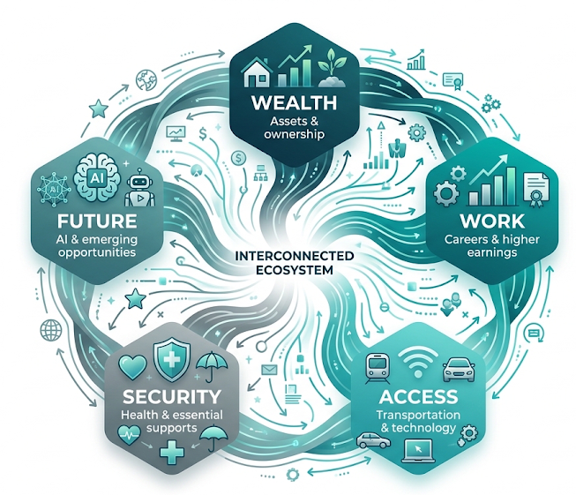
What Happens When the Pillars Work Together?

Slide 10
The Vision: A Disability Middle Class
A disability middle class means people with disabilities can:
Pursue competitive, well-paid careers
Build savings, assets, and wealth
Own homes and businesses
Access health care and essential supports without being trapped by benefits cliffs
Move, work, learn, and participate fully in their communities
Build financial security across the lifespan

