Slide 1

Minor Project on Resume Parser
Dinesh Nepal(PUR077BCT033)
Bhuwan Ojha(PUR077BCT020)
Biswash Raj Koirala (PUR077BCT029)
Kushal Poudel(PUR077BCT043)

Slide 2
INTRODUCTION
In today's fast-paced world, the hiring process demands efficiency and precision. Our project addresses the need for an intelligent resume parser that can automatically extract key details from resumes, reducing manual effort and expediting candidate evaluations.

Slide 3
PROBLEM STATEMENT
The manual parsing of resumes is time-consuming and prone to errors. HR professionals often spend significant hours extracting relevant details from resumes, leading to delays in the hiring process. Our project seeks to eliminate this bottleneck by automating the extraction process.

Slide 4
Literature Review
Problem: Manual resume screening is time-consuming and inefficient for large applicant pools.
Solution: This project addresses this by developing a web application utilizing a Named Entity Recognition (NER) AI model to automatically extract key information from resumes.
Existing Work:
NLP techniques: Studies demonstrate the effectiveness of Natural Language Processing (NLP) for resume parsing, particularly rule-based and machine learning approaches..
NER models: NER models have shown promising results in identifying specific entities within resumes, such as names, skills, and work experience.
Our Contribution: This web application leverages an NER AI model for efficient and accurate resume parsing, potentially streamlining the recruitment process.

Slide 5
OBJECTIVES
Develop a resume parser using ML NER to automate the extraction of key information from resumes.
Enhance recruitment efficiency by accurately identifying and categorizing entities, streamlining the candidate screening process.

Slide 6
Technologies Used
Github
Overleaf and Google Slides
Python
Python Libraries/Framework
i. Spacy
ii. Django
HTML
CSS
JavaScript

Slide 7
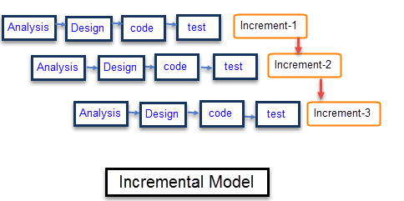
SOFTWARE DEVELOPMENT METHODOLOGY
Incremental Model
We have chosen to adopt the incremental model for our project, leveraging its distinct features to ensure a systematic and flexible development process.
In this approach, we plan to break down the development of our resume parser into smaller, manageable parts called increments.

Slide 8
SOFTWARE DEVELOPMENT METHODOLOGY
Requirement Analysis
Design & Development
Testing
Implementation

Slide 9
Project Scope
Resume Ranking System:
Job Recommendation System:
Customized Interview Questions:
Career Pathway Recommendations:

Slide 10
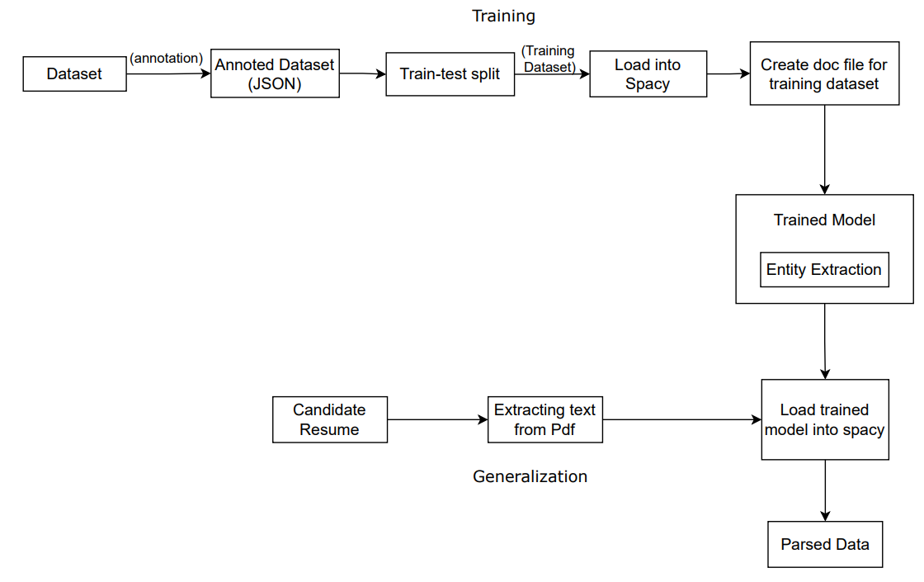
SYSTEM BLOCK DIAGRAM

Slide 11
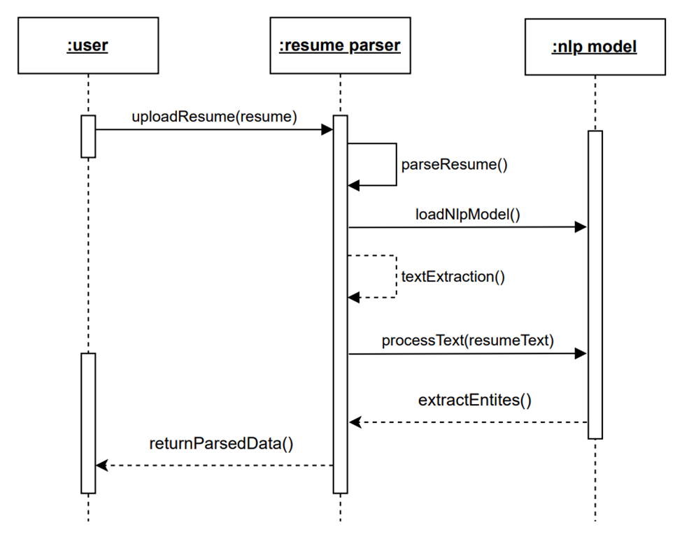
SEQUENCE DIAGRAM

Slide 12
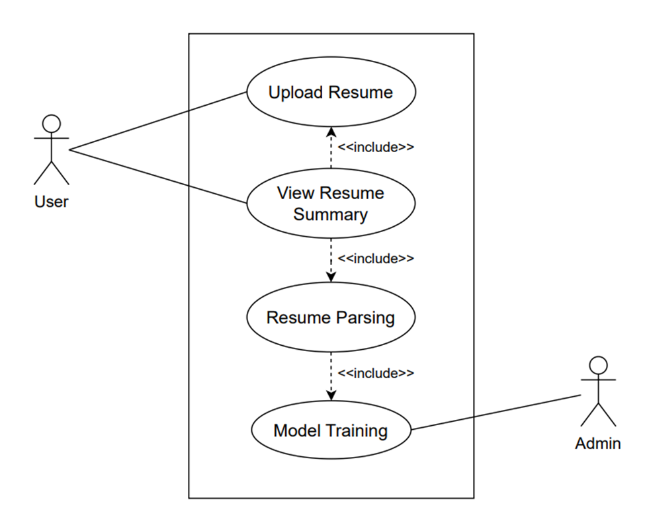
USE CASE DIAGRAM

Slide 13
REQUIREMENT ANALYSIS
Non-functional requirements
Availability:
The system is available for use 24 hours without planned downtime.
User Friendly:
The system has easy to use user interface, requires minimal training for users.
Compatibility:
The system is compatible with common browsers, operating systems, and devices.

Slide 14
REQUIREMENT ANALYSIS
Functional requirements
File Upload:
The system allow users to upload resumes in popular formats such as PDF and DOCX.
Resume Parsing:
The system recognizes and categorizes entities such as names, skills, educational qualifications, and experiences from the resumes.
Resume Summary Generation:
The system generates a structured summary for each uploaded resume, presenting extracted information in a clear and organized manner.

Slide 15
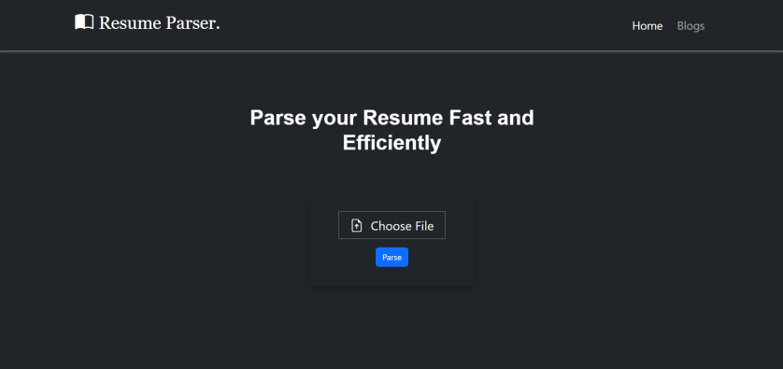
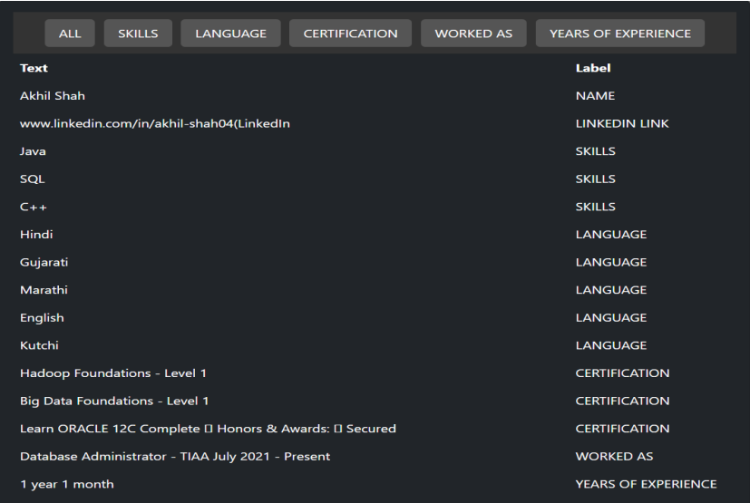
RESULT

Slide 16
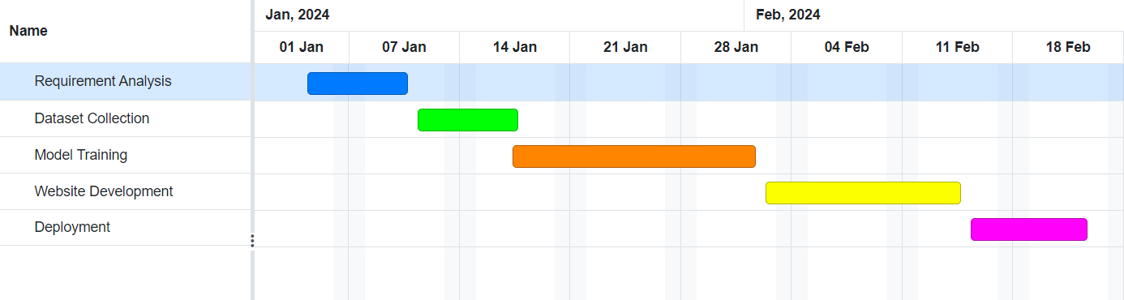
SCHEDULE

Slide 17
REFERENCES.
[1] G. Narendra and S. Hashwanth, “Named entity recognition based resume parser and summarizer.”
[2] D. S. Chavare and A. B. Patil, “Resume parsing using natural language processing.” Grenze International Journal of Engineering & Technology (GIJET), vol. 9, no. 1, 2023.
[3] V. Mittal, P. Mehta, D. Relan, and G. Gabrani, “Methodology for resume parsing and job
domain prediction,” Journal of Statistics and Management Systems, vol. 23, no. 7, pp.
1265–1274, 2020.

Slide 18
THANK YOU.

