Slide 1



Computational and collaboration skills for synthesis science A training workshop for SNAPP postdoctoral associates, held at NCEAS, UCSB, Jun 27-30, 2016 Sponsored by:
http://snappartnership.net
http://www.nceas.ucsb.edu
Notes:
SNAPP is a partnership among The Nature Conservancy, TNC, the Wildlife Conservation Society, WCS, and NCEAS, UCSB, in order to promote collaborative and integrative conservation science. SNAPP is funded through generous donations from Shirley and Harry Hagey, Steve and Roberta Denning, Angela Nomellini and Ken Olivier, Seth Neiman, the Gordon and Betty Moore Foundation, Ward W. and Priscilla B. Woods, and the David and Lucile Packard Foundation. The primary purpose of this workshop is to bring together the SNAPP postdoctoral associates, working on diverse SNAPP Working Group projects, in order to better understand the overarching goals of the SNAPP project, especially relative to building greater multi-institutional prospects for collaborative science, greater knowledge-sharing and community identity among SNAPP participants, and greater awareness and more effective use of the computational infrastructure and services provided at NCEAS.

Slide 2
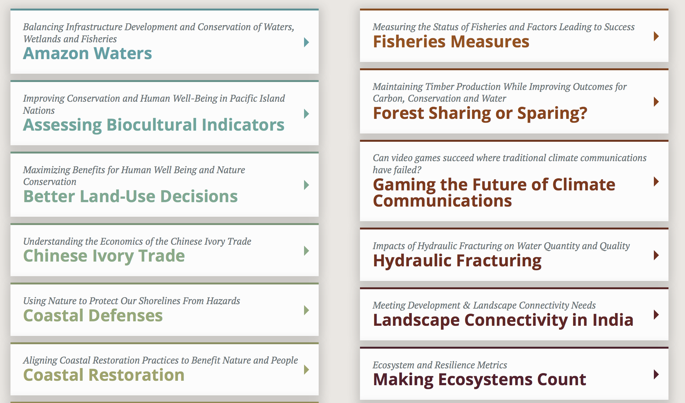
*
*
*
Notes:
Working Groups as of June 2016; Coastal Defenses and Amazon Waters are officially concluded– but continued conversation/interaction. These represent a diverse, global portfolio of research interests at the junction of conservation science and human well-being

Slide 3
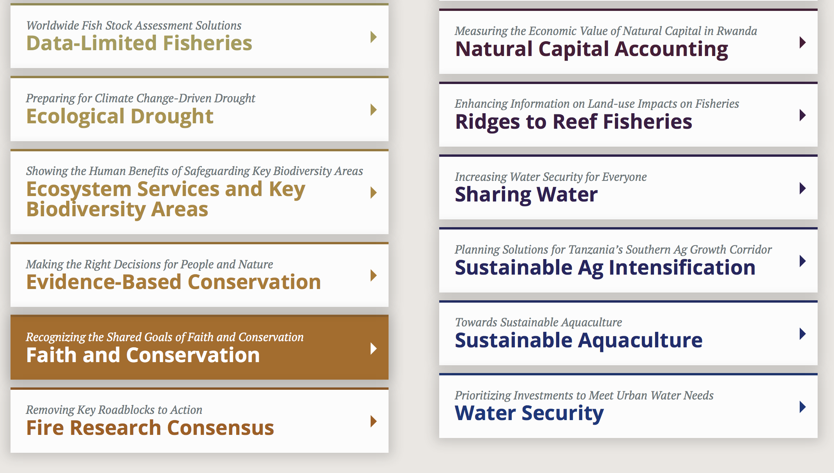
*
*
*
*
Notes:
Working Groups as of June 2016. 3-5 more new WG’s anticipated starting in 2017

Slide 4
A Challenge for Synthesis
It is often said that 80% of data analysis is spent on the process of cleaning and preparing the data *
* Wickham 2014. Tidy Data. J. Stat Soft 59(10):

Slide 5
The New Age of “Data Science”
“Open Science takes over:
In principle, the purpose of scientific publication is to enable reproducibility of research findings. For centuries, computational results and data analyses have been referred to in scientific publication, but
typically only have given readers a hint of the full complexity of the data analysis being described...
To meet the original goal of scientific publication, one should share the underlying code and data.” *
.*
* Donoho, D. 2015. “50 years of Data Science”, presented at Tukey Centennial Workshop.

Slide 6
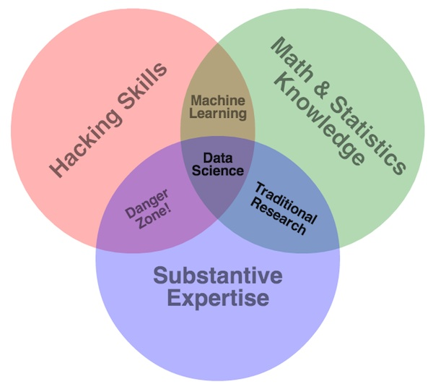
Image Attribution: Drew Conway
http://drewconway.com/zia/2013/3/26/the-data-science-venn-diagram
Notes:
Quoting Drew Conway: “The difficulty in defining these skills is that the split between substance and methodology is ambiguous, and as such it is unclear how to distinguish among hackers, statisticians, subject matter experts, their overlaps and where data science fits. What is clear, however, is that one needs to learn a lot as they aspire to become a fully competent data scientist. “ Conway licensed the image CC-BY.

Slide 7
SNAPP’s Data Principles
“When making societally important decisions based on science, it’s more important than ever that the underlying data be publicly available. The value of global scientific collaborations and synthetic research builds on the synergies derived from sharing and disseminating data. The spirit of “Open Science”- making scientific research, and its supporting data and information, accessible to all levels of society - is at the heart of the SNAPP Data Principles”
https://www.nceas.ucsb.edu/snap/dataprinciples

Slide 8
NCEAS’ Data Policy
The Center is committed to making ecological data available to the broader scientific community. To meet this goal, the Center:
Requires that derived data generated during an NCEAS research project be well documented and made publicly available. NCEAS provides technical assistance to do so.
Urges that data used to generate derived products be well documented and made openly available. NCEAS provides technical assistance to do so.
Respects the intellectual property rights of data owners who use their data in NCEAS research projects.

Slide 9
Workshop Goals
Instill understanding of collaborative science best practices within SNAPP Working Groups
Empower participants to adopt computing best practices in their scientific workflows and data management
Create a greater sense of SNAPP community identity among the postdocs
Foster potential collaboration and enhanced knowledge-sharing across SNAPP Working Groups
Familiarize and instruct researchers in the use of NCEAS (and other) cyberinfrastructures and scientific computing services
Clarify and reinforce SNAPP’s commitment to Open Science
Notes:
Postdocs have always been critical, key participants in successful Synthesis Working Groups

Slide 10
Workshop Expectations
Participate!
Learn some new technology concepts and tools!
Create connections with new SNAPP (and other) colleagues!
Don’t be afraid to ask questions!
If you already know a topic, help out your colleagues who might not
Become better aware of NCEAS’ computational services and scientific computing staff
Notes:
Postdocs have always been critical, key participants in successful Synthesis Working Groups

Slide 11

10 types of people
Those who understand binary
Those who don’t
Source Image credit: Brett Jordan, Licensed CC-BY

