Slide 1
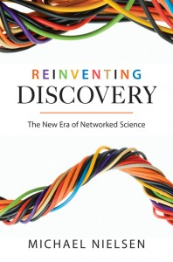
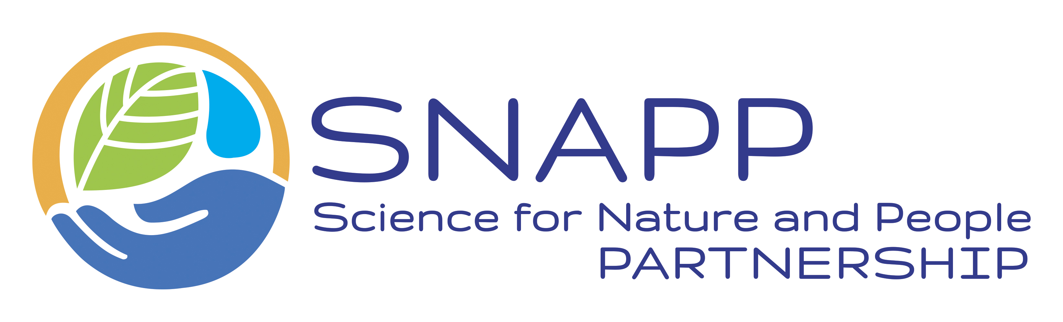
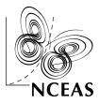
Open Science
crowdsourcing
collective intelligence
micro-expertise
transdisciplinary
Notes:
Book that describes well new ways of doing science, enabled by expanding technology and network capabilities

Slide 2
Need for Open Science
[in the wake of the UEA/CRU affair…]
“It is essential that the scientific community work urgently to make standards for analyzing, reporting, providing access to, and stewardship of research data operational…
Failure to make research data and related information accessible not only impedes science, it also breeds conflicts.”
Ralph J. Cicerone, President of U.S. National Academy of Sciences (“Ensuring Integrity in Science”, Science 5Feb2010, p. 624.)

Slide 3
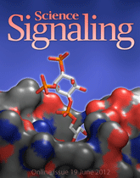
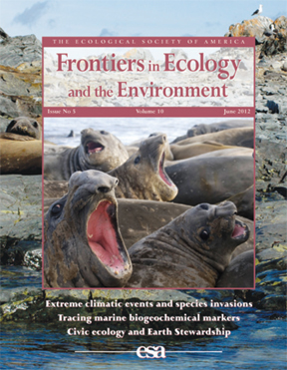
Open Access
Rapid, highly affordable or free access to the latest scientific findings --
for everyone/anyone

Slide 4
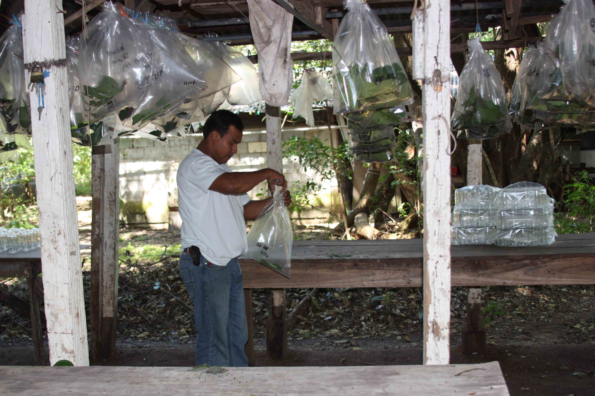
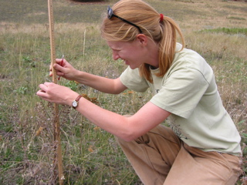
Open Data
Rapid, highly affordable or free access to ALL the data supporting scientific findings

Slide 5
Open Notebook
Rapid, highly affordable or free access to the design details, logistical considerations, analytical decision points and justifications, anecdotes/marginalia, etc. that support scientific findings

Slide 6
Open Source
Rapid, highly affordable or free access to the algorithms and other code used in an analysis, to enable examination and verification of appropriateness, and ideally suitable for re-use

Slide 7
Open Science:
Open Access
Open Data
Open Source
Open Notebook

Slide 8
Open Science
Data &
Observations
Notebooks & Workflows
Commentary & annotations
Code & Algorithms
Findings & revisions

Slide 9
Why Open Science now?
Technology is available
Growing politicization of science: need for transparency
Importance of large-scale/interdisciplinary science
Efficiencies in re-using or sharing available data, code
A return to fundamental premise of science:
objective, repeatable, replicable, “general”

Slide 10
Obstacles to Open Science?
Lack of time and funds
Lack of rewards: money, status, promotion
Breaking from traditional publication model
Other concerns: scooping? poaching?

Slide 11
Some Resources
Nielsen, Michael. 2011. Reinventing Discovery: The New Era of Networked Science. Princeton University Press. 208pp.
Hampton et al. 2015. The Tao of open science for ecology. Ecosphere 6(7), article 120.

