Slide 1
Open and Reproducible Science
Data Science for Coral Reefs
Data Rescue Workshop – 2018

Slide 2
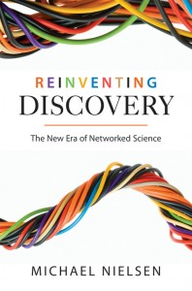
crowdsourcing
collective intelligence
micro-expertise
transdisciplinary
Notes:
Book that describes well new ways of doing science, enabled by expanding technology and network capabilities

Slide 3
Why Open Science now?
Technology is available (World Wide Web)
Growing politicization of science: need for transparency
Importance of large-scale/interdisciplinary science
Efficiencies in re-using or sharing available data, code
A return to fundamental premise of science: objective, repeatable, replicable, “general”

Slide 4
Need for Open Science
“It is essential that the scientific community work urgently to make standards for analyzing, reporting, providing access to, and stewardship of research data operational…
Failure to make research data and related information accessible not only impedes science, it also breeds conflicts.”
Ralph J. Cicerone, President of U.S. National Academy of Sciences (“Ensuring Integrity in Science”, Science 5Feb2010, p. 624.)

Slide 5
Open Science
Open Access
Open Data
Open Source
Open Notebook

Slide 6
Open Science
Open Access
Open Data Products
Open Source
Open Notebook

Slide 7
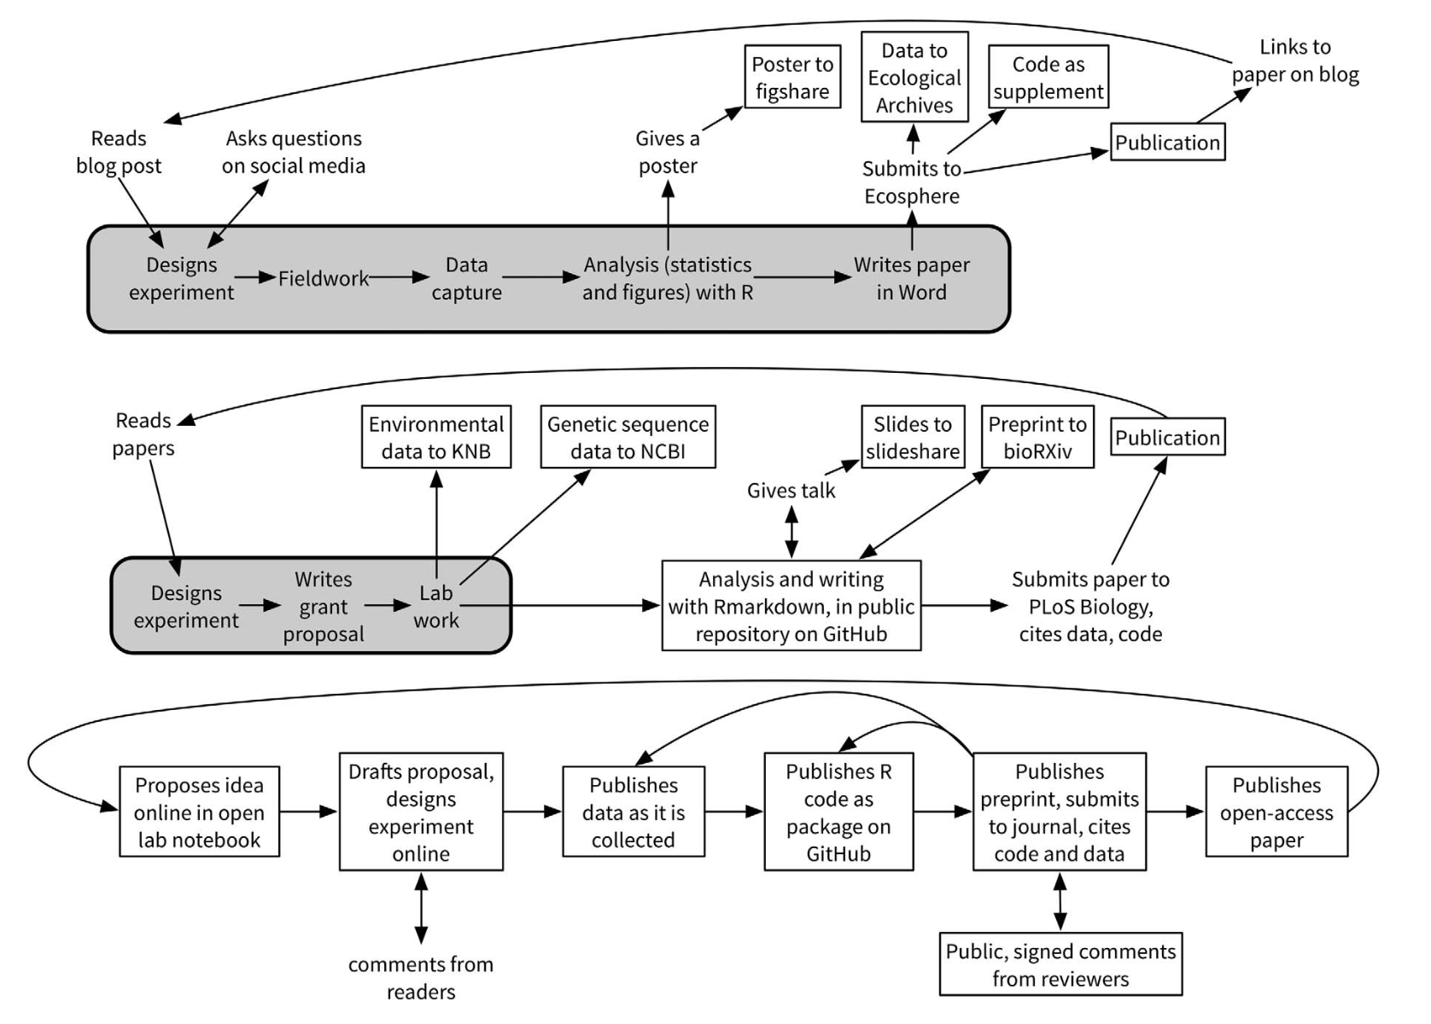
Open Science Workflows
Openness
Hampton et al., 2015

Slide 8

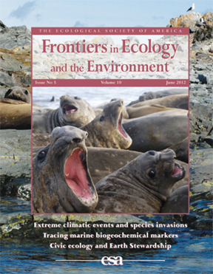
Open Access
Rapid, highly affordable or free access to the latest scientific findings --
for everyone/anyone

Slide 9
Open Data
Rapid, highly affordable or free access to ALL the data supporting scientific findings
Open data is data that are:
Properly licensed for re-use
Accessible w/o gates (e.g., paywall, login)
Use open formats (formats you can work with)

Slide 10
FAIR Principles
Findability
Accessibility
Interoperability
Reusability

Slide 11
Few Check
Open Access
Open Data Products
Open Source
Open Notebook

Slide 12
Open Notebook
Rapid, highly affordable or free access to the design details, logistical considerations, analytical decision points and justifications, anecdotes/marginalia, etc. that support scientific findings

Slide 13
Open Source
Rapid, highly affordable or free access to the algorithms and other code used in an analysis, to enable examination and verification of appropriateness, and ideally suitable for re-use

Slide 14
Obstacles to Open Science?
Lack of time and funds
Lack of rewards: money, status, promotion
Breaking from traditional publication model
Other concerns: scooping? poaching?

Slide 15
Some Resources
Nielsen, Michael. 2011. Reinventing Discovery: The New Era of Networked Science. Princeton University Press. 208pp.
Hampton et al. 2015. The Tao of open science for ecology. Ecosphere 6(7), article 120.

