Slide 1
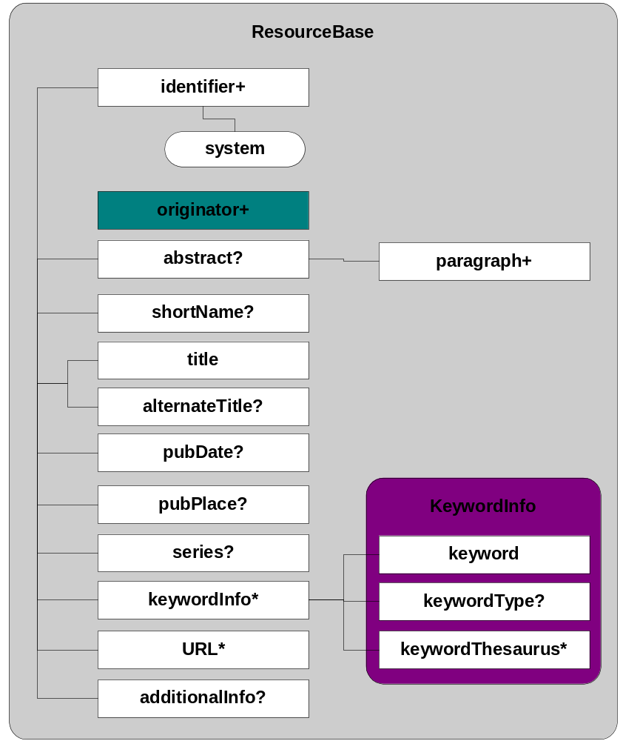
eml-resource (2)

Slide 2
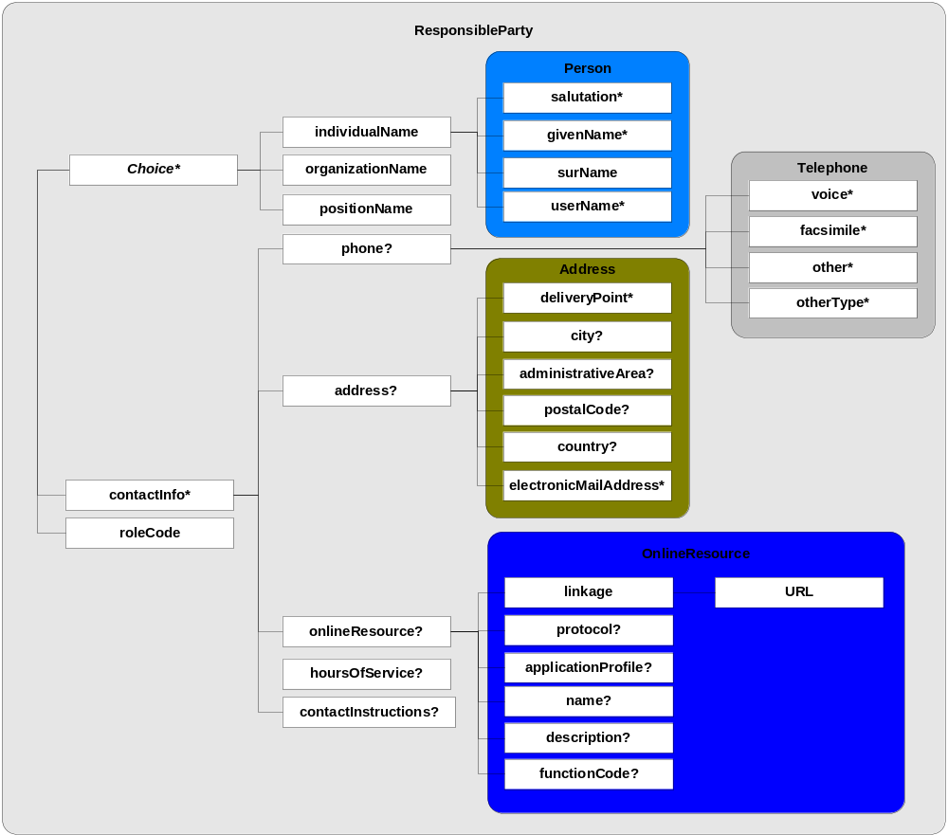
iso-party (2)

Slide 3
eml-resource (3)
Resource contains an originator
originator is a Responsible Party
  so, has all of the properties of a Responsible Party
Put picture here of
dataset -> originator -> name, contactInfo, role

Slide 4
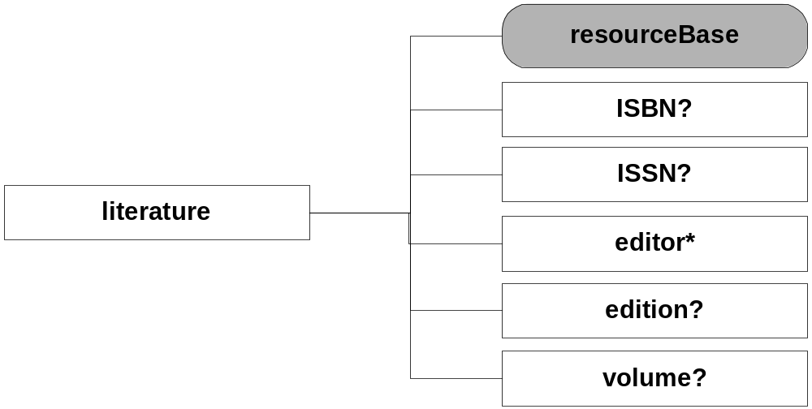
Literature resources

Slide 5
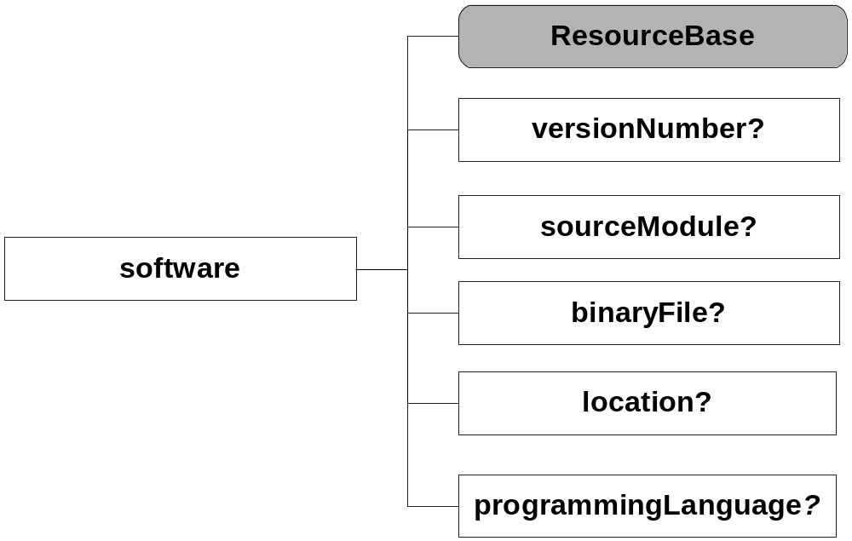
Software resources

Slide 6
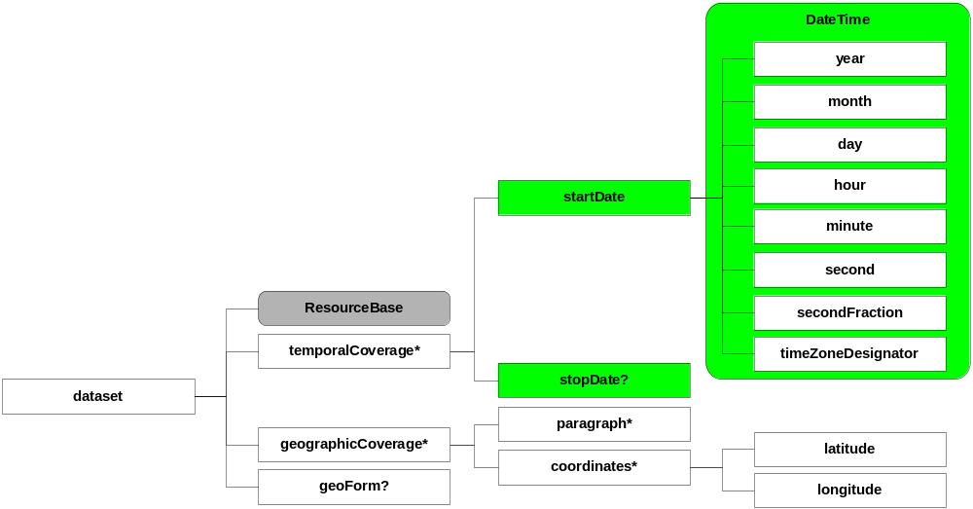
Dataset resources

Slide 7
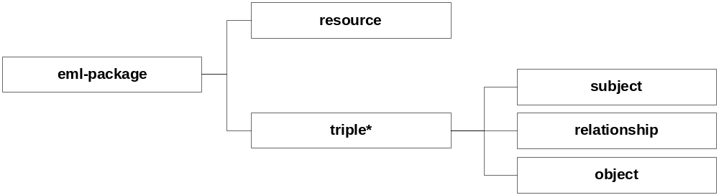
eml-package (3)

Slide 8
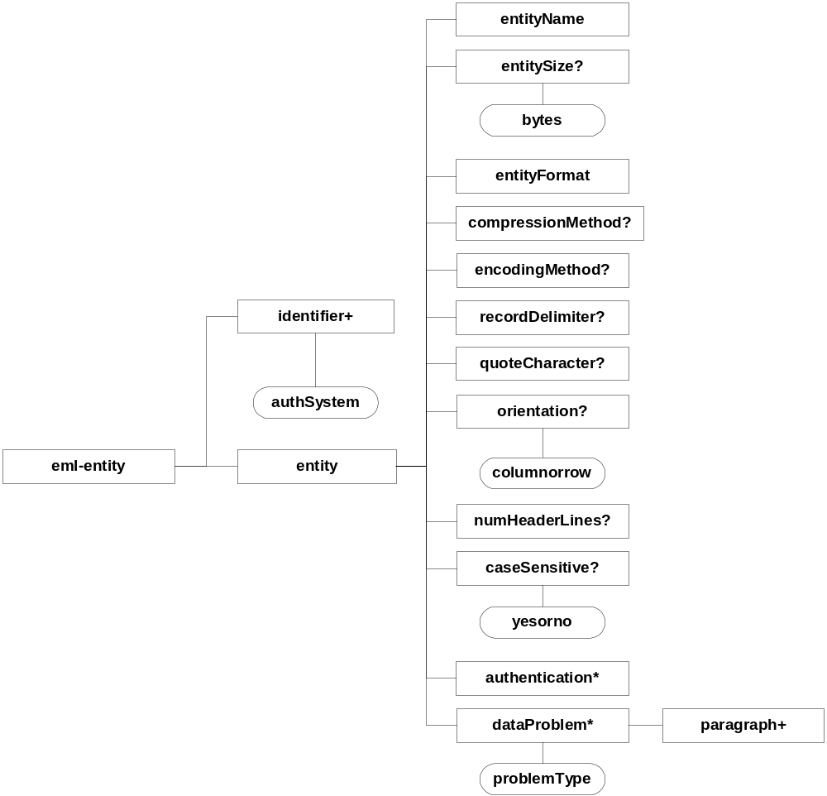
eml-entity (2)

Slide 9
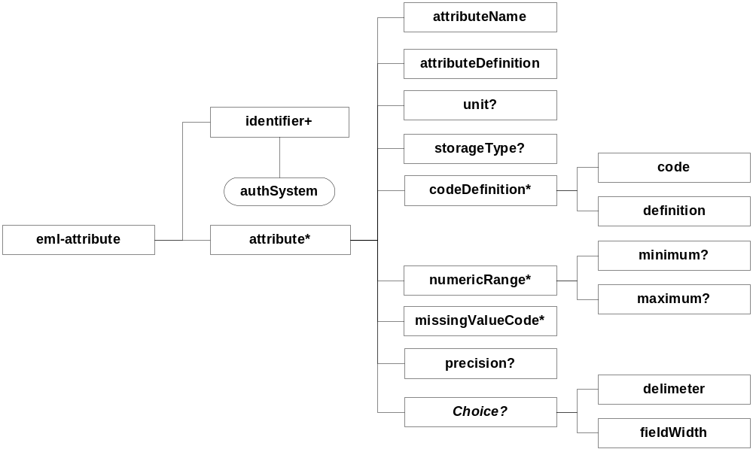
eml-attribute (2)

Slide 10
eml-constraint (2)

Slide 11
eml-access (2)

Slide 12
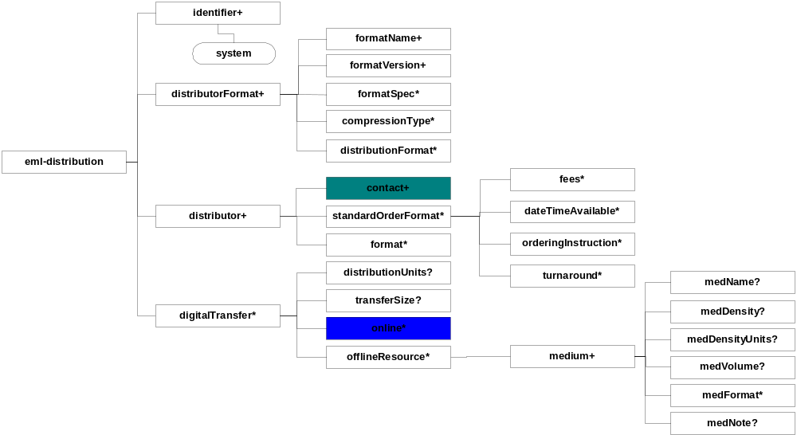
eml-distribution (2)

Slide 13
eml-research (2)

