Slide 1

Ecological Metadata Language (EML)
The Knowledge Network for Biocomplexity
Matthew B. Jones
National Center for Ecological Analysis and Synthesis
University of California Santa Barbara
http://www.nceas.ucsb.edu
http://knb.ecoinformatics.org

Slide 2
Contributors
Chad Berkley, NCEAS
David Blankman, LTER Net
Jivka Bojilova, NCEAS
Owen Eddins, LTER Net
John Harris, NCEAS
Dan Higgins, NCEAS
Chris Jones, PISCO
Mark Schildhauer, NCEAS

Slide 3
Funding
National Science Foundation
  Knowledge and Distributed Intelligence Program
    DEB99-80154
  Database Activities in the Biological Sciences
    DBI99-04777
NCEAS
  NSF
    DEB-0072909
  University of California
  UC Santa Barbara

Slide 4
Objectives of the KNB
National network for data sharing
  Autonomous sites
  Individual researchers
Accommodate data heterogeneity
Accommodate metadata heterogeneity
Enable advanced services
  Data integration
  Quality management
  Hypothesis modeling
  Visualization and analysis

Slide 5
Solutions
Metadata (EML)
  Use XML for syntax representation
  Grassroots standardization effort
  Metadata conversion tools
Metadata server (Metacat)
  Centralized harvest engine
Distributed data network (Metacat)
Data management software for ecologists (Morpho)
  Manage metadata and data
  Standalone and networked capabilities

Slide 6
Metadata Systems Design (1)
NCEAS
Metacat
LTER
Metacat
SDSC
Metacat
Key
Metacat Catalog (replicated)

Slide 7
Metadata Systems Design (3)
AND
OBFS
NRS
SEV
NCEAS
Metacat
CAP
LTER
Metacat
SDSC
Metacat
Key
Metacat Catalog (replicated)
Morpho clients
Web clients
Site metadata system

Slide 8
Metadata Systems Design (4)
AND
OBFS
NRS
SEV
NCEAS
Metacat
CAP
LTER
Metacat
SDSC
Metacat
Key
Metacat Catalog (replicated)
Morpho clients
Web clients
Site metadata system
XML output filter

Slide 9
An Alternative Design (2)
SEV
AND
OBFS
NRS
Metacat
SEV
Metacat
NCEAS
Metacat
CAP
LTER
Metacat
SDSC
Metacat
Key
Metacat Catalog (replicated)
Morpho clients
Web clients
Site metadata system
XML output filter

Slide 10
Distributed metadata
Centralized metadata hub
  harvest metadata from sites
  allow direct client interaction
Distributed metadata and data
  Sites can run Metacat
  Direct client interaction @ site
  Can choose to whom their metadata and data are accessible

Slide 11
What’s cool
Store ‘any’ metadata standard
  (must be formatted in XML)
Convert ‘any’ metadata standard to HTML
  (uses XSLT for transformation)
Convert one metadata standard to another
  (uses XSLT for transformation)
Validate metadata documents
  (doctype is an assertion)
Fast centralized structured query
  (uses XML query representation)
  (uses pre-computed structural index)

Slide 12
What’s hot
Specialized clients easily developed
  Simple API over http for metadata
  Accessible to java, perl, vb, etc.
Cross-platform client & server
Any JDBC database for metadata backend

Slide 13
How it *really* works...
Open standards for broad accessibility
  Metadata exchanged in XML
  Transport over HTTP
  Servlet API for I/O
  Conversion using XSLT
  Validation using DTD
    will support datatypes with XML Schema

Slide 14
Ecological Metadata Language
Built on LTER’s long history of work in metadata systems
  ESA FLED Report
  Michener et al. 1997. Non-geospatial metadata for the ecological sciences.
  Initial EML 1.0 in 1998. Minor updates to EML 1.4.1 available now.

Slide 15
EML 1.4.1
Strict implementation of Michener et al. paper
Uses XML format
Modularized
  keeps requirements simple
  only provide modules you need
  add new metadata modules as needed (for site, or otherwise)

Slide 16
Michener et al.
Class I -- Data set
  eml-dataset
Class II -- Research context
  eml-research
Class III -- Data set status & accessibility
  eml-access, eml-status
Class IV -- Data structure
  eml-file, eml-variable
Class V -- Supplemental
  eml-supplement, eml-software

Slide 17
Goals for EML 2.0
Consistency among modules
Completeness
Extensibility
Integration of modules
Machine processing
Mappable to existing standards

Slide 18
EML 2.0 beta 2
eml-resource -- bibliographic info
iso-party -- people and organizations
eml-package -- components
eml-entity -- file/object info
eml-attribute -- variable/attribute info
eml-constraint -- integrity constraint
eml-access -- access control
eml-distribution -- distribution info
eml-research -- research origin
eml-quality -- quality management info
eml-lineage -- processing and lineage

Slide 19
eml-resource (1)
ResourceBase
  identifier, title(s), name, originator
  publication date, place series
  abstract, keywords, URL
  comments
dataset specific extensions
literature specific extensions
software specific extensions

Slide 20
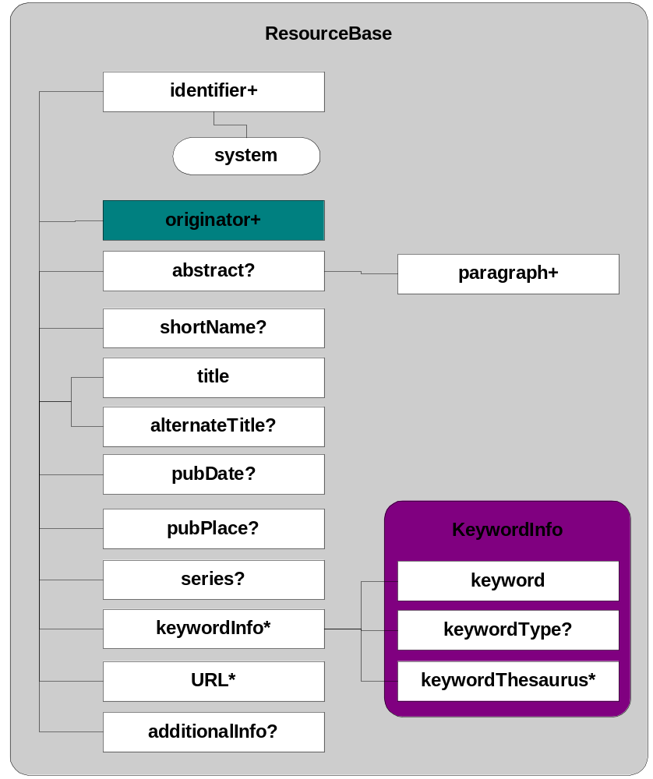
eml-resource (2)

Slide 21
iso-party (1)
ResponsibleParty
    re-usable component
    Person or Organization
  name
  contact information
  role of party
    e.g. owner, author, editor

Slide 22
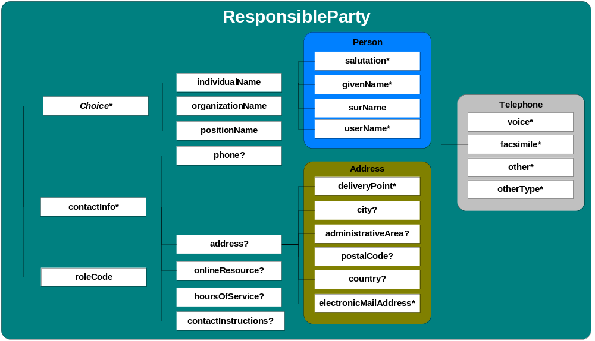
iso-party (2)

Slide 23
eml-resource (3)
Resource contains an originator
originator is a Responsible Party
  so, has all of the properties of a Responsible Party

Slide 24
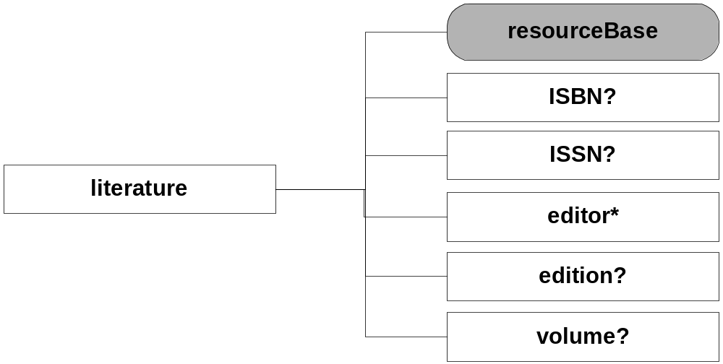
Literature resources

Slide 25
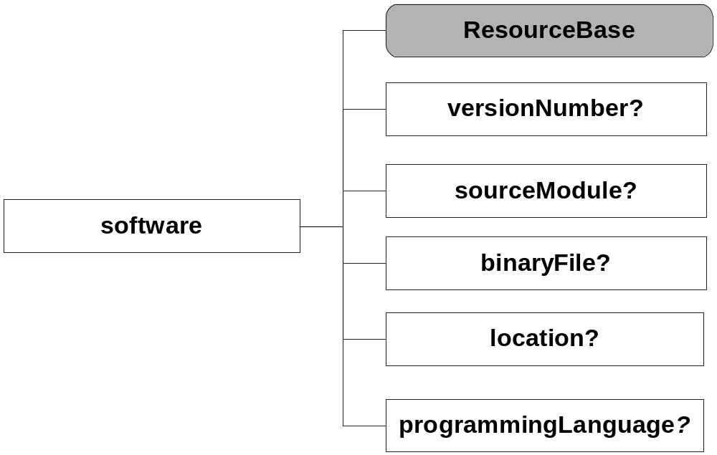
Software resources

Slide 26
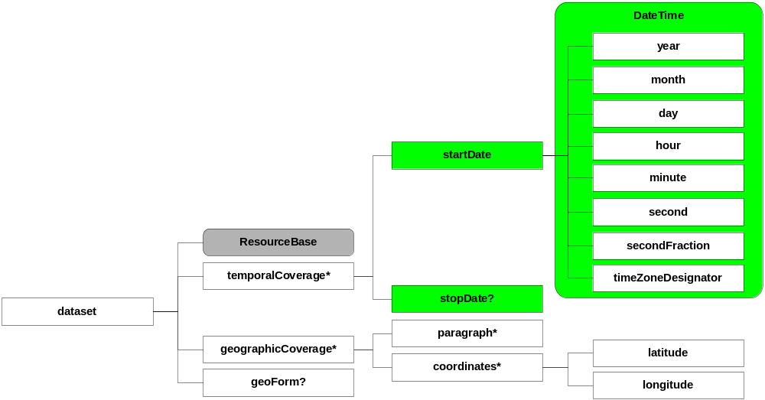
Dataset resources

Slide 27
eml-package (1)
Resource information
List of related objects
  containment
    e.g., data file 1 is “part of” the package
  association
    e.g., “metadata file 2 “describes the attributes in” data file 1

Slide 28
eml-package (2)
Expressed as a “triple”
subject, relationship, object
subject
object
relationship
Metadata
Object 2
“describes the
attributes in”
Data Entity 1

Slide 29
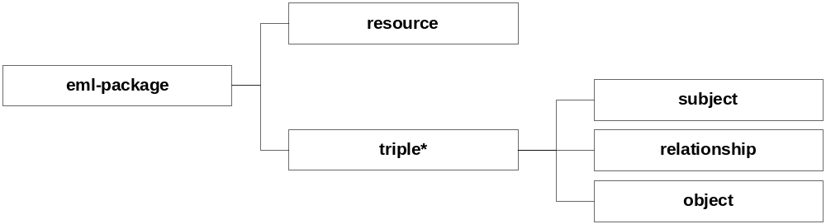
eml-package (3)

Slide 30
<dataset>
<identifier>A</identifier>
<title>Biodiversity data</title>
<originator>
<surname>Jones</surname>
</originator>
</dataset>
eml-package:
An Example

Slide 31
<dataset>
<identifier>A</identifier>
<title>Biodiversity data</title>
<originator>
<surname>Jones</surname>
</originator>
</dataset>
D₁ “is data entity in” A
D_{n} “is data entity in” A
D₁ ...D_{n}

Slide 32
<dataset>
<identifier>A</identifier>
<title>Biodiversity data</title>
<originator>
<surname>Jones</surname>
</originator>
</dataset>
D₁ “is data entity in” A
D_{n} “is data entity in” A
Subject
D₁ ...D_{n}

Slide 33
<dataset>
<identifier>A</identifier>
<title>Biodiversity data</title>
<originator>
<surname>Jones</surname>
</originator>
</dataset>
D₁ “is data entity in” A
D_{n} “is data entity in” A
Relationship
D₁ ...D_{n}

Slide 34
<dataset>
<identifier>A</identifier>
<title>Biodiversity data</title>
<originator>
<surname>Jones</surname>
</originator>
</dataset>
D₁ “is data entity in” A
D_{n} “is data entity in” A
Object
D₁ ...D_{n}

Slide 35
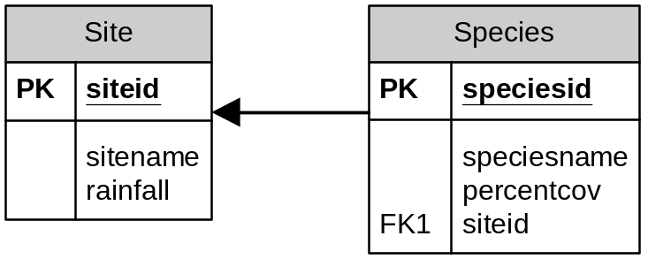
Entity, Attributes, Constraints
Relational data models consist of:
  entities (tables)
    which are collections of:
      attributes (variables)
    which are inter-related by:
      integrity constraints

Slide 36
eml-entity (1)
Describes properties of each entity in a collection of data
  identifier, name, size, format, orientation
  compression and encoding
  record & quote delimiters
  number header lines
  case sensitivity
  authentication checksums
  data problems

Slide 37
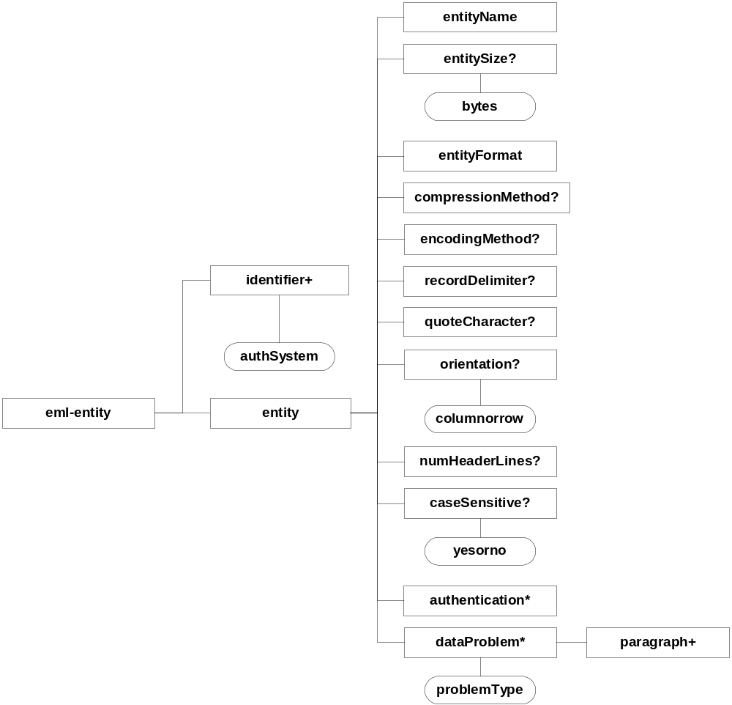
eml-entity (2)

Slide 38
eml-attribute (1)
Describes each variable in an entity
  identifier
  attribute name, definition
  units, storage type and precision
  definition of coded values
  allowable numeric range
  missing value codes
  delimiter or length

Slide 39
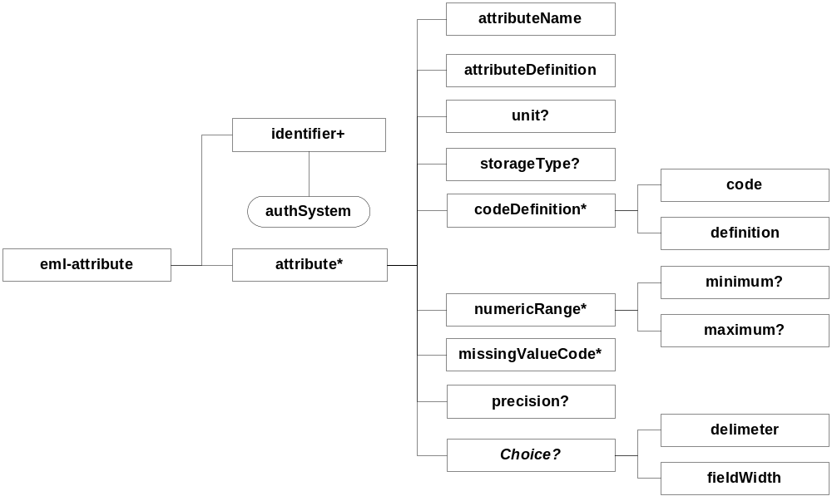
eml-attribute (2)

Slide 40
eml-constraint (1)
Express integrity constraints within and among entities
  identifier
  constraint(s)
    primary key
    foreign key
    unique key
    candidate key
Extend to generalized assertions about data?

Slide 41
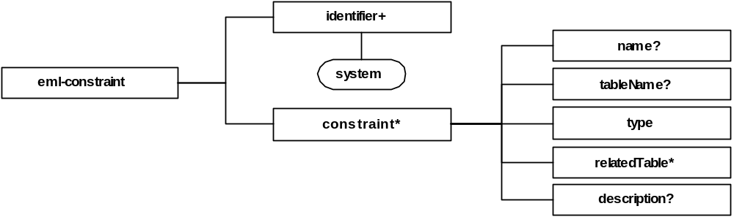
eml-constraint (2)

Slide 42
eml-access (1)
Express access control rules for objects (metadata or data) within a data management system
  authentication system used
  order to apply access control rules
  allow/deny access control rules
    who gets what permission(s) and for how long

Slide 43
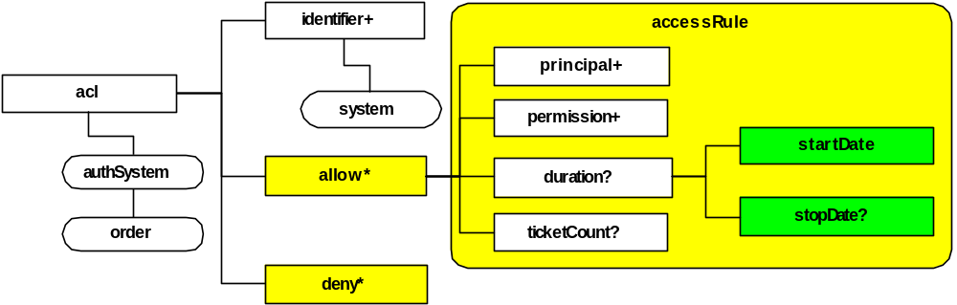
eml-access (2)

Slide 44
eml-distribution (1)
Describes how a data package is distributed
  identifier
  distribution format
  distributor contact
  digital transfer options
Need work!
  eliminate redundancies
  reduce complexity

Slide 45
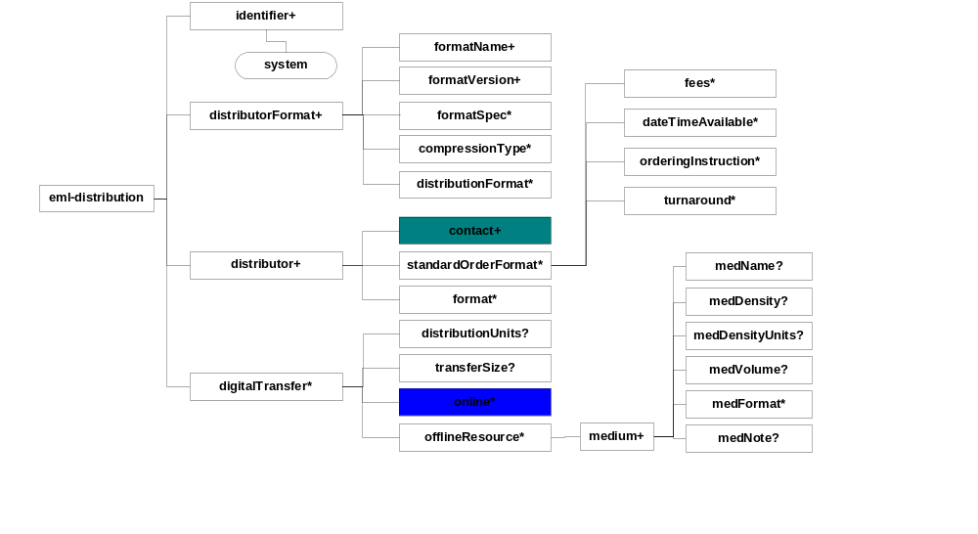
eml-distribution (2)

Slide 46
eml-research (1)
Describes the research context and origin of the data collected
  identifier
  research Project(s)
    title, originator, abstract, objectives
    temporal coverage
    funding and staff
    site description, design + methods
Needs work!
  import ResourceBase, examine coverage

Slide 47
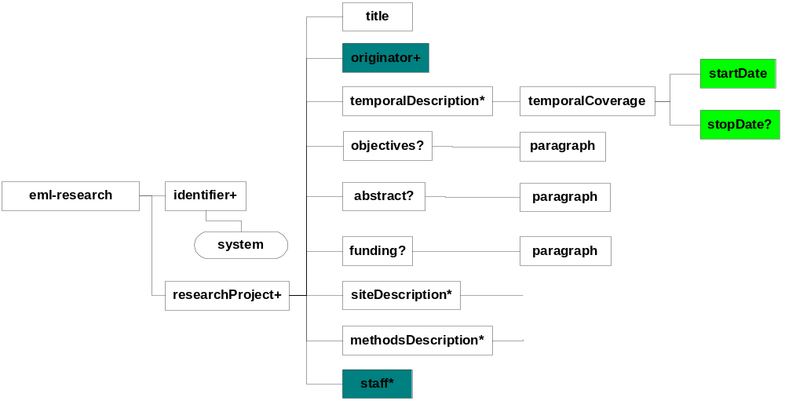
eml-research (2)

Slide 48
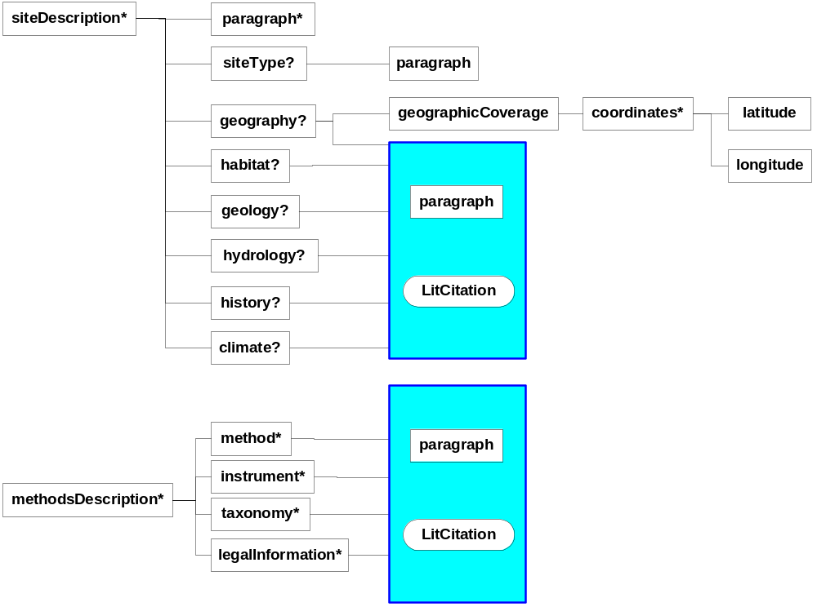
eml-research (3)

Slide 49
eml-quality
Quality management information
  (unimplemented)
  EML 1.4 has some scattered info
    eml-supplement (quality_assurance)
    eml-file (data_problem)
  Quality info needed in many places
    project methods, dataset, entity, attributes, etc.

Slide 50
eml-lineage
  (unimplemented)
Describe the lineage across versions of packages, data entities, etc.
Ability to show processing relationships among entites
  A + B created C using process D
FGDC process step, asuProtocol work relevant
Other relevant work (Frew et al.)

Slide 51
<dataset>
<identifier>A</identifier>
<title>Biodiversity data</title>
<originator>
<surname>Jones</surname>
</originator>
</dataset>
D₁ “is data entity in” A
D_{n} “is data entity in” A
D₁ ...D_{n}

Slide 52
<dataset>
<identifier>A</identifier>
<title>Biodiversity data</title>
<originator>
<surname>Jones</surname>
</originator>
</dataset>
D₁ “is data entity in” A
D_{n} “is data entity in” A
R “is research context for” A
R
D₁ ...D_{n}

Slide 53
<dataset>
<identifier>A</identifier>
<title>Biodiversity data</title>
<originator>
<surname>Jones</surname>
</originator>
</dataset>
D₁ “is data entity in” A
D_{n} “is data entity in” A
R “is research context for” A
E₁ “is entity structure of” D1
E_{n} “is entity structure of” Dn
R
D₁ ...D_{n}
E₁ ...E_{n}

Slide 54
<dataset>
<identifier>A</identifier>
<title>Biodiversity data</title>
<originator>
<surname>Jones</surname>
</originator>
</dataset>
D₁ “is data entity in” A
D_{n} “is data entity in” A
R “is research context for” A
E₁ “is entity structure of” D1
E_{n} “is entity structure of” Dn
A₁ “is attribute structure of” D1
A_{n} “is attribute structure of” Dn
R
D₁ ...D_{n}
A₁ ...A_{n}
E₁ ...E_{n}

Slide 55
<dataset>
<identifier>A</identifier>
<title>Biodiversity data</title>
<originator>
<surname>Jones</surname>
</originator>
</dataset>
D₁ “is data entity in” A
D_{n} “is data entity in” A
R “is research context for” A
E₁ “is entity structure of” D1
E_{n} “is entity structure of” Dn
A₁ “is attribute structure of” D1
A_{n} “is attribute structure of” Dn
C “is constraints for” D1
C “is constraints for” Dn
C
R
D₁ ...D_{n}
A₁ ...A_{n}
E₁ ...E_{n}

Slide 56
<dataset>
<identifier>A</identifier>
<title>Biodiversity data</title>
<originator>
<surname>Jones</surname>
</originator>
</dataset>
D₁ “is data entity in” A
D_{n} “is data entity in” A
R “is research context for” A
E₁ “is entity structure of” D1
E_{n} “is entity structure of” Dn
A₁ “is attribute structure of” D1
A_{n} “is attribute structure of” Dn
C “is constraints for” D1
C “is constraints for” Dn
C
???
Edu
R
D₁ ...D_{n}
A₁ ...A_{n}
E₁ ...E_{n}

Slide 57
Breakout groups
Activity 1
  Review and revise modules assigned to you
  Document your rationale and changes completely
Activity 2
  Review modules resulting from Activity 1 -- flag any problems
  Complete documentation and changes as needed

Slide 58
Breakout Groups (2)
Group 1
eml-resource
eml-package
iso-party
eml-lineage
Group 2
eml-access
eml-distribution
eml-quality
eml-research
Group 3
eml-entity
eml-attribute
eml-constraint

Slide 59
Guidelines for revisions
Target the broad ecology community
  Individual scientists
  Station based scientists
  Station needs
Differentiate machine processing from human-readable content
Reduce complexity if possible

Slide 60
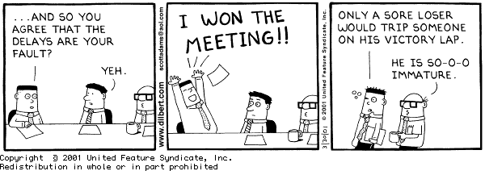
Final thoughts

