Slide 1

Identification of scientific data
Matthew B. Jones
National Center for Ecological Analysis and Synthesis (NCEAS)
University of California Santa Barbara
May 22, 2007
Notes:
NCEAS is an NSF funded research center whose mission is to advance the state of ecological knowledge through synthetic, cross-cutting studies using existing data. Soon after NCEAS formed it became obvious that there was a large need for informatics tools that support synthetic research.

Slide 2
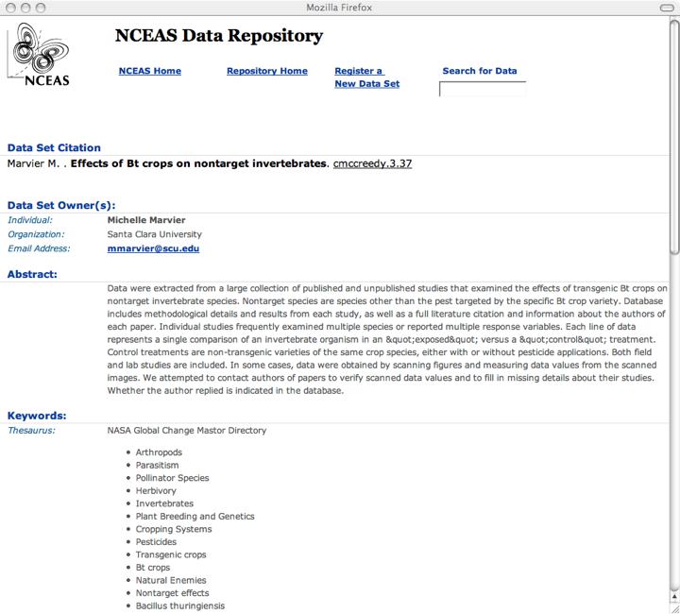
A simple EML example

Slide 3
Date Site Plot Species Height
10/12 Hendricks 1 AHYA 12.2
10/12 Hendricks 1 AHYA 11.0
10/12 Hendricks 1 AHYA 9.7
… … … … …
h

Slide 4
Tree Plot Species Count
A 1 AHYA 3
A 2 AHYA 2
A 3 AHYA 8
… … … …
B
C
A

Slide 5
Identity
Identifier
  unique label for an object, concept, or phenomenon
    if an object can be duplicated, sometimes the identifier refers to any of the replicas (e.g., ISBN)
  locally or globally unique
    e.g., primary key for a record in a database
    e.g., ISBN number for a book printing
  generally, changes to the context of a resource do not affect its identity
    moving an object should not change its identifier
Notes:
An idempotent operation is one where no difference, errors or inconsistencies will result if the operation is carried out once, or many times.

Slide 6
Location
Location
  logical address from which an object can be retrieved
    within some formal coordinate scheme
    e.g., URLs, geospatial coordinates
  almost always transient
    both for real instances and for representations
Notes:
An idempotent operation is one where no difference, errors or inconsistencies will result if the operation is carried out once, or many times.

Slide 7
The conflation problem
Conflating identity and location is harmful
http://some.poor.org/goes/bankrupt/dataset1.csv
http://ucsb.edu/professor/moves/to/moscow/dataset1.txt

Slide 8
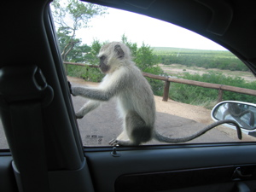
The reification problem
What is identified?
  An instance
    e.g., that monkey in the window
  A representation of an instance
    e.g., the picture of the monkey itself (data)
    e.g., data record of the weight of the monkey
  A class of instances
    e.g., Monkey or VervetMonkey

Slide 9
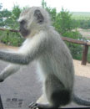
The composition problem
Is part-of a resource the resource? (No)
  An arm is part of a monkey
  A cropped picture is part of a picture
  A page is part of a book
  A record is part of a data table

Slide 10
Automation
Carefully manage identification to support automation
A
Date
Plot
Species
Height
10/12
1
AHYA
12.2
Date
Date
Plot
Plot
Species
Species
Height
10/12
Height
D
X
10/12
1
2
AHYA
AHYA
12.2
10/12
1
AHYA
8.8
10/12
3
AHYA
11.0
10/12
1
AHYA
11.0
14.0
Date
Plot
Species
Height
10/12
F
10/12
2
3
AHYA
AHYA
8.8
13.6
10/12
1
AHYA
12.2
10/12
1
AHYA
11.0
10/12
2
AHYA
8.8
10/12
2
AHYA
8.8
10/12
3
AHYA
14.0
10/12
1
AHYA
9.7
10/12
3
AHYA
13.6
B
Date
Plot
Species
Height
10/12
2
AHYA
8.8
10/12
2
AHYA
10.3
E
10/12
2
AHYA
13.1
C
Date
Plot
Species
Height
10/12
3
AHYA
10.1
10/12
3
AHYA
14.0
10/12
3
AHYA
13.6

Slide 11
What needs global identity?
Resources (objects, phenomena)
Metadata
  parties? (creator, contact, etc)
  methods?
  coverage definitions?
    TCS ids for taxa, ids for named places, etc.
  projects?
Data
  physical file(s) or stream
  each table or image?
  each record?
  each attribute?
  each cell?
  each constraint?
Classes
Notes:
how do these relate to observations?

Slide 12
EML
EML id and references
  could contain global identifiers
Ecological Metadata Language
<EML>
Identity and
Discovery Information
Coverage:
Space, Time, Taxa
Methods
Physical
Data
Format
Logical
Data
Model
Access and Distribution
Notes:
Address lack of dataset documentation
Provide structure to traditionally unstructured information
Aid transition toward synthetic research
Enable both human-readable and machine-readable metadata
Enable long-term archives
Community-driven development process

Slide 13
EML: Selected relationships
Michener ’97 paper
NBIIBDP
FGDC created
ISO 19115
CSDGM
1.0
EML
1.0.0
1990
EML
1.3.0
ESA FLED
Report
EML
1.4.x
EML
2.0.0
EML
2.0.1
OBOE
XML
1.0
Dublin
Core
1995
2000
2005
‘91
‘92
‘93
‘94
‘96
‘97
‘98
‘99
‘01
‘02
‘03
‘04
‘06
‘07
‘08
‘09
Notes:
Many other standards activities were occurring at the same time, such as Geography Markup Language (GML), left out for brevity, especially where EML did not directly draw from or contribute to development of another standard. OBOE has not yet been formally released.

Slide 14
Error correction and record additions
1999
2000
2001
esa:23:1
(metadata)
esa:23:2
(metadata)
esa:23:3
(metadata)
esa:22:1
(data)
esa:22:2
(data)
esa:22:3
(data)
Correct errors
in data
Add new
observations
Science
Paper
2000
Nature
Paper
2001

Slide 15
Identifier formats
EML: String @packageID, @system
Metacat: esa.26.3
Non-standard syntax
No resolution protocol
scope
id
revision
EcoGrid: ecogrid://knb/esa.26.3
Handle/DOI: 10.1371/j.pbio.0050144
Non-URI syntax
Central resolution
LSID: urn:lsid:esa.org:esa:26:3
URI syntax
Distributed resolution
authority
namespace
object
revision

Slide 16
Identifier formats
PURL: http://esa.org/esa/26/3
Non-standard syntax
Resolution via http

Slide 17
Versioning and Identifiers
Identifying data uniquely and tracking revisions are critical aspects of data management
  Errors in data are fixed over time
  Data are combined into aggregate products
  Critical to reproducing statistical results
Identifiers are a contract regarding uniqueness
  Incorporates both ‘identity’ and ‘version’
  Two data sets with the same ID are defined as identical

Slide 18
LSID Resolution
DNS SRV lookup on authority
  returns Authority service host and port
Query Authority service with LSID
  returns metadata and data services
    multiple endpoints can be returned
Call getMetadata with LSID
  returns (RDF) metadata
Call getData with LSID
  returns byte stream
urn:lsid:esa.org:esa:26:3

Slide 19
LSID Resolution
DNS
Server
LSID
Authority
Service
2. getAuthority()
1. Lookup
SRV
LSID
Metadata
Service
LSID
Client
3a. getMetadata()
3b. getData()
LSID
Data
Service
urn:lsid:esa.org:esa:26:3

Slide 20
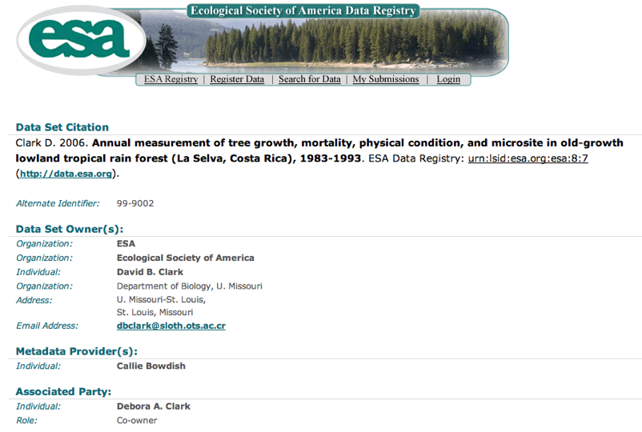
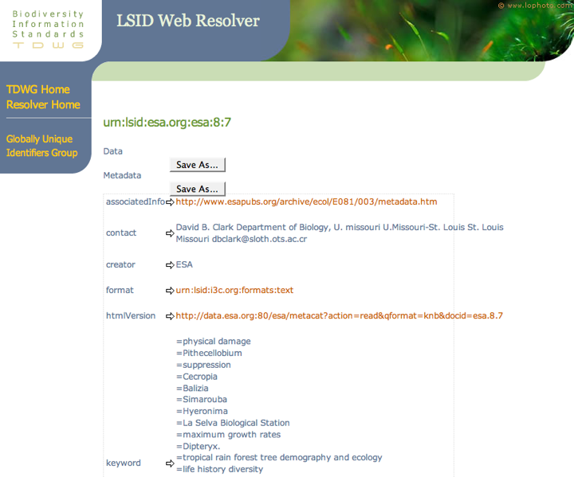

Slide 21
Supporting LSIDs
Metacat
  Basic support present now
  Maps LSID to docid, converts EML to RDF
  TODO: better RDF, support multiple authorities
Morpho
  Uses ecogrid:// identifiers
  TODO: change to LSID
EML/OBOE
  Explicitly use LSID type rather than String?

Slide 22
Acknowledgments
This material is based upon work supported by:
The National Science Foundation under Grant Numbers 9980154, 9904777, 0131178, 9905838, 0129792, and 0225676.
Collaborators: NCEAS (UC Santa Barbara), University of New Mexico (Long Term Ecological Research Network Office), San Diego Supercomputer Center, University of Kansas (Center for Biodiversity Research), University of Vermont, University of North Carolina, Napier University, Arizona State University, UC Davis
The National Center for Ecological Analysis and Synthesis, a Center funded by NSF (Grant Number 0072909), the University of California, and the UC Santa Barbara campus.
The Andrew W. Mellon Foundation.
Kepler contributors: SEEK, Ptolemy II, SDM/SciDAC, GEON, RoadNet, EOL, Resurgence

