Slide 1
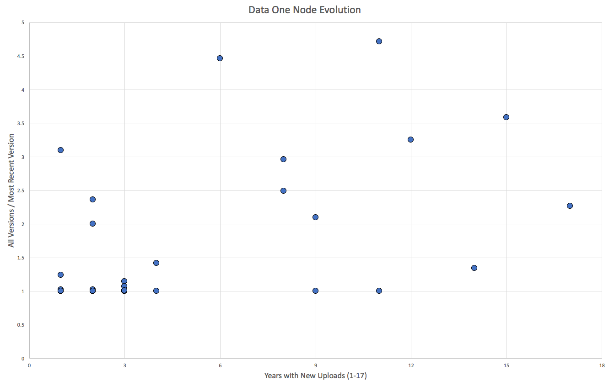
Sanparks
GOA
PISCO
TFRI
KNB
LTER
TDAR
Dryad

