Slide 1
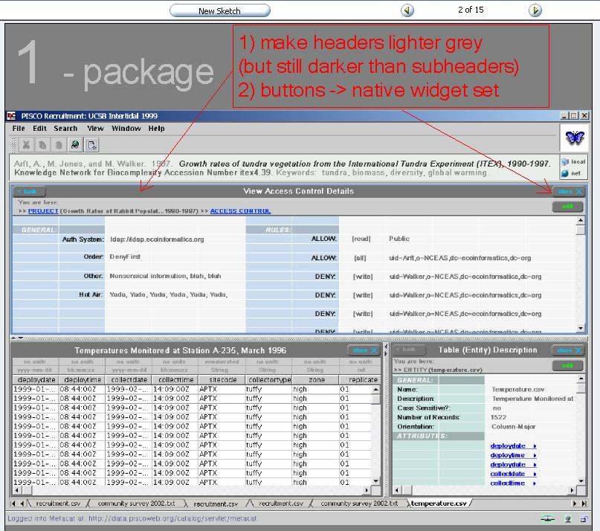
DataView
Container
Panel

Slide 2
dataViewContainerPanel
packageMetadataPanel
Tabbed List of Entities
dataViewPanel
entity
Metadata
Panel
tabbedEntitiesPanel
entityPanel (one for each tab)

Slide 3
DataViewContainerPanel
  Container for other panels
  Two SplitPanes - horizontal + vertical
PackageMetadataPanel
  Top Subpanel within DataViewContainerPanel
  Displays any package level metadatamodule (with links)
DataViewPanel
  Displays data (table or image)
  Shows Entity List as scrolling tabs at bottom
EntityMetadataPanel
  Displayed to the right of the DataView
  Shows EntityMetadata by default
  Attribute metadata shown when data column ‘selected’
  Always shows metadata associated with selected entity

Slide 4
Initialization: Must start with a package ID or a Package Object
Must separate out DataSet top level metadata, find the list of
entities, and then the data and entity info for the first entity
(i.e. the selected entity)
Create data display and each metadata display

Slide 5
Initialization: (for each entity)
Look up selected entity and
find associated data (and physical metadata)
modules.
Tabular and certain images can be displayed
Tabular data is editable
DataViewPanel
Tabular Data Display:Initialization requires table metadata (e.g. delimiters,
formats, etc., in order to parse data for display in a grid.

Slide 6
Entity metadata titles as tabs (horizontal scrolling)
ColumnHeaders
Rows&Columns
Use JTable display with custom TableModel for working with very large datasets
JTable should be in a scroll pane
DataTable

Slide 7
PackageMetadataPanel
PackageMetadataSummaryPanel (fixed size)
AdditionalPackageMetadata (scrollable)

