Slide 1
Data modeling, and relational databases
Mark Schildhauer OSS Training Institute 2
July 28, 2014

Slide 2
Learning Objectives
Understand the difference between a Spreadsheet and a Table
Understand why relational database concepts are important
Develop a better mental model for your own and others’ data
Understand the relationship between data and the models that represent them

Slide 3
Types of Data
Data Types include:
Vector (e.g. time-series)
Matrix (e.g. life-history tables)
Hierarchical (e.g taxonomies)
Grid (e.g. raster)
Spatial Vector (e.g. point, line, polygon)
Focus here on Tabular Data
Lots of specialized formats for storing and exchanging these various data types; but relational databases are mainly used for storing tabular data

Slide 4
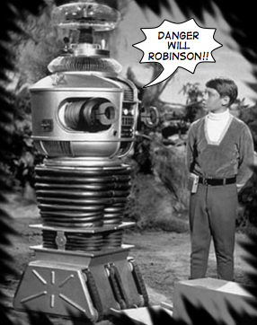
Spreadsheets: primordial data entry tool of the digital age
Essentially, a tabula rasa with grid-lines

Slide 5
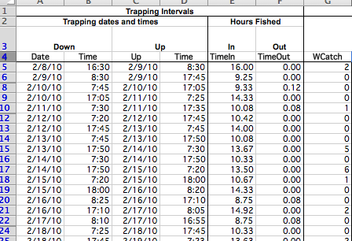

Slide 6

Spreadsheets:
The Good
Quick on the draw (clickety-click and you’re ready to fire)
Shows up in every town (on most everyones’ computer)
Smarter than he lets on (stats, pivot tables, VB scripts)
Cleans up real pretty (graphics, fonts, colors, borders)

Slide 7

Spreadsheets:
The Bad
Fast but lose shooter (click&fire; click&fire; click&fire.. sloppy)
No scruples (delete row, save, ctrl-x/ctrl-c, save, re-sort, save)
Deserts you in a pinch (column and row size limitations)
Won’t give you straight answers (hard to query)
Talks a good story, but didn’t get much education (e.g. http://www.practicalstats.com/xlsstats/excelstats.html)

Slide 8

Spreadsheets:
The UGLY
Ill-mannered: takes data prisoner in binary formats; conflates raw data with summary data, metadata
Gaudy: Use of visual cues– color, font, borders– to indicate critical metadata or other semantic tidbits
Shifty & unreliable: Cross-linking of worksheets sets up “invisible” dependencies (remember the Reinhart-Rogoff miscalculation?)
Shiftless: Provenance is entirely lost– versions encoded in names or not at all

Slide 9
Spreadsheets:
The UGLY
The more complicated your Spreadsheet, the UGLIER it gets
...in terms of using with other software, integrating with other data, detecting mistakes, extracting (querying for) specific records, enabling future interpretation, etc.

Slide 10
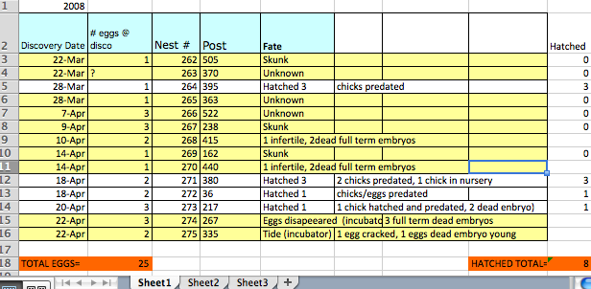
UGLY
Notes:
Note color coding, mixing of raw data with summary data, placement of metadata (e.g. year) above header, etc.

Slide 11
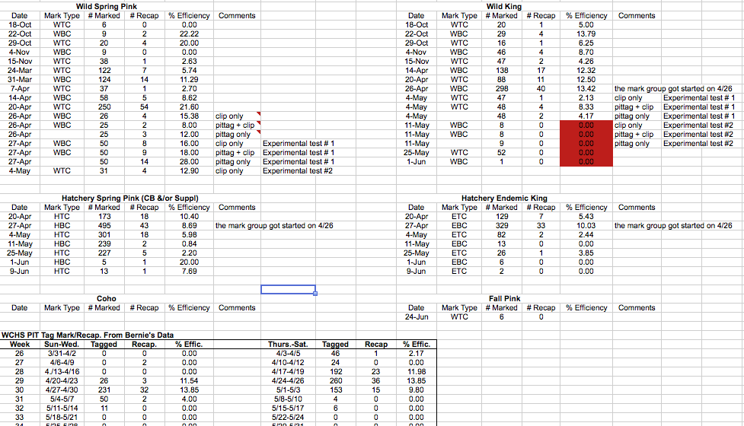
UGLY
Notes:
Note multi-line headers associated with multiple tables on a single spreadsheet. Human can differentiate headers, raw data, and different “Tables” by visual separation; much harder for computers.

Slide 12
Spreadsheets: Best Practices
create “true’ TABLEs
Formally defined in RELATIONAL ALGEBRA:
a Set of VALUES organized into COLUMNS, with COLUMNS grouped together in a TUPLE or ROW
You can add ROWs and it’s still the same TABLE
But if you add COLUMNS, it’s really a different TABLE; you’ve made a modification to your DATA MODEL
One COLUMN in every TABLE is identified as a KEY
No two ROWs can have the same KEY, thus no two ROWS can be the same (i.e. need unique ID– default is row-num; how else would you know if you have mistakenly created a duplicate?)

Slide 13
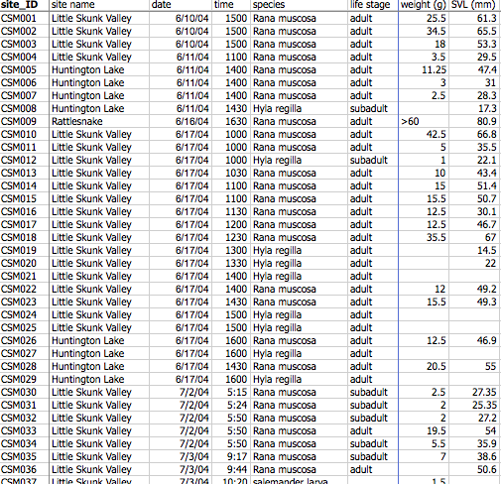
GOOD!
Notes:
Note single header line; single table on single worksheet. All rows with identical structure. But notice that “>60” on the 9th line?

Slide 14
Formally creating a Table in an RDBMS
SQL: Structured Query Language
create Tables (Data Definition Language)
query and manipulate Tables (Data Manipulation Language)
CREATE TABLE SNARL_amphib
(site_ID char(5), site_name char(20), date date, time time, species char(50), life_stage char(25), weight real, SVL int);
i.e.--
Name your Tables
Name the Attributes in the Tables
Type your Attributes
Then Establish Key relationships among your Tables
(PS– don’t forget to provide other CRITICAL METADATA; the above information is necessary but not sufficient…)

Slide 15
Terminological Soup
Table = Relation = Worksheet = Data set = Data Frame (R)
Column = Variable = Attribute = Characteristic
Row = Record = Tuple <> Observation (eek)
Keys are used to Join or Merge
Cell = Value = Measurement (“Observation”)
Data Model = Schema
Even if you are using a Spreadsheet/Worksheet, you should model its contents like a “true” Table

Slide 16
A word about Formats
There is no shame in using CSV (comma-separated value) format for archiving Tables:
Every computer can read it
It’s been around forever
It will be around for a long while more
Databases typically require a specific application to read their proprietary binary formats: DBF (DB IV), MDB (MS Access), or e.g. even XLS; no good for long-term preservation
CSV in ASCII (watch out for dreaded LF or CRLF line endings!) or UTF; however, can be inefficient storage-wise, and not readily queryable

Slide 17
Databases & Alternatives
You can use Spreadsheets like a simple Database
You can also store your data in “R”, or SAS, MATLAB, etc. and be using it like a Database
But this means you are conforming to best practices…
Naming your Tables
Defining the Variables/Attributes in your Tables
Typing your Attributes (character, numeric: real, integer)
Joining/merging Tables based on Key values (constraints)

Slide 18
So why (relational) Databases?
Databases typically ENFORCE good practice: You are required to define TABLES, ATTRIBUTES (and their TYPES), and their relationships (CONSTRAINTS-- KEYS)
Heuristic benefits of modeling data
Practical benefits of reducing redundancy, reducing errors
(Also, handles high transactions– ACID)
Also, Databases typically provide:
Far better scalability (millions+ records)
Far better features for subsetting/querying data
A highly standardized Scripted language (SQL) for creating and querying your data
Notes:
ACID=atomicity, consistency, isolation, durability

Slide 19
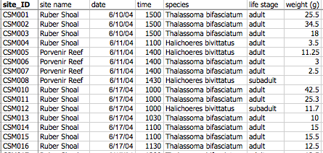
Normalization?
A formal process for modeling your data: reducing redundancy to improve storage efficiency, and lower risk of errors
Look for redundancies in cell values (e.g Ruber; Thalassoma bifasciatum)
Look for strong relationships across columns (e.g. species, life_stage, weight)

Slide 20
Normalization?
A formal process for modeling your data
Quick start:
Atomization (1NF)– don’t put compound values into single cells, e.g.
Separate LNAME, FNAME (but what about “Thalassoma bifasciatum”?)
Separate ADDRESS into CITY, STATE, ZIP_CODE (but “Porvenir Reef”?)
Don’t proliferate COLUMNS; proliferate ROWS
(go LONG, not WIDE)
Date | Site | Count
2001 | NY | 22
2001 | LA | 8
2001 | TX | 13
DATE | NY | LA | TX
2001 | 22 | 8 | 13

Slide 21
Normalization?
A formal process for modeling your data
Quick start:
(2NF) Identify “entities” in your data, and put these into separate tables
E.g. in table below, could separate Taxonomic information and Geographic information into two tables each containing more information
species | date | site_name | weight
Thalassoma bifasciatum | 2004Jun10 | Ruber Shoal | 25.5
Thalassoma bifasciatum | 2004Jun10 | Ruber Shoal | 34.5
Thalassoma bifasciatum | 2004Jun10 | Ruber Shoal | 18

Slide 22
Normalization?
“species”: Table for taxonomic information:
TaxID | species | Authority | CommonName | MatingType
212 | Thalassoma bifasciatum | (Bloch 1791) | Bluehead wrasse | protogyny
213 | Amphiprion clarkii | (Bennett 1830) | Brown anemonefish | protandry
“site_name”: Table for geographic information:
G_ID | site_name | Lat | Lon | Cntry | Prov | Area-m2
569 | Ruber Shoal | 9.5576 | -78.94 | Panama | San Blas Isl. | 758
570 | Porvenir Island | 9.5424 | -78.93 | Panama | San Blas Isl. | 1692
Note “extra” information we get about “species” (e.g. CommonName. MatingType) and “site_name” (e.g. Country, Area-m2) by separating these ENTITIES into separate TABLES
By using unique “KEYS”– e.g. TaxID, and G_ID,for each record of “species” or “site_name” long character strings can be stored once in the Database, reducing risk of spelling errors, and any other information associated with a given “species” or “site_name” can be referenced (by their KEYs) from the appropriate table.

Slide 23
Normalization?
“Taxa”: Table for taxonomic information:
TaxID | species | Authority | CommonName | MatingType
212 | Thalassoma bifasciatum | (Bloch 1791) | Bluehead wrasse | protogyny
213 | Amphiprion clarkii | (Bennett 1830) | Brown anemonefish | protandry
“GeoLocations”: Table for geographic information:
G_ID | Location | Lat | Lon | Cntry | Prov | Area-m2
569 | Ruber Shoal | 9.5576 | -78.94 | Panama | San Blas Isl. | 758
570 | Porvenir Island | 9.5424 | -78.93 | Panama | San Blas Isl. | 1692
Note “extra” information we get about Taxon and Location, compared with initial table:
species | date | site_name | weight
Thalassoma bifasciatum | 2004Jun10 | Ruber Shoal | 25.5
Thalassoma bifasciatum | 2004Jun10 | Ruber Shoal | 34.5
Thalassoma bifasciatum | 2004Jun10 | Ruber Shoal | 18

Slide 24
Powerful Command Language called Structured Query Language or SQL (see-quel)
This table is called SoilSensor
Date | Plot | Treatment | SensorDepth | Soil_Temp
2010-02-01 | C | R | 30 | 12.8
2010-02-01 | B | C | 10 | 13.2
2010-02-02 | C | R | 0 | 6.3
2010-02-02 | A | N | 0 | 15.1
SQL PROJECT: Select Date, Plot, Treatment, Soil_Temp from SoilSensor where Date = ‘2010-02-01’
Date | Plot | Treatment | Soil_Temp
2010-02-01 | C | R | 12.8
2010-02-01 | B | C | 13.2
SQL SELECT: Select * from SoilSensor where Treatment=‘N’ and SensorDepth=‘0’
Date | Plot | Treatment | SensorDepth | Soil_Temp
2010-02-02 | A | N | 0 | 15.1

Slide 25
Joining Tables in a Relational Database
Geolocation
Samples
Species
*siteID
site_name
latitude
longitude
description
*sampleID
siteID
sample_date
speciesID
height
flowering
flag
comments
*speciesID
species_name
common_name
family
order
* Denotes the primary key
Select * from Geolocation g, Samples s, Species p where g.siteID=s.siteID
and s.speciesID=p.speciesID;
(alternative SQL queries can also be constructed, that will give you output records
from each table whether or not these have a match in one of the other tables):
select * from (Geolocation g left join Samples s on g.siteID=s.siteID) left join
Species p on s.speciesID=p.speciesID;

Slide 26
Spreadsheet vs. Database
OK for simple, self-contained Charts,Graphs,Calculations
Handy for collecting raw data
Flexible cell content type
BUT:
Hard to subset or sort
Lack “record” integrity (can sort a colum independently of all others)
Easy to use – but harder to maintain as complexity and size of data grows (lots of repeats in records)
Lacks provenance
Works well with lots of data
Easy to query and subset data
Data fields are typed – e.g., integers only are allowed in integer fields
Columns cannot be sorted independently of each other (tuple)
Normalization reduces data entry and potential for error
BUT:
More to learn and harder to use than a spreadsheet

Slide 27
Conclusion
Follow Best Practices when designing your data sets
Choose a data entry method that allows some validation of data as it is entered
Invest time in learning how to use a database if your datasets are large or complex
Consider investing time in learning how to use databases if your data are small and humble
Consider investing time in learning how to use databases if you ever intend to share your data
Consider learning databases if you are a scientist who analyzes tabular data.

Slide 28
Handy References for Better Data Structures
Best Practices for Preparing Environmental Data Sets to Share and Archive. September 2010. Les A. Hook, Suresh K. Santhana Vannan, Tammy W. Beaty, Robert B. Cook, and Bruce E. Wilson. http://daac.ornl.gov/PI/BestPractices-2010.pdf
Some Simple Guidelines for Effective Data Management. Elizabeth Borer, Eric Seabloom, Matthew B. Jones, and Mark Schildhauer. Bull. Ecol. Soc. Amer., April 2009, pp 205-214.

