Slide 1
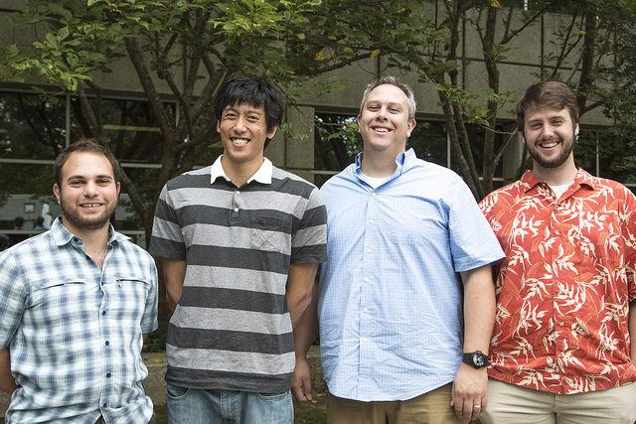

*
* Photoshop not covered in OSS 2014

Slide 2
Quantifying the Ecohydrological Impacts of Forest Disturbance
(Doing things the hard way)
Tony Chang, Montana State
Jon Duncan, UNC-CH
Tian Gan, Utah State
John Lovette, UNC- CH
Mike Treglia, Texas A&M / U Tulsa

Slide 3
Broad-scale effects of forest loss on stream resources are not well understood.
Problem
Understanding effects of forest disturbance across watersheds can allow identification of areas most in need of management.
Issue
Disturbances related to climate change & development will increase in the future, altering availability of clean, fresh water.
Forest disturbances from natural and human causes have been observed to change water quantity and quality.
Benefits
So What?
Solution
Perform a continental scale analysis of watershed response to forest disturbance.

Slide 4


Medical Triage Analogy?

Slide 5

Imagine a landscape where a great number of watersheds are injured. That injury being a type of disturbance.
Problem
Problem
This facilitates dedicating triage and long-term management efforts to most sensitive watersheds.
Issue
We don’t have the time to examine each watershed closely to know which one to address first.
Forest disturbance from natural and human causes have been observed to change water quantity and quality.
Benefits
So What?
Solution
Analyze effects of disturbance on watersheds (figure out which watersheds are injured, and more resilient to injury)

Slide 6





Our Team’s Open Source
Technical Skills
Some Software:
Technical Expertise:
Process-based Hydrologic Models and Hydrology(Jon, John & Tian)
Algorithm and Model-based Statistics (Tony and Mike)
Data Acquisition/Data Sources (Everybody)
GIS Data Manipulation (Everybody - in varied forms)

Slide 7
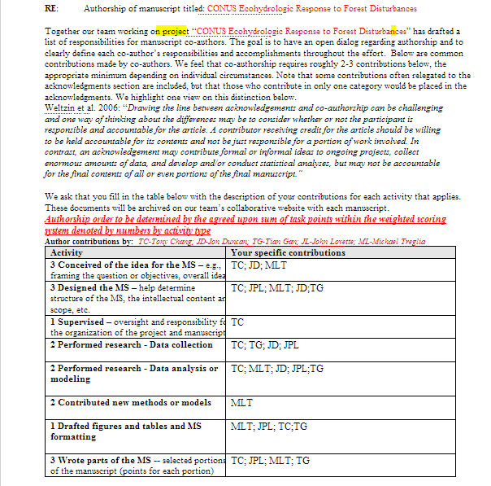
Some Initial Steps
Important Discussions:
Authorship
Collaboration
(What else?)

Slide 8
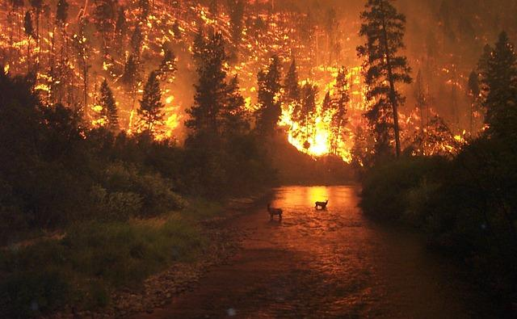
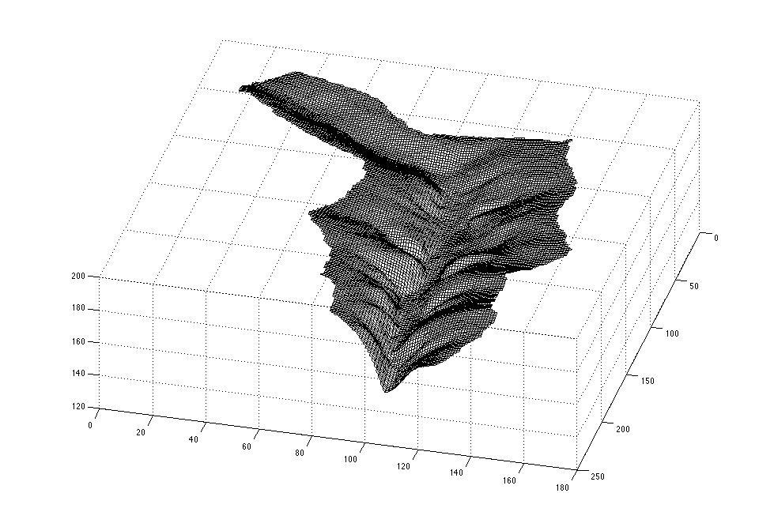
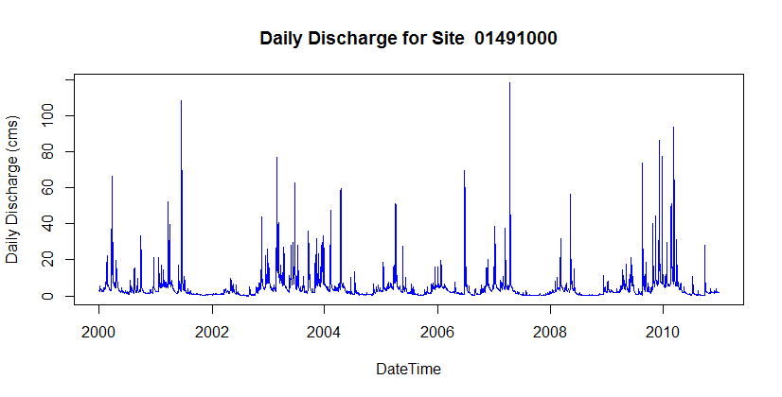
Conceptual Model
Drivers
Controls
Responses
Size
Soils
Forest Type
Climate
Forest Disturbance
Streamflow
Water Quality
Fire
Logging
Insect/pathogen
Urbanization

Slide 9
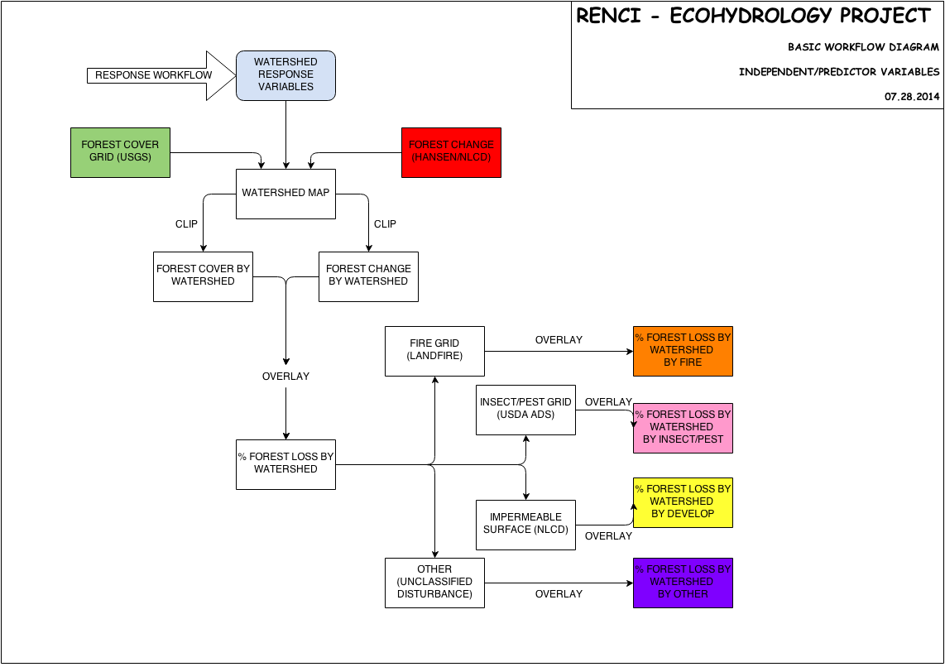
The Workflow

Slide 10
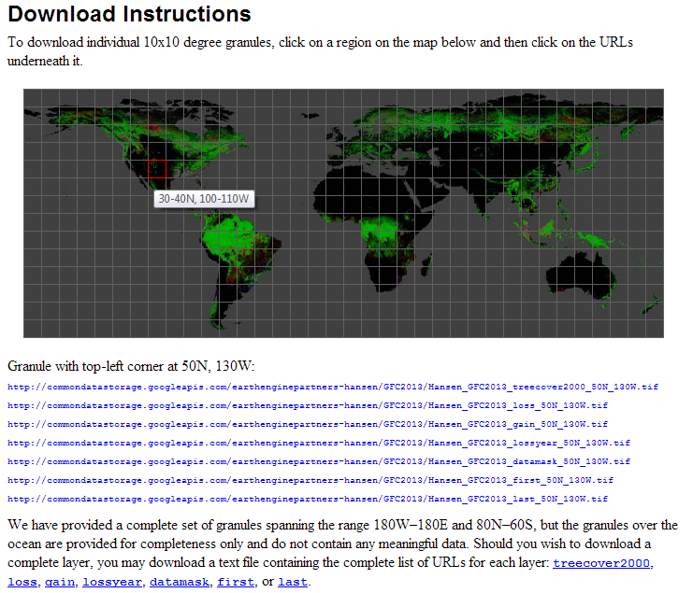
First Dataset...
http://earthenginepartners.appspot.com/science-2013-global-forest/download.html

Slide 11
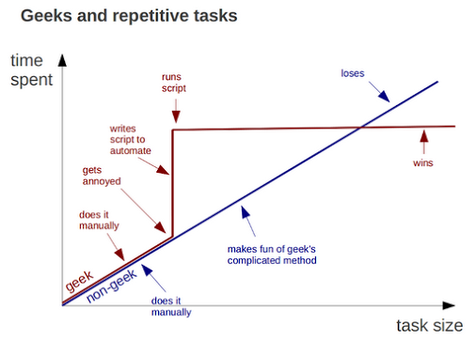
The Strategy
https://plus.google.com/+BrunoOliveira/posts/MGxauXypb1Y?pid=5694023113460433314&oid=102451193315916178828

Slide 12
Division of Labor
(Kind of… Lots of Helping Each Other Out)
https://www.draw.io/

Slide 13
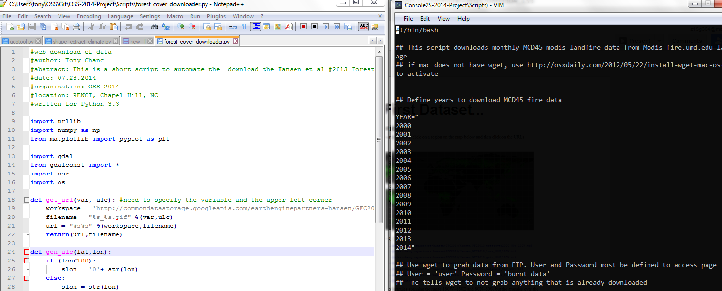
Automated Downloaders
https://github.com/RENCI-Ecohydro/OSS-new/blob/master/Scripts/forest_cover_downloader.py
https://github.com/RENCI-Ecohydro/OSS-new/blob/master/Scripts/MCD45_wget_2.sh

Slide 14
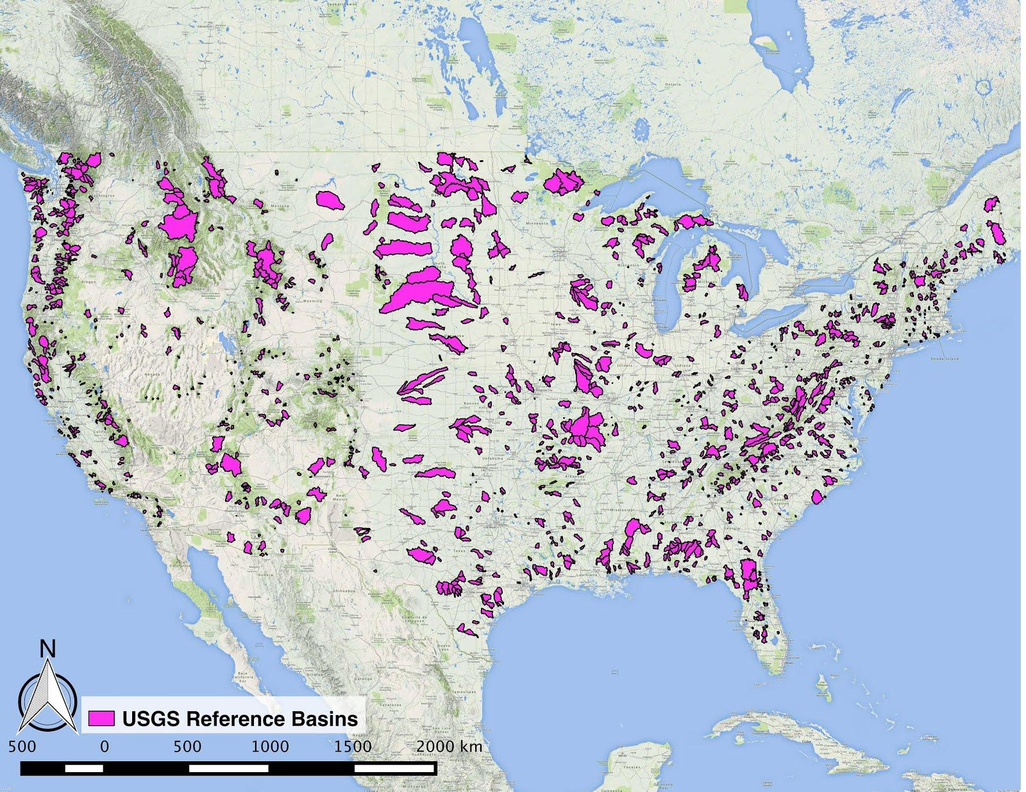
The good...
http://water.usgs.gov/GIS/dsdl/gagesII_9322_point_shapefile.zip
Notes:
Lots of great reference basins with great data from USGS (1900 wsheds)

Slide 15
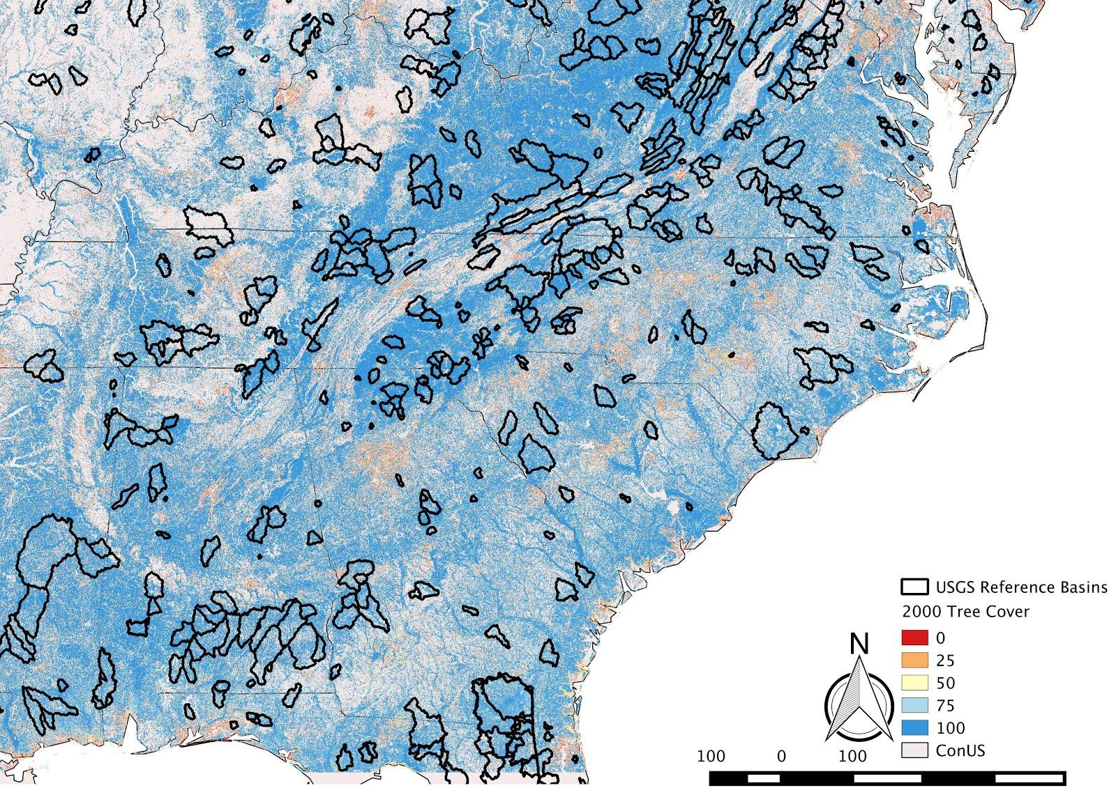
The bad...
- ~ 200 GB of raster data
- 1.5 petapixels
- 1856 watersheds
Notes:
469 in SE, just with Hansen dataset

Slide 16
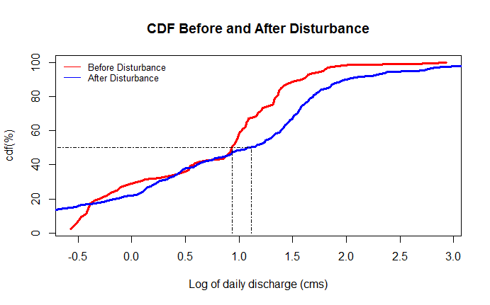
Really bad...
Notes:
cumulative distribution vs daily discharge. Before disturbance, 50% of daily discharges are <1 cms, increases to >1 cms after dist

Slide 17
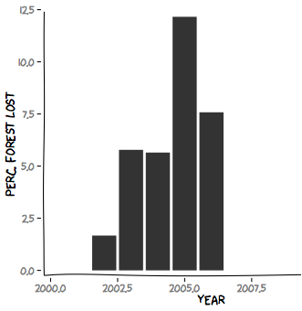
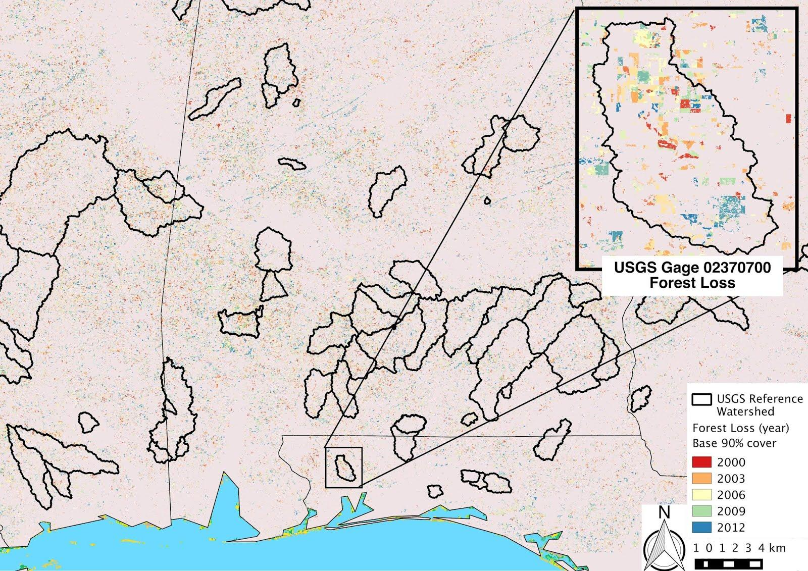
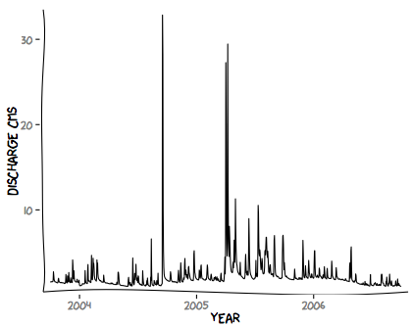
Also Really Bad...
?
wet year + pulse disturbance obscures response variable

Slide 18
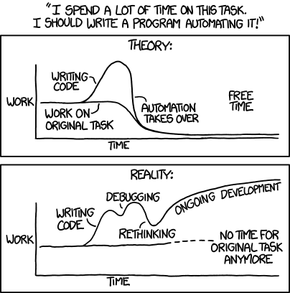
The ugly...
http://xkcd.com/1319/

Slide 19


Challenges and Solutions
Big Data Problems
Large remote-server for Python scripts
PostGIS/Postgres and Spatial SQL
https://github.com/RENCI-Ecohydro/OSS-new/tree/master/Scripts
Dennis van Zuijlekom

Slide 20
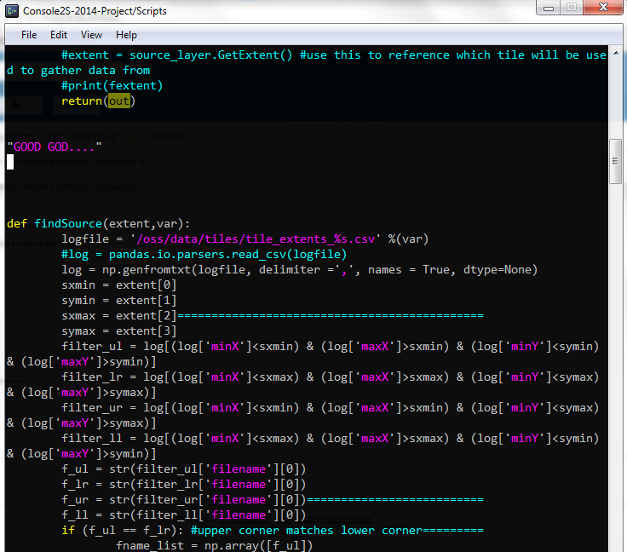
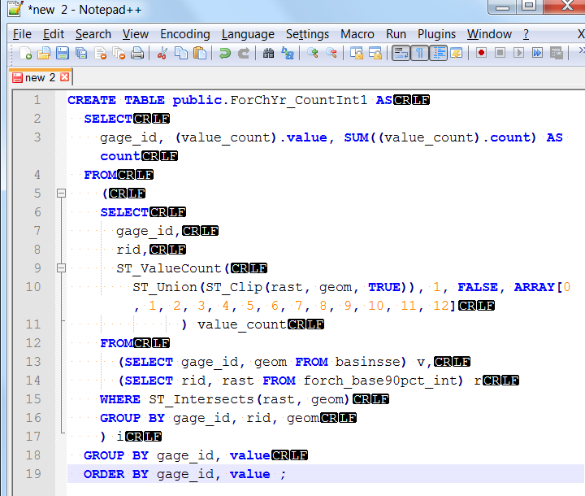
Python or SQL?
Python Code to Extract Forest Loss by Watershed:
Not efficient but readable...sort of.
PostGIS SQL Code to Extract Forest Loss by Watershed:
Efficient but a Steep Learning Curve
279 Lines: ~12 hours to run entire U.S.
19 Lines; ~5 minutes to run for the entire Southeastern U.S.
(Some post-processing of tables in R)
Worked well for QA/QC: EXACT SAME ANSWERS!!!

Slide 21
To do...
- Collect remaining response/predictor data
- Extract new predictor variables to watershed shapes
- Build statistical models
- Time series analysis
- Pre/Post treatment analysis
- Poster at AGU (Dec 2014)

Slide 22
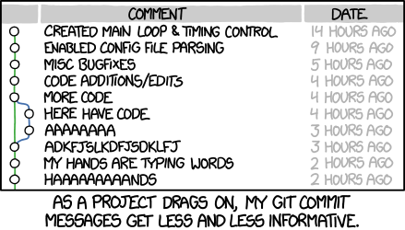
Lessons Learned
(Try not to do this… and thanks to Terrell for helping us with GIT!)
http://xkcd.com/1296/

Slide 23

Clone our repository!
https://github.com/RENCI-Ecohydro/OSS-new
You will be assimilated!

