Slide 1

Transformative Research in Synthesis Centers
John N. Parker
Arizona State University
(with contributions from Ed Hackett, Stephanie Hampton, Laura Sheble, and Ismael Rafols)

Slide 2
Transformative Research
Research driven by ideas that have the potential to radically change our understanding of an important existing scientific or engineering concept or leading to the creation of a new paradigm or field of science or engineering. Such research also is characterized by its challenge to current understanding or its pathway to new frontiers. (NSB-07-32, 2007)

Slide 3
Overview
1. Synthesis as transformative
2. Research environment
3. Social processes
4. Guiding Principles

Slide 4
Methods
Observations
Interviews
Surveys
Network analysis
Statistical modeling
Bibliometric analyses

Slide 5
Scientific Synthesis
Integration of research questions, theories, methods and data across disparate forms of expertise, scales and study systems to increase the generality, applicability, or empirical soundness of scientific explanations.
(Hackett and Parker 2011)
Data overload
Hyper-specialization
Conceptualize problems
Devise elegant solutions

Slide 6
Defining Research Synthesis Methods
Family of research methods
  Systematic review, integrative research review, Cochrane review, meta-analysis, qualitative meta-synthesis, meta-ethnography,…
Secondary analysis of prior research studies to examine the extent, meaning, and/or implications of what is (not) known or understood
(Sheble, 2014)
Notes:
Systematic review, integrative research review, qualitative research synthesis (Major & Savin-Baden, 2010); meta-ethnography (Noblit & Hare, 1988); systematic research synthesis (Gough, 2004); best evidence synthesis (BES) (Slavin, 1995); and realist synthesis (Pawson, 2006) are examples of sub-types of research synthesis. In the literature, “meta-analysis” has often been used to denote the composite process of a research synthesis. Conceptually, I define meta-analysis more narrowly as the statistical methods used to combine quantitative data across studies, an analytic technique that may be used within a research synthesis. This usage follows the original definition of meta-analysis proposed by Glass (1976).

Slide 7
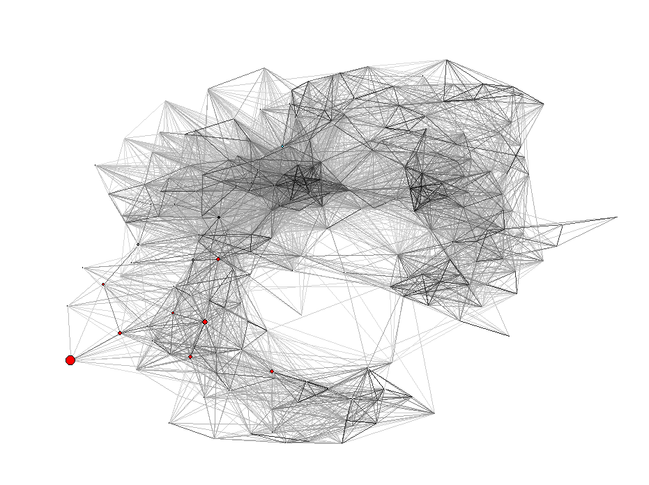
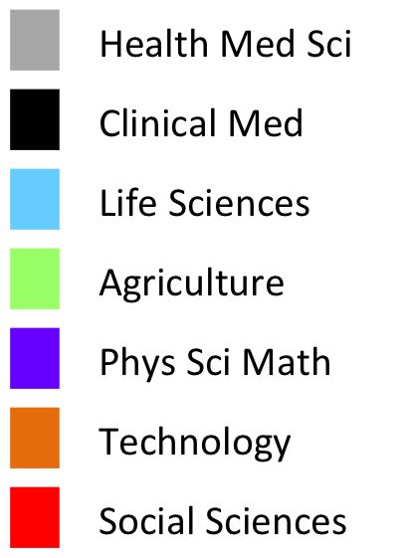
Diversity of fields: 1972-1981

Slide 8
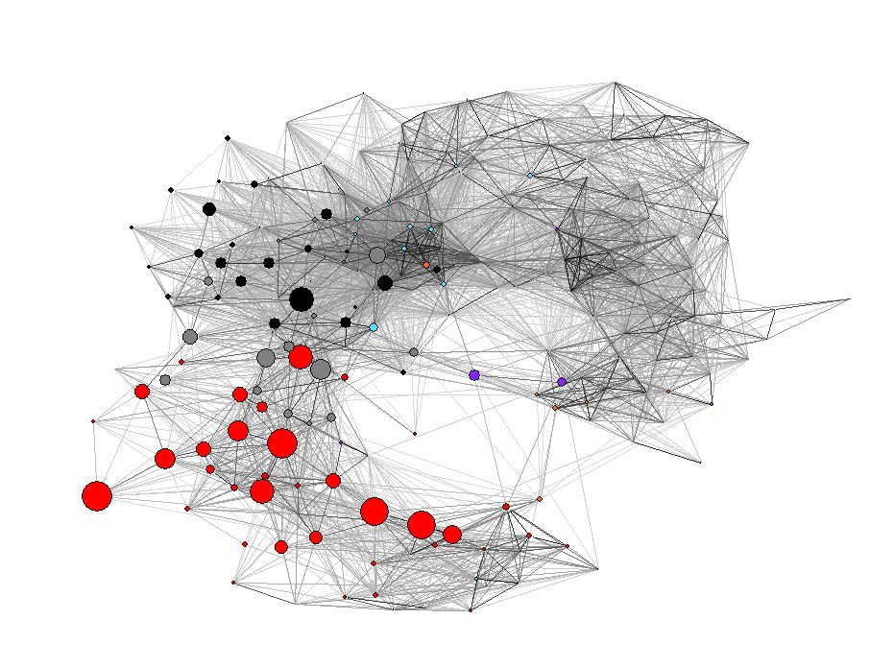
Diversity of fields: 1982-1991

Slide 9
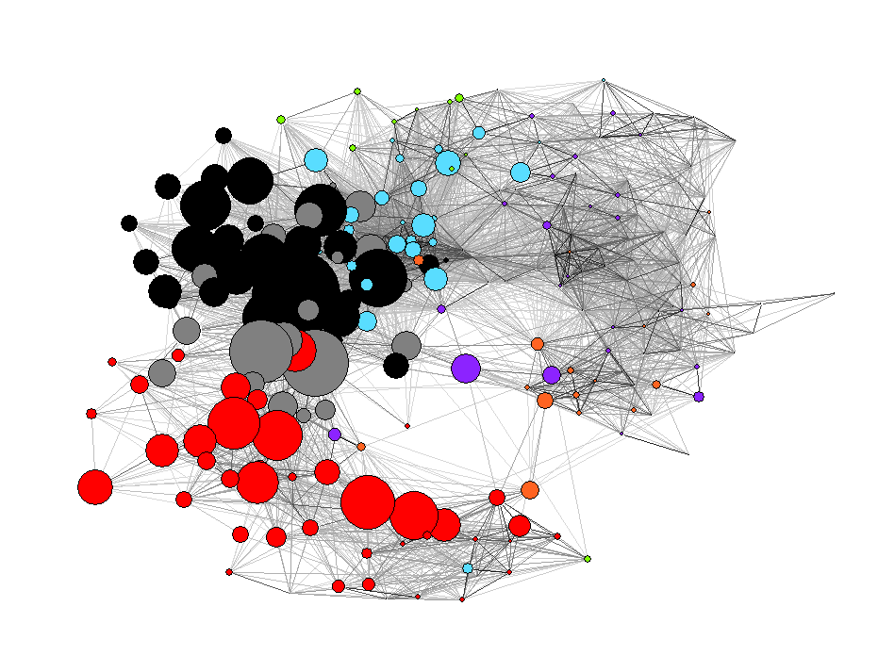
Diversity of fields: 1992-2001

Slide 10
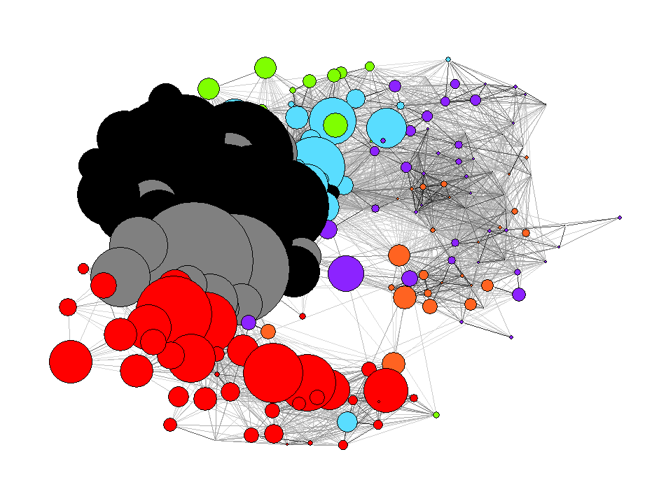
Diversity of fields: 2002-2011

Slide 11
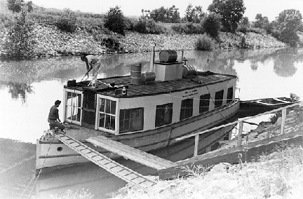
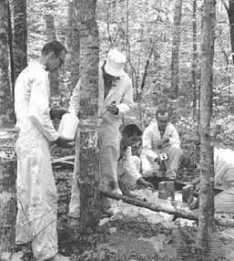
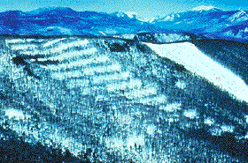
Photos from Bocking, 2004
History of Big Ecology
OAK RIDGE
HUBBARD BROOK
And other AEC sites…
“Gamma Forests” @ Brookhaven
Model for LTER

Slide 12

OAK RIDGE
1960s
NCEAS
1996
NESCent
2005
IBP
1970-75
MEA
2001
NIMBios
2008
NEON
Now
LTER
1980
FIBR
2003
SYSNC 2011
Hubbard Brook
1963
RA
1996
IMOSEB
2005

Slide 13
Working Groups
10-15 people
4-8 days
Several times, several years
Interdisciplinary
Cross-sectorial
Intense, engaged, F2F

Slide 14
NCEAS Research
1% most highly cited institutions
6X rate of increase in co-authorship
Changes in attitudes and behaviors
Differ in substance, scope and ambition
More engaged, embedded and directed
Measureable career effects

Slide 15
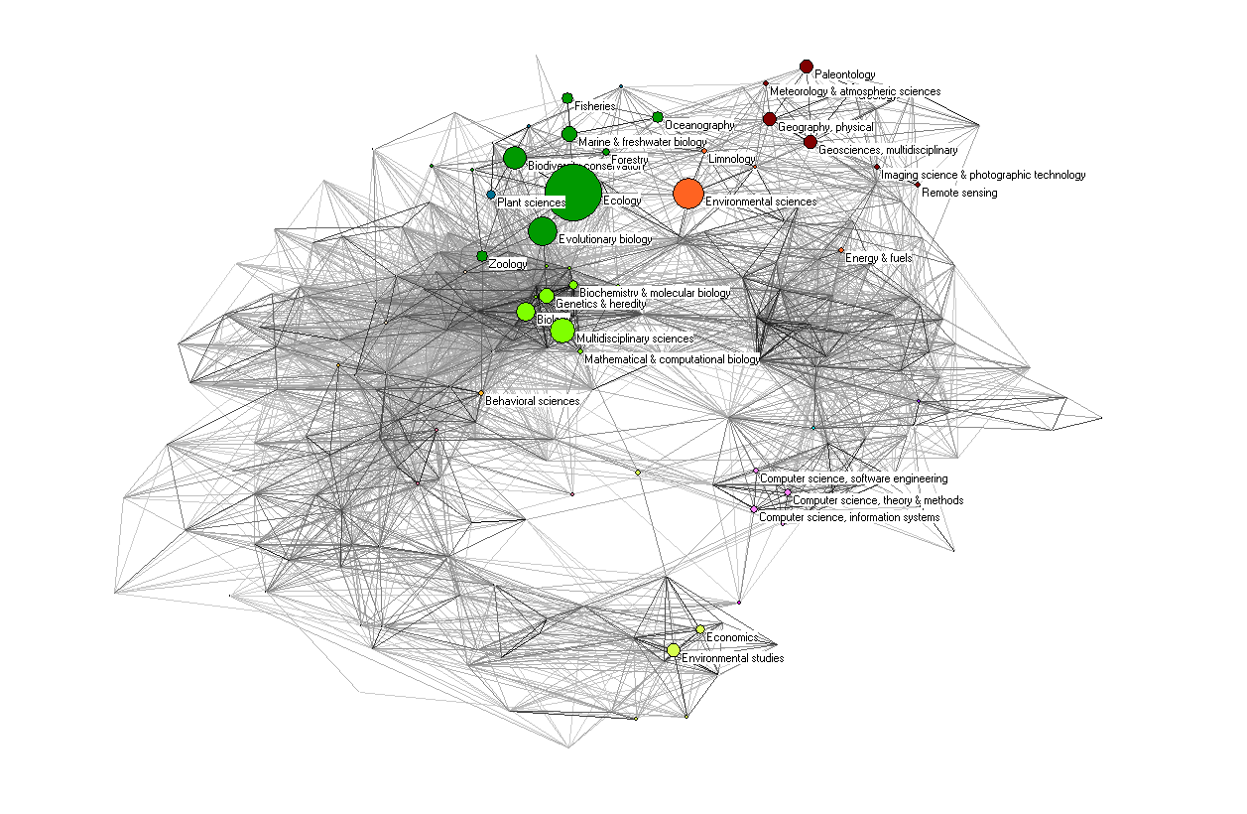
NCEAS Publications
(Rafols, 2013)

Slide 16
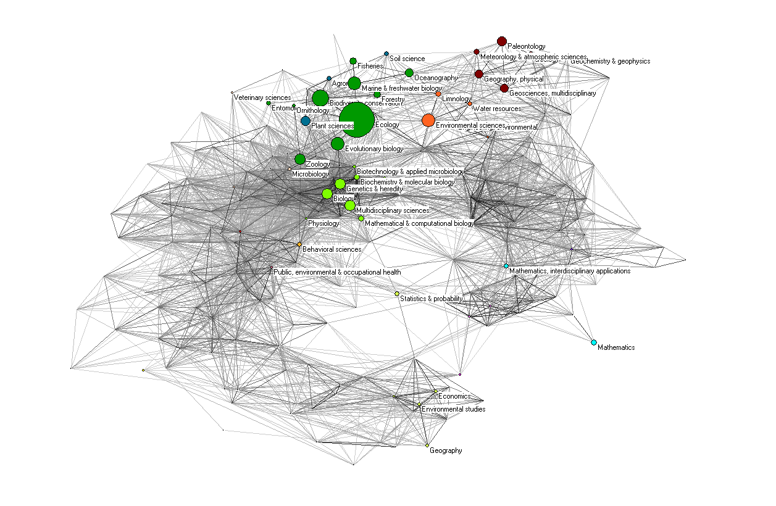
NCEAS References

Slide 17
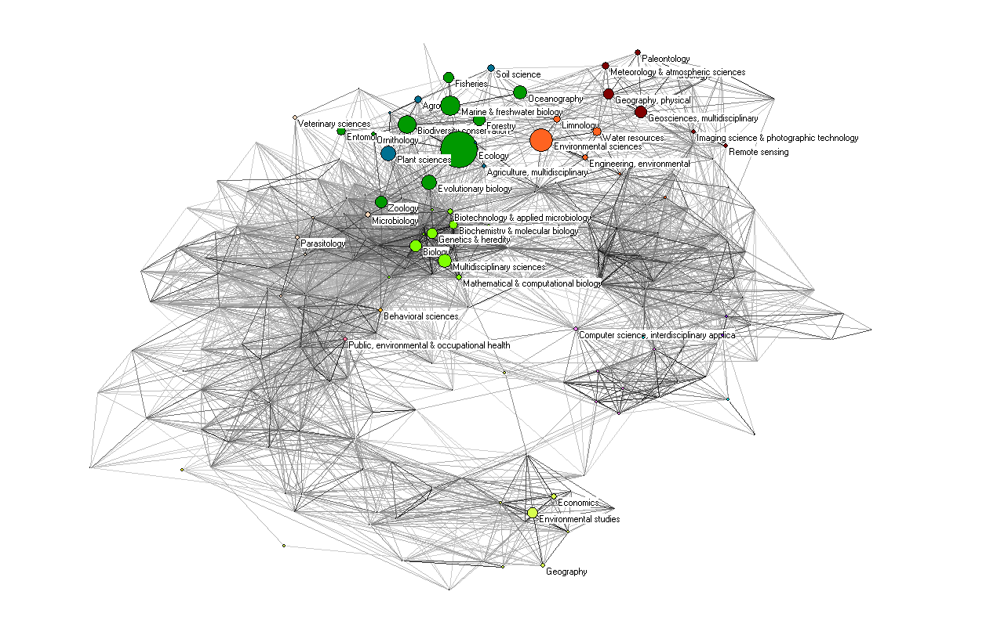
NCEAS Citations

Slide 18
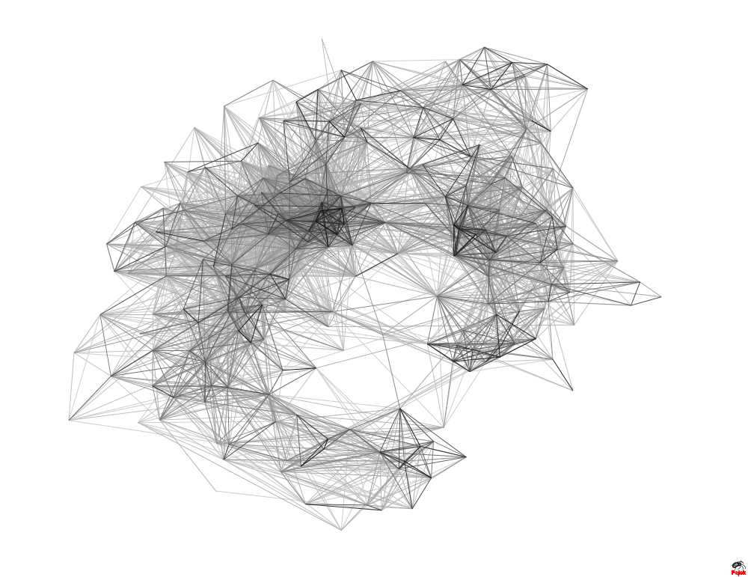
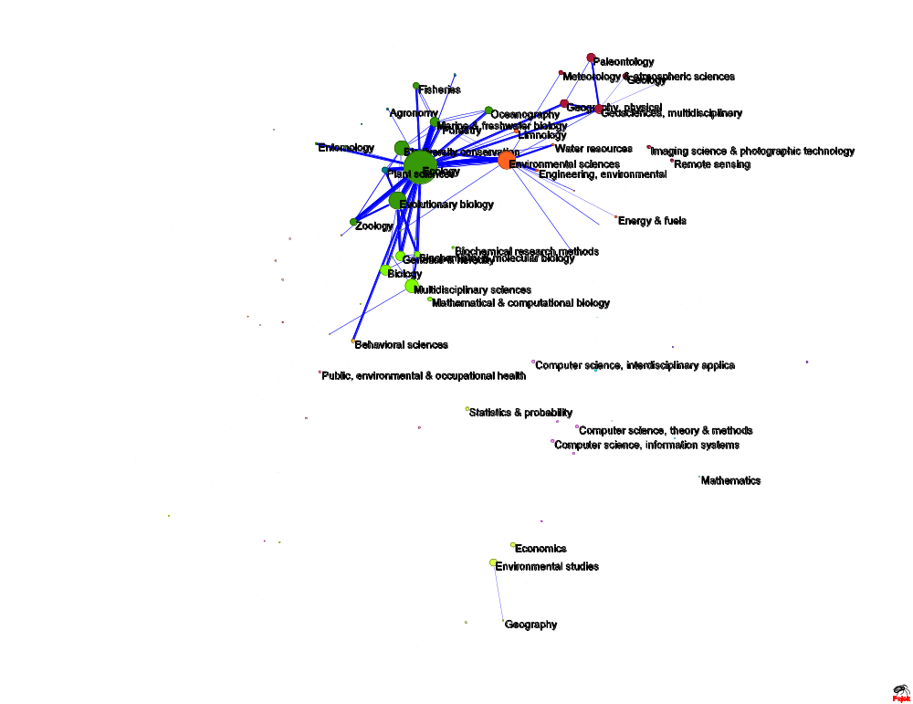
Expected cross-citations
Line Size= # citations
Node Size = # citations from each SC

Slide 19
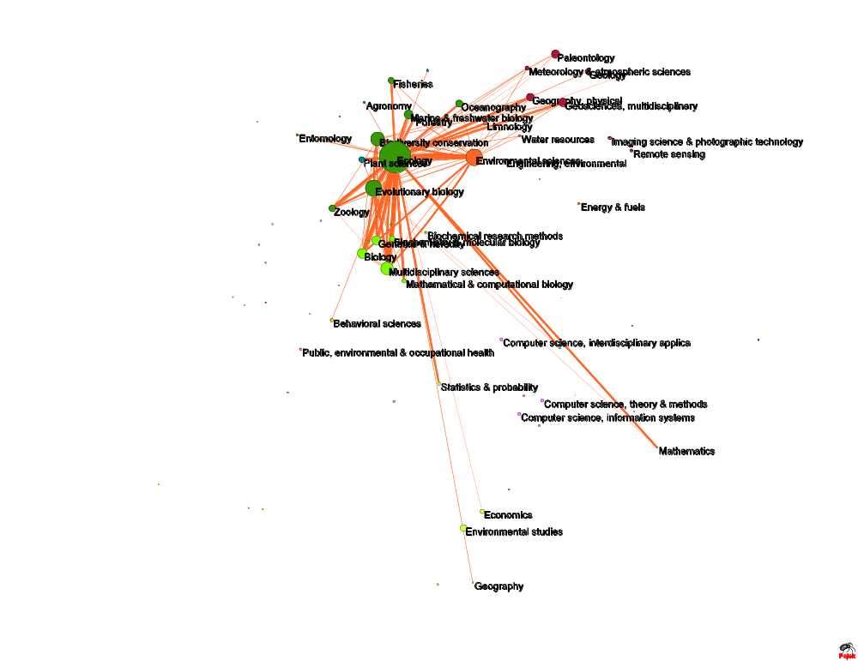
Observed cross-citations
Line Size= # citations
Node Size = # citations from each SC

Slide 20
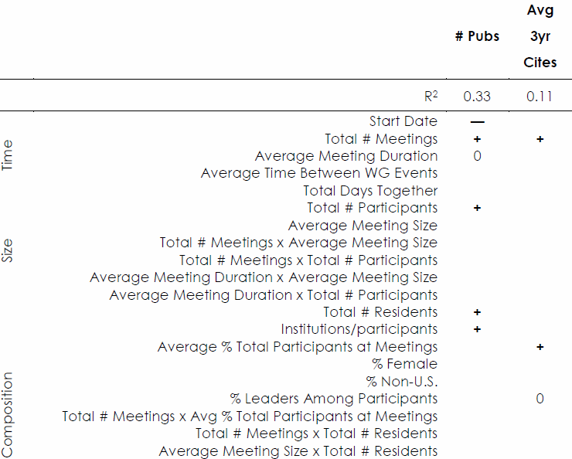
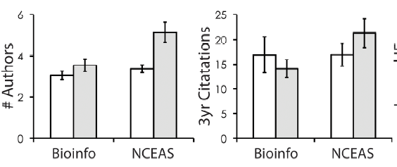
Success in Synthesis (Hampton and Parker 2011)

Slide 21
Synthesis Centers as a Mobilizing Structures
Mobilize collective action (e.g. N.O.W.)
Key Insight: Social movements happen in science
Disciplines, specialty areas also social movements
Leaders, followers, opponents
(Frickel & Gross 2005; Parker 2010)

Slide 22

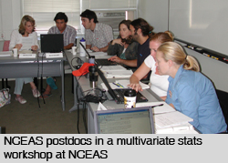
“Moist” transition
Field
Analysis
Molecular Biology
Ecology
Wet
Dry
Primary
Secondary
(Penders et al. 2008)

Slide 23
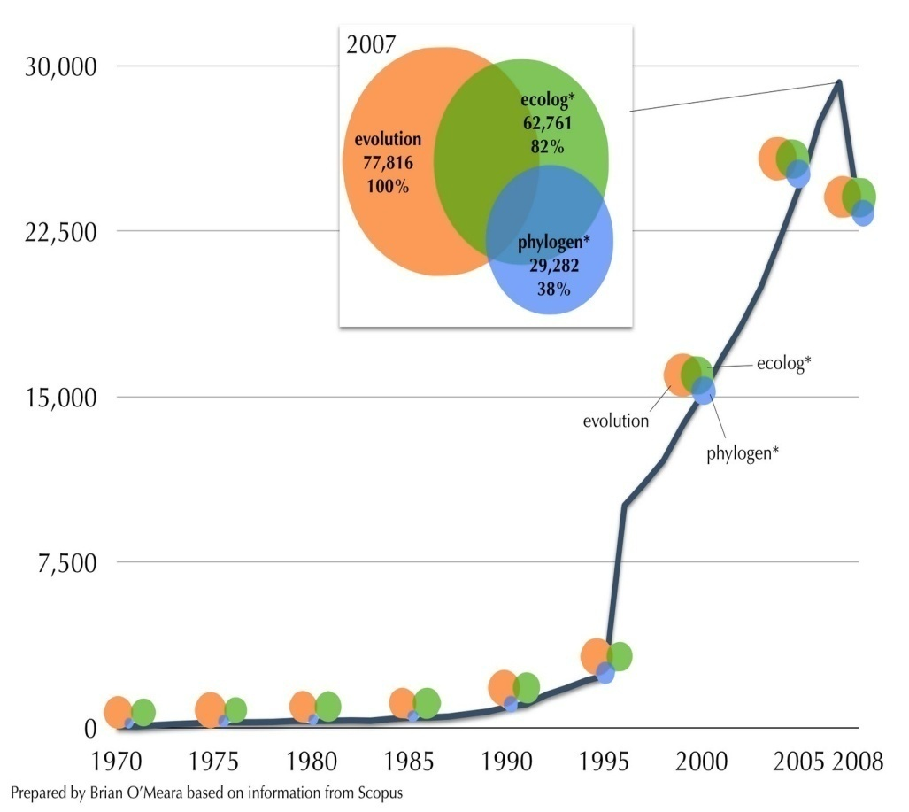
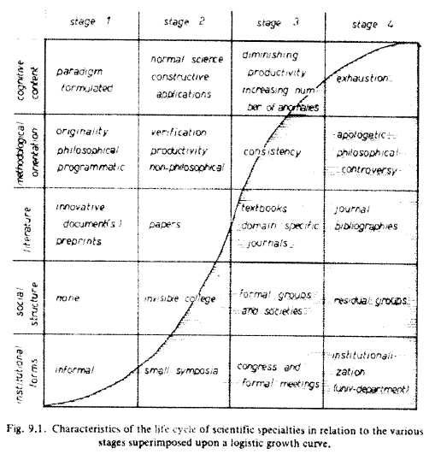
Life Cycles of Scientific Specialties
(O’Meara 2008)
(De May 1992)
More than an organization…

Slide 24
A Genealogy of Scientific Organizations
NESCent
RAVON
NOAA
NIMBios
CUAHSI
ACEAS
NCEAS
BioSynC
AEON
SRC
ISSNSFEO
IPLANT
IPL
Many others…
Disrupting Science Moore, 2008

Slide 25
Synthesis as Mode Two Research
Traditional Ecology
Field
30 meter plots
Primary data
Single discipline
Single institution
Single nation
Academic setting
NCEAS Working Groups
NCEAS
Huge areas of study
Secondary data
Multiple disciplines
Multiple institutions
Multiple nations
Nonacademic setting
(Hackett 1990; Gibbons et al., 1994; Etzkowitz and Leydesdorff, 2000)

Slide 26
Theories of Transformative Creativity
1. Coherent Groups (Mullins 1972)
2. Collaborative Circles (Farrell 2001; Corte 2013)
3. Sociology of Philosophy (Collins 1998)
3. Flow Psychology (Csikszentmihalyi 1997; Sawyer 2007)
4. Hot Spots and Hot Moments (Parker and Hackett 2012)
5. John Cleese

Slide 27
In-Group Solidarity and Positioning
Span disciplines, institutions, nations
Leave local contexts and enter F2F at center
Result: trust, leadership roles, division of labor
Accomplished in two ways
  Period of ritualized adjustment
  Group symbols and rituals
Allows for: trust, bridging of social groups, and operational division of labor
Trading zones, pidgin, Creole

Slide 28
Age Structure and Interaction
Distinct division of labor
Essential tension (Kuhn, 1977)
Sr. Scientists: socialization, networking, institutional memory, orientation in the field, ask important questions
Jr. Scientists: fresh ideas and techniques, labor, energy, ask challenging questions
Ground practice while admitting creative insights

Slide 29
Generative Small Group Processes
Flow
Instrumental intimacy
Escalating Reciprocity
Serendipity
Peer-review on the fly
Velocity

Slide 30
Guiding Principles
Face-to-face (intensive or extensive)
Social and physical isolation
Time (x 2)
Rituals, identities, and informality
Playfulness
Balance diversities (stoichiometry)
Beware the ‘band of brothers’

Slide 31
THANKS!

