Slide 1

Overview of Data Management
W. Christopher Lenhardt
OSS Training Institute
23 July 2014
Notes:
Transition to another thread, technical part; data management
Data is generative / synthesis science/working groups generative

Slide 2
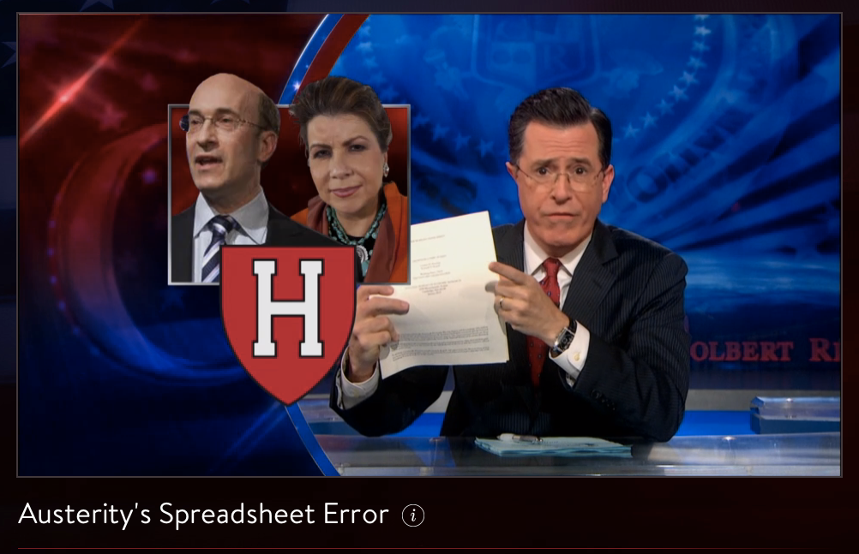
Don’t end up on the Colbert Report
http://thecolbertreport.cc.com/videos/dcyvro/austerity-s-spreadsheet-error
Notes:
Don’t end up here
Harvard economists had an error in their spreadsheet; found by a grad student
Ties back with some of the messaging and related issues talked about Day 1 & 2

Slide 3
Goals
Why data management matters
What is data management
Why data management is hard
Present some basic notions and principles of data management
Notes:
Shift your thinking
Not trying to turn you into a data manager
Bounce between perspectives – you as researchers and thinking bigger picture
You’ve gotten this far…

Slide 4
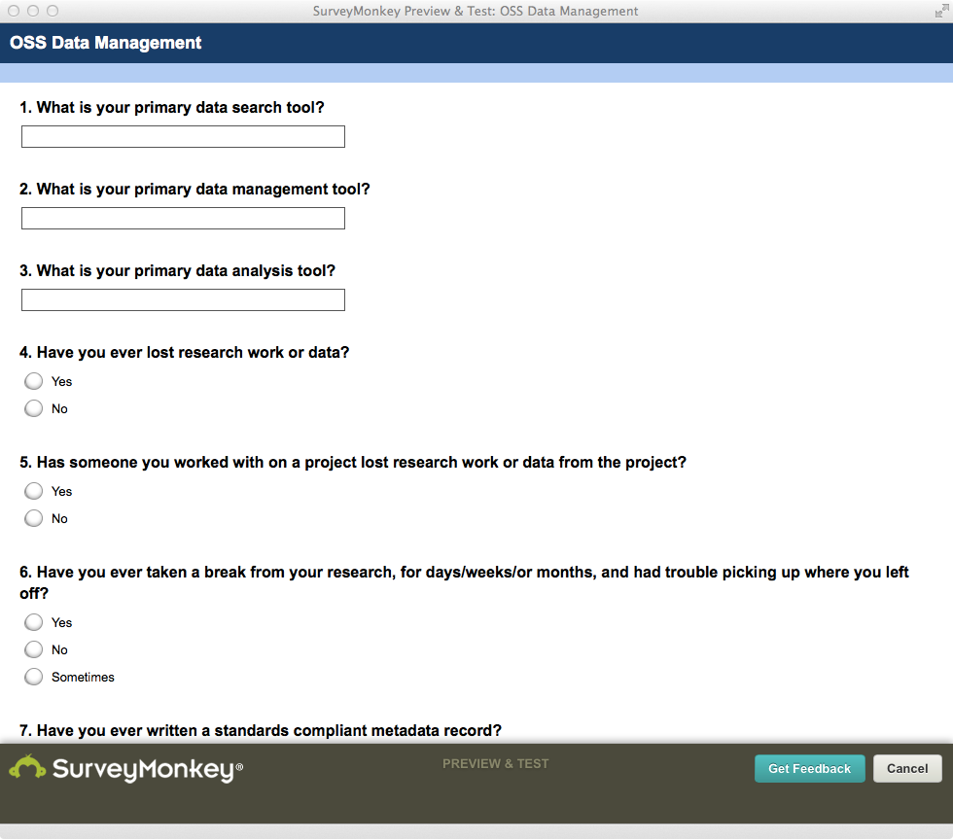
Take a Look at the Survey Results

Slide 5
80/20 Rule
80%
20%
Notes:
80% of the work gets done in 20% of the time….
How many of you spend 80 % on data gathering, data massage, cleanup, reformatting, etc.; 20% on actual analysis??
Should be the other way around! 20% on finding, accessing, understanding, etc. and 80% on analysis…

Slide 6
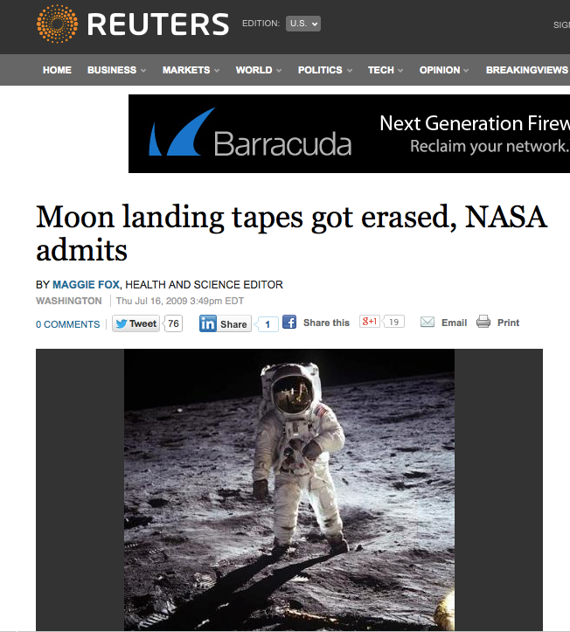
Whoops…
http://www.reuters.com/article/2009/07/16/us-nasa-tapes-idUSTRE56F5MK20090716
Notes:
Something else to be avoided…

Slide 7
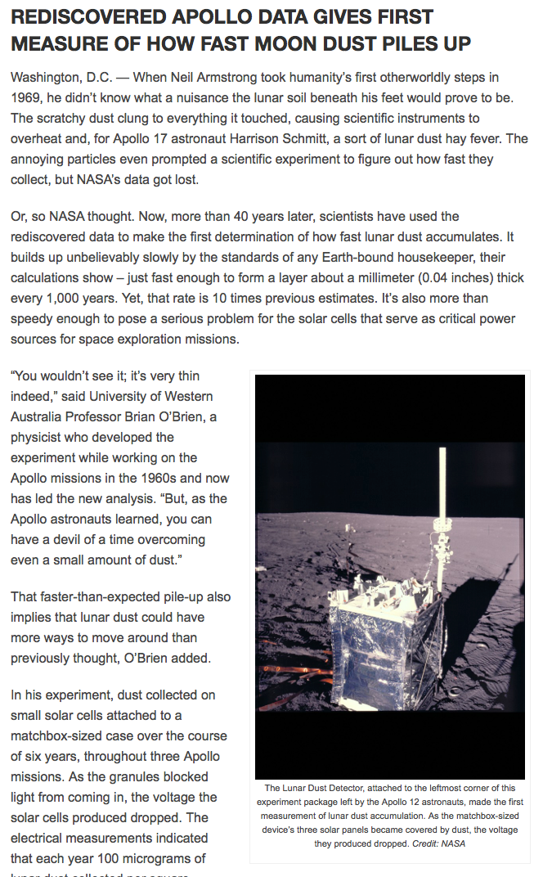
45th Anniversary on 20 July
The detectors flown on Apollo 12, 14 and 15 operated until NASA shut them off in September 1977 due to budgetary concerns. While the detectors worked properly, NASA did not preserve the archival tapes of the data they collected. For three decades NASA assumed the dust detector data had been lost forever, until 2006 when O’Brien heard about NASA’s mistake and told them he still had a set of backup copies.
Old Data, New Science
http://news.agu.org/press-release/rediscovered-apollo-data-gives-first-measure-of-how-fast-moon-dust-piles-up/
Notes:
Bad data management planning with a lucky outcome
Tension between keeping everything and only keeping what you need.
Data can be repurposed years later to enable new science…

Slide 8

Dark Data
Source: http://cinema-fanatic.com/2010/07/05/oscar-vault-monday-raiders-of-the-lost-ark-1981-dir-steven-spielberg/
Notes:
Recognize this scene?
What’s a dark archive?
Don’t want your data to end up unusable in a dark archive somewhere…

Slide 9
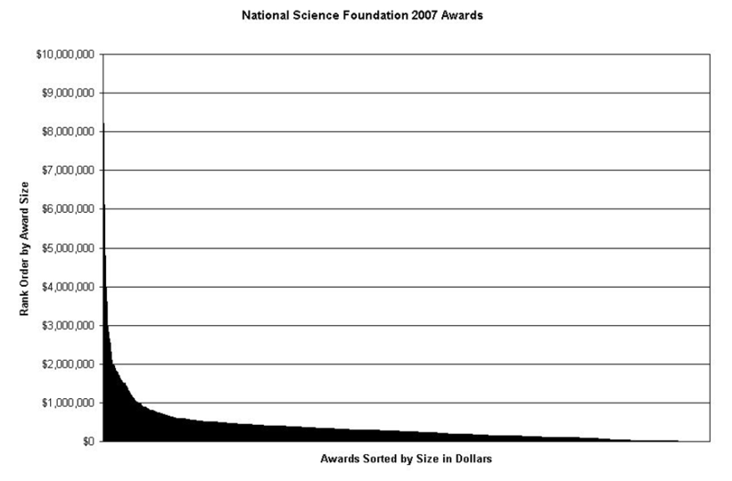
“Dark” data in the long tail
Heidorn, P. 2008. doi:10.1353/lib.0.0036
Notes:
A lot of potential data is going unused

Slide 10
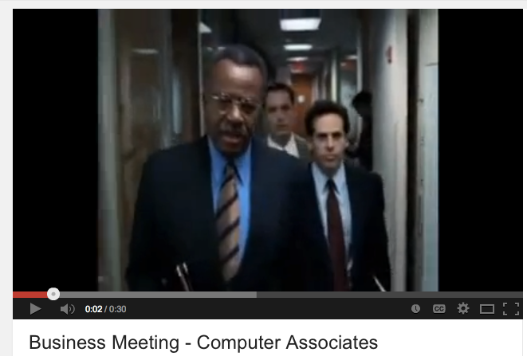
Quick Segue to YouTube
http://youtu.be/NDDYW2b3HSs

Slide 11
What is Data Management?
“Data management is the process of controlling the information generated during a research project. Any research will require some level of data management, and funding agencies are increasingly requiring scholars to plan and execute good data management practices.”
Source:
http://www.libraries.psu.edu/psul/pubcur/what_is_dm.html

Slide 12
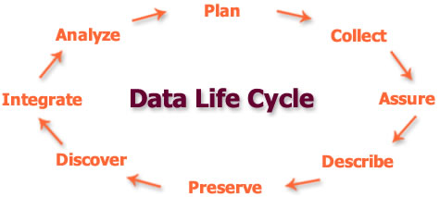
Data Management Lifecycle
Notes:
From the data center or archival or data center manager point of view we think about this this way
You should too
Think about data life story

Slide 13
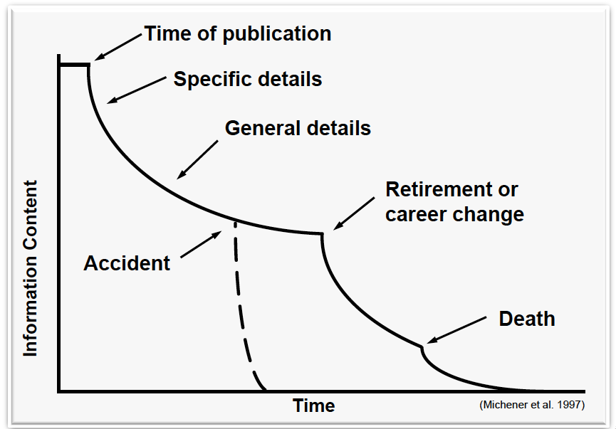
Data Entropy
Notes:
Where data management and physics collide

Slide 14
Why does it matter?
The outcome of your research depends in part on how well you manage your data. Managing data helps you as a researcher organize research files and data for easier access and analysis. It helps ensure the quality of your research. It supports the published results of your work and, in the long term, helps ensure accountability in data analysis. Effective data management practices include:
Designating the responsibilities of every individual involved in the study.
Determining how data will be stored and backed up.
Implementing the data management plan.
Deciding how data will be dealt with through each modification of the study.
Source: http://www.libraries.psu.edu/psul/pubcur/what_is_dm.html
Notes:
Integral to successful science
Crucial for reproducibility
You can get another publication/credit for new data created

Slide 15
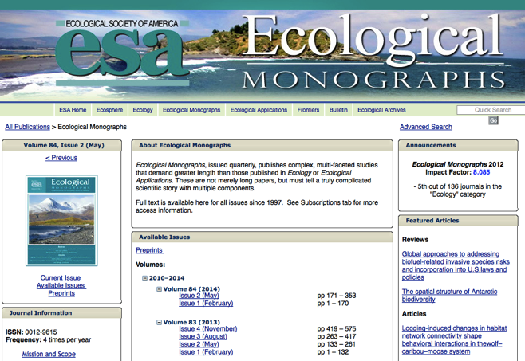
More reasons for managing your data
Publishers may require it
Data Policy. The editors and publisher expect authors to make the data underlying published articles available. Authors of manuscripts submitted to Ecological Monographs as of January 1, 2011 and manuscripts submitted to Ecological Applications as of January 1, 2014 are required to make available all data associated with the results in a permanent, publicly accessible data archive or repository, if their manuscript is accepted.

Slide 16

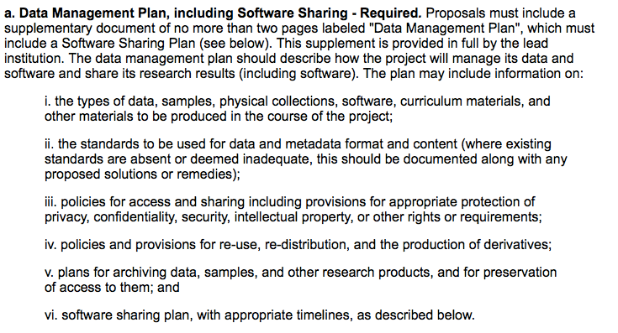
More reasons for managing your data
Funders require it…

Slide 17
10 Minutes on Group Facilitation
Turn to neighbor and come up with top 3 – 5 barriers to data management
Any good data management horror stories folks care to share?
Come back and compare notes

Slide 18
Barriers to [Synthesis] Science
Data not preserved
Tiny proportion of ecological data are readily available
Dispersed, isolated repositories
Each community has its own; disconnected; underutilized
Lack of software interoperability
Heterogeneous data
Many data formats, metadata formats, and varying semantics
Metacat, DSpace, Mercury, iRODS, XMCat, OPeNDAP, ...
18
Notes:
In addition to the functional requirements and interAdditional drivers for guiding implementation.
- Scalable

Slide 19


Solutions
Preserve data
Adopt standards
Create networks
Create interoperable software

Slide 20
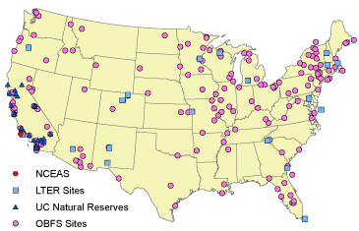
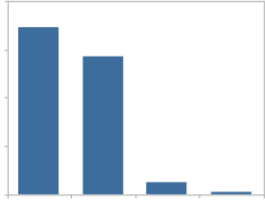
Example: Preserve data in the Knowledge Network for Biocomplexity (KNB)
Data Types
Ecological
Environmental
Demographic
Social/Legal/Economic
60
Diverse Contributors
Individual investigators
Field stations and networks
Government agencies
Non-profit partnerships
Scientific Societies
Synthesis centers
45
Data
Sizes
%
30
15
0
< 1
1-10
>200
10-200
MB
20

Slide 21
Metadata and data heterogeneity – But use relevant standards
Every community has
many data schemas
one for each project and person
many data formats
ASCII, NetCDF, HDF, GeoTiff, ...
many metadata schemas
Biological Data Profile, Darwin Core, Dublin Core, Ecological Metadata Language (EML), Open GIS schemas, ISO Schemas, ...
Accepting this heterogeneity is necessary

Slide 22




A Federation of Cyberinfrastructure
Diverse Federation == Resilience
Failover for temporary outages
Insurance against project/institutional failure
Avoid correlated failures
Diverse Federation == Scalability
Storage increases with Member Nodes
Incremental costs to each MN to replicate
Distributes sustainability costs

Slide 23





Creating Interoperability
Interoperable Catalogs
Heart of the federation
Harness the power of local curation
Develop Data Services
Services to link participants
Tools for end-users
Tools for the whole data lifecycle
Interoperability

Slide 24
Data Management Resources
Best Practices
DataONE, Best Practices Primer
http://www.dataone.org/sites/all/documents/DataONE_BP_Primer_020212.pdf
ESIP, Data Management Short Course for Scientists
http://commons.esipfed.org/datamanagementshortcourse
Data Management Planning
DataONE, Data Management Planning
http://www.dataone.org/data-management-planning
DataONE, Data Management Plan Tool
https://dmp.cdlib.org/

Slide 25
Data Dictionary
Variable ID | V1 | V2
Variable Long Name | Population Density | Population Count
Variable Short Name | PopDen | PopCount
Format | F5.0 | F10.0
Units | Persons per square km | Etc…
Minimum Value | 0
Maximum Value | 11,000
Average | 2,331
Description | This variable is calculated by dividing the number of persons in that country by the total area.
Source | Gridded Population of the World (CIESIN/CU)

Slide 26
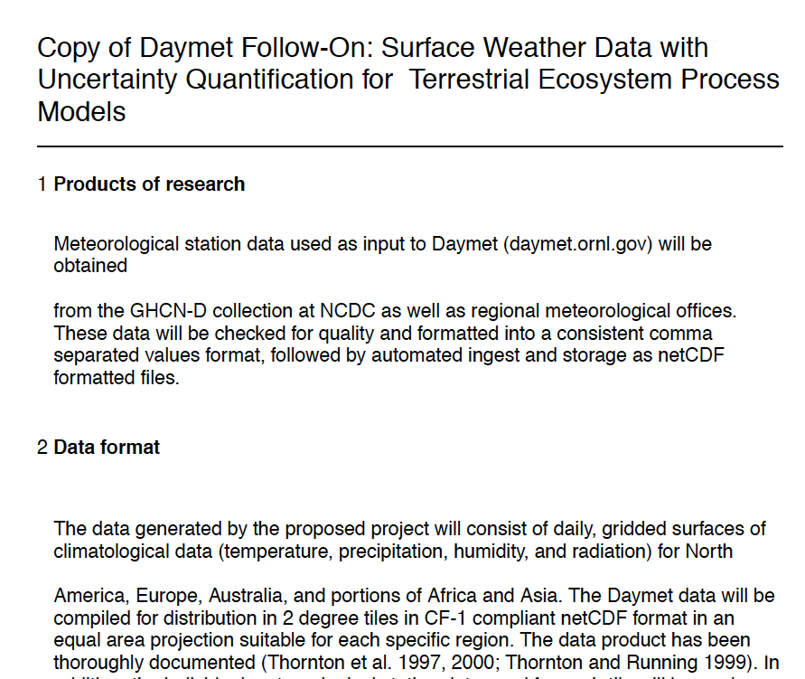
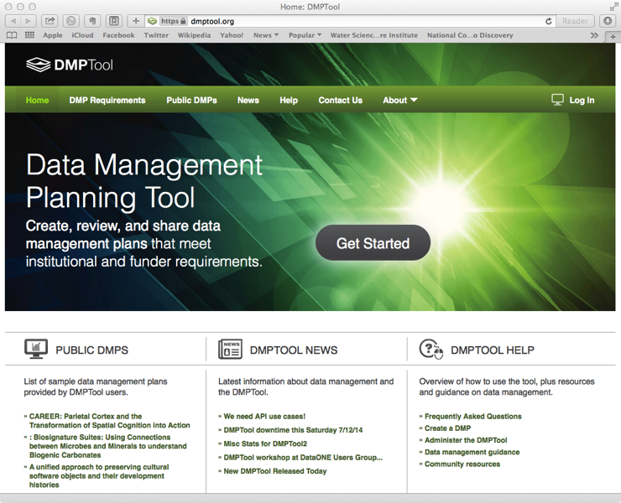
Data Management Plan
https://dmptool.org

Slide 27
Quick Exercise
Take a couple of minutes and skim through the example data management plan.
Think about it from two perspectives:
From your perspective as a participant in this course. What makes sense, what doesn’t
From the perspective of a reviewer, would you fund this project based on the data management plan.

Slide 28
Top 10 Tips for Data Management
No empty cells/fields/don’t concatenate information in one field when it should be split apart
Back up early and often
Make a copy, save original, version control
Plan
Make a data dictionary
Document as you go
Consult an expert
Address licensing/confidentiality/restricted access
Metadata, metadata, metadata
Archive/publish your data
Notes:
Ask about how much time on a project to devote to data management?

Slide 29
thanks
And remember…
Don’t end up on the Colbert Report!
Notes:
Don’t end up here
Harvard economists had an error in their spreadsheet; found by a grad student
Ties back with some of the messaging and related issues talked about Day 1 & 2

