Slide 1

Scientific Workflows
Matthew B. Jones
Jim Regetz
National Center for Ecological Analysis and Synthesis (NCEAS)
University of California Santa Barbara
NCEAS Synthesis Institute
June 28, 2013
Notes:
NCEAS is an NSF funded research center whose mission is to advance the state of ecological knowledge through synthetic, cross-cutting studies using existing data. Soon after NCEAS formed it became obvious that there was a large need for informatics tools that support synthetic research.

Slide 2
Fri 27 June Schedule
Workflows
8:15-8:30 (Disc) Feedback/thoughts on previous day
8:30- 9:30 (Lect) Workflow concepts, benefits
9:30-10:15 (Actv) Diagram workflow(s) from your GPs
10:15-10:30 * Break *
10:30-11:30 (Demo) Kepler, provenance, distributed execution,
and other SWF apps
11:00-12:00 (Disc) Scripting versus dedicated workflow apps
12:00- 1:00 * Lunch *
1:00- 4:30 GP: (possibly architect and flesh out project workflows)
4:30- 5:00 GP updates
5:00 - 5:15 "The view from the balcony" - [Jennifer, Narcisa]
2
Notes:
In addition to the functional requirements and interAdditional drivers for guiding implementation.
- Scalable

Slide 3
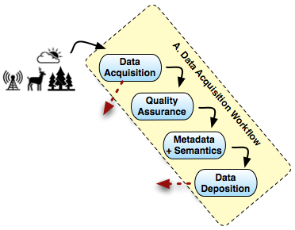
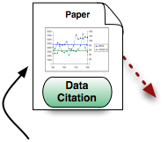
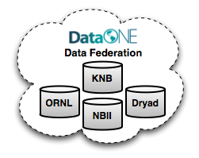
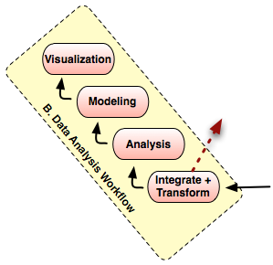
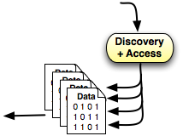
NCEAS’ model for Open Science
From Reichman, Jones, and Schildhauer;
doi:10.1126/science.1197962

Slide 4
Diverse Analysis and Modeling
Wide variety of analyses used in ecology and environmental sciences
Statistical analyses and trends
Rule-based models
Dynamic models (e.g., continuous time)
Individual-based models (agent-based)
many others
Implemented in many frameworks
implementations are black-boxes
learning curves can be steep
difficult to couple models

Slide 5
Common practices
Tedious, manual preparation of input data
Poor documentation of processing steps
No accepted way to publish/share exact methodological steps
Code itself is difficult to understand at a glance
Tedious, manual plotting & extraction of results
In and out of different software programs
Use most familiar tools rather than best tools
Reinventing the wheel even for common tasks
No plan for revising and/or redoing analyses
No accepted way to publish models to share with colleagues
Difficult to use multiple computers for one analysis/model
Only a few experts use grid computing

Slide 6
Reproducible Science
Analytical transparency
open systems
works across analysis packages
documents algorithms completely
Automated analysis for repeatability
must be scriptable
must be able to handle data dynamically
Archived and shared analysis and model runs

Slide 7
Informal written workflow
Open my_important_data.xls in Excel
create a pivot table using ...
Import the result into a stats package
select from menus, check some boxes, click run to “do some statistics”
Bring the data and some stats output into graphics software
create some plots
...
We can (and will) do better than this – but it’s a start!

Slide 8
Models as ‘scientific workflows’
Current analytical practices are difficult to manage
Model the steps used by researchers during analysis
Graphical model of flow of data among processing steps
Each step often occurs in different software
Matlab, R, SAS, C/C++, Fortran, Swarm, ...
Each component can ‘wrap’ external systems, presenting a unified view
Refer to these graphs as ‘Scientific Workflows’
Data
Clean
Analyze
/Model
Graph

Slide 9
Scientific workflows
What are scientific workflows?
Graphical model of data flow among processing steps
Inputs and Outputs of components are precisely defined
Components are modular and reusable
Flow of data controlled by a separate execution model
Support for hierarchical models
Source
(e.g., data)
Processor
(e.g., regression)
Sink
(e.g., display)
A
B
B
C
A’
D
E
F

Slide 10
Workflow parts
Description of:
all inputs
all procedural steps (i.e., operations)
what flows out of one step, into the next
intermediate outputs and inputs
required order of operations
all outputs
The (top-level) workflow itself focuses on what actions, not how

Slide 11
Benefits of SWFs
Why go to the bother of creating a scripted workflow (or even one using dedicated SWF software, as we’ll see later)?

Slide 12

Executability

Slide 13

Repeatability
Notes:
You can do it again – it is not destructive, not one-off
You can apply exact same procedural steps to a different inputs and/or parameters, producing new results
You can regenerate your results, so in principle, the results themselves are not so precious!

Slide 14
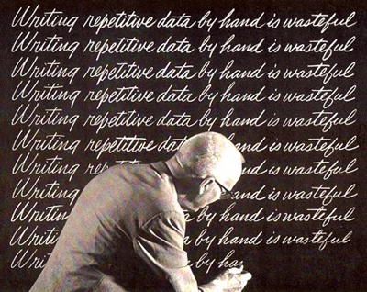
Replicability
Notes:
Given the same inputs and parameters, repeated wf execution should yield the same outputs
Permits verifiability

Slide 15
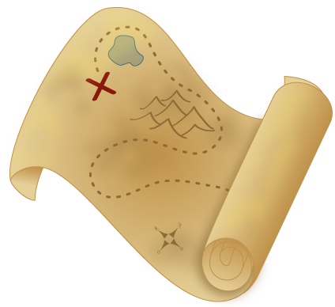
Reproducibility
Notes:
Fine for now to consider this a synonym of replicability
In the lit, often means *someone else* doing the replicating
Tends to be used more broadly to an independent carrying out of the whole sci process, testing whether the same scientific findings emerge (not the same as strict replicability)
See: Replicability is not reproducibility: Nor is it good science Chris Drummond (2009) In Proceedings of the Twenty-Sixth International Conference on Machine Learning: Workshop on Evaluation Methods for Machine Learning IV

Slide 16
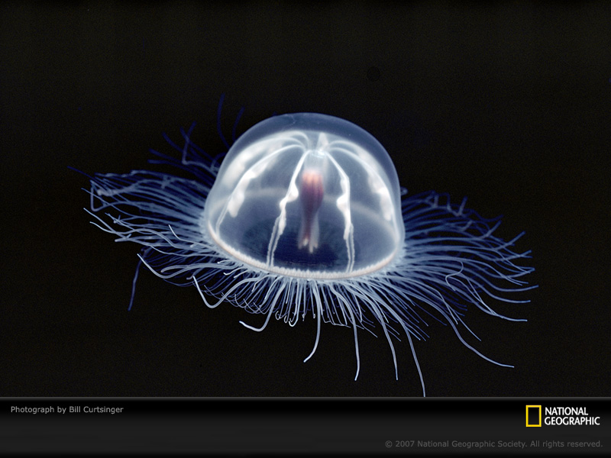
Transparency

Slide 17
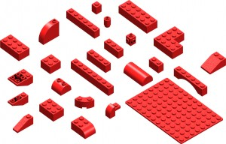
Modularity
Notes:
Easily swap algorithms, implementations, etc as needed
Requires separation of interface from implementation
- interface: what goes in, what goes out, *what* happens in the middle
- implementation: *how* it happens
(Note: being transparent doesn't mean we want all the guts on the outside!)

Slide 18
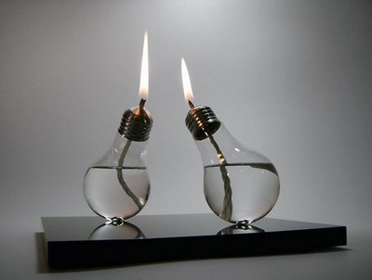
Reusability
Notes:
Repurpose components for other (sometimes unanticipated!) uses

Slide 19

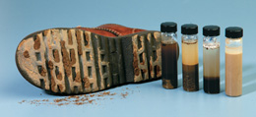
Provenance
Notes:
"able to follow data throughout entire life cycle (collection, organization & quality control, analyses, visualization)"
documenting origins of data and tracing it’s movement through different processing steps”

Slide 20
Recap
Executability
Repeatability
Replicability
Reproducibility
Transparency
Modularity
Reusability
Provenance

Slide 21
Descriptive workflows
Workflow as an organizational construct
formalized way of thinking about, and describing, an end-to-end analytical process
Notes:
We’ve mostly been discussing workflows as a concept, a way of approaching a complete analytical task an organizing the way we think about it.

Slide 22
Scientific workflows
Workflow as instance
The workflow is the process!
Two major approaches
Scripted workflows
in R, or Python, or bash, or ...
Dedicated workflow engines
Kepler and others
Let’s focus on this for a while
Notes:
But in the computer, we can create workflow instances, each of which is the complete and self-contained expression of some end-to-end analysis.

Slide 23
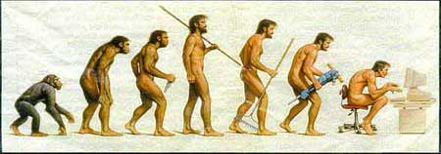
Evolution of a scripted workflow

Slide 24
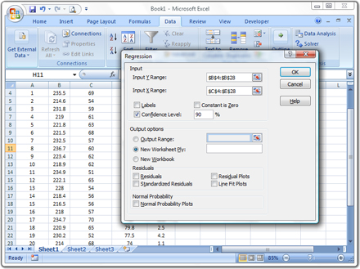

Don’t monkey around

Slide 25

“Notes”
Careful prose (if you must)
Pseudocode
Actual code snippets
reading in data
validating, shaping data
exploratory analyses
writing out results
creating visualizations

Slide 26

“Outline”
Notice and organize sections
Add some inline comments
Add an "abstract" at the top
what it does ... for what purpose
using what inputs
subject to what dependencies and usage notes
producing what outputs
with what caveats ... and noting any to-dos
written by whom, and when
Notes:
Start to put your snippets in order

Slide 27

End-to-end script
Let’s specifically think of runnable scripts
A complete narrative
read specified inputs
do something important
create desired outputs
Runs without intervention from start to finish
can thus be run in “batch” mode
this means we can automate
This is a big achievement!
Notes:
Start to put your snippets in order

Slide 28
A high-level R script
# R script that simulates bird fitness in
# different habitat types and [...]
source(“sim-functions.R”) # load my functions
# read in raw bird data
birds <- read.csv(“birds.csv”)
# clean up the data
birds.clean <- clean(birds)
# run two different simulation models
sim1 <- simFitness(birds.clean, habitat=“field”)
sim2 <- simFitness(birds.clean, habitat=“forest”)
# save the results as CSV
write.csv(sim1, file=“sim-field.csv”)
write.csv(sim2, file=“sim-forest.csv”)
What is this all about?

Slide 29
Manage complexity
What happens when our script gets long?
abstraction
componentization
modularity
Notes:
Start to put your snippets in order

Slide 30
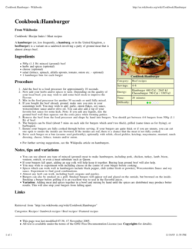
Abstraction
Occasionally we really do care about all the details
But in the big picture,
“Make 8 turkey burgers”
will do just fine
# or as we might say in R
dinner <- make.burgers(n=8, meat=“turkey”)

Slide 31
Functionalize!
Function name as the what
…and function definition as the how
Encapsulate the details
Enables you to abstract away details
Enables reuse (also: DRY principle)
Expose flexibility via parameters

Slide 32

A high-level script
Highlights the inputs
Highlights what is done to them
main sequence of steps
the main operational logic
not so much the how
Specifies parameters of the what
Highlights the outputs
Communicates a transparent workflow
stick complex logic in functions

Slide 33
Other best practices
Keep “raw” data separate
Don't modify actual data
All modifications in code
Use version control
[Write tests for custom functions]

Slide 34
More benefits of dedicated workflow systems
Multiple computation “engines”
Revision history; execution history
Embedded documentation
Distinguish data vs parameters vs constants
Dynamic reporting
Workflow itself can be stored & shared
script files
workflow software files/archives

Slide 35
Exercise
Break into GP groups
Try to construct your workflow
Flow diagram + supporting text
Each node represents a ‘step’
Each connecting edge represents data flow
Identify major gaps in your reconstruction
What parts aren’t clear?
What parts simply aren’t described?
Are there different kinds of data flowing?

Slide 36
Questions?
Contact:
Matt Jones <jones@nceas.ucsb.edu>
Jim Regetz <regetz@nceas.ucsb.edu>
Links
http://www.nceas.ucsb.edu/ecoinfo/
http://kepler-project.org/

