Slide 1
California Drought: How bad is it?
Vicken Hillis, mirela Tulbure, Debora drucker, Antonio Peréz, sara varela, sparkle malone, tim assal, paul selmants, leah bremer
Notes:
Line or two about MPB ecology… then go into tree mortality….

Slide 2
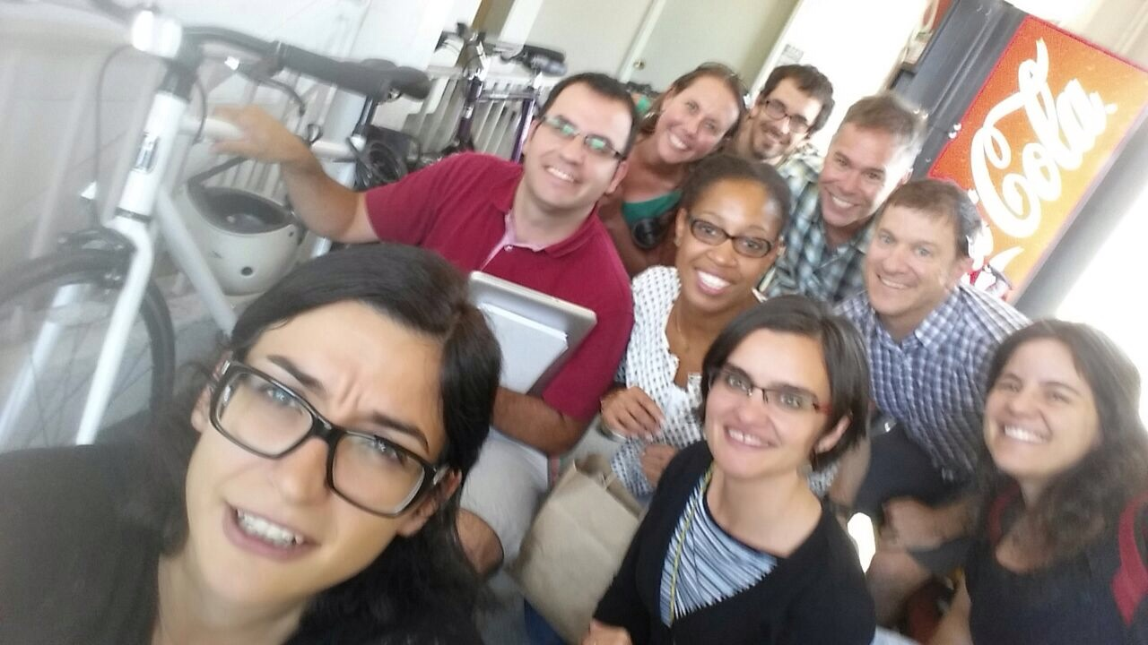
¿Qué tan malo es el drought?

Slide 3
Message Box
Problem
The entire state of California is in severe to exceptional drought
Benefits
Inform future planning
Issue
Is California's water bubble about to burst?
So What?
50% of U.S. fruit
is produced in CA
Drought can seriously impact C emissions
Solutions
Provide information to managers/ policy members (e.g. to improve water management, land use change)

Slide 4
Research Questions
1. What are the spatial and temporal dynamics of the current drought?
2. What are the impacts of drought on ecosystem services?
Water
Carbon
Agricultural production
3. Are natural systems more resilient than agricultural systems to drought?

Slide 5
What’s been done?
Most severe of all 20th century hazards (Mishra & Singh 2010)
Climate change and increasing water demand make it worse
Millennium drought (2000-2004) in Western U.S (Schwalm et al. 2012, Nature Geoscience)
Reduced annual CO2 uptake by 51%
Reductions in crop yield and stream flow
Grasslands, followed by forest and savanna most sensitive
California (Howitt et al. 2014)
Modeled effects of drought on crop yield and estimates of changes in GW (based on surveys)
No empirical data, no carbon
Notes:
** did not include agricultural systems

Slide 6
Data Acquisition
Data Analysis
Products
Questions
Long term frequency and Intensity of Drought
How bad is the current drought?
PDSI
Trends Analysis
Rain/Runoff
Reservoir Storage
Ecosystem Sensitivity Analysis (Linear)
How much has C sink strength been reduced by the current drought?
MODIS GPP
MODIS NPP
Model/Validate R_{eco}
Times Series Plots:
PDSI
Runoff
Reservoir Storage
GPP
NPP
Reco
MODIS EVI
Flux Data
Are natural ecosystems more resilient than agricultural ecosystems?
LST
Quantify Differences Between Ecosystems
Land Cover Type
Time Series Analysis
Manuscript
Crop Yield

Slide 7
Statistical Message Box
Question
How does drought influence H₂O and CO₂ dynamics in natural and Agricultural systems?
Data
-PDSI (Drought)
-GPP (C)
-Run off (H₂0)
-Reservoir Storage
-Crop Yield
-Land cover/Ecosystem type
-Flux data
-EVI
-LST
Hypothesis
Drought will decrease ecosystem services
Agricultural systems will appear more resilient than natural ecosystems
Assumptions
PDSI is a good indicator of drought
MODIS data can capture changes in productivity
Methods
-Trend Analysis (Drought, CO₂, Crop Yield)
-Model R_{eco} (Flux & MODIS)
-Quantify differences in Ecosystem productivity and CO₂ sequestration

Slide 8
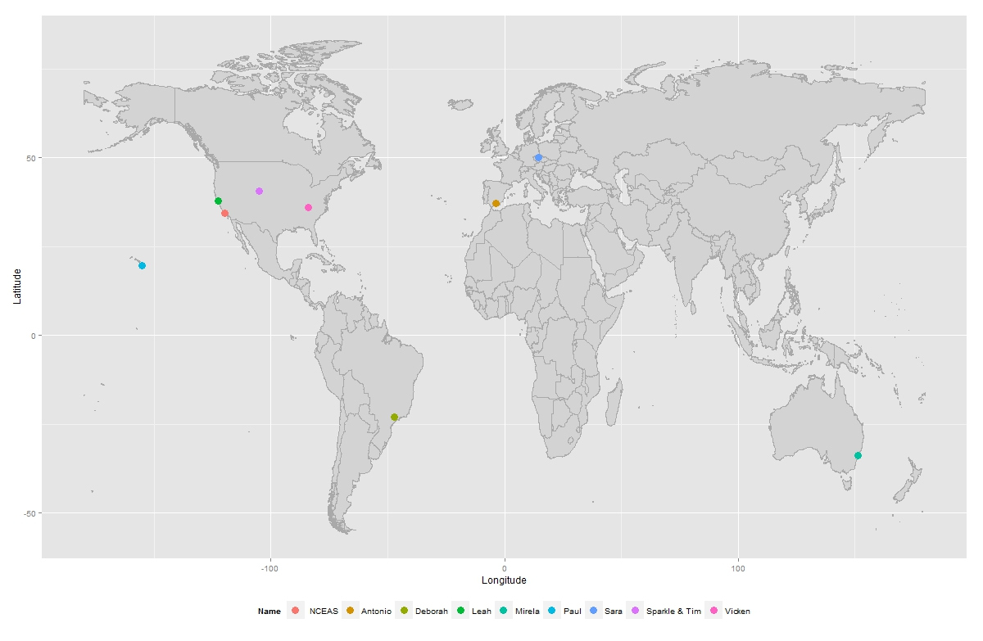
Where in the world are we?

Slide 9
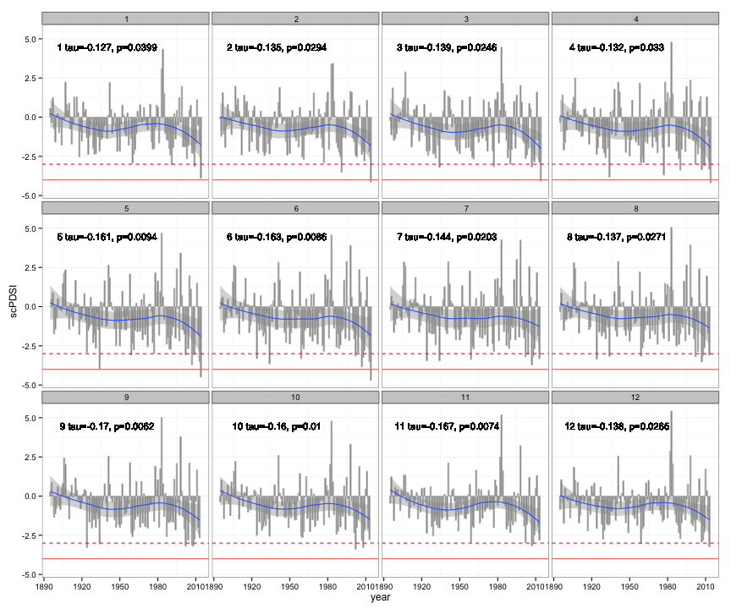
Palmer Drought Severity Index (PDSI)

Slide 10
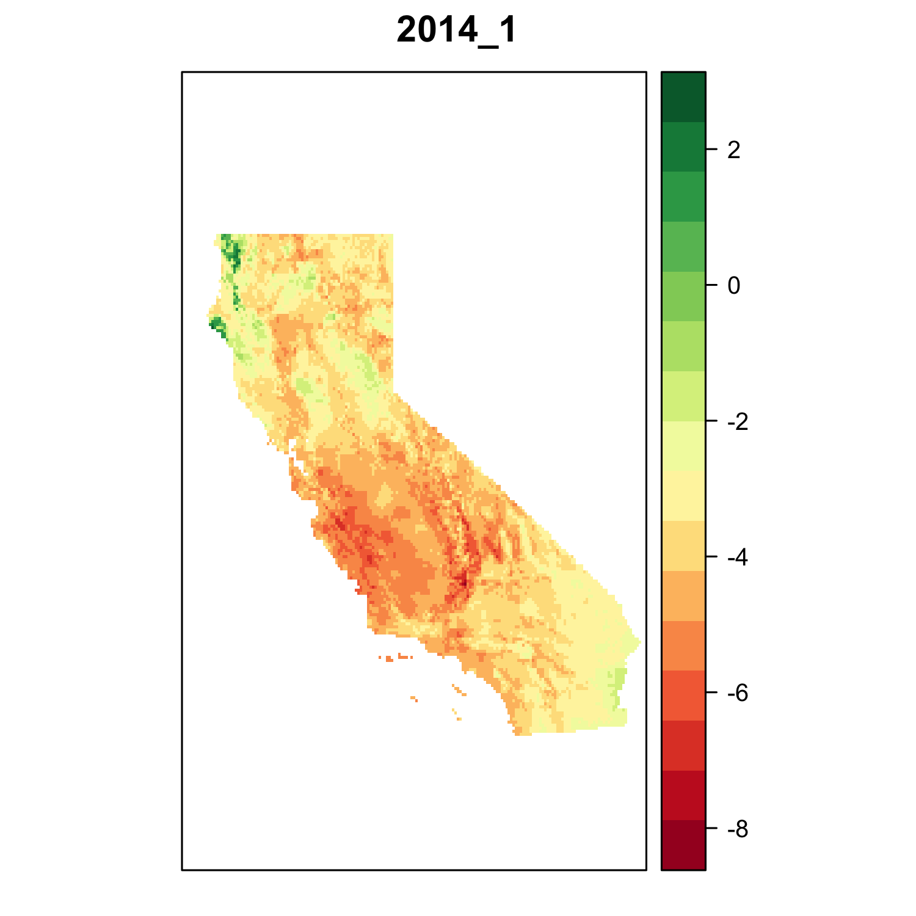
PDSI
http://vimeo.com/102880074

Slide 11
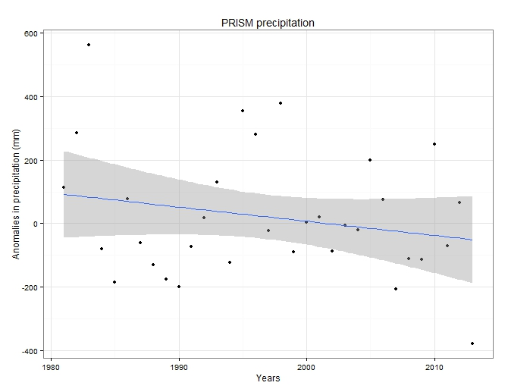
Precipitation

Slide 12
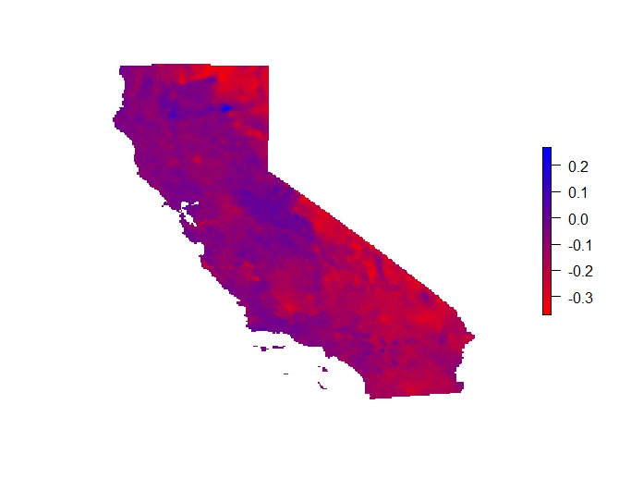
Precipitation
Notes:
1981-2013

Slide 13
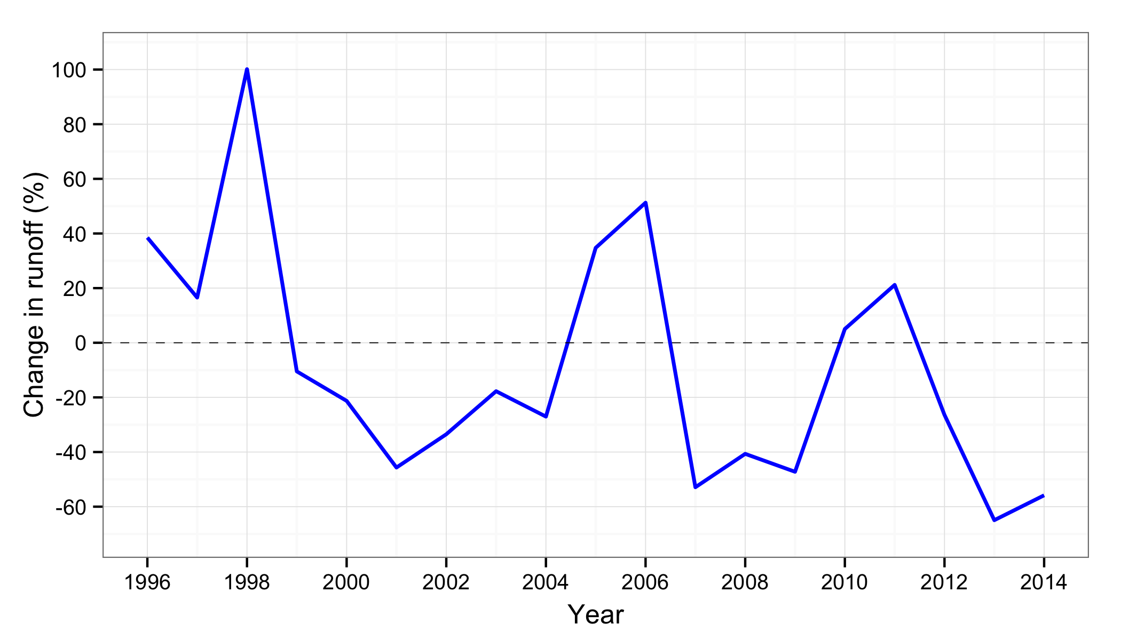
Stream Water Runoff

Slide 14
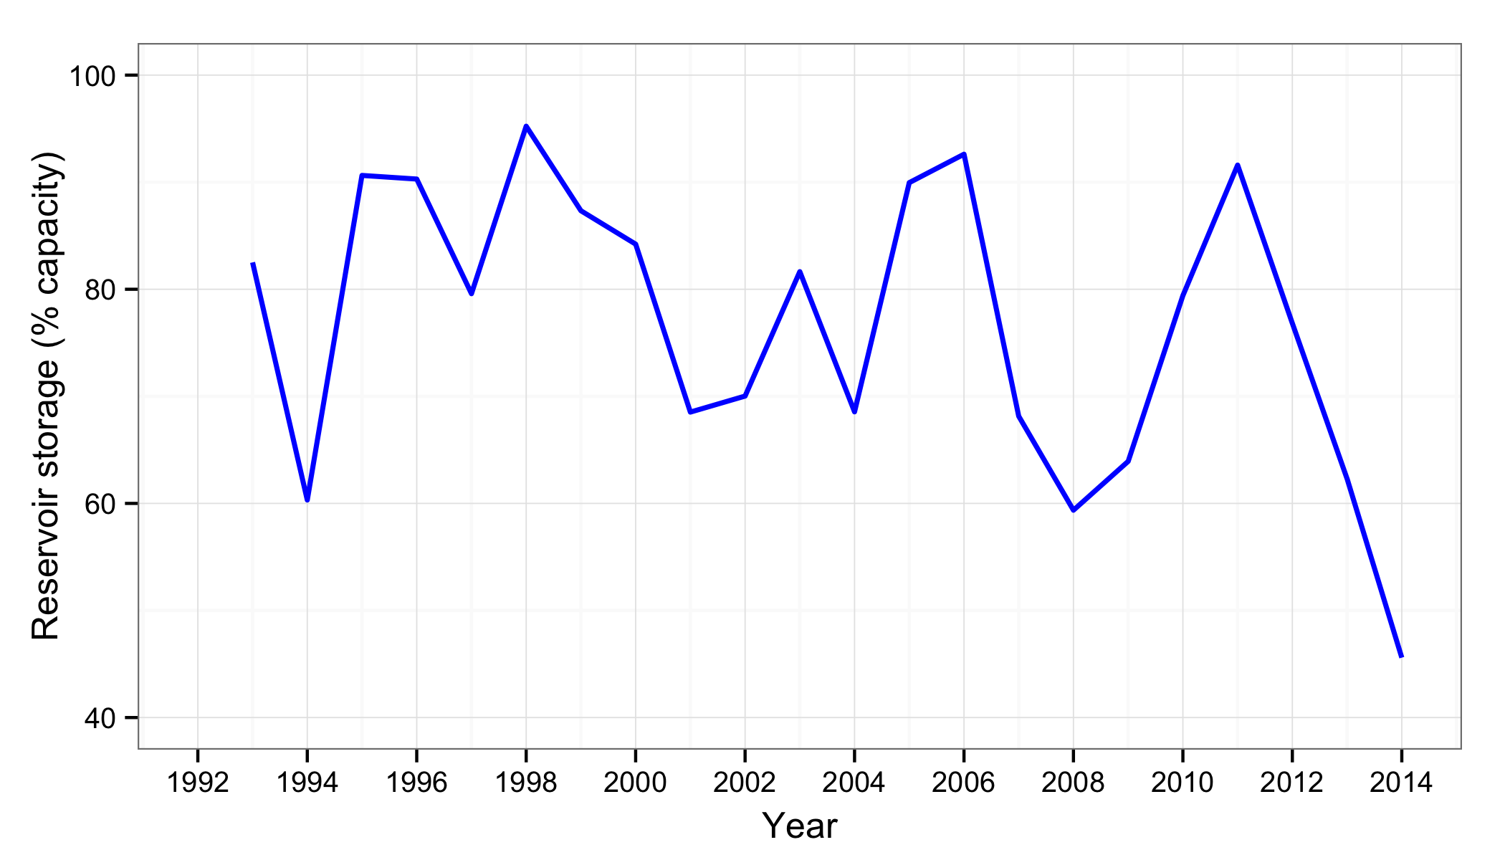
Reservoir storage

Slide 15
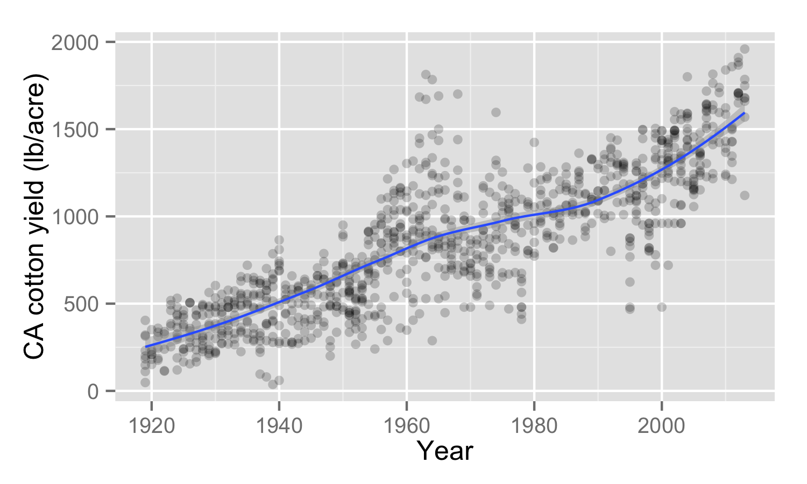
Crop Yield

Slide 16
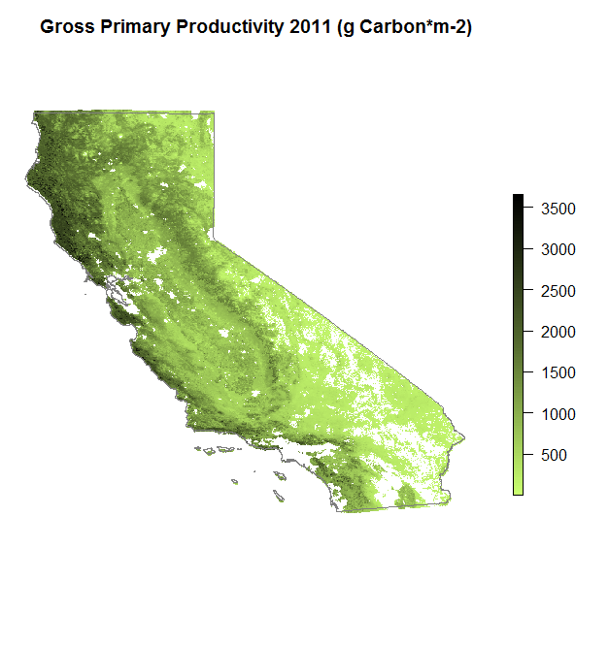
Carbon sink strength
2011 – NPP ( 638 Tg C y-1)

Slide 17
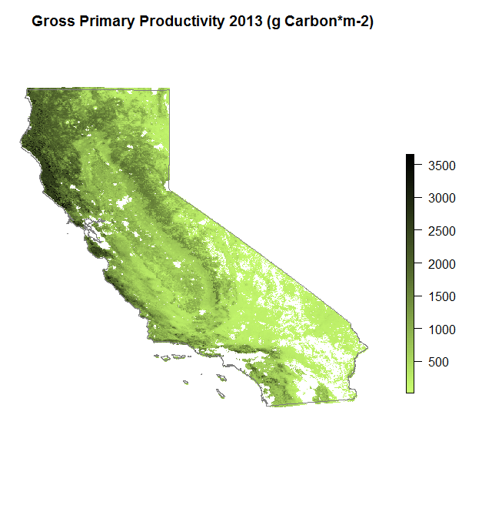
Carbon sink strength
2013 – NPP (617 Tg C y-1)

Slide 18
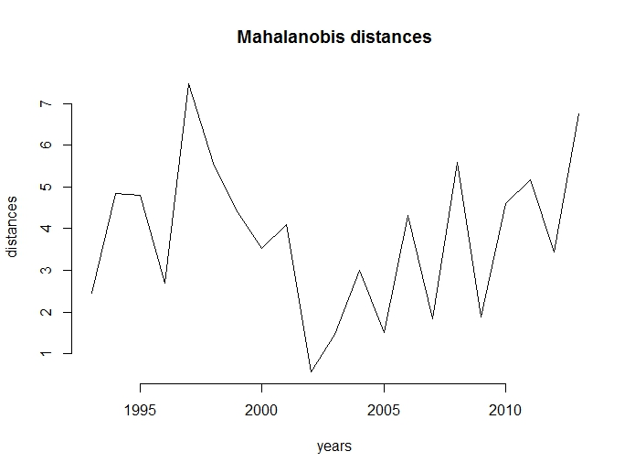
It’s a weird year!

Slide 19
Data Acquisition
Data Analysis
Products
Questions
Long term frequency and Intensity of Drought
How bad is the current drought?
PDSI
Trends Analysis
Rain/Runoff
Reservoir Storage
Ecosystem Sensitivity Analysis (Linear)
How much has C sink strength been reduced by the current drought?
MODIS GPP
MODIS NPP
Model/Validate R_{eco}
Times Series Plots:
PDSI
Runoff
Reservoir Storage
GPP
NPP
Reco
MODIS EVI
Flux Data
Are natural ecosystems more resilient than agricultural ecosystems?
LST
Quantify Differences Between Ecosystems
Land Cover Type
Time Series Analysis
Manuscript
Crop Yield

Slide 20
Our ultimate goal
Science or nature paper without signing away the copy right!
BAM!!

Slide 21
Thank you!
Mahalo!
Obrigada!
Gracias!
Multumesc!

