Slide 1
Open Source
Ray Idaszak
RENCI
Open Science for Synthesis Training
August 07, 2014

Slide 2
Common View of Open Source
Universal free access to software
Free to use, copy, distribute, change by anyone
Open source licenses typically require that source code be made available with software
Though software itself is not always free

Slide 3
Common View of Open Source
Examples of open source software
Linux operating system
Firefox web browser
Python programming/scripting language
Rstudio integrated development environment for R

Slide 4
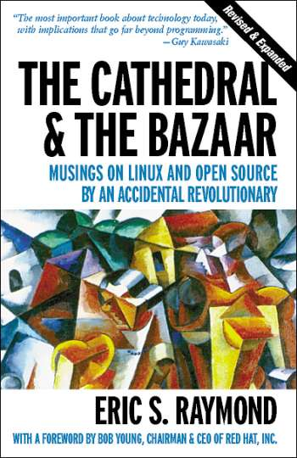
The Cathedral and the Bazaar
“Cathedral Model” of Open Source
GCC
“Bazaar Model” of Open Source
Linux
Fetchmail
Book anatomizes a successful open-source project, fetchmail, that was run as a deliberate test of the surprising theories about software engineering suggested by the history of Linux.
http://www.firstmonday.dk/ojs/index.php/fm/article/view/1472/1387

Slide 5
The Cathedral and the Bazaar
Some of the 19 Lessons Learned from open source development of fetchmail
Good programmers know what to write. Great ones know what to rewrite (and reuse) for modification or access by anyone
Plan to throw one [version] away; you will, anyhow. (Copied from Frederick Brooks “The Mythical Man Month”)
Treating your users as co-developers is your least-hassle route to rapid code improvement and effective debugging.
Release early. Release often. And listen to your customers.
Notes:
2. While I don't claim to be a great programmer, I try to imitate one. An important trait of the great ones is constructive laziness. They know that you get an A not for effort but for results, and that it's almost always easier to start from a good partial solution than from nothing at all.
3. Or, to put it another way, you often don't really understand the problem until after the first time you implement a solution. The second time, maybe you know enough to do it right. So if you want to get it right, be ready to start over at least once.
6. “Linus' cleverest and most consequential hack was not the construction of the Linux kernel but rather his invention of the Linux development model.”
7. Linus Torvalds's model that is opposite of the Cathedral model. Linus was keeping his hacker/users constantly stimulated and rewarded - stimulated by the prospect of having an ego-satisfying piece of the action, rewarded by the sight of constant (even daily) improvement in their work.

Slide 6
The Cathedral and the Bazaar (con’t)
Some of the 19 Lessons Learned from open source development of fetchmail
Given a large enough beta-tester and co-developer base, almost every problem will be characterized quickly and the fix obvious to someone.
The next best thing to having good ideas is recognizing good ideas from your users. Sometimes the latter is better.
Often, the most striking and innovative solutions come from realizing that your concept of the problem was wrong.
Notes:
8. Or, less formally, "Given enough eyeballs, all bugs are shallow.“ Linus stated that the person who understands and fixes the problem is not
necessarily or even usually the person who first characterizes it.
11.
12. When you hit a wall in development - when you find yourself hard put to think past the next patch - it's often time to ask not whether you've got the right answer, but whether you're asking the right question. Perhaps the problem needs to be reframed.

Slide 7
Open Source
Users
Contributors
Value
Software
It Works.
Notes:
You’ve either heard or will hear about this community amplification effect of Open Source. If implement and operating to its fullest, open source facilitates an ever increasing number of contributors to code that has ever increasing value to ever increasing numbers of users.
So if there is one thing you’ll hear today, it’s that Open Source works.
e.g. There are lots of contributors to linux, even more users.

Slide 8
Open Source
Users
Contributors
Value
? Thing ?
Do open source mechanics work for things other than software?

Slide 9
Related to Open Source
Open Source principles used in, or related to:
Crowdsource
Open Innovation
Open Hardware
Open Research
Open Data
Notes:
http://en.wikipedia.org/wiki/Crowdsourcing
http://en.wikipedia.org/wiki/Open_innovation
http://en.wikipedia.org/wiki/Open_source_hardware
http://en.wikipedia.org/wiki/Open_research
http://en.wikipedia.org/wiki/Open_data

Slide 10
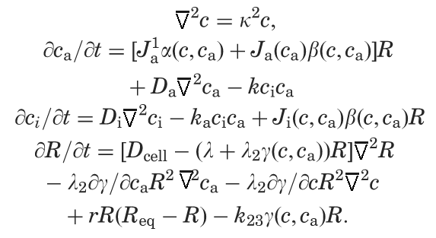
Open Source Math
Polymath
Notes:
<Discuss Polymath>
Tim Gowers, a math professor at Cambridge
In Jan 2009 he used his blog to post a difficult unsolved math problem
It started somewhat slowly, but after 6 weeks and 800 posts, the problem was solved along with a special case
And since then there have been similar Polymath-like endeavors.
Emphasize approach used was open blog with goal.

Slide 11
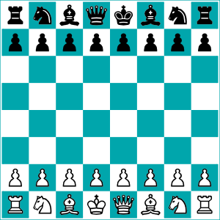
Open Source Chess
1999: Garry Kasparov vs. “The World”
Notes:
1999, world chess champion Garry Kasparov played a game of chess agains “The World”
Organized by Microsoft, anyone could go to the game website and vote on what move should be taken next
On a typical move, more than 5000 people voted
Over the entire game, more than 50,000 people from 75 countries voted
The world team decided a new move every 24 hours; move taken was the one that got the most votes
Kasparov won after 62 moves.
But the point was that the average quality of player was far below Kasparov, yet collectively the world team played a far stronger game than any of the individuals normally would
Kasparov commented that he expended more energy on this game than any other in his career, including all his world championship games.
Emphasize that method used was votes.

Slide 12
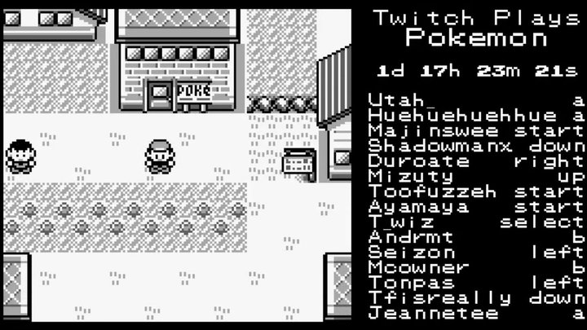
Twitch Plays Pokémon
http://www.polygon.com/2014/2/14/5411790/twitch-plays-pokemon-creator-interview-twitchplayspokemon
http://en.wikipedia.org/wiki/Twitch_Plays_Pok%C3%A9mon
Notes:
A massively multiplayer online co-op version of Pokémon that lets you play Pokemon collaboratively with a lot of other people by typing commands into chat.
While chat users can type whatever they want into the channel's chat, the software that powers Twitch Plays Pokémon only parses a handful of commands: up, down, left, right, select, start, a and b, the inputs of the original Game Boy.

Slide 13
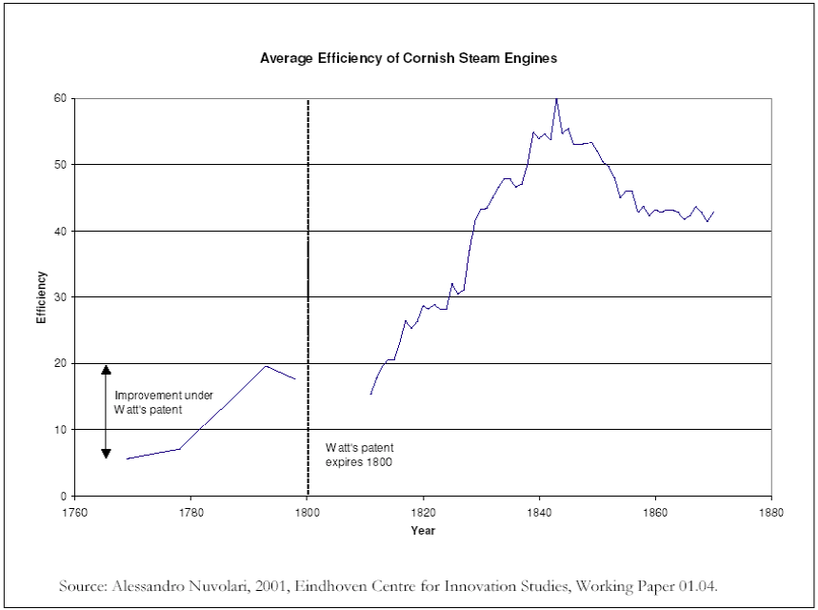
Open Steam Engine
Cornish Pumping (Steam) Engine
Notes:
An example of “collective invention”
James Watt improves upon the Newcomen steam engine in 1769 and later patents it.
The patent runs out in 1800, and the efficiency greatly improves
Shows that open better than closed for innovation
http://ojphi.org/ojs/index.php/fm/article/view/1284/1204

Slide 14
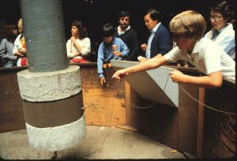

How Open Source Principles Amplify Properly Coordinated Inputs
A finite Software Institute staff with properly coordinated inputs into the community can amplify its actions by moving together and coordinating actions.
“Most importantly, and this is a key idea: lots of little ideas, if permitted to freely combine, can themselves be understood to be a really great idea.”
WHAT OPEN SOURCE ACCOMPLISHES FOR SOFTWARE, OCEP ACCOMPLISHES FOR RESEARCH.
Michael Tiemann, Amplifying creativity and business performance with open source, Feb 16, 2010, http://opensource.com/business/10/2/amplifying-creativity-and-business-performance-open-source
Michael Tiemann, VP Open Source Affairs at RedHat
and WSSI Advisory Board Member
Notes:
Emphasize open source amplification principle.

Slide 15
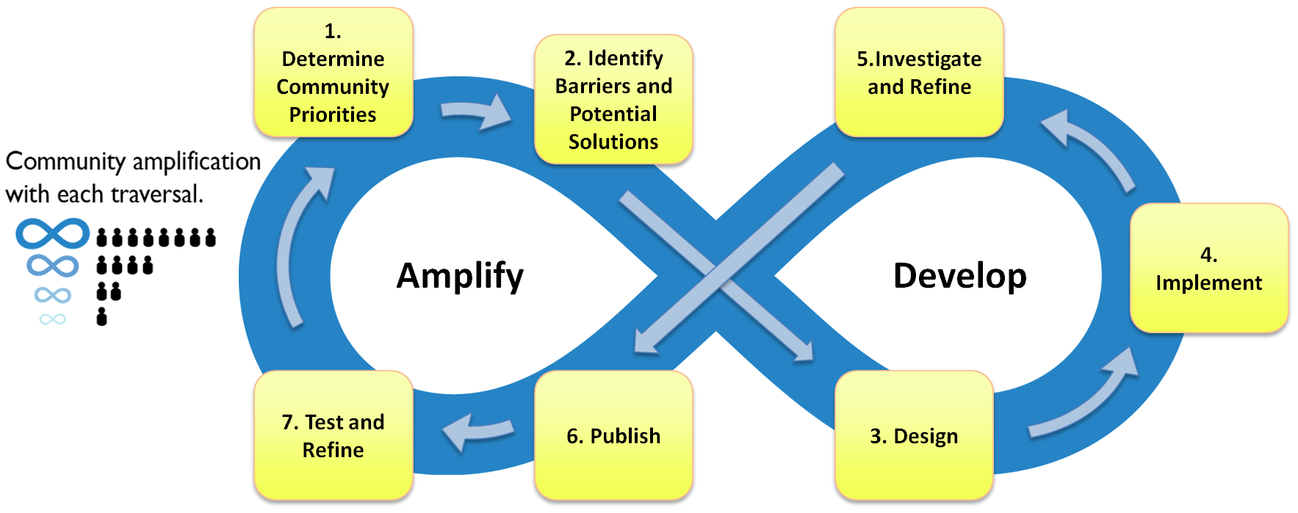
http://dx.doi.org/10.1109/MCSE.2014.5
Open Community Engagement Process
(OCEP)
Notes:
An Open Community Engagement Process (OCEP) applies open source mechanics and software engineering to water science research. This article describes the OCEP open source community amplification principle as well as the authors' experiences, lessons learned, and challenges with operationalizing OCEP.

Slide 16
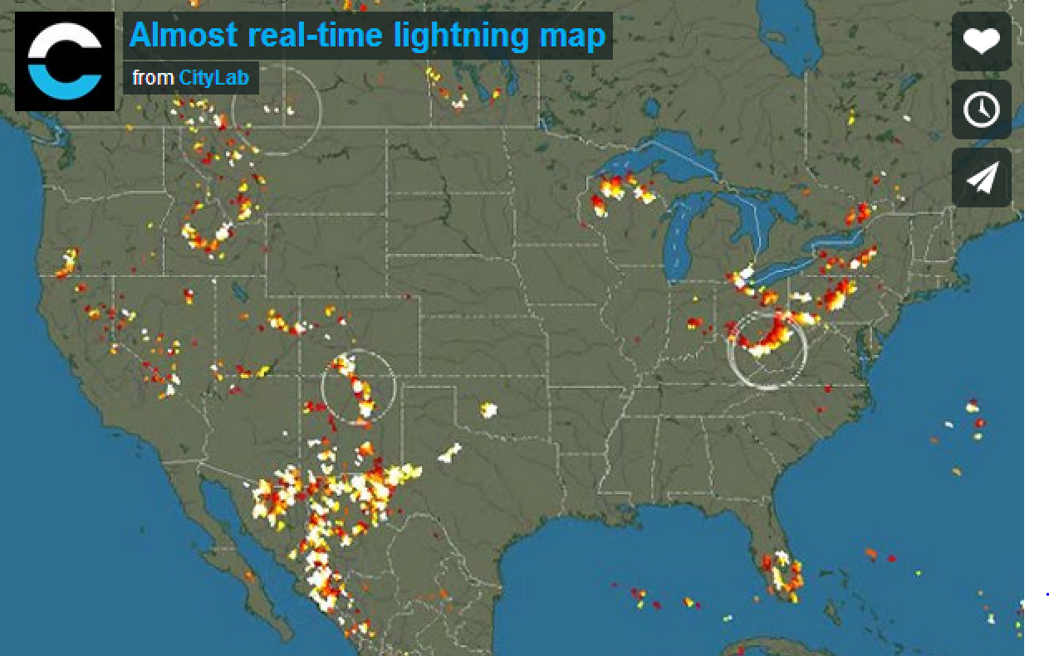
Crowdsourcing Lightning Strikes
http://www.citylab.com/weather/2014/07/crowdsourcing-lightning-strikes-actually-works-pretty-well/375359/
Notes:
A group using low-priced lightning detectors to crowd-source foul weather, including real-time lightning strikes shown on the map.
Almost 800 participants participating internationally.
Each strike is color-coded to show when it happened, with white being newest (within 20 minutes) and red oldest (at least two hours ago).

Slide 17
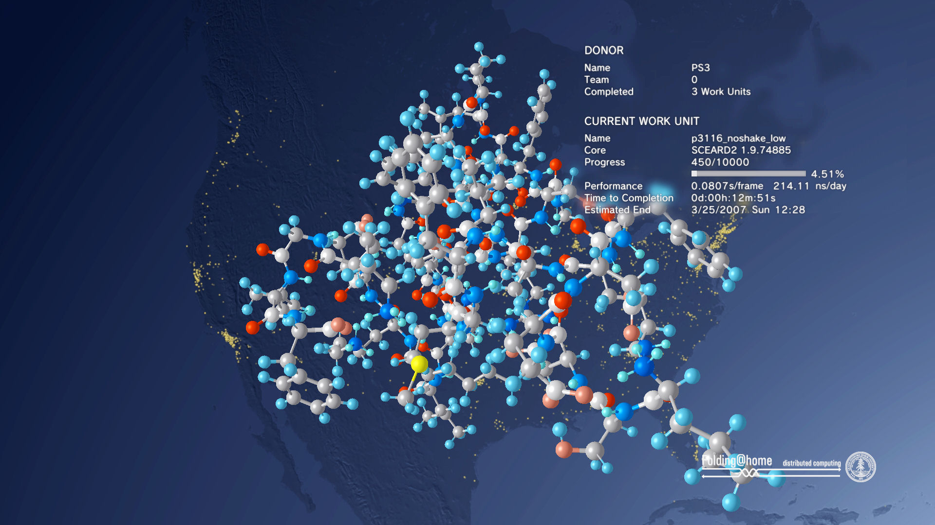
Folding@HOME
http://folding.stanford.edu/
http://www.crowdsourcing.org/site/foldinghome/foldingstanfordedu/3975
Notes:
Folding@home is a distributed computing project run out of Stanford, people from throughout the world download and run software to band together to make one of the largest supercomputers in the world. Think of it as crowdsourcing computing.
Helps scientists studying Alzheimer's, Huntington's, Parkinson's, and many cancers by simply running a piece of software on your computer.
About 174,000 people around the world participating.

Slide 18
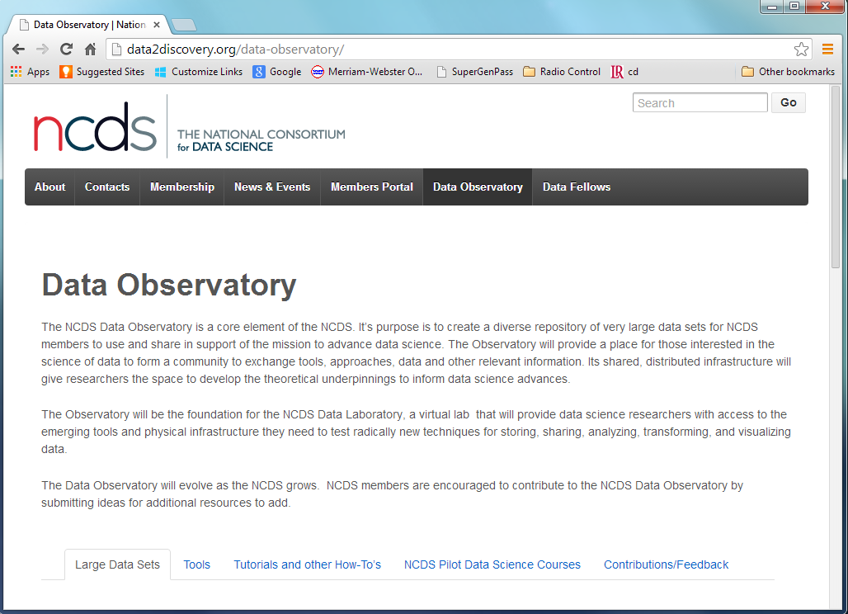
NCDS
Open Data
http://data2discovery.org/data-observatory/
Notes:
The NCDS Data Observatory is a core element of the NCDS. It’s purpose is to create a diverse repository of very large data sets for NCDS members to use and share in support of the mission to advance data science.

Slide 19
Open Data: Data Citation and Attribution
When to publish your data?
Onset of project
After you’ve published one or more initial papers referencing the data?
Never – always hold data “close to the vest?”
Incentives, culture
How do we affect culture change so that data citation and attribution leads to one’s tenure and promotion?
How do we facilitate peer-review of data?
Infrastructure to publish data
Is open data infrastructure conducive to protecting and promoting proper citation?
Notes:
Transparent, user-friendly way

Slide 20
Take Aways
Open Source mechanics works for more than just software, and with a variety of approaches
Math, Chess, Steam Engines
Data, Research, Weather
Amplification Effect: Create an open framework where lots of little ideas and inputs can freely combine into one, or more, greater ideas
Innovation
Collaboration
Solutions to problems
From bug fixes to research solutions
Notes:
Transparent, user-friendly way

Slide 21
END
http://www.nsf.gov/awardsearch/showAward?AWD_ID=1216894
http://www.nsf.gov/awardsearch/showAward?AWD_ID=1216817
Notes:
http://www.nsf.gov/awardsearch/showAward?AWD_ID=1216894
http://www.nsf.gov/awardsearch/showAward?AWD_ID=1216817

