Slide 1
Overview of Data Management
W. Christopher Lenhardt
OSS Training Institute
23 July 2014

Slide 2
Goals
Why does data management matter?
What is data management?
Why is data management hard?
Present some basic notions and principles of data management
Notes:
Shift your thinking
Not trying to turn you into a data manager
You’ve gotten this far…

Slide 3
Don’t let this happen to you…
http://youtu.be/wU99CCWr77k

Slide 4
80/20 Rule
80%
20%
Notes:
80% of the work gets done in 20% of the time….
How many of you spend 80 % on data gathering, data massage, cleanup, reformatting, etc.; 20% on actual analysis??
Should be the other way around! 20% on finding, accessing, understanding, etc. and 80% on analysis…

Slide 5
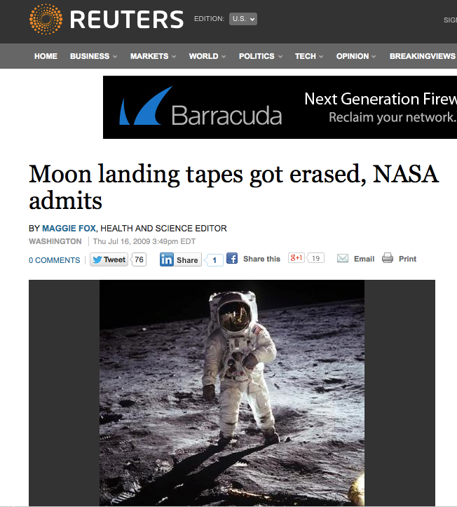
Whoops…
http://www.reuters.com/article/2009/07/16/us-nasa-tapes-idUSTRE56F5MK20090716

Slide 6
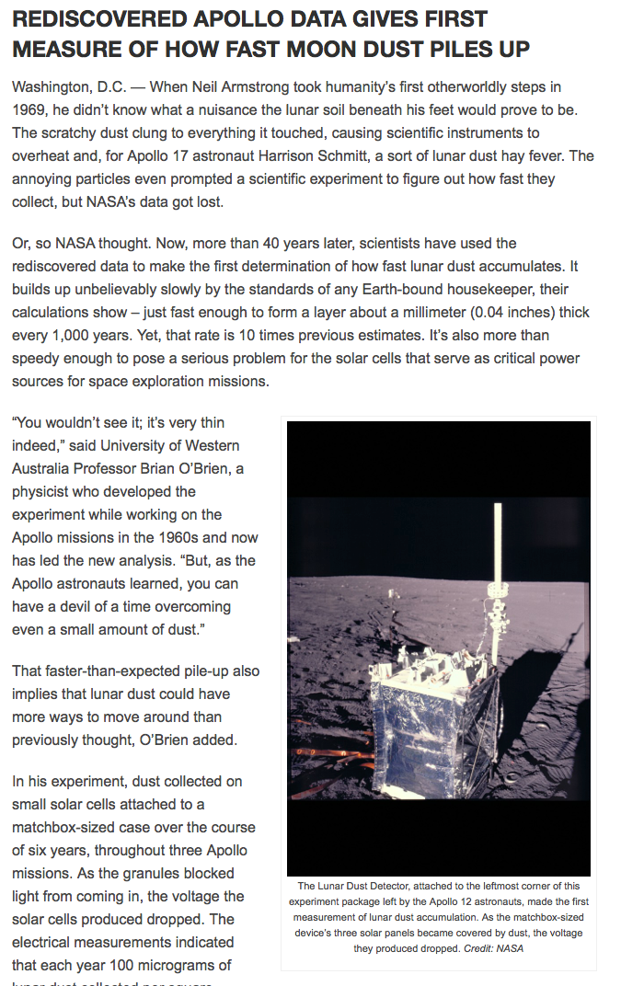
45th Anniversary on 20 July
The detectors flown on Apollo 12, 14 and 15 operated until NASA shut them off in September 1977 due to budgetary concerns. While the detectors worked properly, NASA did not preserve the archival tapes of the data they collected. For three decades NASA assumed the dust detector data had been lost forever, until 2006 when O’Brien heard about NASA’s mistake and told them he still had a set of backup copies.
Old Data, New Science
http://news.agu.org/press-release/rediscovered-apollo-data-gives-first-measure-of-how-fast-moon-dust-piles-up/
Notes:
Bad data management planning with a lucky outcome
Data can be repurposed years later to enable new science…

Slide 7

Dark Data
Source: http://cinema-fanatic.com/2010/07/05/oscar-vault-monday-raiders-of-the-lost-ark-1981-dir-steven-spielberg/
Notes:
Don’t want your data to end up unusable in a dark archive somewhere…

Slide 8
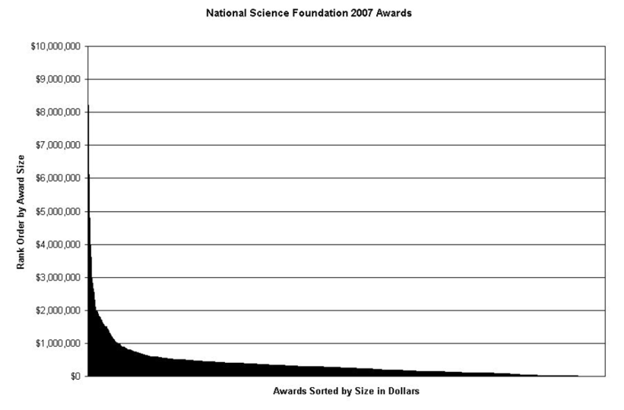
“Dark” data in the long tail
Heidorn, P. 2008. doi:10.1353/lib.0.0036

Slide 9
10 Minutes on Group Facilitation
Turn to neighbor and come up with top 3 – 5 barriers to data management
Any good data management horror stories folks care to share?
Come back and compare notes

Slide 10
Barriers to [Synthesis] Science
Data not preserved
Tiny proportion of ecological data are readily available
Dispersed, isolated repositories
Each community has its own; disconnected; underutilized
Lack of software interoperability
Metacat, DSpace, Mercury, iRODS, XMCat, OPeNDAP, ...
Heterogeneous data
Many data formats, metadata formats, and varying semantics
10
Notes:
In addition to the functional requirements and interAdditional drivers for guiding implementation.
- Scalable

Slide 11
What is Data Management?
“Data management is the process of controlling the information generated during a research project. Any research will require some level of data management, and funding agencies are increasingly requiring scholars to plan and execute good data management practices.”
Source:
http://www.libraries.psu.edu/psul/pubcur/what_is_dm.html

Slide 12
Why does it matter?
The outcome of your research depends in part on how well you manage your data. Managing data helps you as a researcher organize research files and data for easier access and analysis. It helps ensure the quality of your research. It supports the published results of your work and, in the long term, helps ensure accountability in data analysis. Effective data management practices include:
Designating the responsibilities of every individual involved in the study.
Determining how data will be stored and backed up.
Implementing the data management plan.
Deciding how data will be dealt with through each modification of the study.
Source: http://www.libraries.psu.edu/psul/pubcur/what_is_dm.html
Notes:
Integral to successful science
Crucial for reproducibility
You can get another publication/credit for new data created

Slide 13
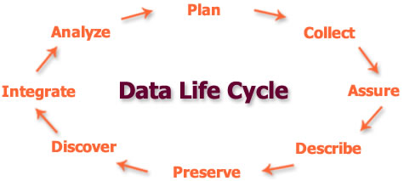
Data Management Lifecycle

Slide 14
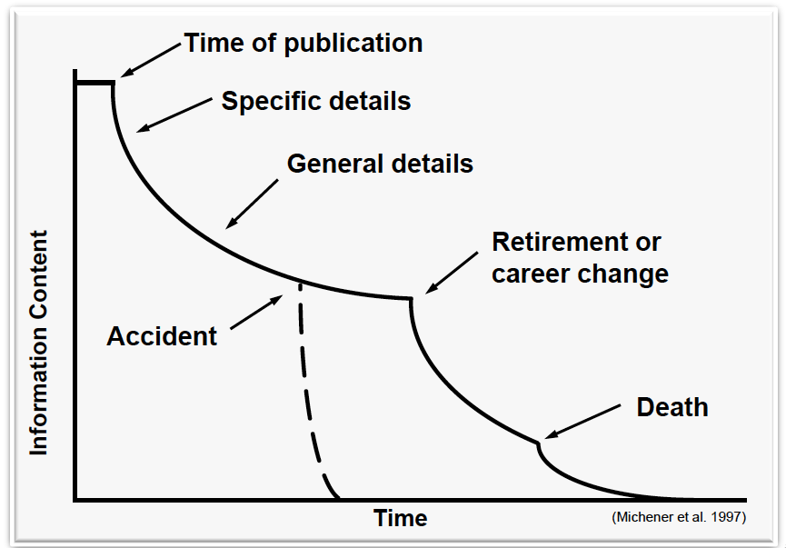
Data Entropy
Notes:
Where data management and physics collide

Slide 15


Solutions
Preserve data
Adopt standards
Create networks
Create interoperable software

Slide 16
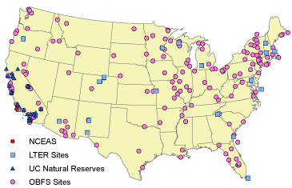
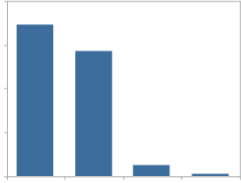
Example: Preserve data in the Knowledge Network for Biocomplexity (KNB)
Data Types
Ecological
Environmental
Demographic
Social/Legal/Economic
60
Diverse Contributors
Individual investigators
Field stations and networks
Government agencies
Non-profit partnerships
Scientific Societies
Synthesis centers
45
Data
Sizes
%
30
15
0
< 1
1-10
>200
10-200
MB
16

Slide 17
Metadata and data heterogeneity
Every community has
many data schemas
one for each project and person
many data formats
ASCII, NetCDF, HDF, GeoTiff, ...
many metadata schemas
Biological Data Profile, Darwin Core, Dublin Core, Ecological Metadata Language (EML), Open GIS schemas, ISO Schemas, ...
Accepting this heterogeneity is critical

Slide 18
A Federation of repositories
Diverse Federation == Resilience
Failover for temporary outages
Insurance against project/institutional failure
Avoid correlated failures
Diverse Federation == Scalability
Storage increases with Member Nodes
Incremental costs to each MN to replicate
Distributes sustainability costs

Slide 19




Creating Interoperability
Member Nodes (MNs)
Heart of the federation
Harness the power of local curation
Coordinating Nodes (CNs)
Services to link Member Nodes
Investigator Toolkit (ITK)
Tools for the whole data lifecycle
Interoperability

Slide 20
Member Nodes
Authoritative members of the Federation
Curate data holdings
Provide unique identifiers for each object
Ensure availability, quality, and reliability
Replicate holdings for other MNs
Provide access and access control
Log and report accesses to objects
Engage with DataONE community
Deploy a DataONE-compatible software system

Slide 21
Data Management Resources
Best Practices
DataONE, Best Practices Primer
http://www.dataone.org/sites/all/documents/DataONE_BP_Primer_020212.pdf
ESIP, Data Management Short Course for Scientists
http://commons.esipfed.org/datamanagementshortcourse
Data Management Planning
DataONE, Data Management Planning
http://www.dataone.org/data-management-planning
DataONE, Data Management Plan Tool
https://dmp.cdlib.org/

Slide 22
Top 10 Tips for Data Management
No empty cells/fields
Back up early and often
Make a copy, save original, version control
Plan
Make a data dictionary
Document as you go
Back up early and often (in the cloud?)
Address licensing/confidentiality/restricted access
Metadata, metadata, metadata
Archive/publish your data

