Slide 1

Scientific Workflows
Matthew B. Jones
National Center for Ecological Analysis and Synthesis (NCEAS)
University of California Santa Barbara
Open Science for Synthesis
July 29, 2014
Notes:
NCEAS is an NSF funded research center whose mission is to advance the state of ecological knowledge through synthetic, cross-cutting studies using existing data. Soon after NCEAS formed it became obvious that there was a large need for informatics tools that support synthetic research.

Slide 2
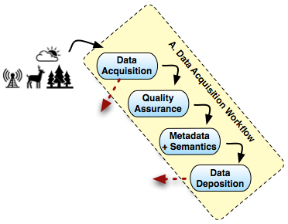
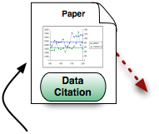
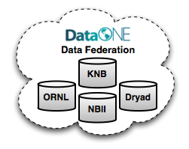
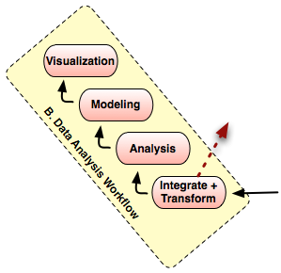
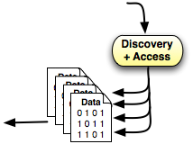
Workflows in Open Science
From Reichman, Jones, and Schildhauer;
doi:10.1126/science.1197962

Slide 3
Diverse Analysis and Modeling
Wide variety of analyses used in ecology and environmental sciences
Statistical analyses and trends
Rule-based models
Dynamic models (e.g., continuous time)
Individual-based models (agent-based)
many others
Implemented in many frameworks
implementations are black-boxes
learning curves can be steep
difficult to couple models

Slide 4
Reproducible Science
Analytical transparency
open systems
works across analysis packages
documents algorithms completely
Automated analysis for repeatability
must be scriptable
must be able to handle data dynamically
Archived and shared analysis and model runs

Slide 5
Models as ‘scientific workflows’
Current analytical practices are difficult to manage
Model the steps used by researchers during analysis
Graphical model of flow of data among processing steps
Each step often occurs in different software
Matlab, R, SAS, C/C++, Fortran, Swarm, ...
Each component can ‘wrap’ external systems, presenting a unified view
Refer to these graphs as ‘Scientific Workflows’
Data
Clean
Analyze
/Model
Graph

Slide 6
Scientific workflows
What are scientific workflows?
Graphical model of data flow among processing steps
Inputs and Outputs of components are precisely defined
Components are modular and reusable
Flow of data controlled by a separate execution model
Support for hierarchical models
Source
(e.g., data)
Processor
(e.g., regression)
Sink
(e.g., display)
A
B
B
C
A’
D
E
F

Slide 7
Benefits of SWFs
Why go to the bother of creating a scripted workflow (or even one using dedicated SWF software, as we’ll see later)?

Slide 8

Executability

Slide 9

Repeatability
It’s all about precision (or imprecision).
Notes:
You can do it again – it is not destructive, not one-off
You can apply exact same procedural steps to a different inputs and/or parameters, producing new results
You can regenerate your results, so in principle, the results themselves are not so precious!

Slide 10
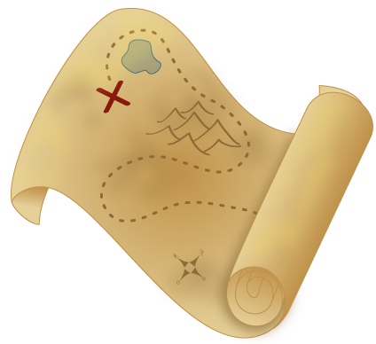
Reproducibility
Notes:
Fine for now to consider this a synonym of replicability
In the lit, often means *someone else* doing the replicating
Tends to be used more broadly to an independent carrying out of the whole sci process, testing whether the same scientific findings emerge (not the same as strict replicability)
See: Replicability is not reproducibility: Nor is it good science Chris Drummond (2009) In Proceedings of the Twenty-Sixth International Conference on Machine Learning: Workshop on Evaluation Methods for Machine Learning IV

Slide 11
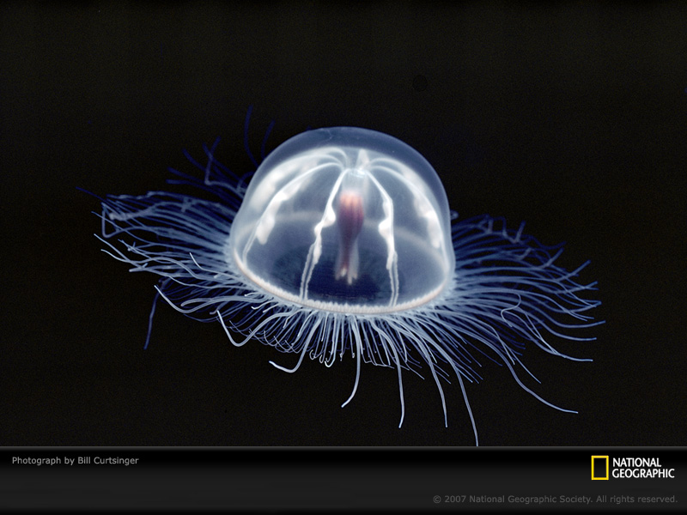
Transparency

Slide 12
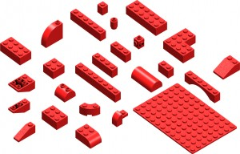
Modularity
Notes:
Easily swap algorithms, implementations, etc as needed
Requires separation of interface from implementation
- interface: what goes in, what goes out, *what* happens in the middle
- implementation: *how* it happens
(Note: being transparent doesn't mean we want all the guts on the outside!)

Slide 13

Reusability
Notes:
Repurpose components for other (sometimes unanticipated!) uses

Slide 14
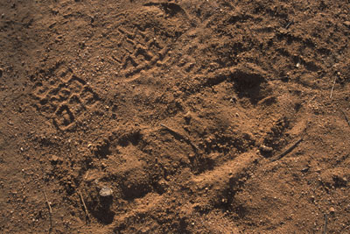
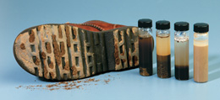
Provenance
Notes:
"able to follow data throughout entire life cycle (collection, organization & quality control, analyses, visualization)"
documenting origins of data and tracing it’s movement through different processing steps”

Slide 15
Recap
Executability
Repeatability
Reproducibility
Transparency
Modularity
Reusability
Provenance

Slide 16
Descriptive workflows
Workflow as an organizational construct
formalized way of thinking about, and describing, an end-to-end analytical process
Notes:
We’ve mostly been discussing workflows as a concept, a way of approaching a complete analytical task an organizing the way we think about it.

Slide 17
Scientific workflows
Workflow as instance
The workflow is the process!
Two major approaches
Scripted workflows
in R, or Python, or bash, or ...
Dedicated workflow engines
Kepler, VisTrails, Galaxy, and others
Notes:
But in the computer, we can create workflow instances, each of which is the complete and self-contained expression of some end-to-end analysis.

Slide 18

“Notes”
Careful prose (if you must)
Pseudocode
Actual code snippets
reading in data
validating, shaping data
exploratory analyses
writing out results
creating visualizations

Slide 19

End-to-end script
Let’s specifically think of runnable scripts
A complete narrative
read specified inputs
do something important
create desired outputs
Runs without intervention from start to finish
can thus be run in “batch” mode
this means we can automate
This is a big achievement!
Notes:
Start to put your snippets in order

Slide 20
Manage complexity
What happens when our script gets long?
abstraction
componentization
modularity
Notes:
Start to put your snippets in order

Slide 21
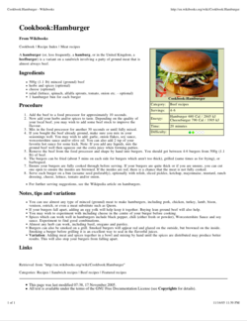
Abstraction
Occasionally we really do care about all the details
But in the big picture,
“Make 8 turkey burgers”
will do just fine
# or as we might say in R
dinner <- make.burgers(n=8, meat=“turkey”)

Slide 22
Functionalize!
Function name as the what is done
…and function definition as the how
Encapsulate the details
Enables you to abstract away details
Enables reuse
Remember DRY: Don’t Repeat Yourself
Expose flexibility via parameters

Slide 23

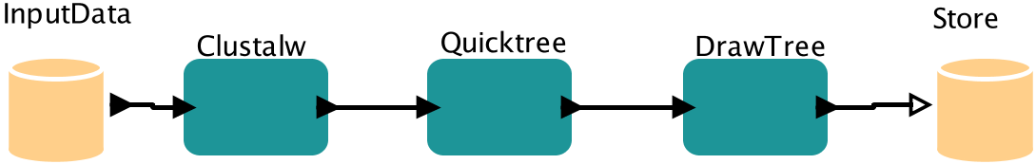
Anatomy of a Kepler Workflow
Actors
Tokens
int, string, record{..}, array[..], ..
Channels
Ports

Slide 24
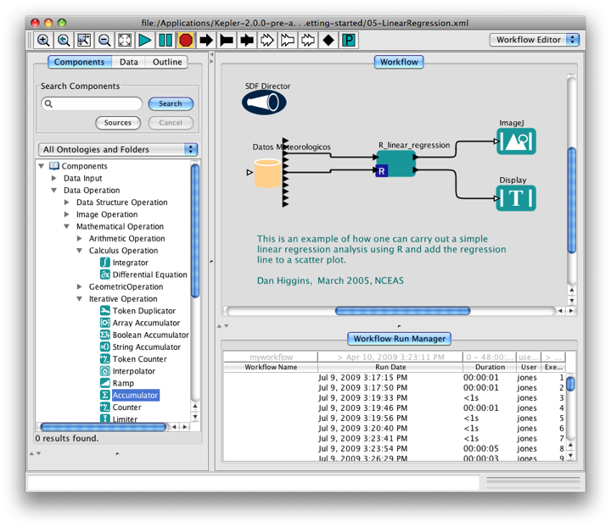
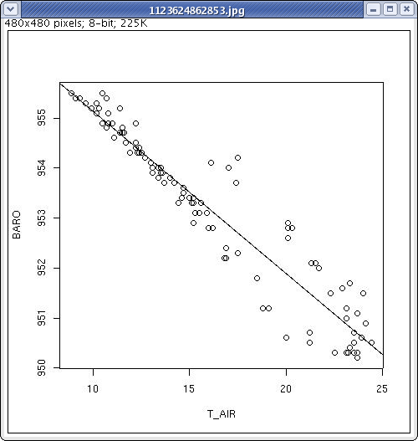
Kepler scientific workflow system
Run Management
Each execution recorded
Provenance of derived data recorded
Can archive runs and derived data
Data source from
repository
R processing script
res <- lm(BARO ~ T_AIR)
res
plot(T_AIR, BARO)
abline(res)

Slide 25
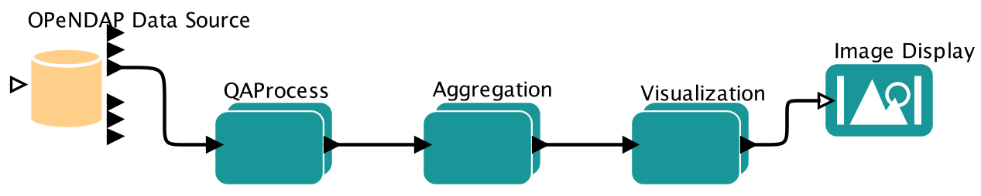



OPeNDAP
Directly access OPeNDAP servers
Apply OPeNDAP constraints for remote data subsetting
Current work: searchable catalogs across OPeNDAP servers

Slide 26
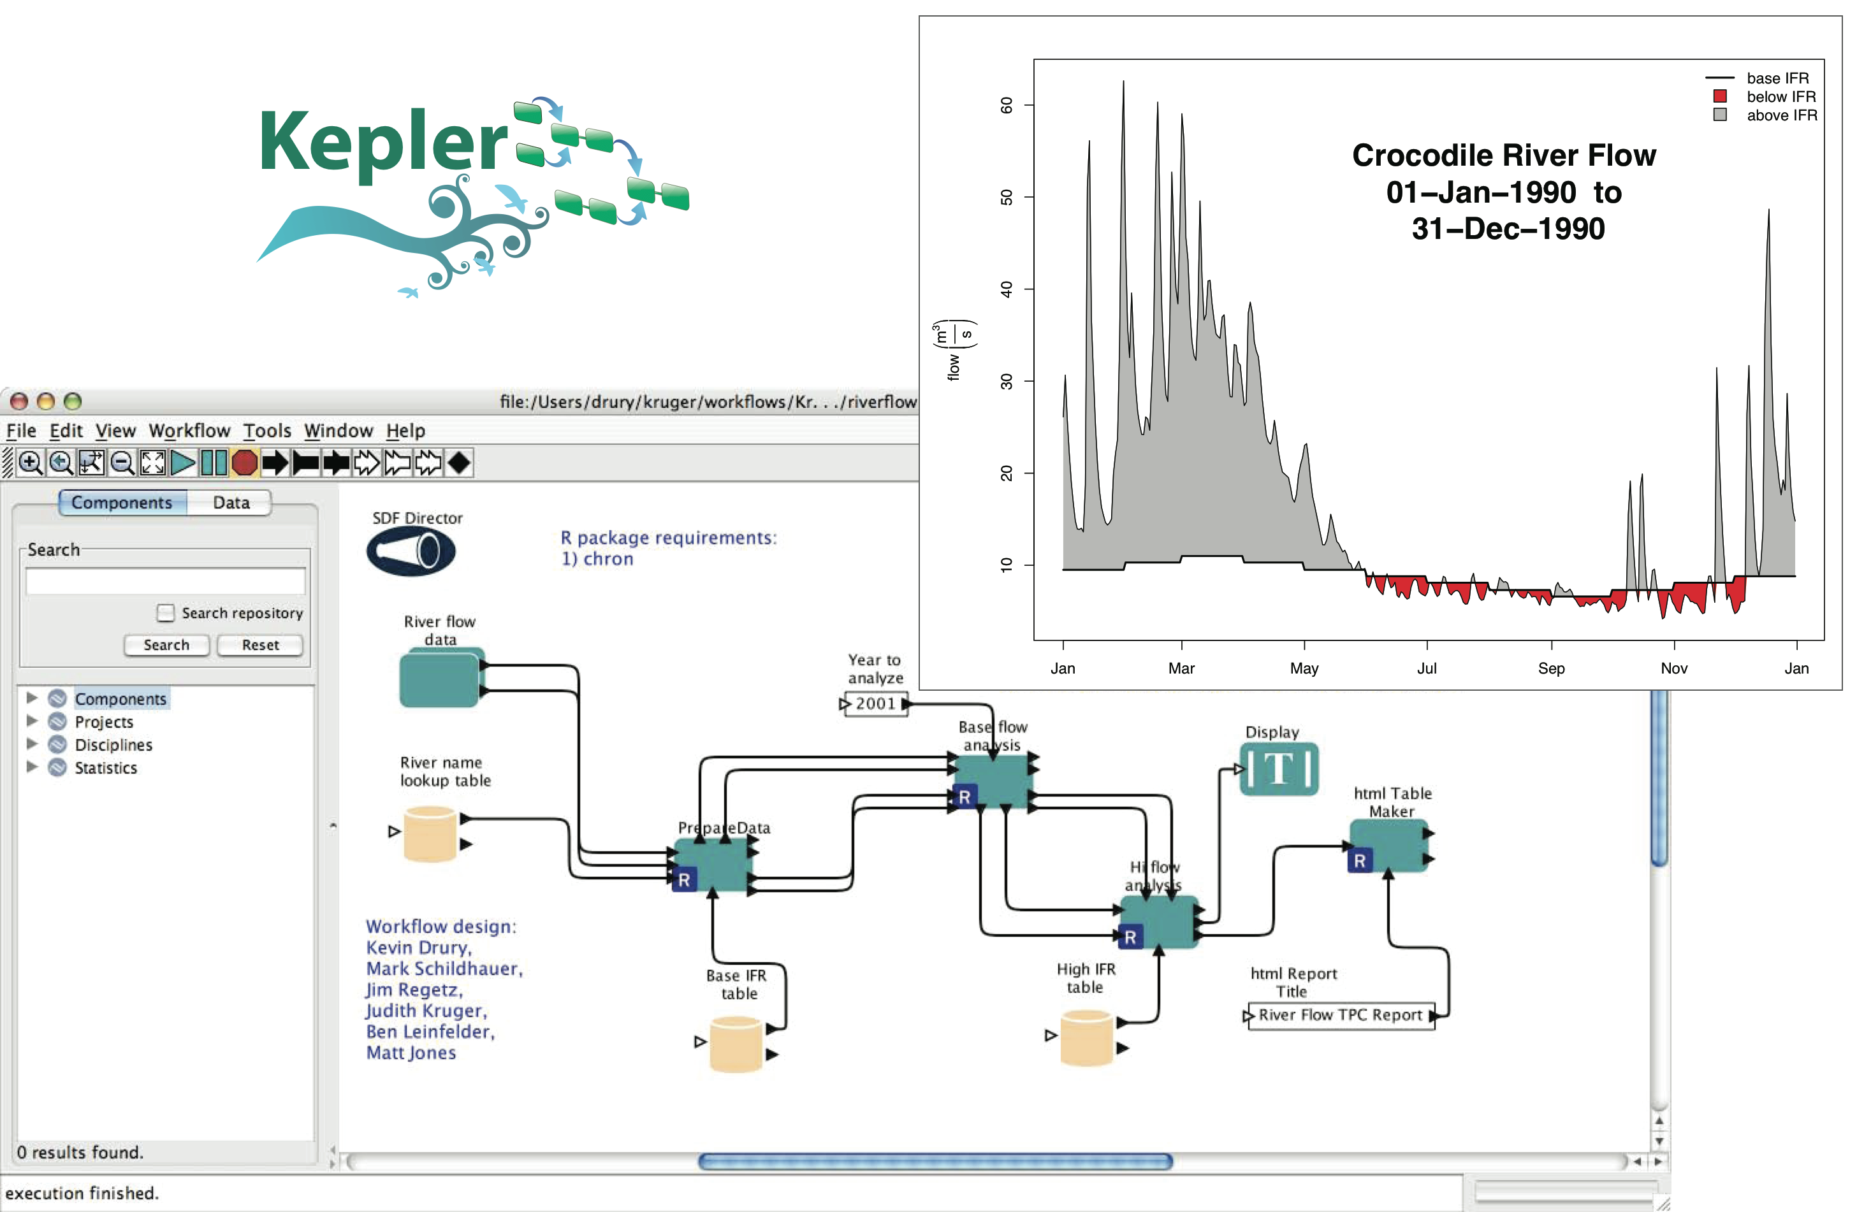
Scientific workflows document adaptive management

Slide 27
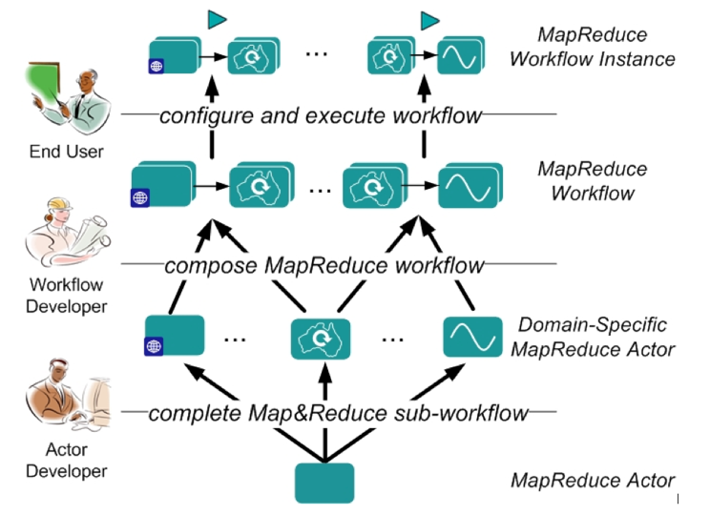
Grid computing
Support for several grid technologies
Ad-hoc Kepler networks (Master-Slave)
Globus grid jobs
Hadoop Map-Reduce
SSH plumbed-HPC

Slide 28

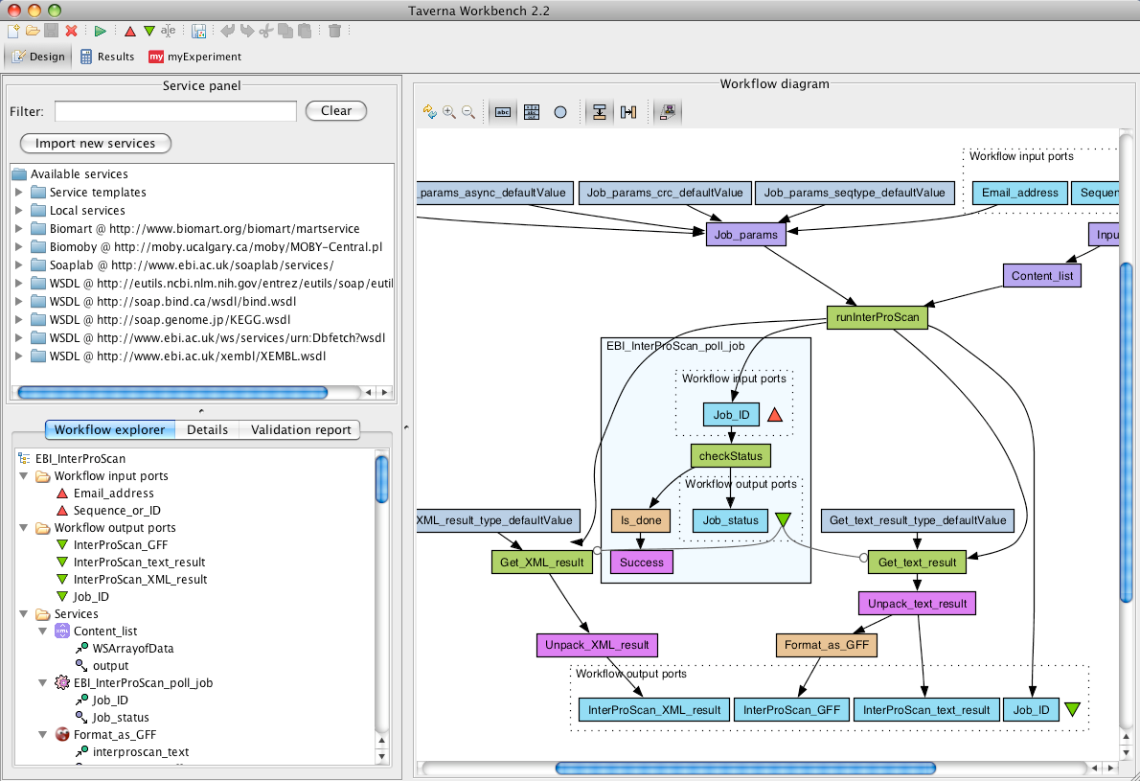
http://www.taverna.org.uk/
Taverna Workbench
Notes:
Especially in bioinformatics
Heavy reliance on web-services?

Slide 29

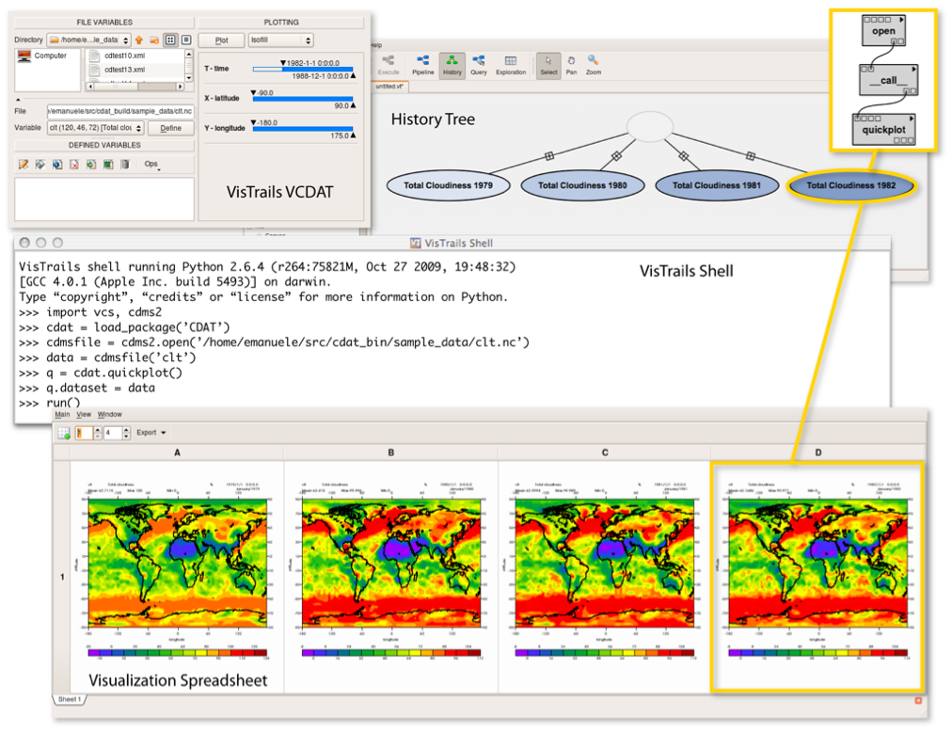
http://www.vistrails.org/
VisTrails
Notes:
Especially exploratory visualization
Nice built-in workflow versioning system

Slide 30

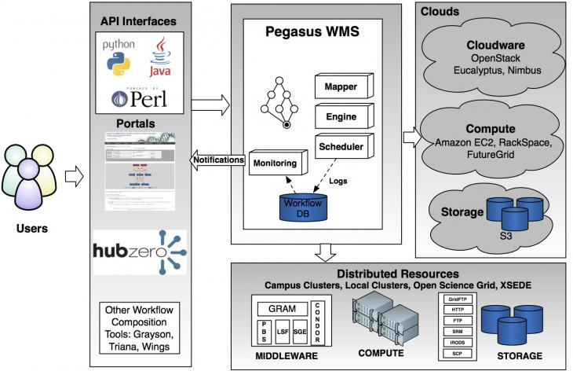
Pegasus

Slide 31
More benefits of dedicated workflow systems
Multiple computation “engines”
Revision history; execution history
Embedded documentation
Distinguish data vs parameters vs constants
Dynamic reporting
Workflow itself can be stored & shared
script files
workflow software files/archives

Slide 32
Exercise
Break into GP groups
Try to construct your workflow
Flow diagram + supporting text
Each node represents a ‘step’
Each connecting edge represents data flow
Identify major gaps in your reconstruction
What parts aren’t clear?
What parts simply aren’t described?
Are there different kinds of data flowing?

Slide 33
Questions?
Contact:
Matt Jones <jones@nceas.ucsb.edu>
Jim Regetz <regetz@nceas.ucsb.edu>
Links
http://www.nceas.ucsb.edu/ecoinfo/
http://kepler-project.org/

