Slide 1
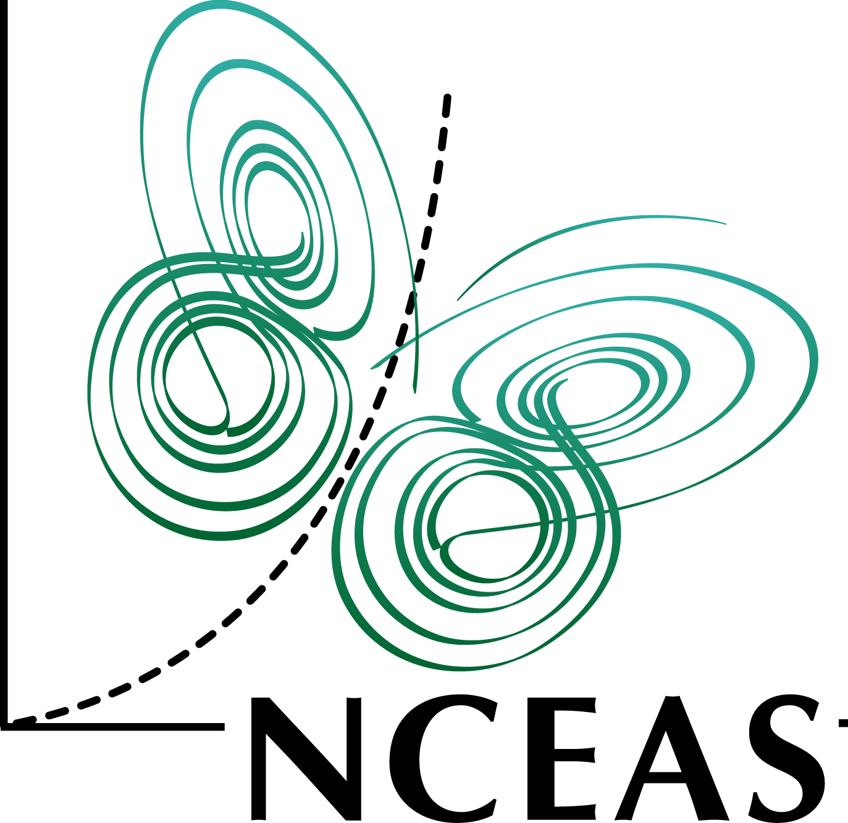
Morpho Tutorial
Matthew B. Jones
Jim Regetz
National Center for Ecological Analysis and Synthesis (NCEAS)
University of California Santa Barbara
NCEAS Synthesis Institute
June 21, 2013
Notes:
NCEAS is an NSF funded research center whose mission is to advance the state of ecological knowledge through synthetic, cross-cutting studies using existing data. Soon after NCEAS formed it became obvious that there was a large need for informatics tools that support synthetic research.

Slide 2
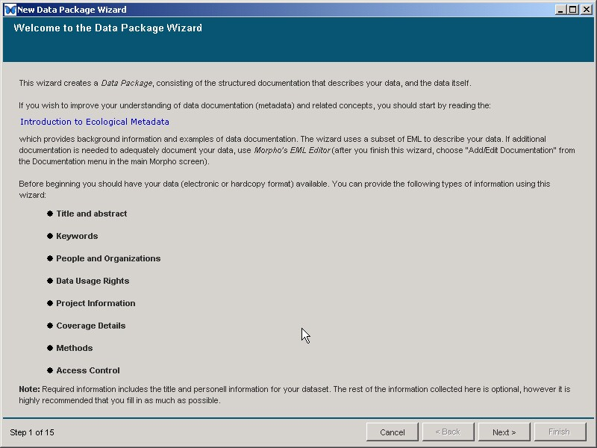

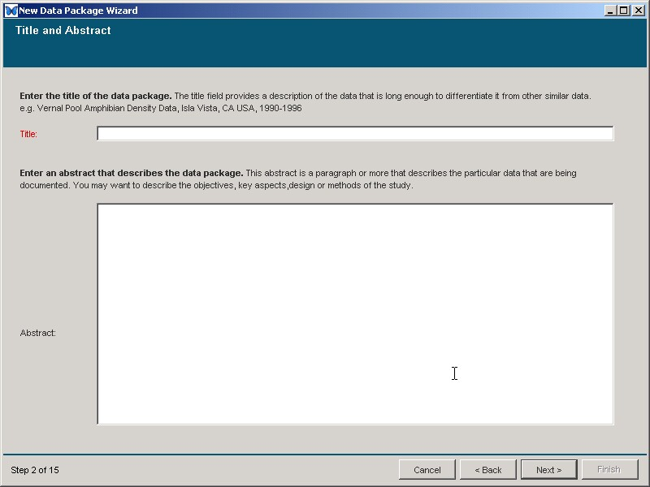
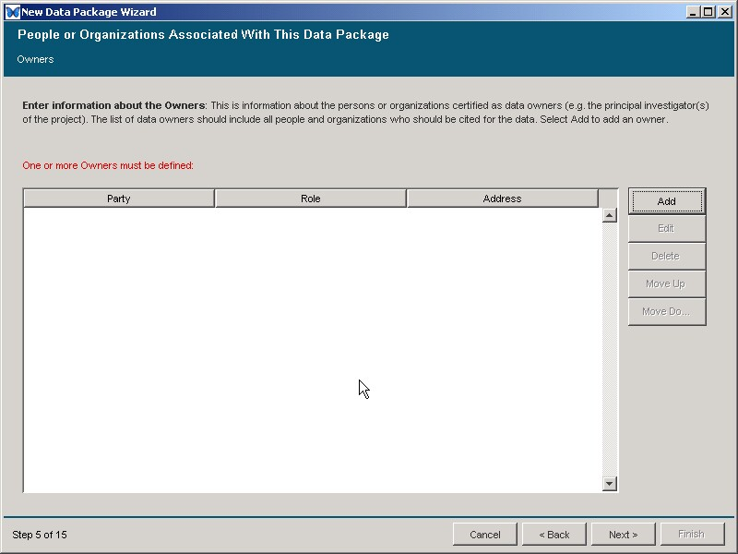
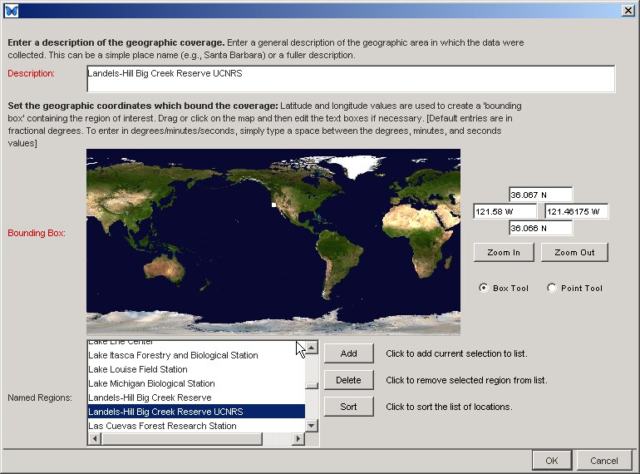
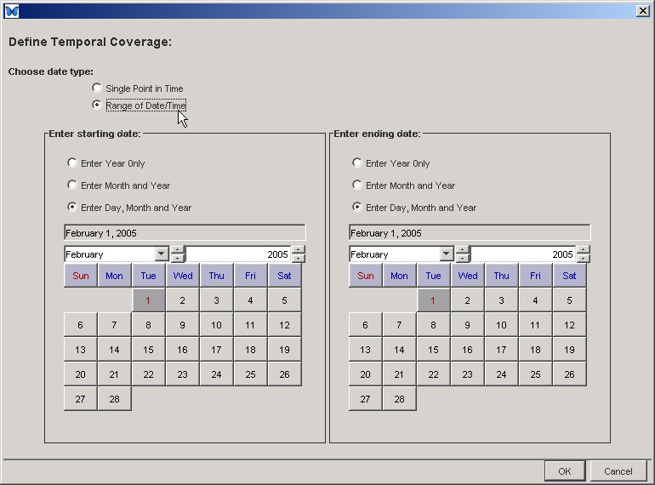
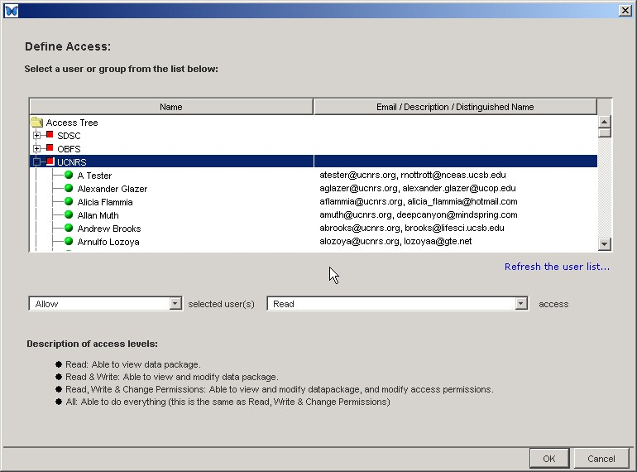
Wizard to create metadata
Morpho

Slide 3
Morpho highlights
Create metadata in EML format
Manage data in EML packages
Save, publish, and share data
Search for data
Multi-language
English, Spanish, Chinese, French, Portuguese, Japanese
Export data and metadata
Cross-platform, and open source
Morpho

Slide 4
Morpho Tutorial
Goals
Install and understand Morpho
Understand basics of metadata editing
Save data to Metacat
Access control, and other more advanced features
Understand relationship of Metacat to DataONE network

Slide 5
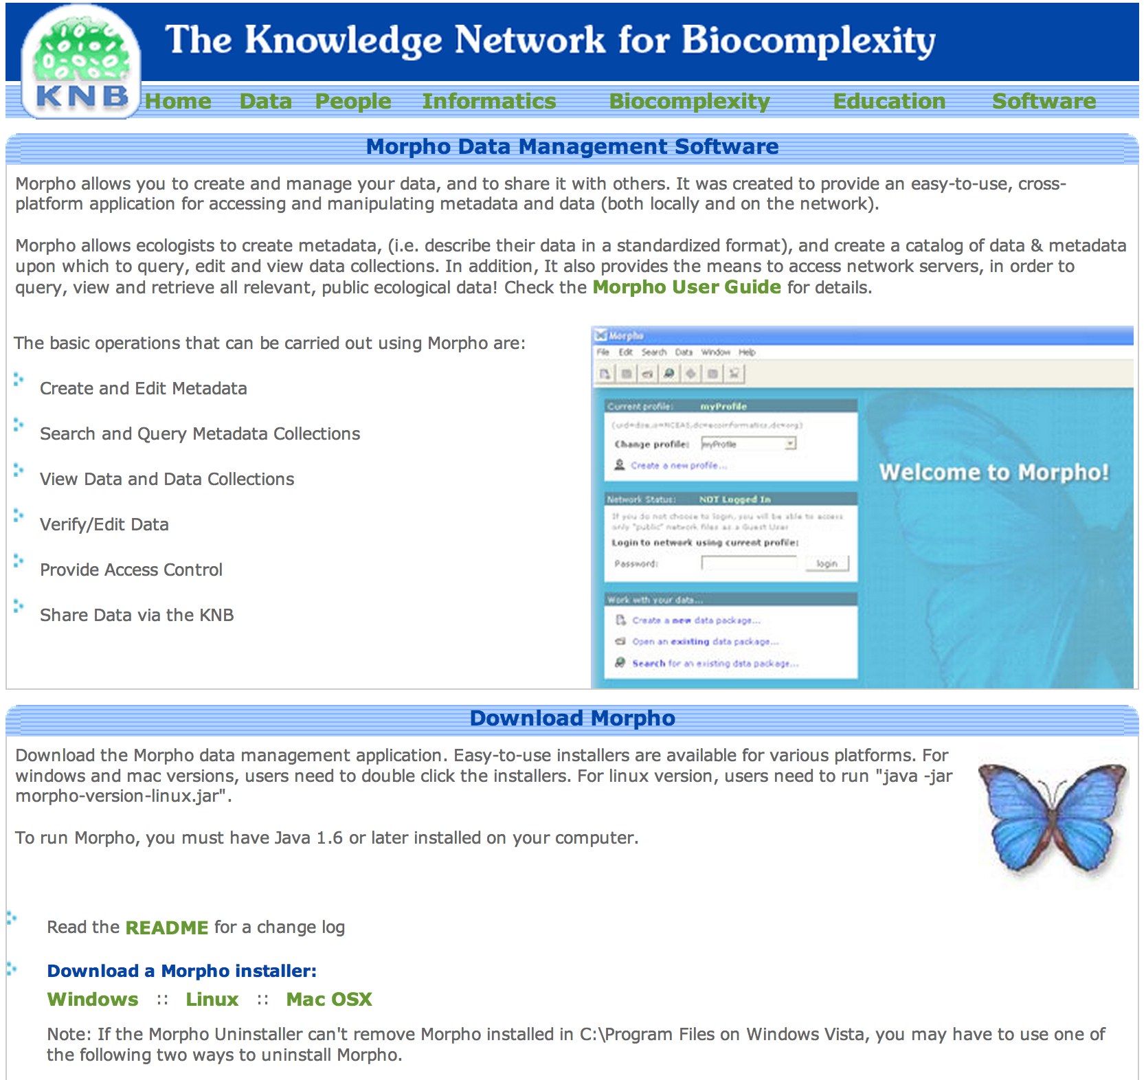
Step 1: Download and install
http://knb.ecoinformatics.org/morphoportal.jsp

Slide 6
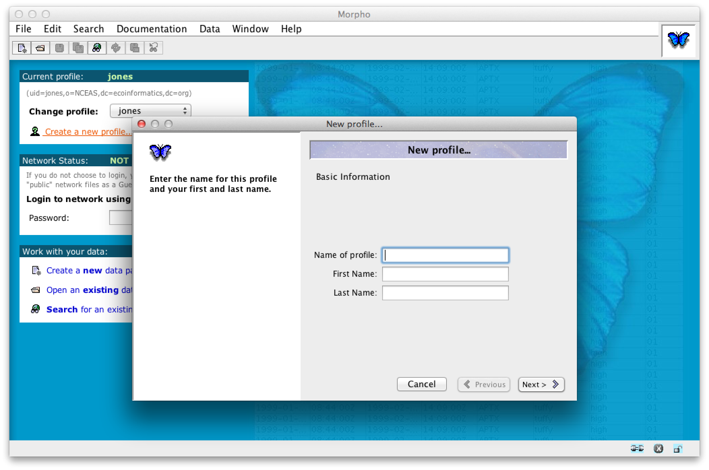
Step 2. Create profile
Profile: a way to allow multiple users to use the same Morpho install without colliding
Each profile is associated with one KNB/Metacat account
Each profile has a ‘prefix’ used to create data set identifiers
E.g., the prefix ‘jones’ is used to create IDs of the form ‘jones.1.1’

Slide 7
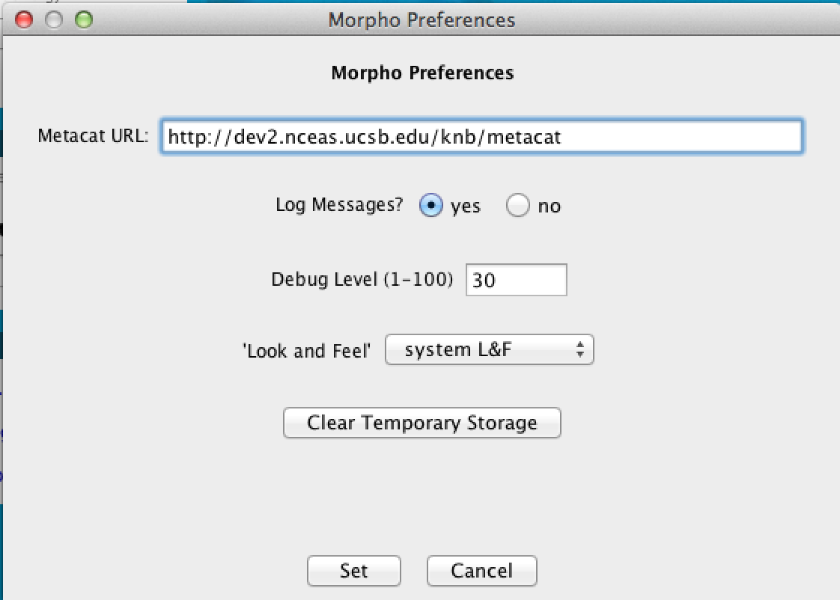
Step 3. Set Metacat to use
http://dev2.nceas.ucsb.edu/knb/metacat

Slide 8
Step 4: Manage data
Login
Find the data set uploaded earlier
Open it and edit it as instructed

Slide 9
Questions?
Contact:
Matt Jones <jones@nceas.ucsb.edu>
Jim Regetz <regetz@nceas.ucsb.edu>
Links
http://www.nceas.ucsb.edu/ecoinfo/
http://knb.ecoinformatics.org/
http://dataone.org

