Slide 1


Slide 2
surprises
Van Kleunen et al. 2010. A meta-analysis of trait differences between invasive and non-invasive plant species. Ecol Lets.
Parker et al. 2006. Opposing Effects of Native and Exotic Herbivores on Plant Invasions. Science.
Gomez-Aparcio et al. 2004. Applying plant facilitation to forest restoration: a meta-analysis of the use of shrubs as nurse plants. Eco Apps.
Maestre et al. 2005. Is the change of plant–plant interactions with abiotic stress predictable? A meta-analysis of field results in arid environments. J. Ecol.
Gurevitch et al. 2002. A Meta-Analysis of Competition in Field Experiments. Am. Nat.

Slide 3
personal surprises
Lortie & Callaway. 2006. Re-analysis of meta-analysis: support for the stress-gradient hypothesis. J Ecol.
Schaffner et al. 2011. Plant invasions, generalist herbivores, and novel defense weapons. Ecology.
Lamarque et al. 2011. Tree invasions: a comparative test of the dominant hypotheses and functional traits. Biological Invasions.
Delmas et al. 2011. A meta-analysis of the ecological significance of density in tree invasions. Community Ecology.
Castanho et al. 2012. Facilitation between plants in coastal dunes: a systematic review and meta-analysis. Anywhere.
Jeschke et al. 2012. Major hypotheses of invasion biology need re-evaluation. Anywhere.

Slide 4
Graphs and the human visual system
Visual decoding = instantaneous perception through vision that comes without apparent mental effort; ability of our visual system to detect geometric patterns and assess magnitudes.

Slide 5
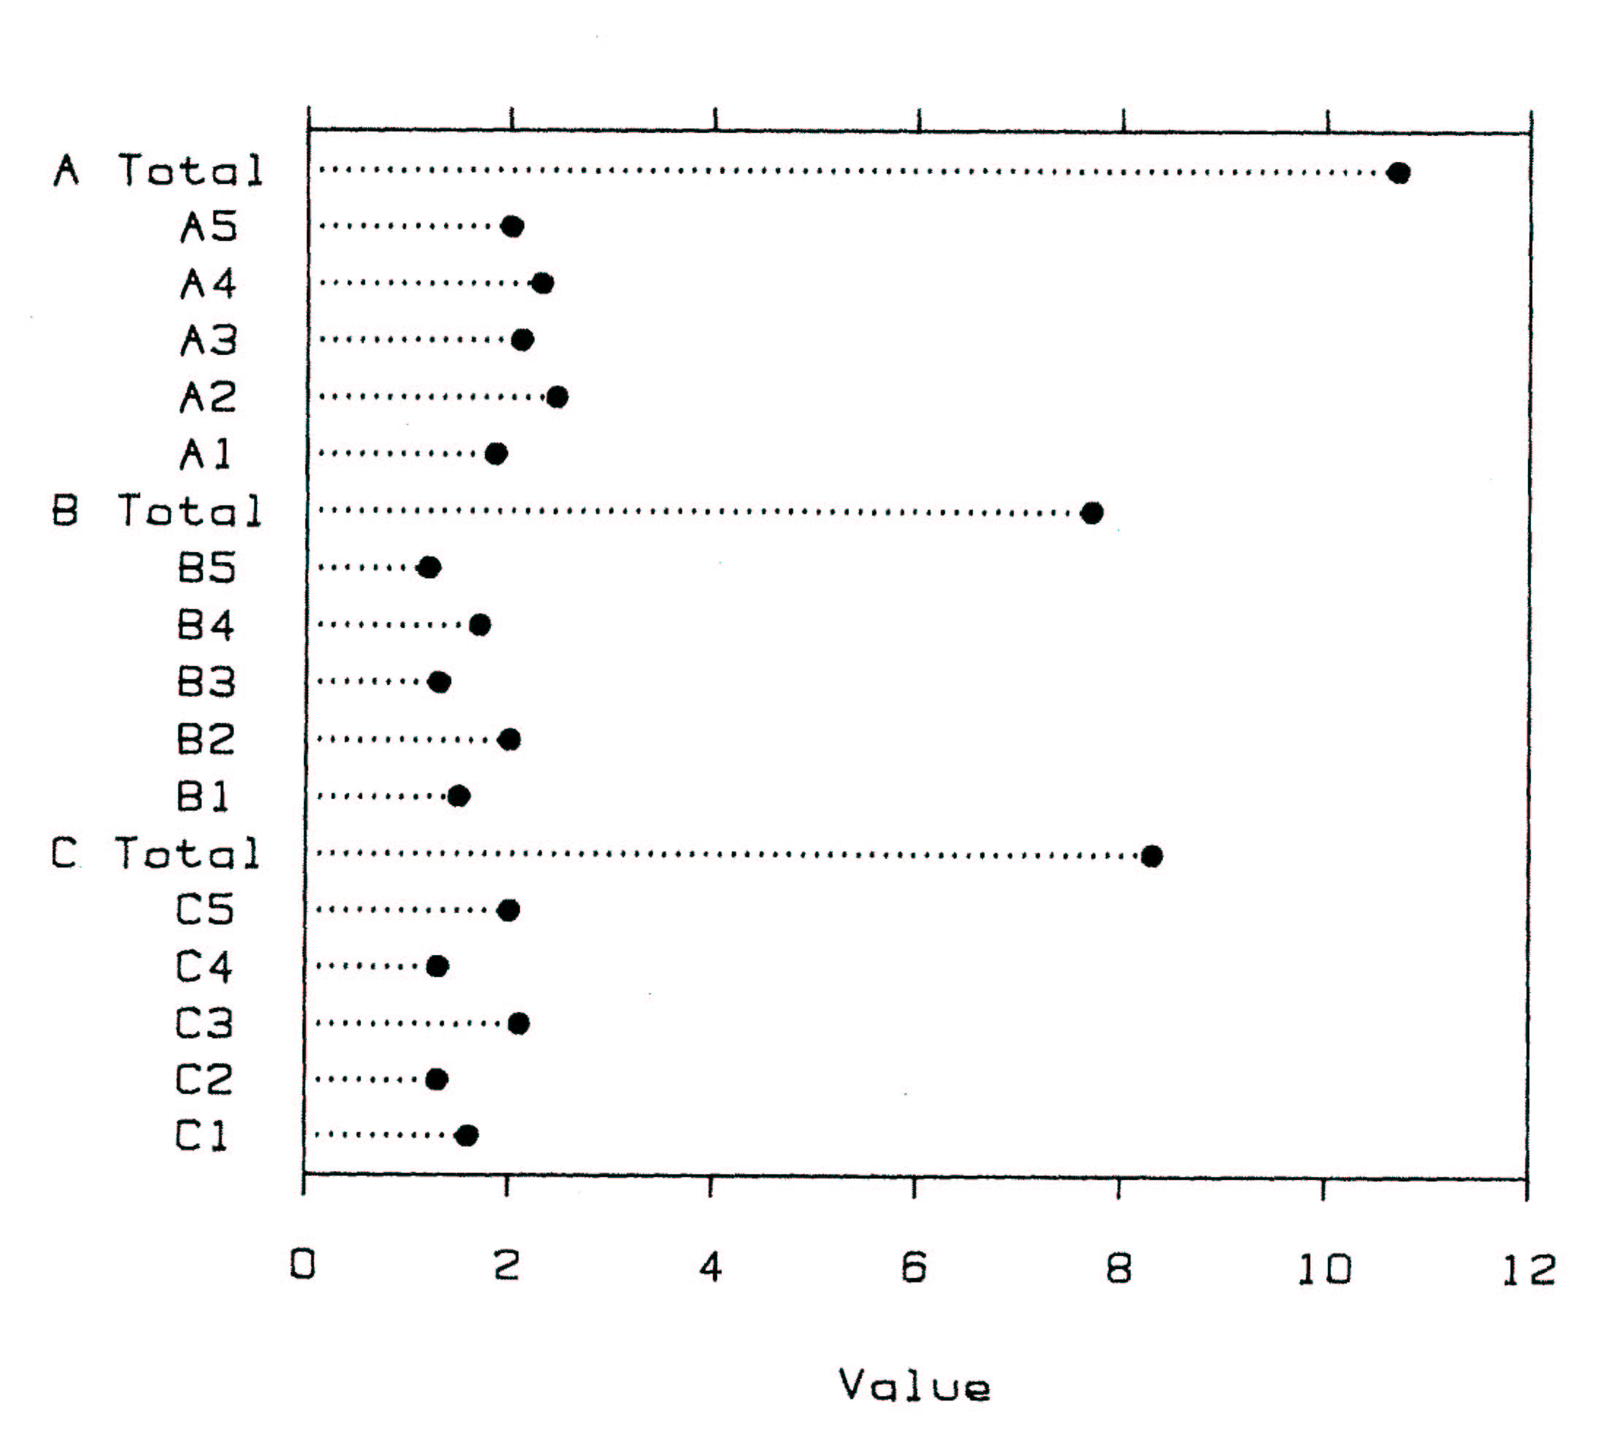
Graphs and the human visual system
Ability to
visual decode Graph aspect
High #1 Position along a common axis

Slide 6
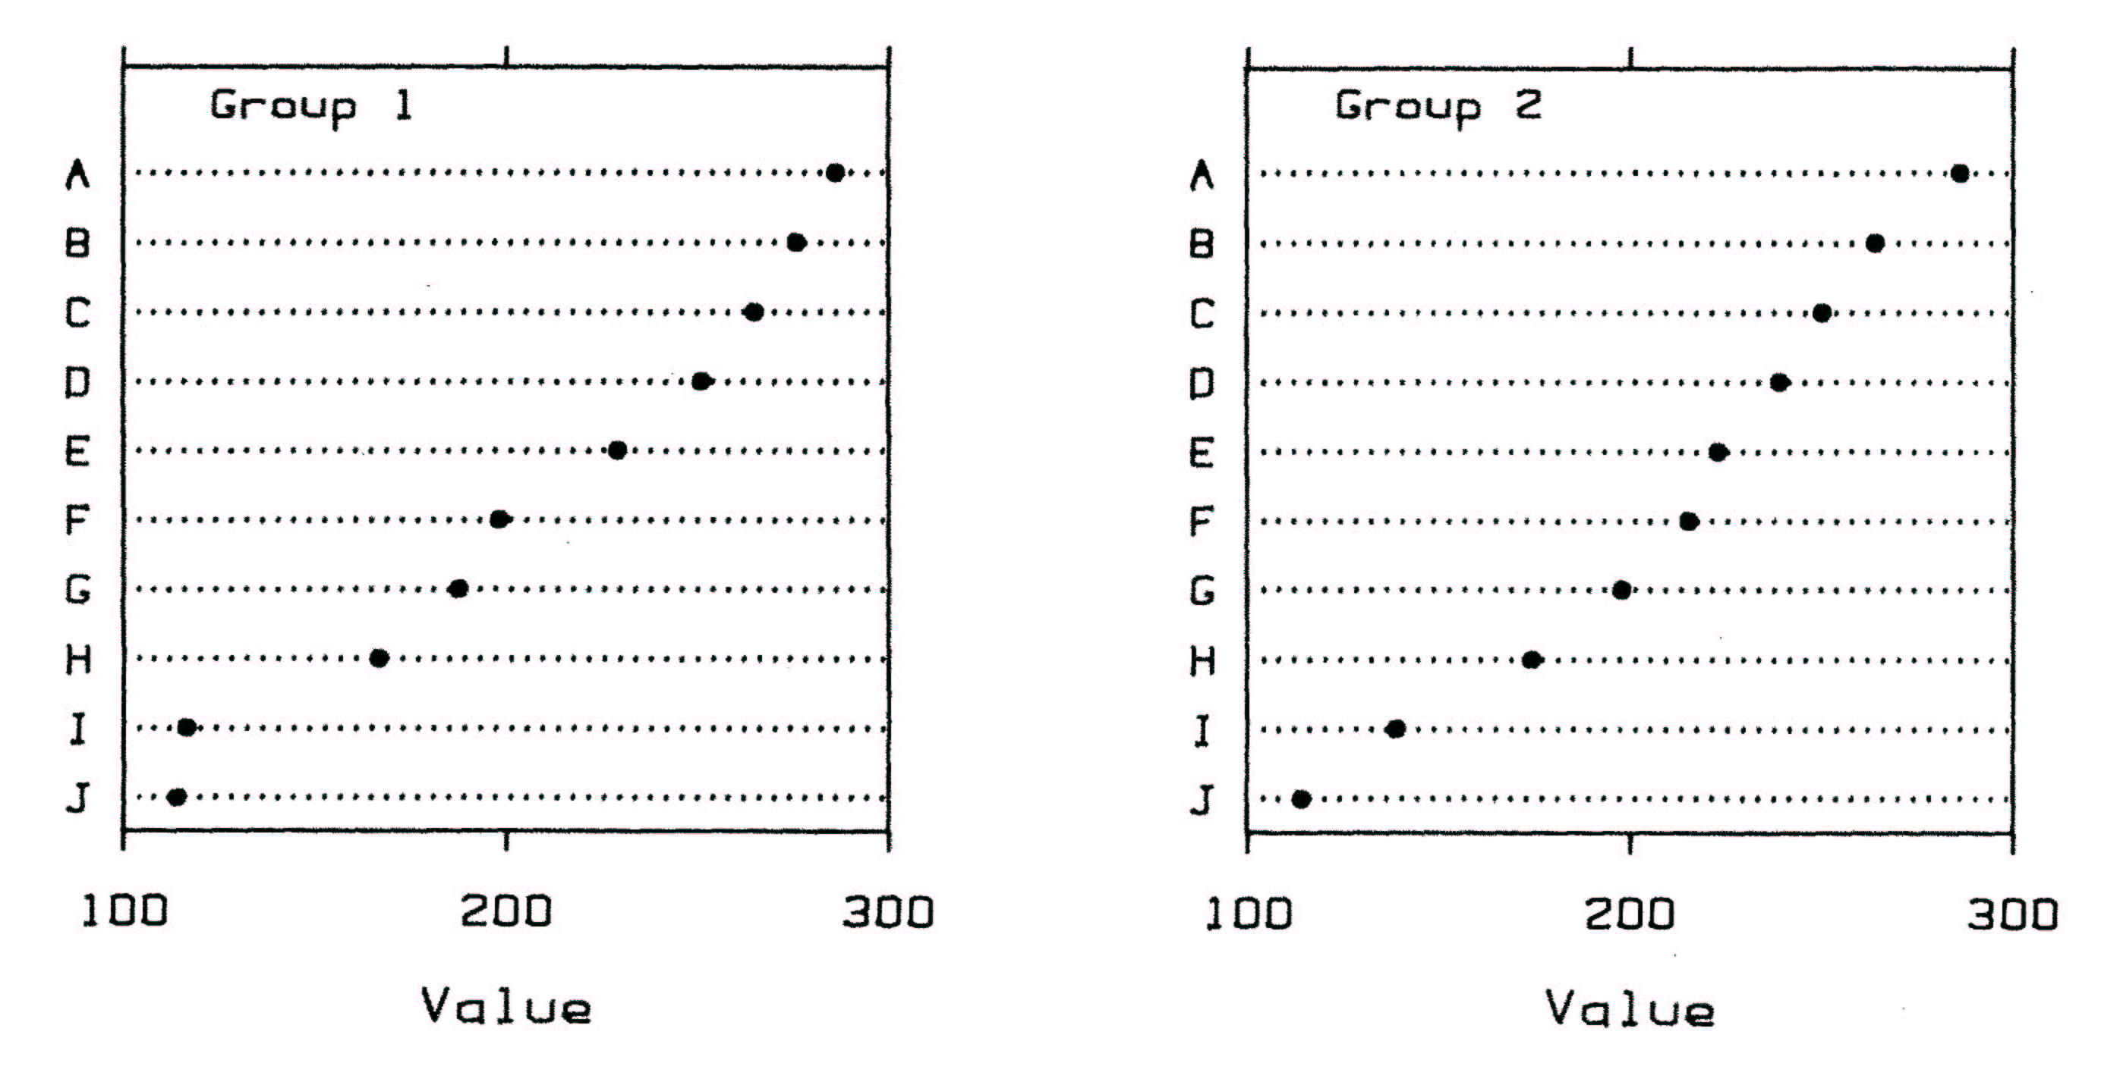
Graphs and the human visual system
Ability to
visual decode Graph aspect
High #1 Position along a common axis
#2 Position on identical but nonaligned scales

Slide 7
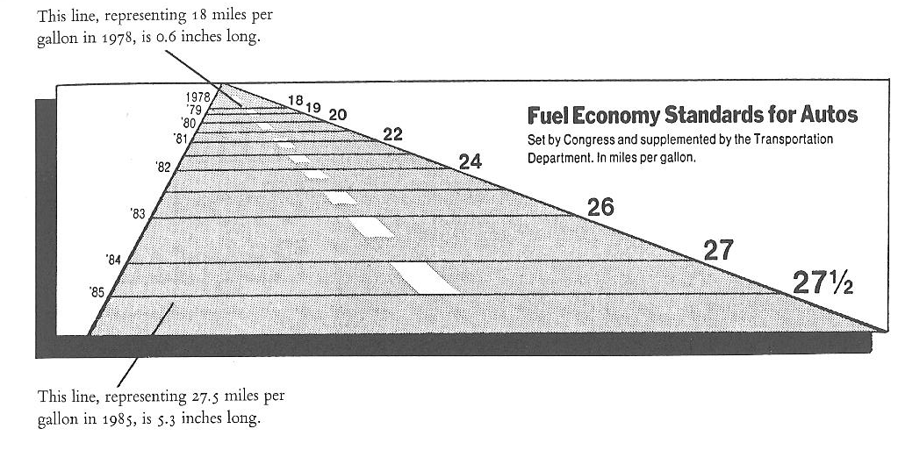
Graphs and the human visual system
Ability to
visual decode Graph aspect
High #1 Position along a common axis
#2 Position on identical but nonaligned scales
#3 Length

Slide 8
Graphs and the human visual system
Ability to
visual decode Graph aspect
High #1 Position along a common axis
#2 Position on identical but nonaligned scales
#3 Length
#4 Angles and slopes when the angle/slope is near 45°,
but not when nearly flat (0°) or straight up (90°)

Slide 9
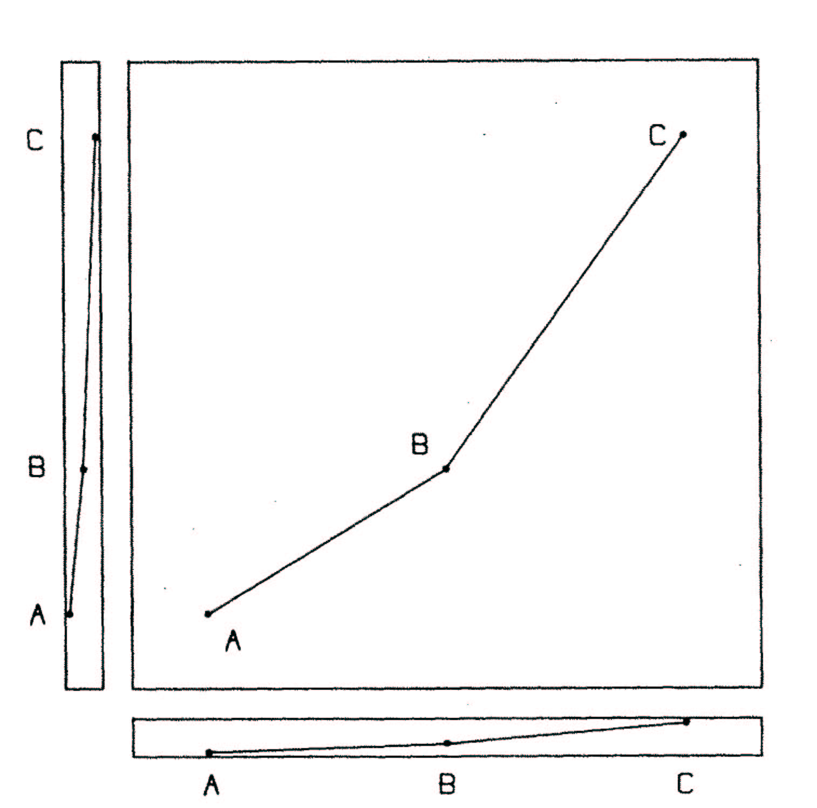

Slide 10
Graphs and the human visual system
Ability to
visual decode Graph aspect
High #1 Position along a common axis
#2 Position on identical but nonaligned scales
#3 Length
#4 Angles and slopes when the angle/slope is near 45°,
but not when nearly flat (0°) or straight up (90°)
#5 Area

Slide 11
Graphs and the human visual system
Ability to
visual decode Graph aspect
High #1 Position along a common axis
#2 Position on identical but nonaligned scales
#3 Length
#4 Angles and slopes when the angle/slope is near 45°,
but not when nearly flat (0°) or straight up (90°)
#5 Area
#6 Volume, density, color saturation

Slide 12
Graphs and the human visual system
Ability to
visual decode Graph aspect
High #1 Position along a common axis
#2 Position on identical but nonaligned scales
#3 Length
#4 Angles and slopes when the angle/slope is near 45°,
but not when nearly flat (0°) or straight up (90°)
#5 Area
#6 Volume, density, color saturation
Low #7 Color hue

Slide 13

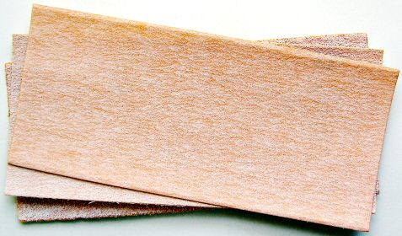

Slide 14
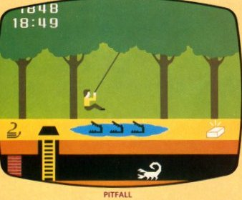
significance
Meta-analyses and systematic reviews will always be useful. Even for very limited bodies of literature.
pitfalls
GIGO
Apples and oranges
Publication bias
Heterogeneity
Fixed vs random
One-sided arguments

