Slide 1
Groundfish 3 Spatial scaling of diversity & stability

Slide 2
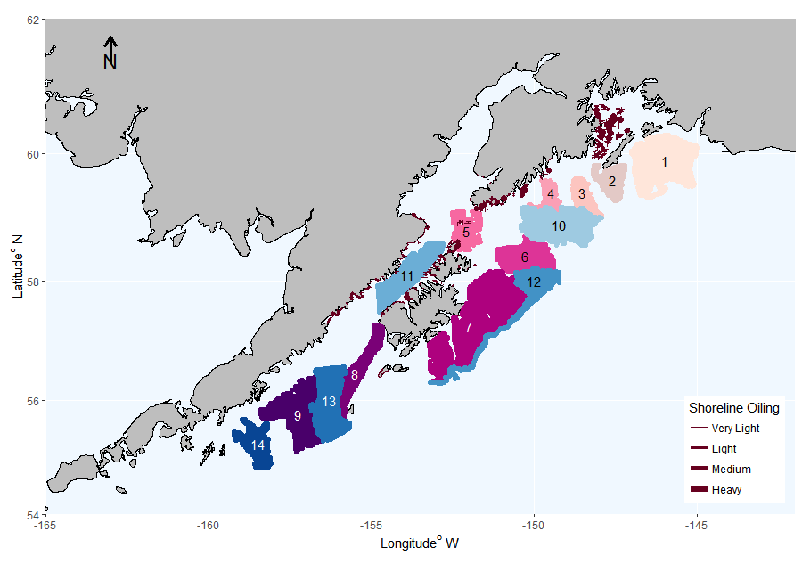
1
…..
9
Shallow (50-150m)
Deep (151-300m)
10
…..
14
Notes:
Patches = local communities
Regional metacommunity = all shallow (and all deep) sites pooled
Oil (ignore)
Spatial diversity (beta diversity) is high: Great deal of spatial turnover in species identity

Slide 3
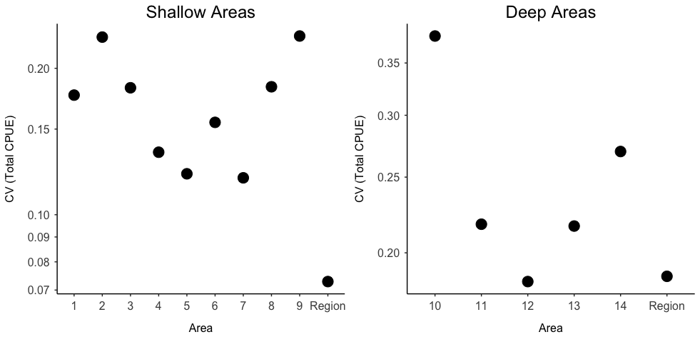
The regional metacommunity is more stable than local communities
mean Local CV / Regional CV = 2.3
mean-variance portfolio effect = 2.93
mean Local CV / Regional CV = 1.4
mean-variance portfolio effect = 2.93

Slide 4
Our Questions
Do spatial (patterns of) groundfish diversity beget regional temporal stability in groundfish community CPUE? And temporal stability in diversity & community structure?
Does this stability, in turn, beget ecosystem resilience to disturbance?

Slide 5
Figures / Plan of Attack
Group discussion 13 Oct 2016
Local vs Regional CV (and weighted for dominance, as per Wang & Loreau 2014)
Cite paper 2 re spatial patterns of diversity
3 hypotheses for diversity-stability relationship: (a)Spatial asynchrony within and between patches (think about storage effect, differential response to climate) - Gross et al. 2014, Loreau 2008 metrics, applied to within patches (ie between-species) and between-patches (ie total community cpue) (b)Do gamma variability calc (re W&L 2014) with and without spatial uneveness (another type of between-area diversity) (c) Diversity per se: i: spatial diversity: Bray spatial-temporal fig (Mellin-type figure) ii. Species-area relationship iii. Alpha diversity (as per W & L) (d) Statistical effect – Blumenthal et al. 2016 Nat Comms (e) To test what each of the above do to Gamma variability, calculate gamma with and without each of the above components
Does temporal stability beget resilience to perturbations in general? (a) Looking at effects of perturbations: look at 1 vs 1&2, vs 1-3 …. Do we see stability as you move away from the site & time of disturbance? Was there an area with a sharp change in cpue or diversity in some year? Look into whether / how it was buffered. Note lowest species richness in 2 areas in 2003.

Slide 6
Hypotheses for spatial diversity-stability relationship
(i) explicitly spatial components of diversity, including spatial turnover in species identity and the scaling of species richness with area (a spatial portfolio hypothesis) (ii) spatial unevenness in community abundance (iii) asynchrony within and between local communities (the insurance hypothesis) (iv) the statistical averaging effect
(v) some combination of the above

Slide 7
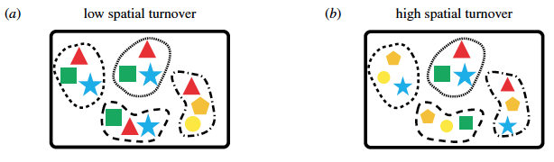
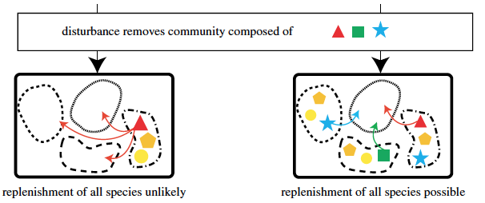
Mellin et al. 2014 Proc. R. Soc. B

Slide 8
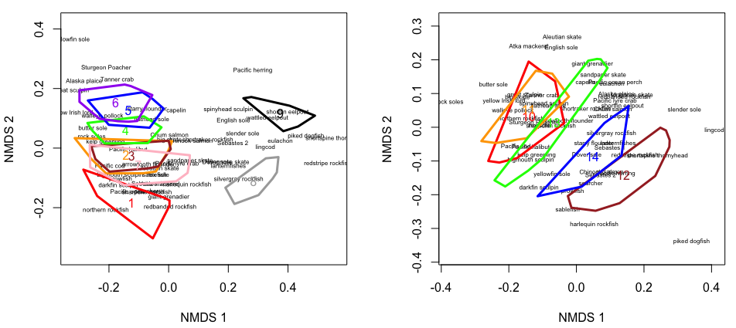
High beta diversity (strong spatial dissimilarity) between local communities

Slide 9
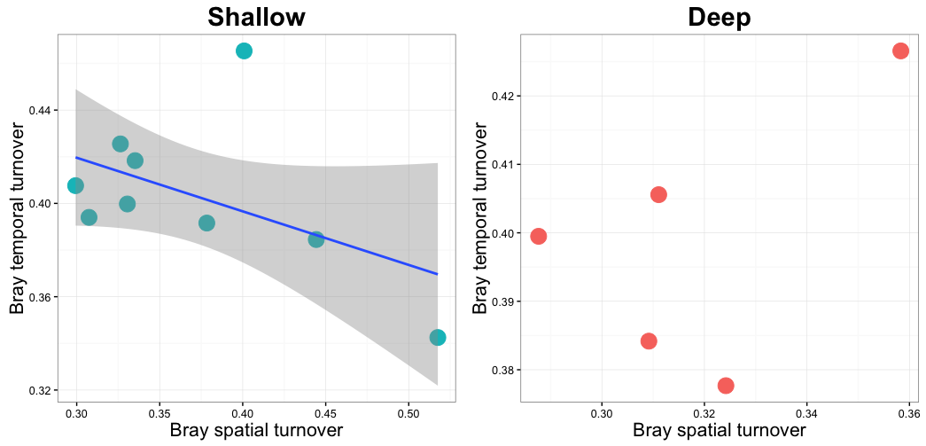
Spatial (beta) diversity begets temporal stability in Shallow areas
Notes:
Next steps: do this for multiple spatial scales

Slide 10
Next steps
Investigate alternative hypotheses for spatial stability:
Asynchrony
Mathematical artifact?
How do results map to primary productivity, SST, life history, … ?
Notes:
Next steps: do last slide for multiple spatial scales

Slide 11
Wang & Loreau 2014, Fig. S1

Slide 12
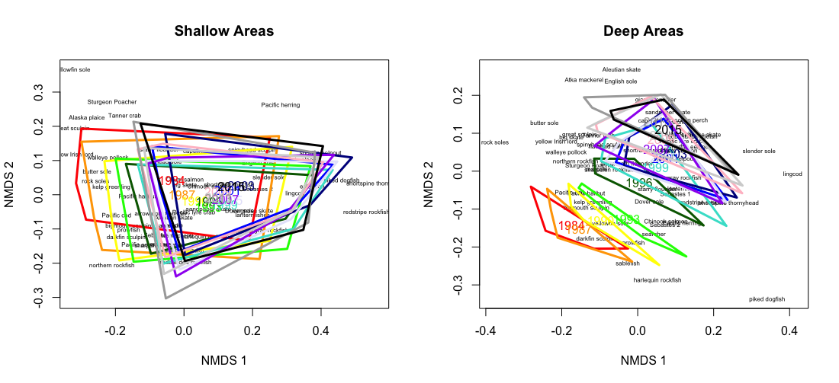
Temporal turnover in community composition

Slide 13
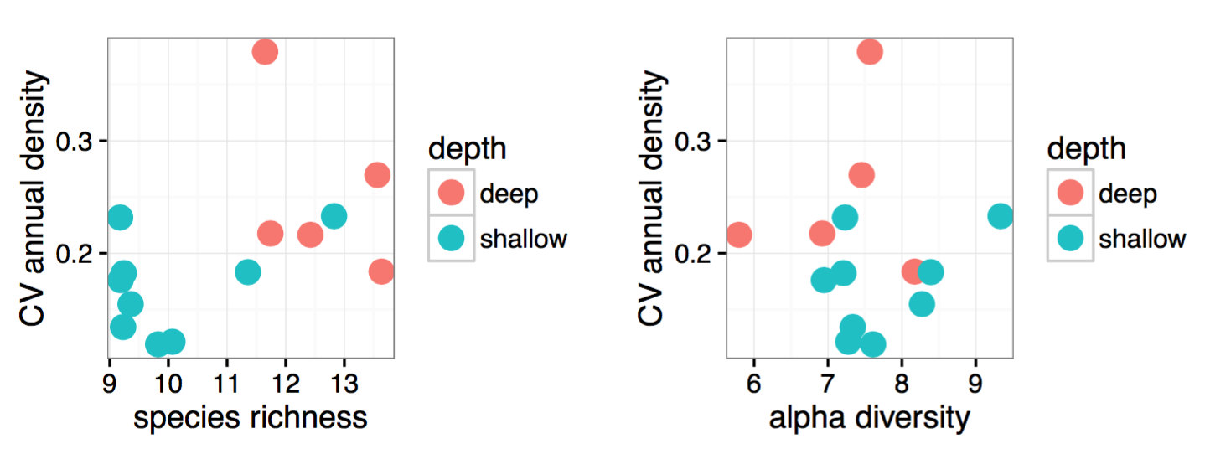
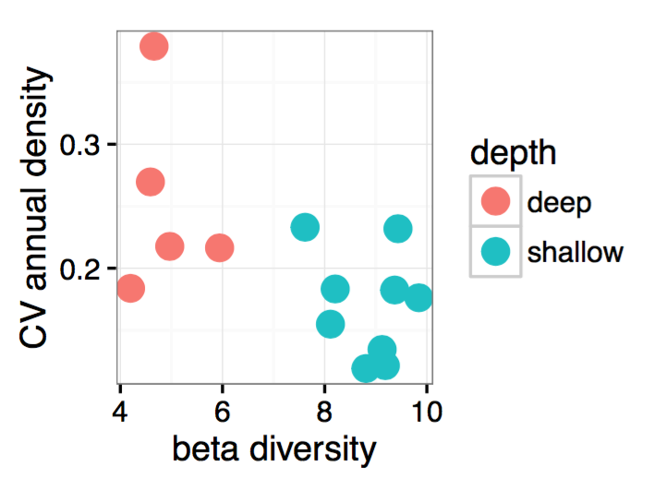
Notes:
Within LOCAL areas

Slide 14
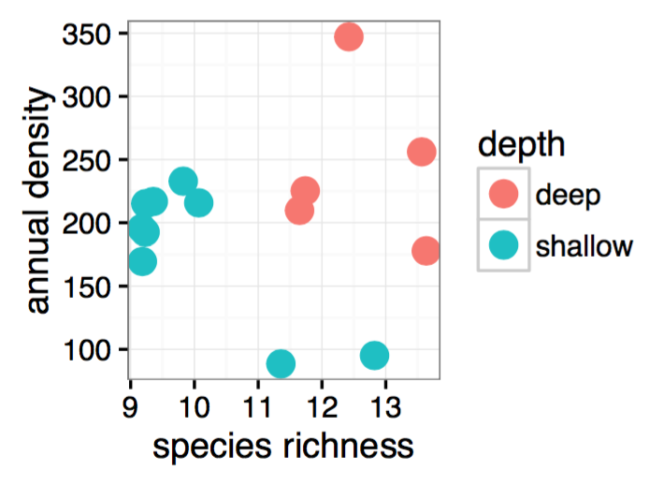
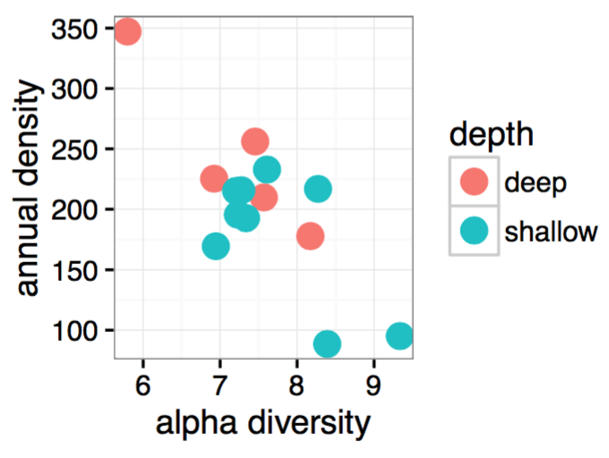

Slide 15
Nov. 22:
Gets at the species-area relationship:
Gets at spatial diversity:
Ecosystem Stability (γ_{CV})
Ecosystem Stability (γ_{CV})
Sp. Richness, H’, etc
Community Dissimilarity
Area (km²)
Distance between centroids (km)
x-axes:
Start with local communities,
intermediate-level spatial groupings (see right),
and whole region
Intermediate-level spatial groupings:
1-4 (maybe drop 1)
5-7
8-10 (maybe drop 10)

