Slide 1

Improving Data Discovery in Metadata Repositories through Semantic Search
CISIS/iSEEK Fukuoka, Japan March 18, 2009
Chad Berkley¹, Shawn Bowers², Matt Jones¹,
Mark Schildhauer¹, Josh Madin³
¹ National Center for Ecological Analysis and Synthesis, UC Santa Barbara
² Genome Center, UC Davis
³ Macquarie University

Slide 2
Motivation
Increasing numbers of data sets becoming available to scientific researchers
Locating data sets of interest is a problem---
  Researcher needs observations of specific phenomena
  Researcher ideally wants comprehensive data
Must improve precision and recall when searching for data

Slide 3
Definitions
Precision: number of relevant items retrieved by a search divided by the total number of items retrieved by that search
Recall: the number of relevant items retrieved by a search divided by the total number of existing relevant items (which should have been retrieved)
In this case, items are data objects

Slide 4
Test Case
Knowledge Network for Biocomplexity (KNB; http://knb.ecoinformatics.org) is a repository for ecological data
KNB contains > 15,000 entries, and growing rapidly
KNB used by NCEAS, LTER, PISCO, ILTER, others
KNB holdings are described in formal metadata specification, Ecological Metadata Language, EML

Slide 5
Test Case
KNB offers traditional text based searching of all or some critical metadata fields (keywords, abstract, author, personnel)
Results often contain extraneous data sets—
  Even keyword matches often too coarse
  Need more refined methods for searching metadata fields
Test extending search capabilities of KNB with semantic approach

Slide 6
Our Semantic Approach
Data-> metadata-> annotations-> ontologies
Ontology: formal knowledge representation in OWL-DL
  Hierarchical structure of concepts
  Relationships can link concepts
Annotations link EML metadata elements to concepts in ontology
EML metadata describe data and its structures

Slide 7
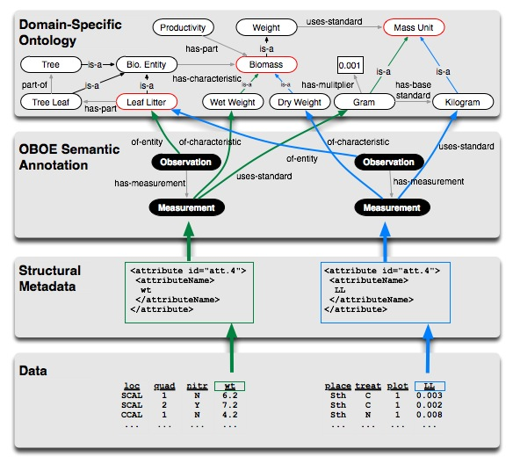
Logical Architecture

Slide 8
Nature of scientific data sets
Scientific data often in tables
Tables consist of rows (records) and columns (attributes)
The association of specific columns together (tuple) in a scientific data set is often a non-normalized (materialized) view, with special meaning/use for researcher
Individual cells contain values that are measurements of characteristic of some thing

Slide 9
Linking data values to concepts
Extensible Observation Ontology (OBOE)
OBOE provides a high-level abstraction of scientific observations and measurements
Enables data (or metadata) structures to be linked to domain-specific ontology concepts
Can inter-relate values in a tuple
Provides clarification of semantics of data set as a whole, not just “independent” values

Slide 10
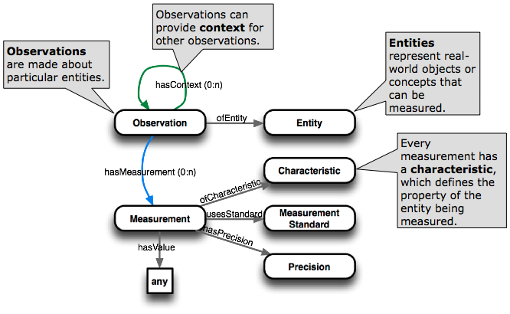
OBOE:
Extensible Observation Ontology

Slide 11
Logical Architecture

Slide 12
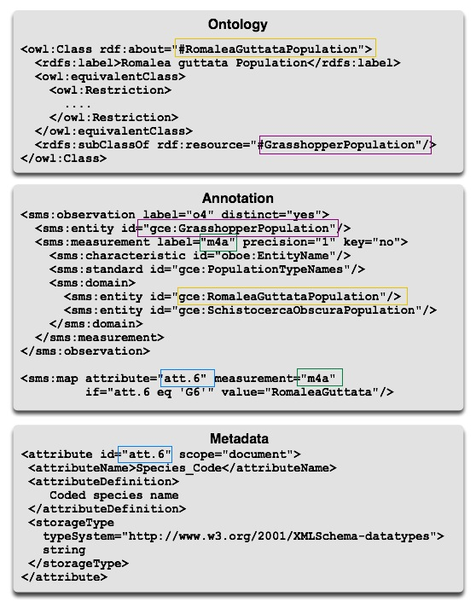
XML Links

Slide 13
KNB metadata catalog
Stores EML (XML) and raw data objects
Extend to store Ontologies, domain and OBOE (OWL-DLs serialized in XML)
Extend to store Annotations (XML)

Slide 14
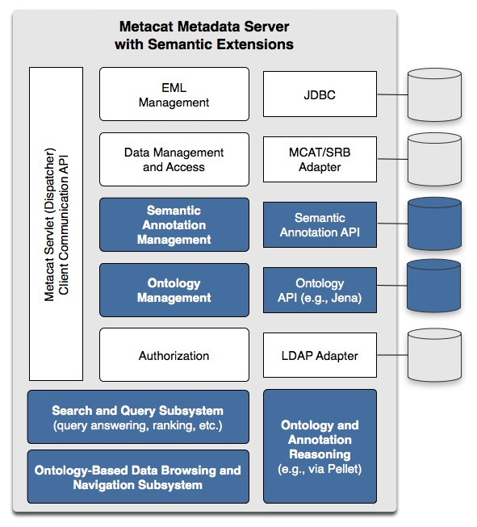
Metacat Implementation

Slide 15
KNB metadata catalog
Stores EML (XML) and raw data objects
Extend to store Ontologies, domain and OBOE (OWL-DLs serialized in XML)
Extend to store Annotations (XML)
Jena to facilitate querying ontologies
Pellet to reason (consistency of ontologies; class subsumption)

Slide 16
Types of Implemented Searches
Simple Keyword (baseline)
Keyword-based (ontological) term expansion
Annotation enhanced term expansion
Observation based structured query

Slide 17
Concepts of Semantic Search
Annotations give metadata attributes semantic meaning w.r.t. an ontology
Enable structured search against annotations to increase precision
Enable ontological term expansion to increase recall
Precisely define a measured characteristic and the standard used to measure it via OBOE

Slide 18
Simple Keyword Search
High false positive rate (low precision)
Metadata structure is often ignored
Project level metadata often conflicts with attribute level metadata
Example: search for “soil” will return frog data because the description of the lake the frogs were studied in contained the word “soil”
Synonyms for search terms are ignored

Slide 19
Keyword-based Term Expansion
Synonyms and subclasses of the search term are discovered via the ontology
Additional terms are added to the query of metadata docs
Example: Search for “Grasshopper” also searches for “Orchilimum,” “Romaleidae,” etc.
Increases recall, possibly decreases precision
Can help fight “semantic drift”: annotations allow interpretation to evolve

Slide 20
Annotation Enhanced Term Expansion
Terms are first expanded similarly to the keyword-based term expansion
Search performed against annotations not the metadata itself
Returns metadata documents that are linked to the annotation
increases recall through term expansion
but also increases precision through explicit assertion of relevance (annotation)

Slide 21
Observation Based Structured Query
Takes advantage of observation and measurement structures and relationships
Search based on an observed entity (e.g. a Grasshopper) and the measurement standards and characteristics used to measure it
Observed entity is a “template” on which the measurement characteristic and standard are applied

Slide 22
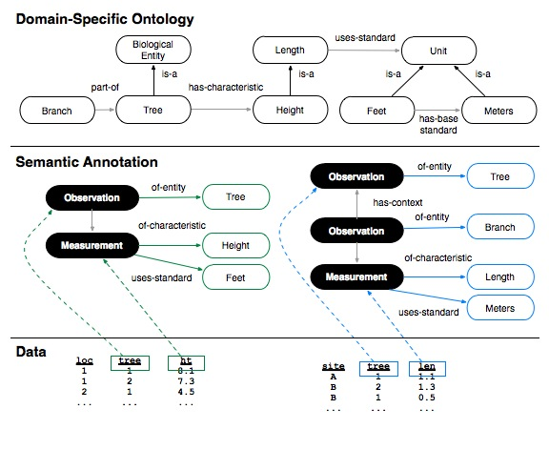
Observation Based Structured Query
Both datasets contain “tree lengths”
Annotation search for “tree length” would return both datasets
Structured search allows the search to be limited by the observed entity (e.g. a tree or a tree branch)
Increases precision and recall

Slide 23
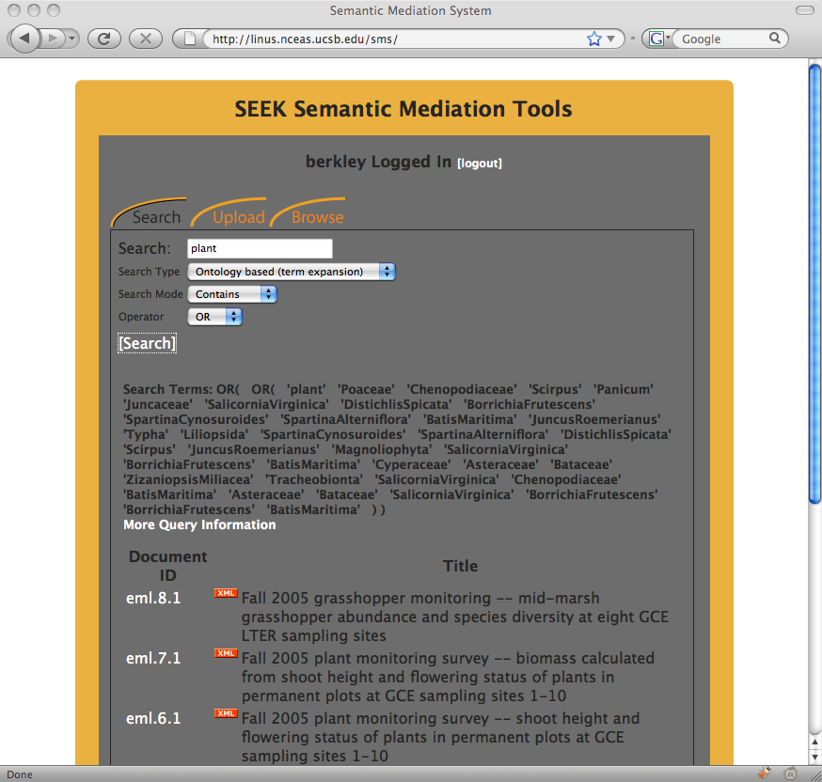
Keyword-based Term Expansion

Slide 24
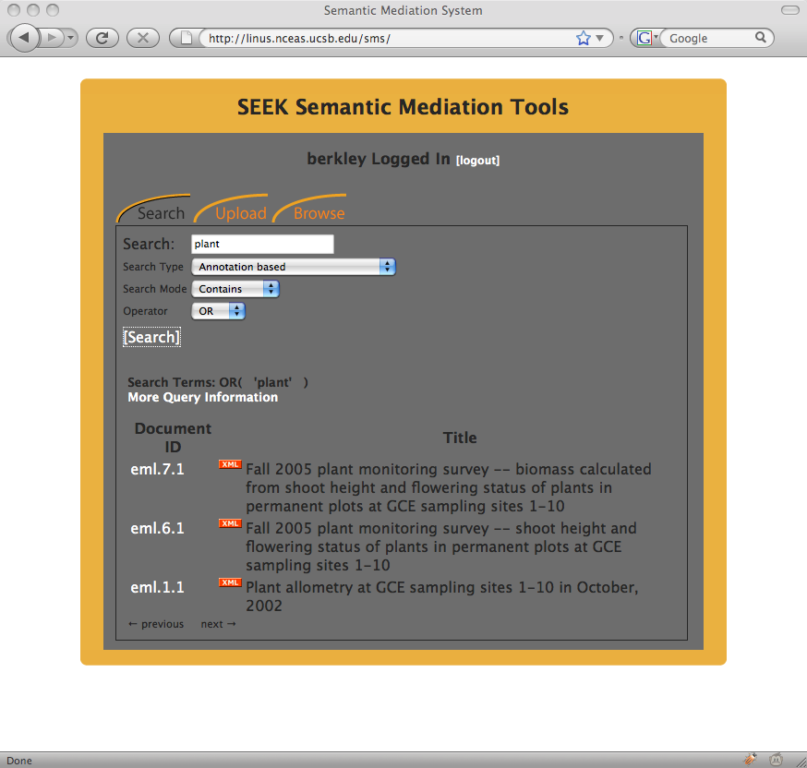
Annotation Enhanced Term Expansion

Slide 25
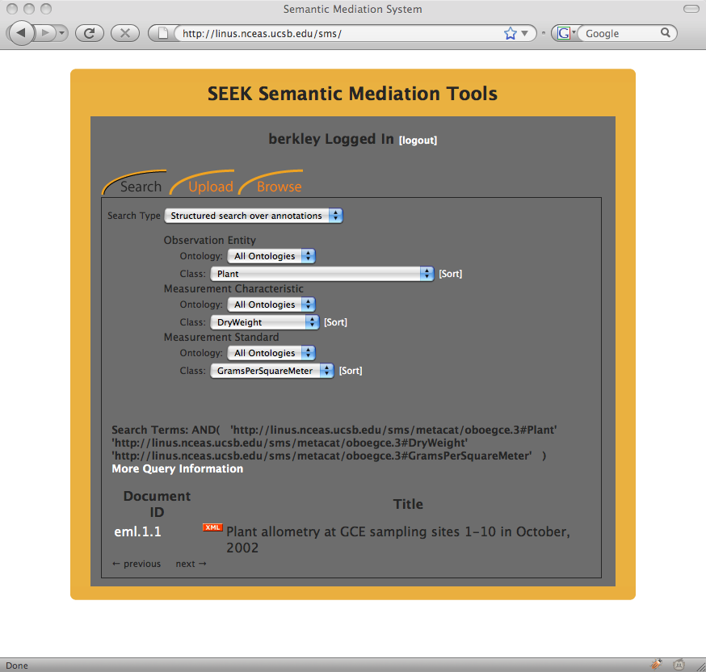
Structured Search

Slide 26
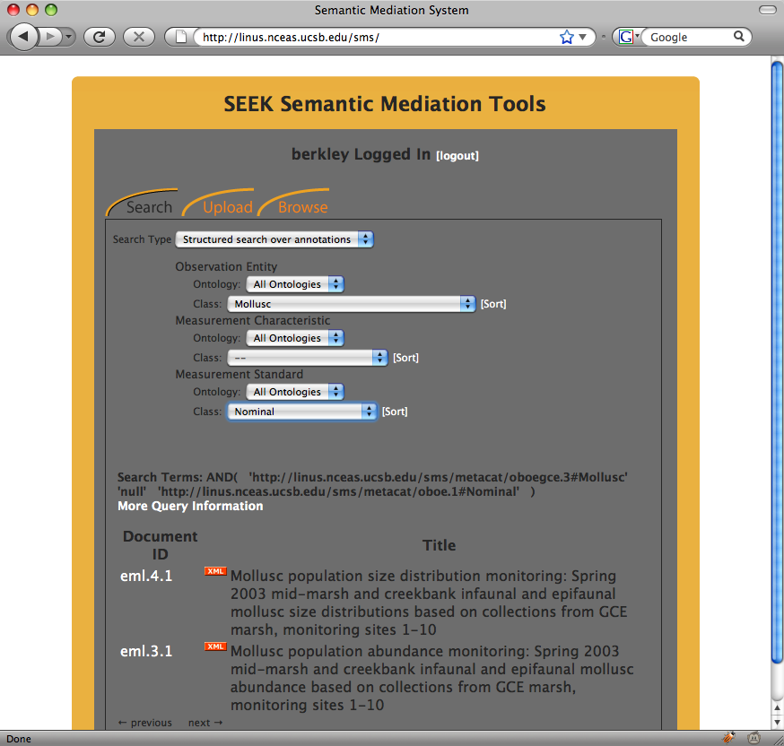
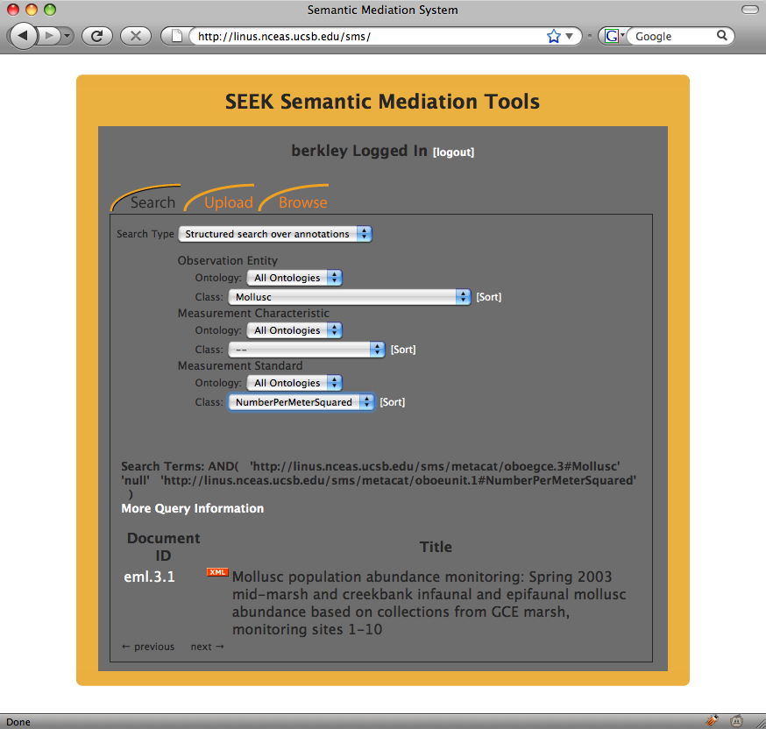
Structured Search

Slide 27
Conclusions
Simple Keyword (baseline)
  (+) precision, (+) recall
Keyword-based (ontological) term expansion
  (+/-) precision, (++) recall
Annotation enhanced term expansion
  (++) precision, (+++) recall
Observation based structured query
  (+++) precision, (+++) recall

Slide 28
Test site: http://linus.nceas.ucsb.edu/sms
Continue developing corpus of annotated data sets to better quantify precision/recall advantages
Enable use of “context” structure in OBOE
New award:
  enhance tools for creating annotations using ontologies
  Improve interfaces for structuring searches
Work supported by National Science Foundation awards 0225674, 0225676, 0743429, 0733849, 0753144, 0630033

