Slide 1


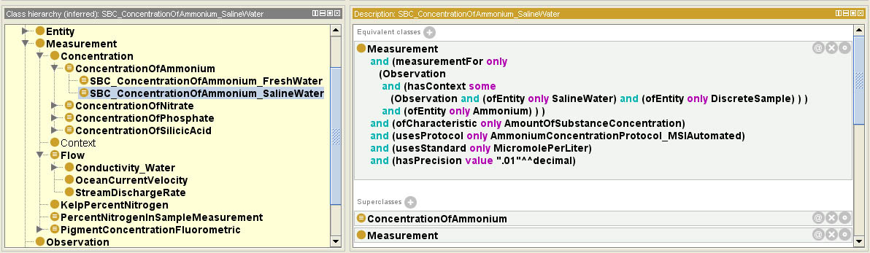
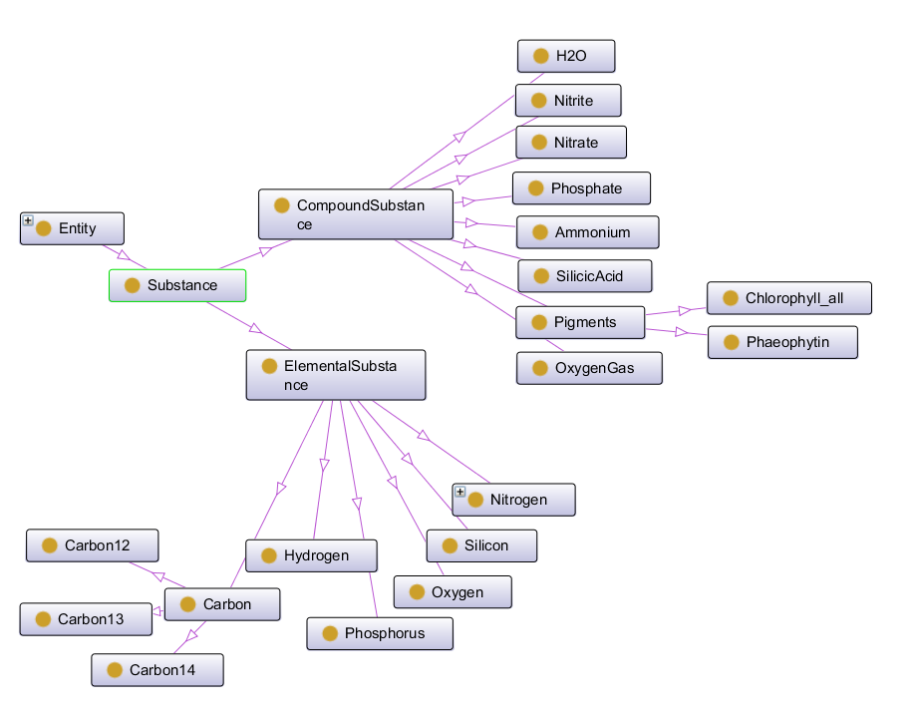
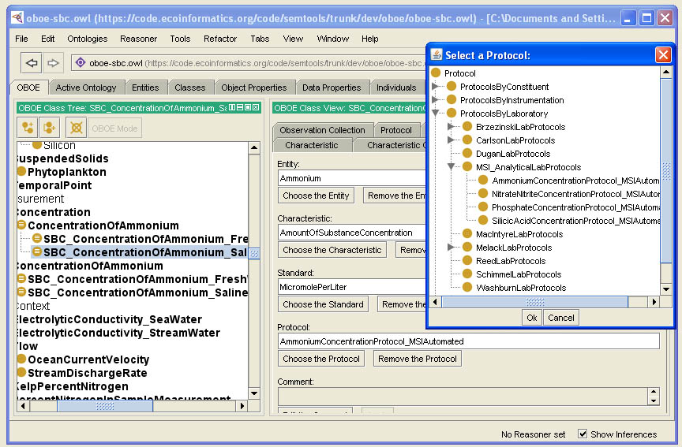
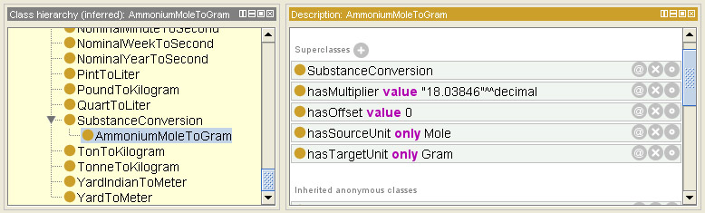
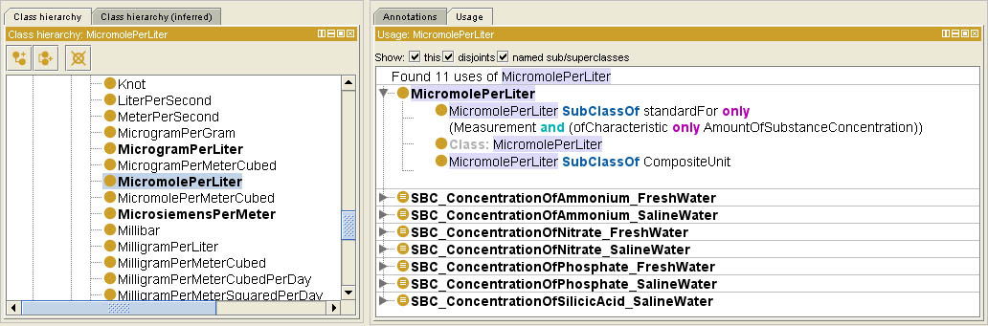
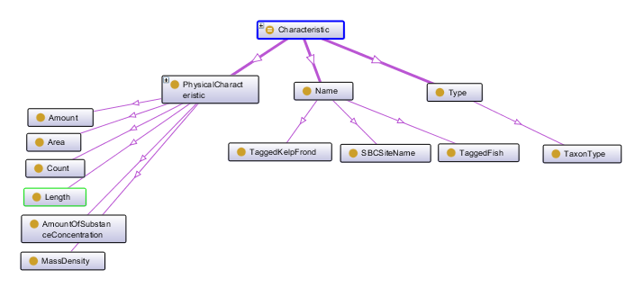
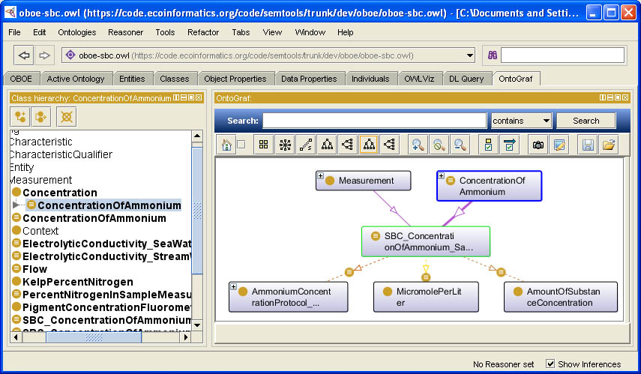
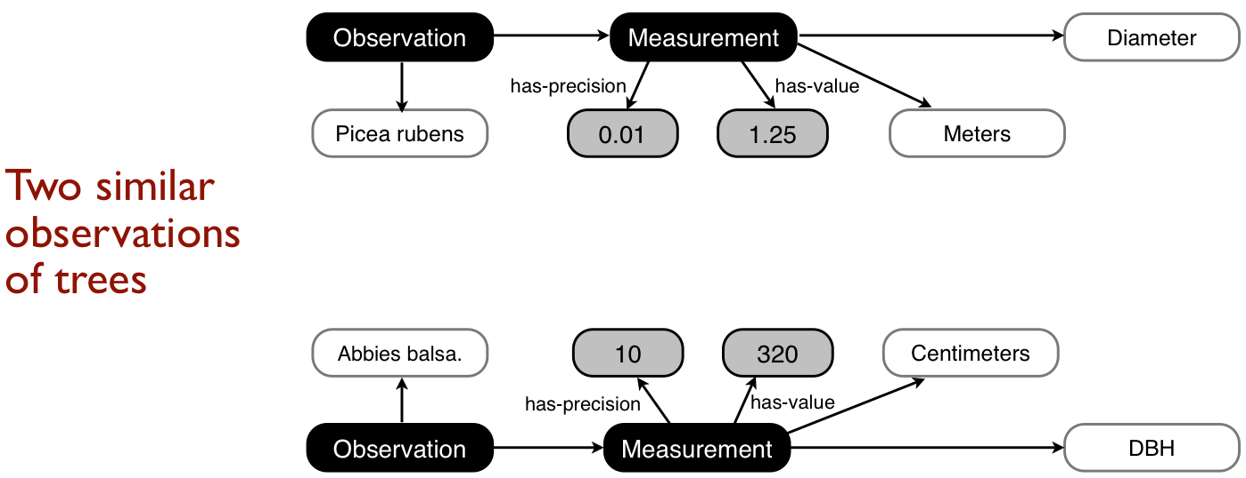
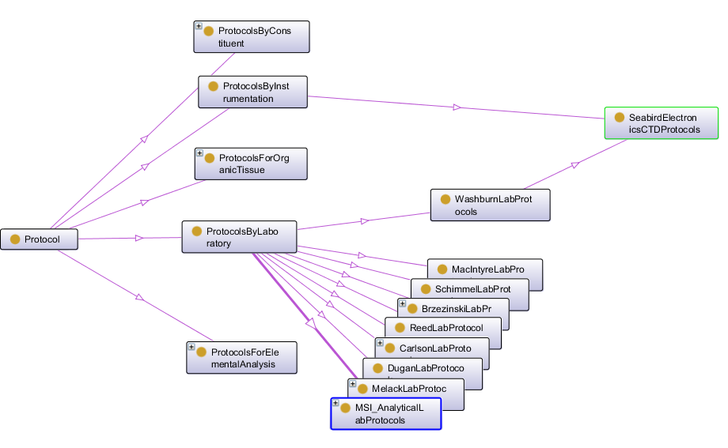
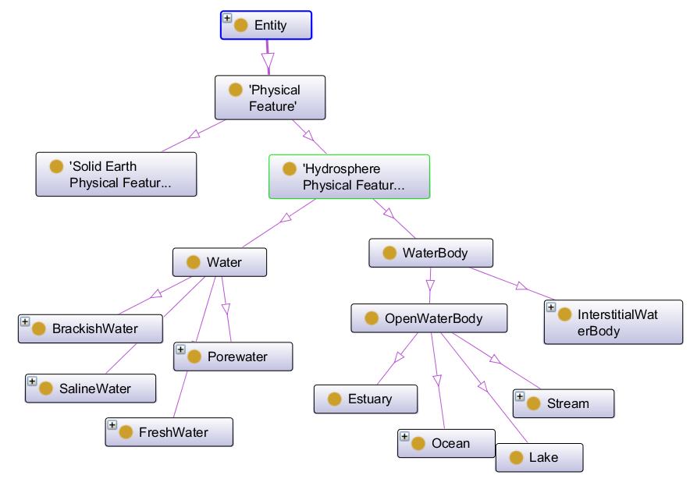
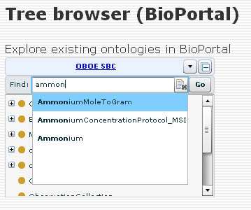
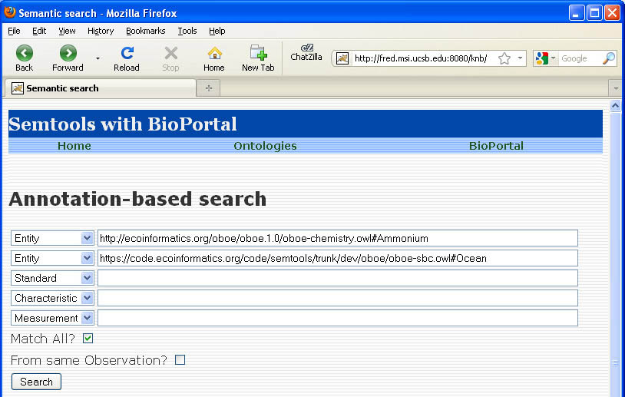
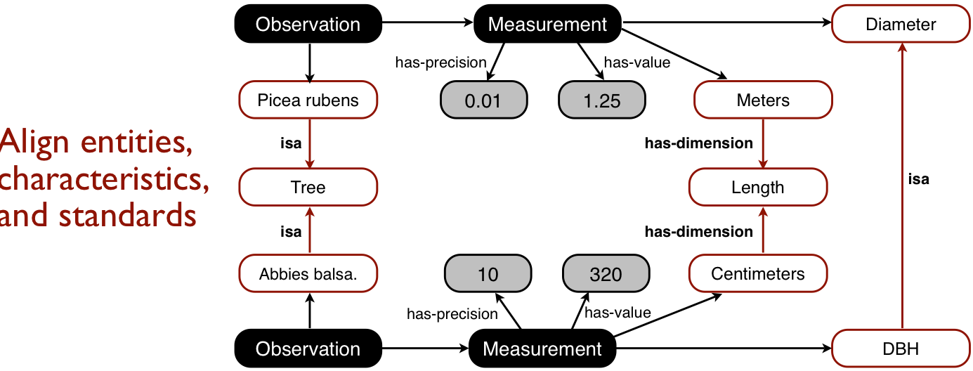
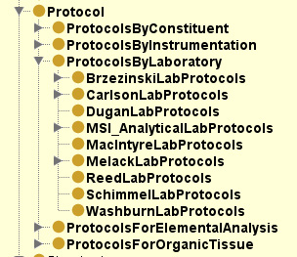




SBC Extension of the OBOE Measurement Ontology
Margaret O’Brien¹, Shawn Bowers², Matt Jones³, Mark Schildhauer³, Ben Leinfelder³
¹UC Santa Barbara (SBC LTER), ²Gonzaga University, ³NCEAS
https://semtools.ecoinformatics.org/
Abstract: SBC’s EML datasets are part of an ontology research project called “Semtools,” which is exploring how an observation ontology can be applied to environmental and ecological data. Here we introduce some features and uses of the ontology.
SBC Extension: As part of the project, SBC is developing a dictionary of its ecological and environmental measurements as an extension of the OBOE ontology, and is annotating its datasets with ontological terms.
OBOE Model
Extension
Tools in Development
Observation
of
entity
Entity
is
a
Ammonium
Dataset Annotation
-- Annotation and ontology management must be separated from datasets.
-- Annotation documents are a separate XML document.
-- EML datasets are keyed by ID to the dataTable and attribute.
-- The annotation is kept separate so that a dataset may be annotated with more than one ontology, or so that the same annotation may be reproduced for multiple datasets.
has measurement
of
has characteristic
is
a
<sms:annotation id="mobrien.36.62" emlPackage="mobrien.50.1" dataTable=“1">
<sms:observation label="o2">
<sms:context observation="o1">
<sms:relationship id="oboe-sbc.owl:Within"/>
<sms:entity id="oboe-sbc.owl:Stream"/>
<sms:entity id="oboe-sbc.owl:DiscreteSample"/>
</sms:context>
<sms:measurement id="oboe-sbc.owl:SBC_ConcentrationOfAmmonium_FreshWater" label="m3" precision="1.0">
<sms:entity id="oboe-chemistry.owl:Ammonium"/>
<sms:characteristic id="oboe-units.owl:AmountOfSubstanceConcentration"/>
<sms:standard id="oboe-units.owl:MicromolePerLiter"/>
<sms:protocol id="oboe-sbc.owl:MelackLabAmmoniumConcentrationProtocolFreshwaterAutomated"/>
</sms:measurement>
<sms:measurement id="oboe-sbc.owl:SBC_ConcentrationOfNitrate_FreshWater" label="m4" precision="1.0">
<sms:entity id="oboe-chemistry.owl:Nitrate"/>
<sms:characteristic id="oboe-units.owl:AmountOfSubstanceConcentration"/>
<sms:standard id="oboe-units.owl:MicromolePerLiter"/>
<sms:protocol id="oboe-sbc.owl:MelackLabNitrateNitriteConcentrationProtocolFreshwaterAutomated"/>
</sms:measurement>
<sms:measurement id="oboe-sbc.owl:SBC_ConcentrationOfPhosphate_FreshWater" label="m5" precision="1.0">
<sms:entity id="oboe-chemistry.owl:Phosphate"/>
<sms:characteristic id="oboe-units.owl:AmountOfSubstanceConcentration"/>
<sms:standard id="oboe-units.owl:MicromolePerLiter"/>
<sms:protocol id="oboe-sbc.owl:MelackLabPhosphateConcentrationProtocolFreshwaterAutomated"/>
</sms:measurement>
</sms:observation>
<sms:map attribute="NH4_uM" measurement="m1"/>
<sms:map attribute="NO3_uM" measurement="m2"/>
<sms:map attribute="PO4_uM" measurement="m3"/>
</sms:annotation>
Text here
Measurement
Characteristic
Concentration
Text here
Text here
uses
Protocol
is
a
NH4 in SW
Automated Flow injection
uses
Standard
is
a
MicromolePerLiter
has
Precision
is
a
0.01
Using the Ontology
Example: Measurement Definition
Populate an EML <attribute> node
Concentration of Ammonium in Seawater
<attribute id="sbc_ammonium_seawater_automated" system="sbc_attribute_dictonary" scope="system">
<attributeName>ammonium concentration</attributeName>
<attributeLabel>NH4 [umol/l]</attributeLabel>
<attributeDefinition>concentration of ammonium in seawater measured by automated flow injection</attributeDefinition>
<storageType typeSystem="http://www.w3.org/2001/XMLSchema-datatypes">float</storageType>
<measurementScale>
<ratio>
<unit>
<customUnit>micromolePerLiter</customUnit>
</unit>
<precision>0.01</precision>
<numericDomain>
<numberType>real</numberType>
</numericDomain>
</ratio>
</measurementScale>
<missingValueCode>
<code>99999.00</code>
<codeExplanation>no measurement collected at this point, or not available</codeExplanation>
</missingValueCode>
</attribute>
1. Entity:
the ‘thing’ you observed
The content of an EML <attribute> can come from the ontology.
Ontology Creation
Tools are in development to assist ontology authors.
4. Standard:
a reference for comparing or naming Entities
Unit Conversion
The ontology can store the information necessary to convert between units, e.g., the molecular weight of a compound.
The OBOE group is creating a plug-in for this application to assist authors designing OBOE extensions.
2. Characteristic: a property of the Entity that can be measured
Data Integration
Other graphical plug-ins are already available for Protégé.
The top data model shows two observations, both of tree diameter, but which are not described the same way.
“Context” associates this measurement with another Entity
3. Protocol:
the procedure for generating data
By aligning the observed entities (“Tree”) and characteristics (“Length”) with annotation, and knowing that “DBH” is a “Diameter,” an application can compare these observations.
Browse, Search and Discovery
More specific and accurate searches can be conducted when datasets are annotated with ontological terms.
This research was supported by the US National Science Foundation’s Long Term Ecological Research program and by DBI-0743429

