Slide 1

Improving Data Discovery Through Semantic Search
Collaborators:
Chad Berkley, Shawn Bowers, Matt Jones,
Mark Schildhauer, Josh Madin

Slide 2
Motivation
Increasing numbers of datasets in online repositories including the KNB
Precision and Recall of current search technology is not satisfactory (definitions on next slide)
Ecological metadata does not lend itself to traditional text based searching
Ecological metadata is susceptible to “Semantic Drift”

Slide 3
Definitions
Precision: number of relevant documents retrieved by a search divided by the total number of documents retrieved by that search
Recall: the number of relevant documents retrieved by a search divided by the total number of existing relevant documents (which should have been retrieved)

Slide 4
Precision
Document set of 20 files
10 files are relevant to your search
If only 8 files are retrieved and they are all relevant documents, the precision is 8/10 or 0.8
If 10 documents are returned and all 10 are relevant, the precision is 1.0
Precision says nothing about whether all relevant documents are actually returned.

Slide 5
Recall
Same document set of 20 with 10 documents relevant to your search.
If 12 documents are returned including all 10 of the relevant documents, recall is 1.0
If 12 documents are returned with only 8 of the 10 relevant documents, recall is 0.8
Recall shows how many relevant documents are returned but says nothing about false positives also returned.

Slide 6
Precision and Recall
They are inversely related.
You can increase precision by decreasing recall and visa versa.
Effective search engines must find a balance between the two.
Better precision and recall generally mean a better search engine
I.E. if you increase precision and recall, you should have more relevant results

Slide 7
Our Semantic Approach
Data, EML (metadata), Annotations and Ontologies
Ontology: specification of a conceptualization.
  Hierarchical structure of concepts
  Concepts lower in the tree are defined with respect to higher level concepts
Annotations link EML attributes to concepts defined in an ontology

Slide 8
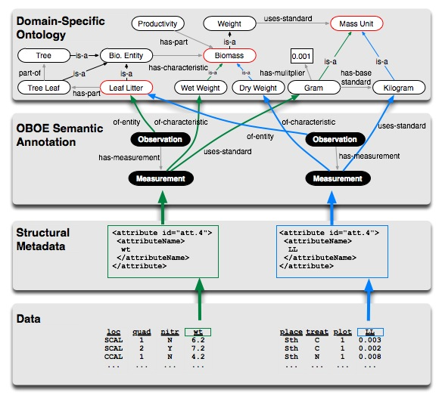
Document Relationships

Slide 9
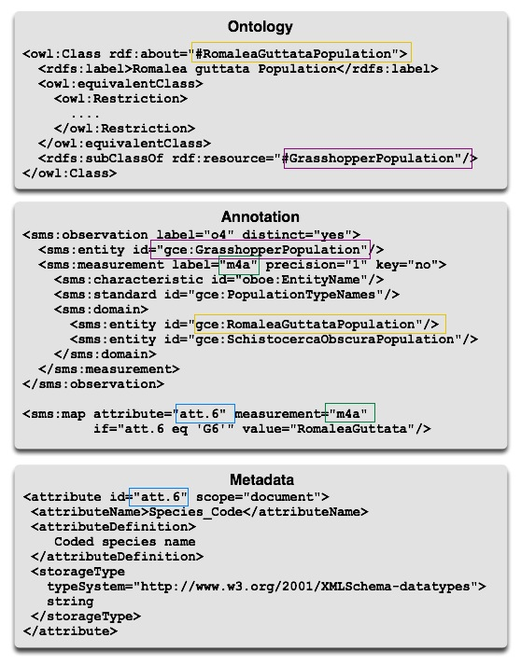
XML Links

Slide 10
Concepts of Semantic Search
Annotations give metadata attributes semantic meaning w.r.t. an ontology
Enable structured search against annotations to increase precision
Enable ontological term expansion to increase recall
Precisely define a measured characteristic and the standard used to measure it via OBOE

Slide 11
OBOE Quick Overview
Extensible Observation Ontology (OBOE)
OBOE provides a high-level abstraction of scientific observations and measurements
Enables data (or metadata) structures to be linked to domain-specific ontology concepts
For more OBOE information, talk to Shawn B., Matt J., Mark S. or Josh M.

Slide 12
Types of Implemented Searches
Simple Keyword (baseline)
Keyword-based (ontological) term expansion
Annotation enhanced term expansion
Observation based structured query

Slide 13
Simple Keyword Search
High false positive rate
Metadata structure is often ignored
Project level metadata often conflicts with attribute level metadata
Example: search for “soil” will return frog data because the description of the lake the frogs were studied in contained the word “soil”
Synonyms for search terms are ignored

Slide 14
Keyword-based Term Expansion
Synonyms and subclasses of the search term are discovered via the ontology
Additional terms are added to the query of metadata docs
Example: Search for “Grasshopper” also searches for “Orchilimum,” “Romaleidae,” etc.
Increases recall, probably decreases precision
Helps fight “semantic drift”

Slide 15
Annotation Enhanced Term Expansion
Terms are first expanded similarly to the keyword-based term expansion
Search performed against annotations not the metadata itself
Returns metadata documents that are linked to the annotation
Increase of precision. Not sure about recall, depending on the document base, it could go up or down.

Slide 16
Observation Based Structured Query
Takes advantage of observation and measurement structures and relationships
Search based on an observed entity (e.g. a Grasshopper) and the measurement standards and characteristics used to measure it
Observed entity is a “template” on which the measurement characteristic and standard are applied

Slide 17
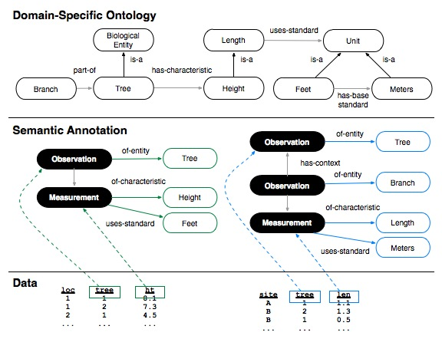
Observation Based Structured Query
Both datasets contain “tree lengths”
Annotation search for “tree length” would return both datasets
Structured search allows the search to be limited by the observed entity (e.g. a tree or a tree branch)
Would seem to increase precision and recall

Slide 18
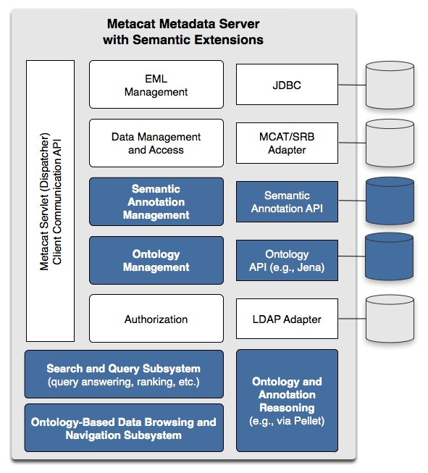
Metacat Implementation

Slide 19
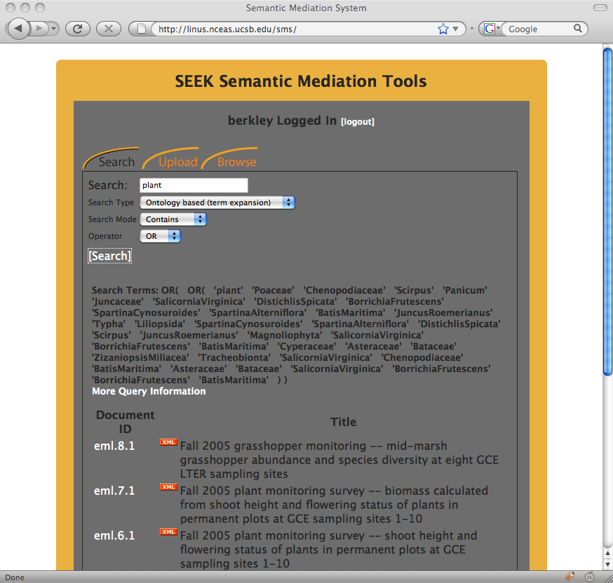
Keyword-based Term Expansion

Slide 20
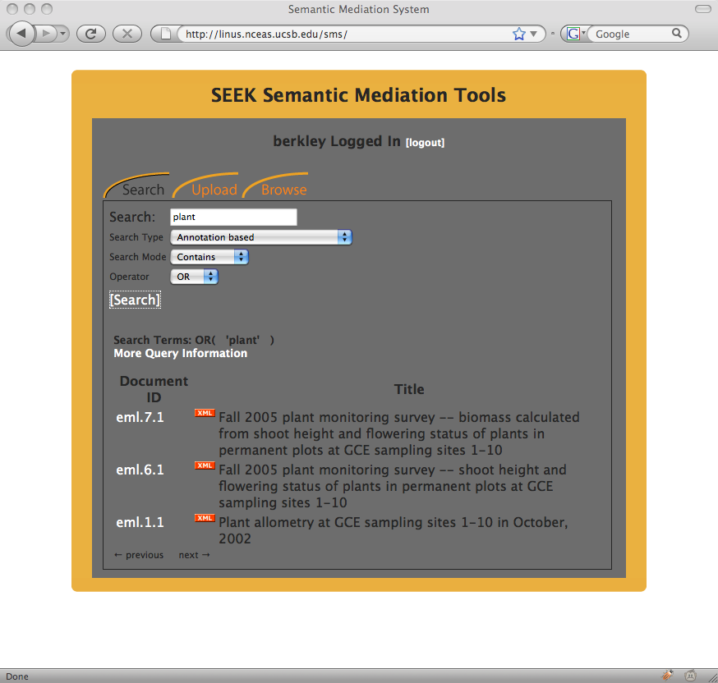
Annotation Enhanced Term Expansion

Slide 21
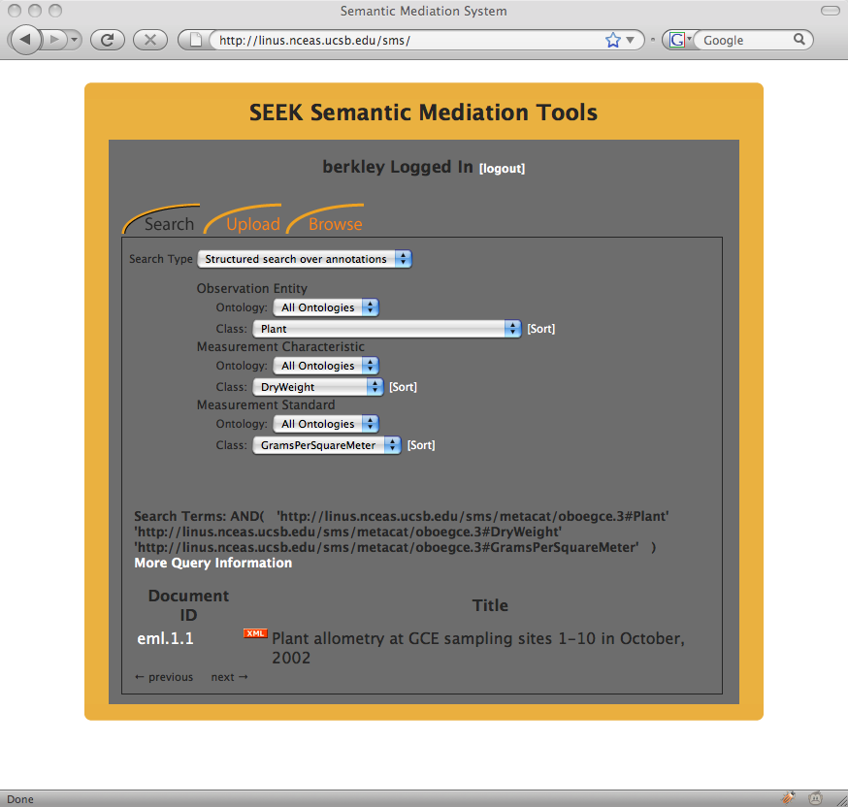
Structured Search

Slide 22
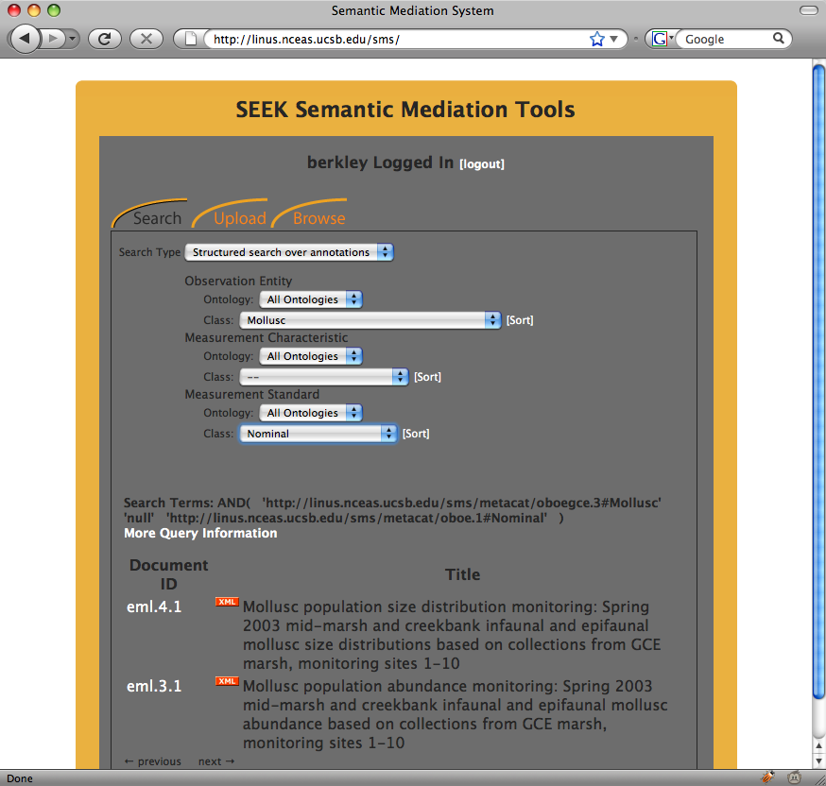
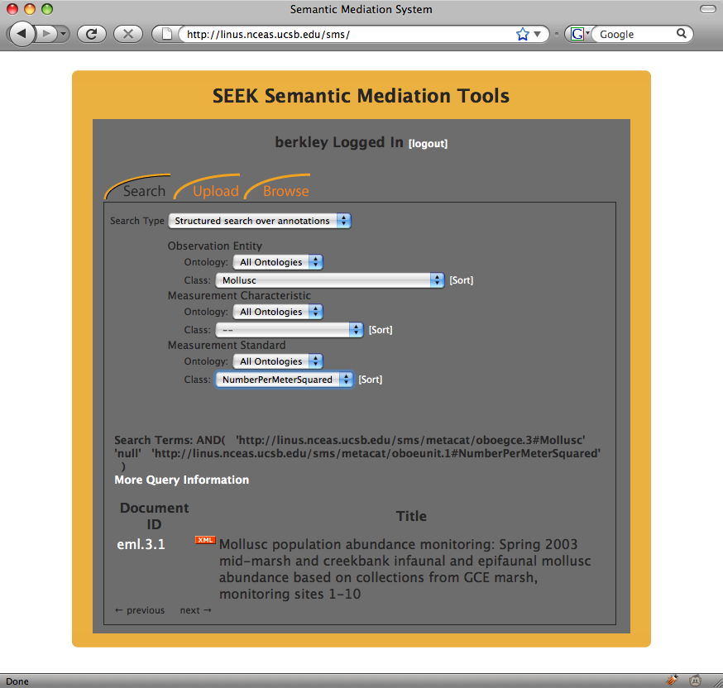
Structured Search

Slide 23
Thanks
Play with it: http://linus.nceas.ucsb.edu/sms
Future: New grant to explore this more
Future: Do better experiments to find out if our intuitions about precision and recall are correct
Paper: https://svn.ecoinformatics.org/semtools/docs/pubs/iSEEK09/iSEEK09.doc
Thanks to Shawn, Matt, Mark and Josh

