Slide 1
SONet: A Community-Driven Scientific Observations Network to achieve Semantic Interoperability of Environmental and Ecological Data
Project Participants
Mark Schildhauer¹, Shawn Bowers², Corina Gries³, Deborah McGuinness⁴, Philip Dibner⁵, Josh Madin⁶, Matt Jones¹, Luis Bermudez⁷, John Graybeal⁷
¹NCEAS UC Santa Barbara, ²UC Davis Genome Center
³CAP/LTER and Univ. of Arizona, ⁴McGuinness Associates,
⁵OGC Interoperability Institute, ⁶Macquarie University,
⁷Monterey Bay Aquarium Research Institute
Notes:
NSF INTEROP Funded Project
Like SemTools, this work came out of the SEEK KR/SMS Effort
This project arrose out of an NSF Workshop on Observational Data Models -- to see if there was a desire/need to define a common/core model for interoperability

Slide 2
Objectives
Broad Objectives
Address semantic interoperability issues in environmental and ecological data [sharing, discovery, integration]
Build a network of practioners (SONet), including domain scientists, computer scientists, and information managers
Build generic, cross-disciplinary data interoperability solutions
Immediate Goals to Develop
An extensible and open observations data model to unify existing domain-specific approaches
A semantic (ontology) framework for scientific terminology, and corresponding domain extensions
Demonstration prototypes using these to address current interoperability issues

Slide 3
Working Groups
Subgroup 1:
Core Data Model for
Observations
Subgroup 2:
Catalog of Common
Field Observations
Subgroup 1
Collect interoperability requirements
Define common, unified data model
Engage tool & data providers, data consumers
Subgroup 2
Identify and catalog common observation types (semantics)
Engage data providers and information managers
Subgroup 3
Define general extension ontologies of scientific terms
Focus work on outputs of group 2
Engage range of domain scientists
Subgroup 4
Define and prototype demonstration projects
Ensure compatability of subgroups
Subgroup 4:
Demonstration
Projects
Core SONet
Team
Subgroup 3:
Scientist-Oriented
Term Organization
Each group consists of two team leads
Postdoc funded to work on demonstration
projects & help ensure compatibility across
subgroups

Slide 4
Workshops & Outreach
Community workshops
  … to bring together project members, data managers, domain scientists, computer scientists, and members of the larger environmental informatics community
  Workshop 1: Collect detailed requirements and use cases for each SONet subgroup
  Workshop 2: Refine and extend use cases; Discuss and evaluate proposed data models and representations
  Workshop 3: Present and discuss refined data models and representations; early evaluation and feedback
  Workshop 4: Training; discuss and plan SONet sustainability
  … continue from prior NSF workshop on observation data models
  … approximately 20-25 particpants at each workshop

Slide 5
Initial Project Timeline
Community
Workshop (1)
(requirements & use cases)
Community
Workshop (2)
(use cases & modeling)
Community
Workshop (3)
(modeling & refinement)
Community
Workshop (4)
(training, sustainability)
Project Leaders
Meeting (1)
(orientation & planning)
Project Leaders
Meeting (2)
(evaluation & planning)
Year 1
Year 2
Year 3
setup project mgmt.
infrastructure,
Postdoc hiring
finalize community
participants,
meeting preparation
document results, begin
implementation & interoperability
tests, setup network website
document results,
continue impl.
& interop. tests
continue impl.
& interop. tests,
meeting preparation
finalize impl.
& interop. tests,
sustainability planning
document results,
execute plan
for sustainability
Workshops and meetings:
  Year 1: first community workshop, project meeting
  Year 2: second community workshop, project meeting
  Year 3: last two community workshops, including training
Project has not officially started (just awarded)

Slide 6
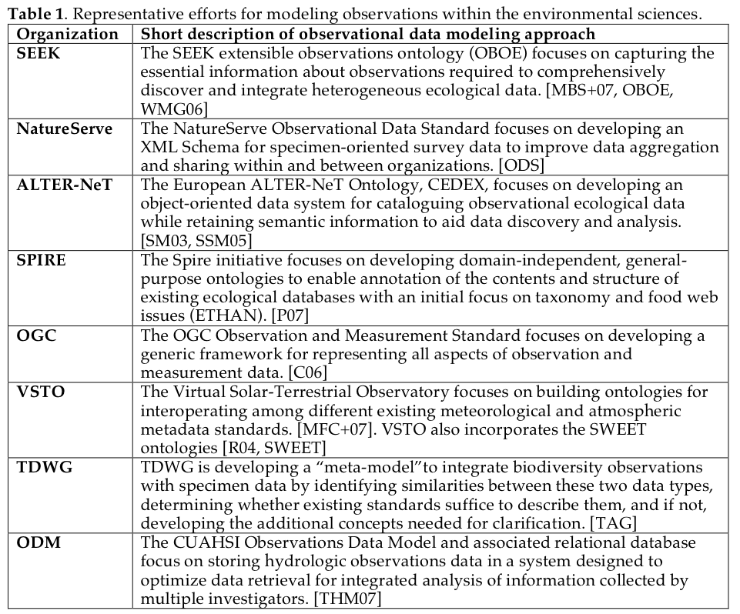
Thank you for your time !!!

