Slide 1

SONet: A Community-Driven Scientific Observations Network to achieve Semantic Interoperability of Environmental and Ecological Data
Mark Schildhauer¹, Shawn Bowers², Corina Gries³, Deborah McGuinness⁴, Philip Dibner⁵, Josh Madin⁶, Matt Jones¹, Luis Bermudez⁷
¹NCEAS UC Santa Barbara, ²Gonzaga University
³NTL/LTER and Univ. of Wisconsin, ⁴McGuinness & Associates,
⁵OGC Interoperability Institute, ⁶Macquarie University,
⁷Southeastern Universities Research Association
http://sonet.ecoinformatics.org
Notes:
NSF INTEROP Funded Project
Like SemTools, this work came out of the SEEK KR/SMS Effort
This project arose out of an NSF Workshop on Observational Data Models -- to see if there was a desire/need to define a common/core model for interoperability

Slide 2
Motivation
Need to answer increasingly complex and critical questions:
What is the (local/regional/global) impact of …
changing climate
overfishing
urban development, human population growth
GMOD crops, fertilization
declining pollinators
globalization of trade
deforestation
On…
food production, spread of disease, drought,
global biodiversity, desertification, soil loss

Slide 3
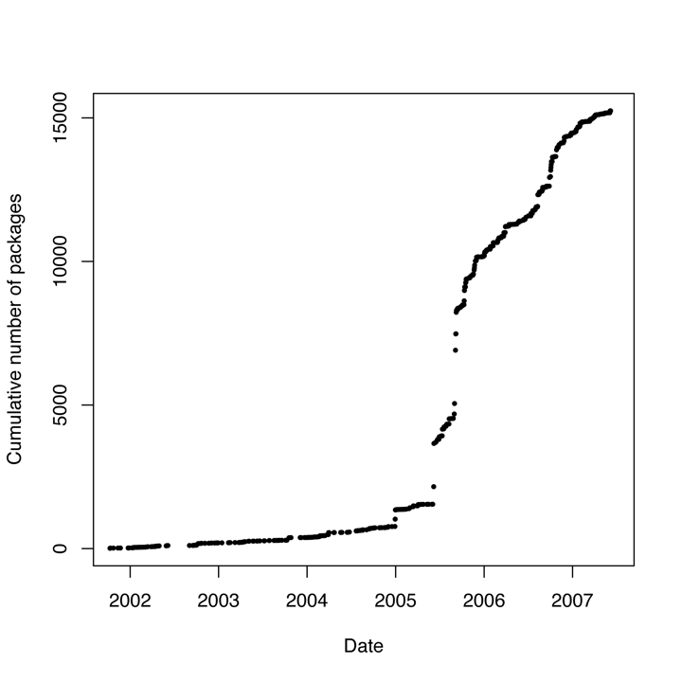
Motivation
And a growing deluge of environmental data to assist
in these investigations …
Notes:
New information resourcesapearing online
Sensor networks being deployed
Remote sensing data accumulating
Long-term information increasing

Slide 4
Motivation
But…
locating desired information is already quite difficult…
  Culling through irrelevant information (precision)
  Failing to find useful information (recall)
using the data you find is problematic…
  Proper interpretation (units, context, methods)
  Merging, transforming for re-use
    Manual, ad-hoc, arduous
… Why?
Notes:
Roughly map to “discovery” and “access”

Slide 5
Motivation
Environmental data are highly heterogeneous…
• Variable syntax (csv, xls, netCDF)
• Structures (tables, rasters, vectors, hierarchical)
• Semantics (terminology, units, methods)
• Encompassing many disciplines:
• Biotic data: genomics, cellular, physiology, morphology, biodiversity, populations, communities, ecosystems
• Abiotic data: hydrology, geospatial, oceanography, atmospheric, soil, geology, etc.

Slide 6
Need for interoperability
MANY different “semantic” efforts underway to unify data within earth/biodiversity/environmental disciplines, converging on use of OBSERVATIONAL data construct
SPECIALIZED needs and concerns of different domains may drive semantic technology solutions to be diverse and incompatible
OPPORTUNITY exists for communicating and coordinating among different domains to achieve greater interoperability of emerging semantic technology solutions
BENEFIT is providing cross-disciplinary scientists with more seamless and powerful access to a broad range of relevant data and information

Slide 7
NSF’s OCI INTEROP
Digital data are increasingly both the products of research and the starting point for new research and education activities.
The ability to re-purpose data – to use it in innovative ways and combinations not envisioned by those who created the data – requires that it be possible to find and understand data of many types and from many sources.
Interoperability (the ability of two or more systems or components to exchange information and to use the information that has been exchanged) is fundamental to meeting this requirement.

Slide 8
NSF’s OCI INTEROP
This NSF crosscutting program supports community efforts to provide for broad interoperability through the development of mechanisms such as robust data and metadata conventions, ontologies, and taxonomies.
Support is provided… for consensus-building activities:
community workshops, web resources such as community interaction sites, and task groups.
… and for providing the expertise necessary to turn the consensus into technical standards with associated implementation tools and resources:
information sciences, software development, and ontology and taxonomy design and implementation.

Slide 9
Objectives of SONet
Broad Objectives
Address semantic interoperability issues in environmental (earth sciences) data [sharing, discovery, integration]
Build a network of practitioners (SONet), including domain scientists, computer scientists, and information managers
Build generic, cross-disciplinary data interoperability solutions
Immediate Goals to Develop
An extensible and open observations data model (“core model”) to unify existing domain-specific approaches
A semantic (ontology) framework for scientific terminology and corresponding domain extensions
Demonstration prototypes using these to address critical data interoperability issues

Slide 10
Working Groups
Subgroup 1:
Core Data Model for
Observations
Subgroup 2:
Catalog of Common
Field Observations
Subgroup 1
Collect interoperability requirements
Define common, unified data model
Engage tool & data providers, data consumers
Subgroup 2
Identify and catalog common observation types (semantics)
Engage data providers and information managers
Subgroup 3
Define general extension ontologies of scientific terms
Focus work on outputs of group 2
Engage range of domain scientists
Subgroup 4
Define and prototype demonstration projects
Ensure compatability of subgroups
Subgroup 4:
Demonstration
Projects
Core SONet
Team
Subgroup 3:
Scientist-Oriented
Term Organization
Each group consists of two team leads
Postdoc funded to work on demonstration
projects & help ensure compatibility across
subgroups
Notes:
Subgroup 1- Core model: Bowers, Dibner
Subgroup 2- Catalog of field observations:Gries, Bermudez
Subgroup 3- Scientific terms: Madin, Schildhauer
Subgroup 4- McGuinness, Cao (postdoc)

Slide 11
Workshops & Outreach
Community workshops
  … to bring together project members, data managers, domain scientists, computer scientists, and members of the larger environmental informatics community
  Workshop 1: Collect detailed requirements and use cases to frame a “Scientific Observations Interoperability Challenge”; begin defining core model
  Workshop 2: Discuss various data models in terms of addressing “Scientific Observations Interoperability Challenge”; refine core model
  Workshop 3: Roll-out of operational prototype; early evaluation and feedback
  Workshop 4: Training; further evaluative discussion, and plan SONet sustainability
  … approximately 20+ participants at each workshop

Slide 12
Project Timeline
Community
Workshop (1)
(develop requirements & use cases)
Community
Workshop (2)
(discuss & refine models)
Community
Workshop (3)
(roll-out & evaluate)
Community
Workshop (4)
(training, sustainability)
Project Leaders
Meeting (1)
(orientation & planning)
Project Leaders
Meeting (2)
( evaluation & planning)
Year 1
Year 2
Year 3
setup project mgmt.
infrastructure,
Postdoc hiring
finalize community
participants,
meeting preparation
begin
implementation & interoperability
tests, setup support infrastructure
document and contrast
results, continue impl.
& interop. tests
continue impl.
& interop. tests,
meeting preparation
finalize impl.
& interop. tests,
sustainability planning
document results,
execute plan
for sustainability
Workshops and meetings:
  Year 1: first community workshop, project meeting
  Year 2: second community workshop, project meeting
  Year 3: last two community workshops, including training
Project has just recently officially started

Slide 13
1st SONet community workshop
  Identify initial key participants for effort (you!)
  Representatives from semantic/observational efforts in diverse environmental sciences:
    Plant genomics, oceanography, hydrology, biodiversity sciences, ecology, atmospheric sciences, geospatial community
  Computer science experts in knowledge representation, semantic web, conceptual data modeling, informatics

Slide 14

1st SONet community workshop
  Postdoctoral fellow starting November 1
  Huiping Cao
  Collaborative web site
    https://sonet.ecoinformatics.org
    Wiki-like editing and file uploading (requires login)
    Public and private areas
    Discussion forum (requires login)
    Logo!

Slide 15
M.O. for SONet, and this meeting
  Group discussion and collaboration, not presentation
  Brainstorming and refinement
  Semantics-based approach
    Controlling concepts within a discipline
    Using concepts across disciplines
    OCI award
  * Observational approach

Slide 16
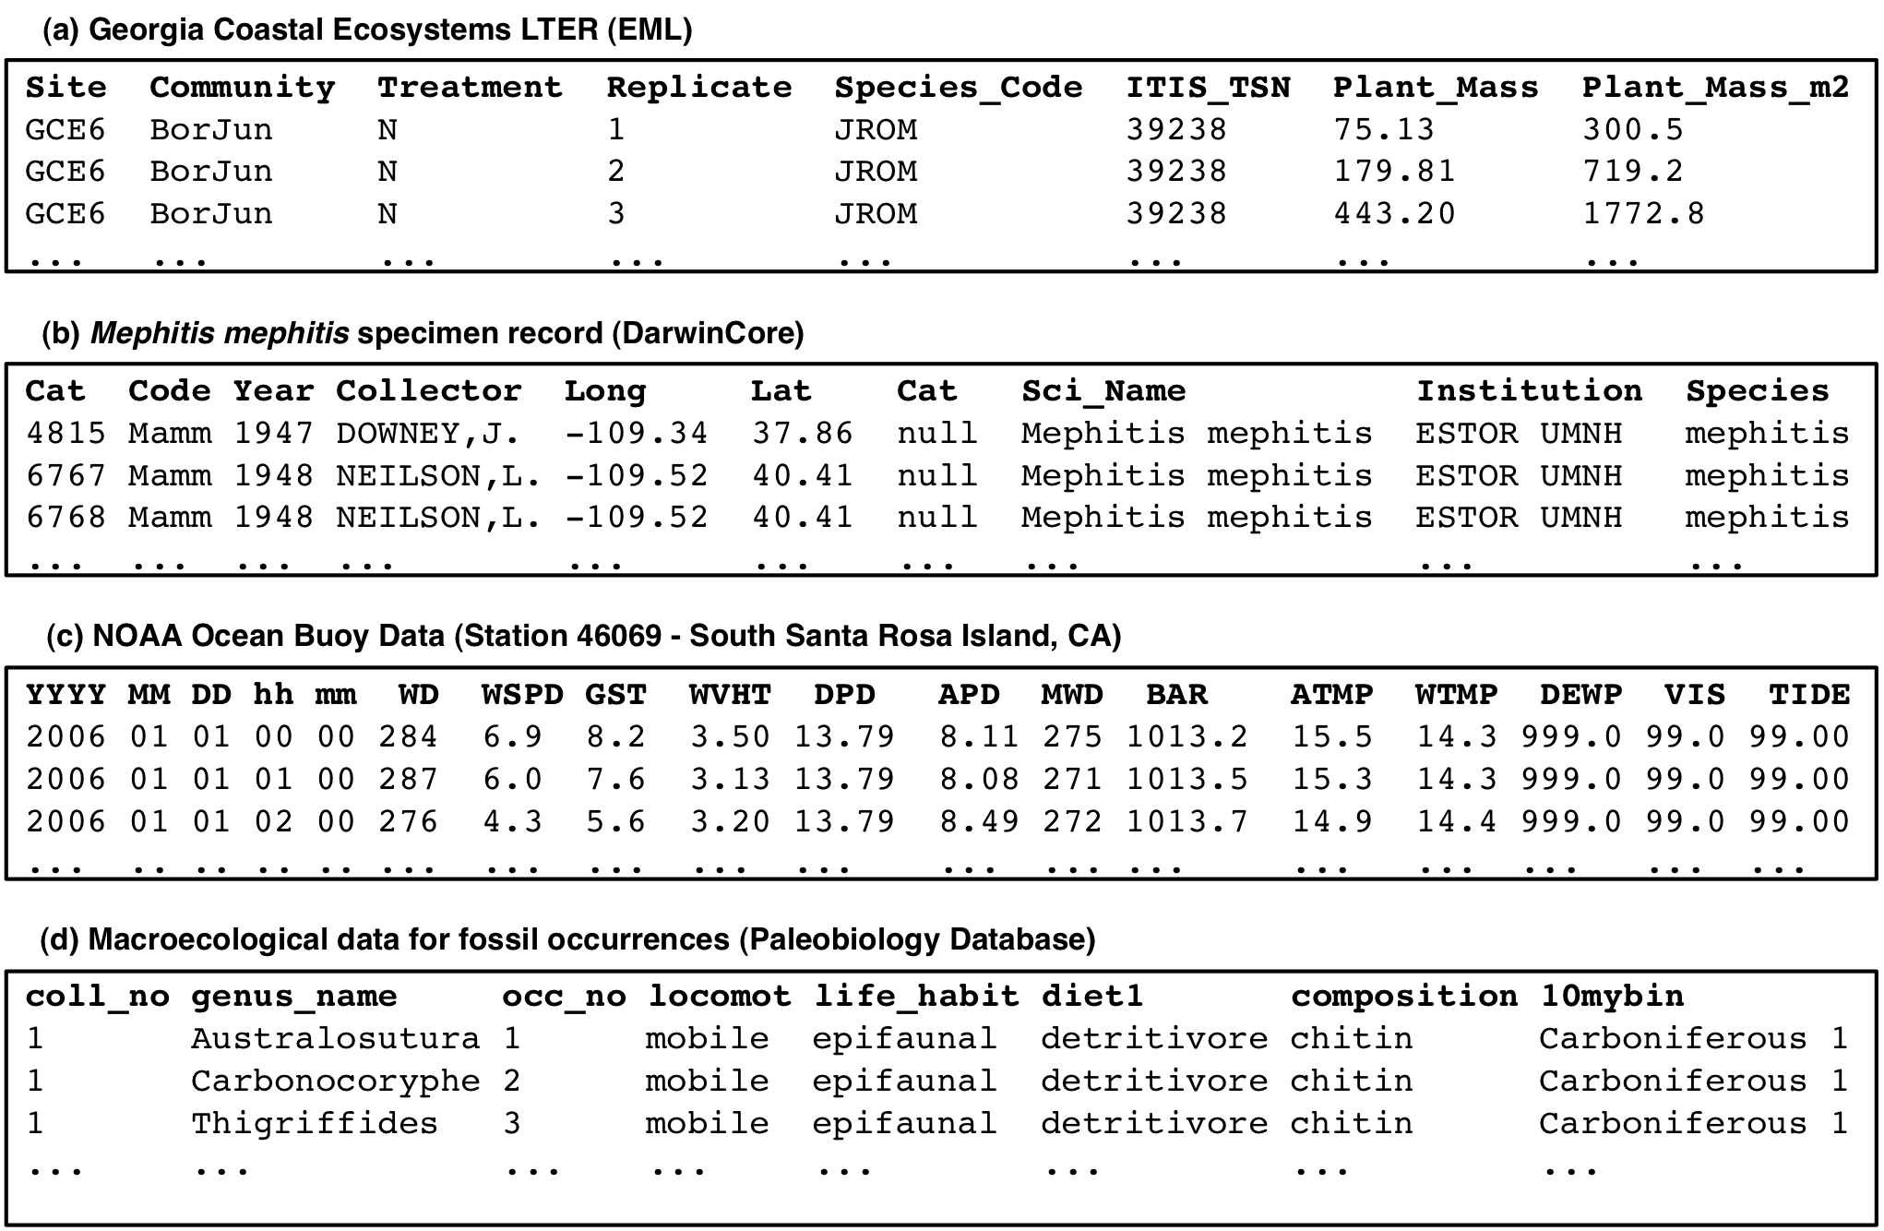
Examples of “raw” observational data

Slide 17
Observation defined
An observation represents any measurement of some characteristic (attribute) of some real-world entity or phenomenon.
A measurement consists of a realized value of some characteristic of an entity, expressed in some well-specified units (drawn from a measurement standard)
Observations can provide context for other observations (e.g. observations of spatial or temporal information would often provide context for some other observation)

Slide 18
Another definition for observation
An observation is an action with a result which has a value describing some phenomenon. The observation is modelled as a Feature within the context of the General Feature Model. An observation feature binds a result to a feature of interest, upon which the observation was made. The observed property is a property of the feature of interest. An observation uses a procedure to determine the value of the result, which may involve a sensor or observer, analytical procedure, simulation or other numerical process. The observation pattern and feature is primarily useful for capturing metadata associated with the estimation of feature properties, which is important particularly when error in this estimate is of interest.

Slide 19
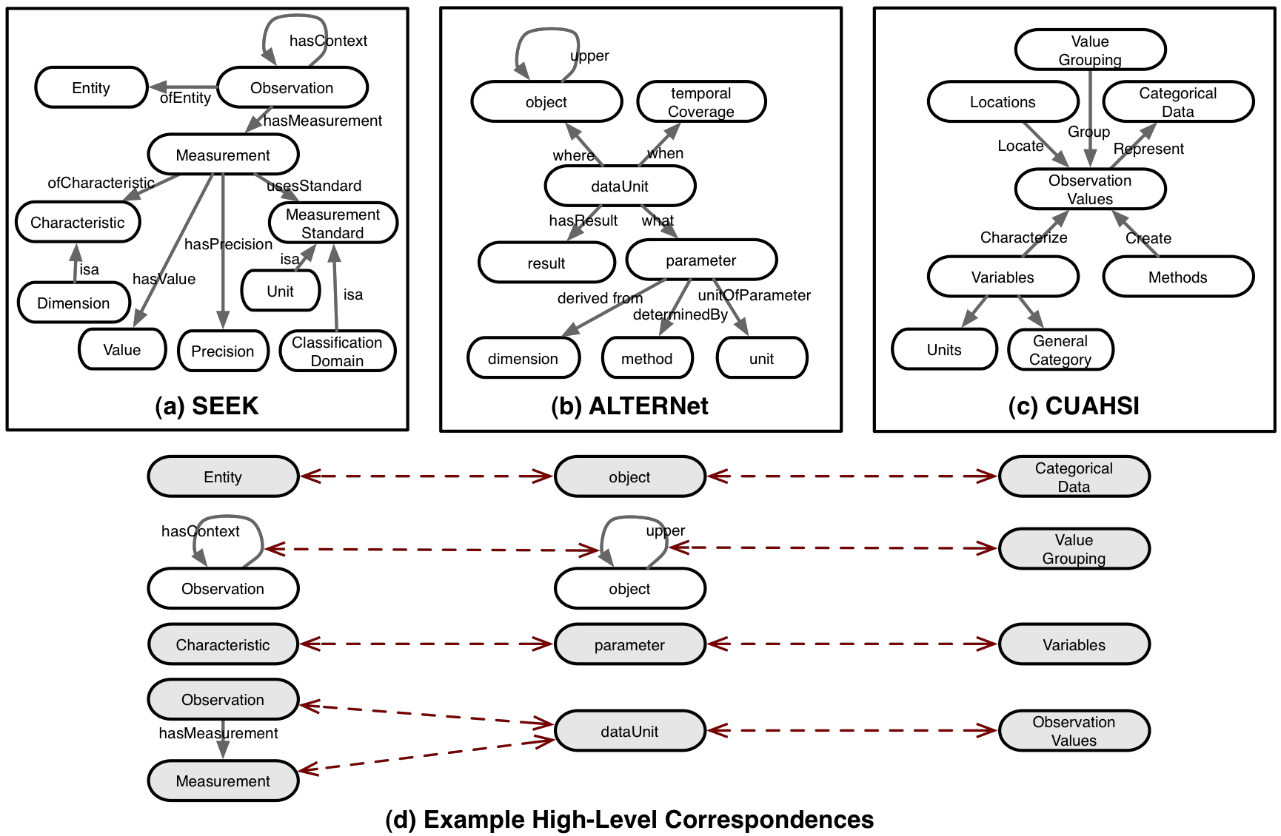
Formalizing “Observational Data” Concept
Notes:
OWL-DL, XML Schema, ER, etc.

Slide 20
Prospective observation models…
Project | Domain | Observational data model
TDWG/OSR | Biodiversity | Meta-model to integrate field observational data with specimen data
VSTO | Atmospheric sciences | Ontologies for interoperations among different meteorological metadata standards
ODM | Hydrology | CUAHSI’s Observational Data Model for storing diverse hydrological data
SERONTO | Socioecological research | Ontology for integrating socio-ecological data
OGC’s O&M | Geospatial | Observations and Measurements standard for enhancing sensor data interoperability
SEEK’s OBOE | Ecology | Extensible Observation Ontology for describing data as observations and measurements

Slide 21
Variations of Observational Data Models

Slide 22
Developing a core model
Identify the key observational models in the earth and environmental sciences
Are these various observational models easily reconciled and/or harmonized?
Are there special capabilities and features enabled by some observational approaches?
What services should be developed around these observational models?

Slide 23
Goals for this meeting
  Begin formally identifying and resolving commonalities and discrepancies among our observational efforts
  Start defining a common core observational model for our data
  Articulate Use Cases (cross-disciplinary data integration tasks) that underpin a “Scientific Observations Interoperability Challenge”

Slide 24
Goals for this meeting
  Clarify specific short-term technology development that can catalyze and assist teams undertaking the “Scientific Observations Interoperability Challenge”
  Plan to publish results of “Interoperability Challenge” in special issue of ??

Slide 25
Scientific Observations Interoperability Challenge
    Understand the similarities, differences, and scope of the existing models for describing scientific observations
    Understand the main modeling concepts and relationships used by the different approaches
    Understand the services offered by systems supporting each approach, e.g., for data discovery, integration, etc.
    Identify approaches for enabling interoperability among the different approaches and systems
    Bring together a community to further develop interoperability solutions for sharing and integrating environmental data
    Further define and evaluate a "straw-man" core observation model and set of services to enable improved interoperability among systems

Slide 26
Scientific Observations Interoperability Challenge
  Use Cases
    Begin gathering data, metadata for Use Cases
    Should involve diverse representative data types
    Should involve cross-domain integration
    Begin developing specific queries
    Use Cases will help define needed services for achieving goals of the interoperability challenge

Slide 27
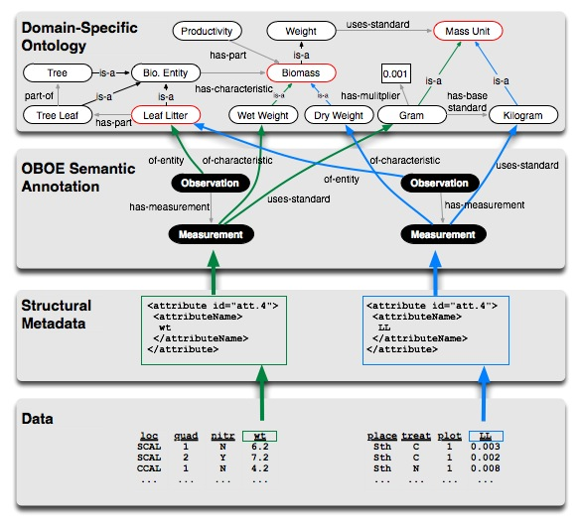
Architecture example (SEEK project)

Slide 28
SONet: Scientific Observations Network
Contact:
Mark Schildhauer (schild@nceas.ucsb.edu) OR
sonet-leaders@ecoinformatics.org
http://sonet.ecoinformatics.org
Sponsored by National Science Foundation, award 0753144

