Slide 1

Vegetation Plots
Data Model
John H. Harris
National Center for Ecological Analysis and Synthesis
University of California Santa Barbara
http://www.nceas.ucsb.edu
September 11, 2000

Slide 2
Acknowledgements
Bob Peet, UNC
Matt Jones, NCEAS
Steve Taswell, TNC
Mike Jennings, NCEAS
Funding:
NSF Award: DBI99-05838 (Peet)
NSF Award: DEB99-80154 (KDI)
NSF Award: DEB-94-21535 (NCEAS)

Slide 3
Goals
Convey current status of data model development.
Transfer issues, currently deterring further
database development, to scientists for discussion.

Slide 4
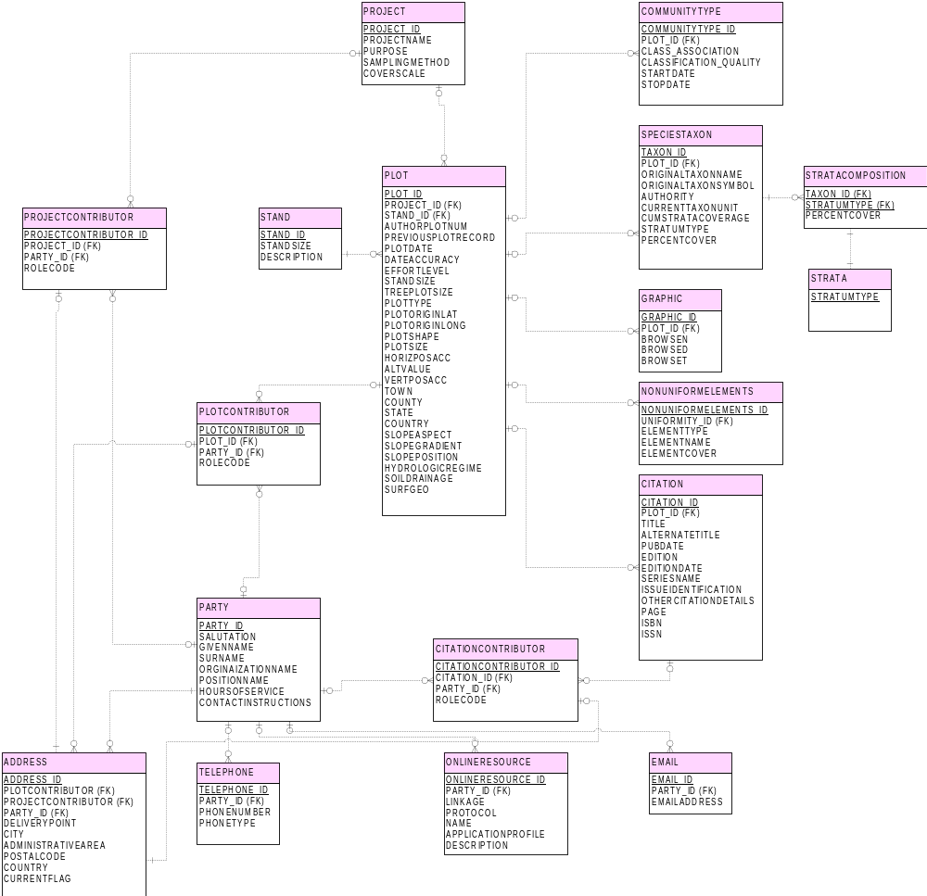



Not yet discussed
Current focus
Previously discussed

Slide 5
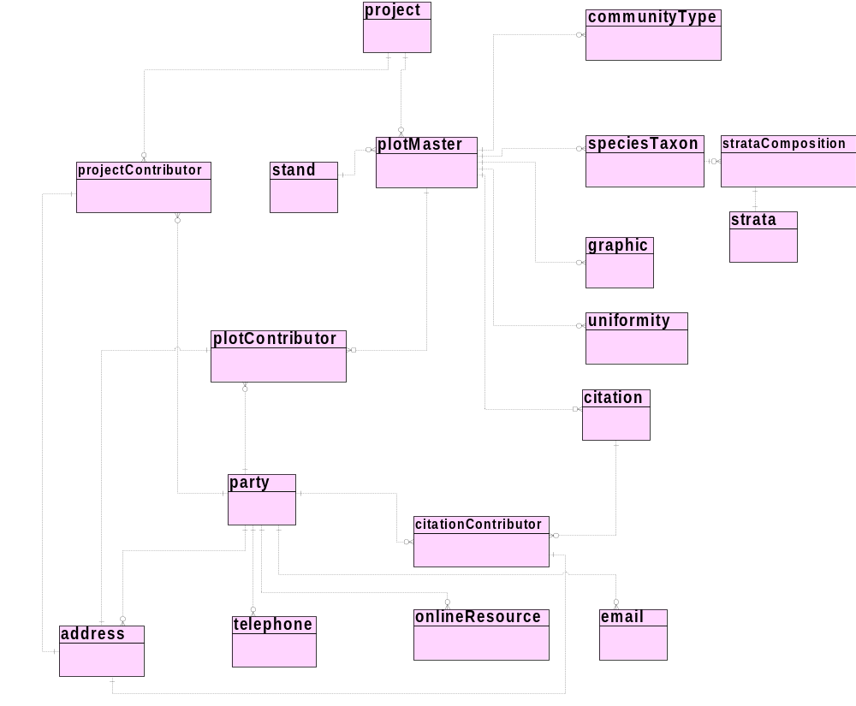
Not yet discussed
Current focus
Previously discussed

Slide 6
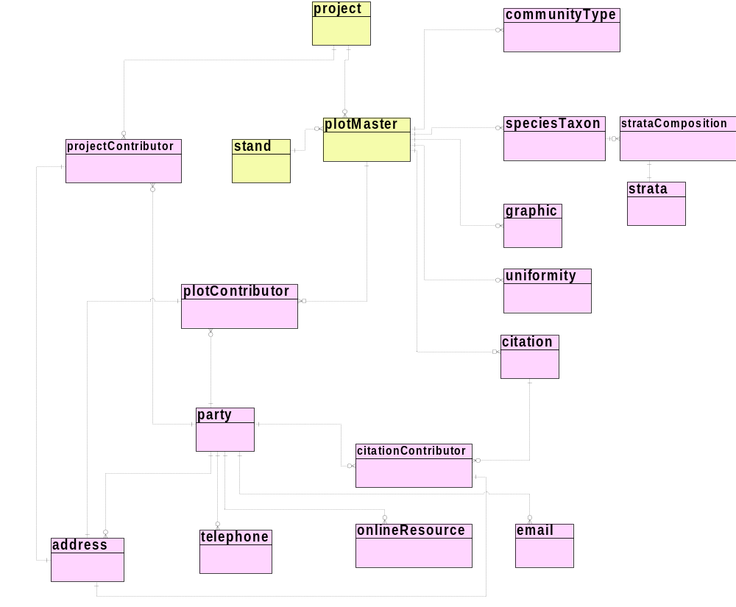
Not yet discussed
Current focus
Previously discussed

Slide 7
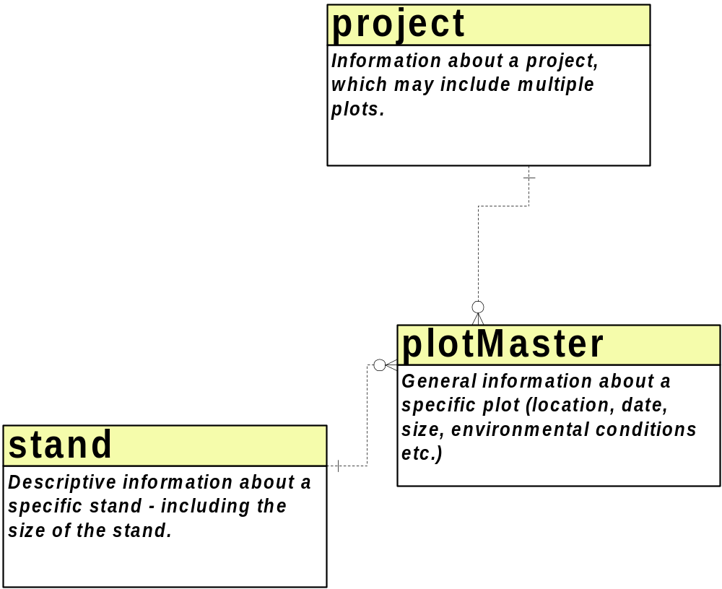
Not yet discussed
Current focus
Previously discussed

Slide 8
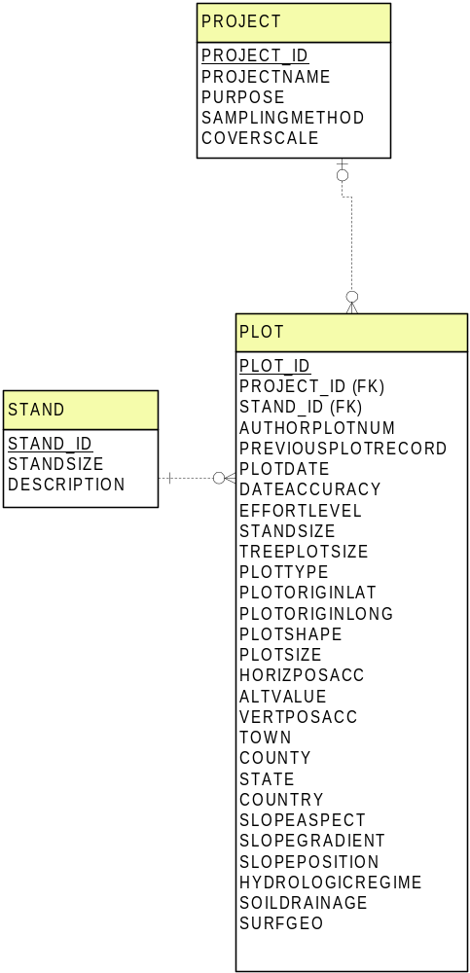
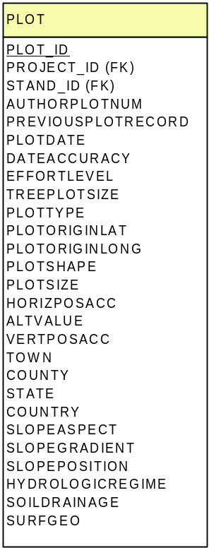
Not yet discussed
Current focus
Previously discussed
Cover scale and sampling method
should probably be plot-level attributes.
Scale Dependency?
(store absolute area)
length of slope, soil moisture/soil drainage, water table depth
soil series soil, soil subgroup soil, soil family, soil texture, soil depth,
organic horizon depth, humus type, stoniness, rockiness, soil water type,
wind exposure, night temperature, day temperature,water erosion/sedim.,
disturbance history, present land use, former land use

Slide 9
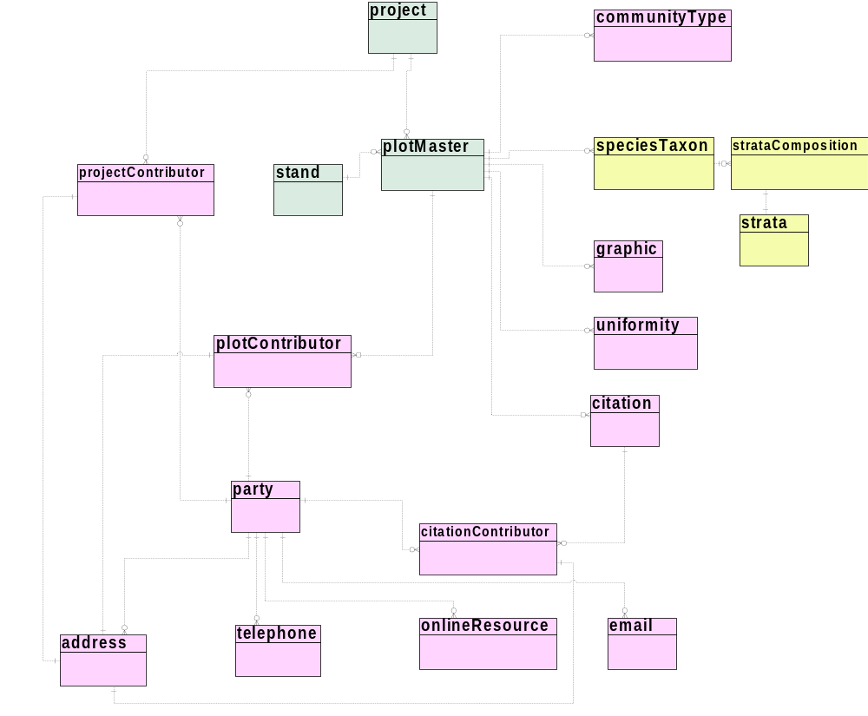
Not yet discussed
Current focus
Previously discussed

Slide 10
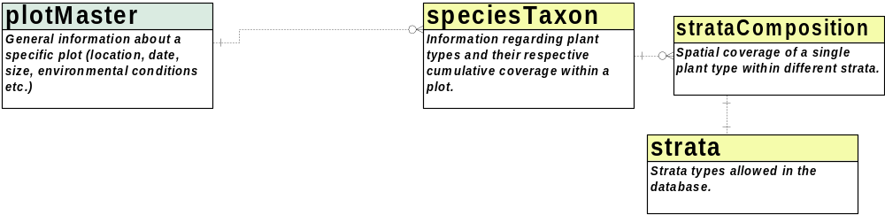
Not yet discussed
Current focus
Previously discussed

Slide 11
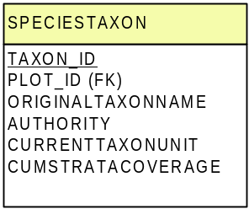
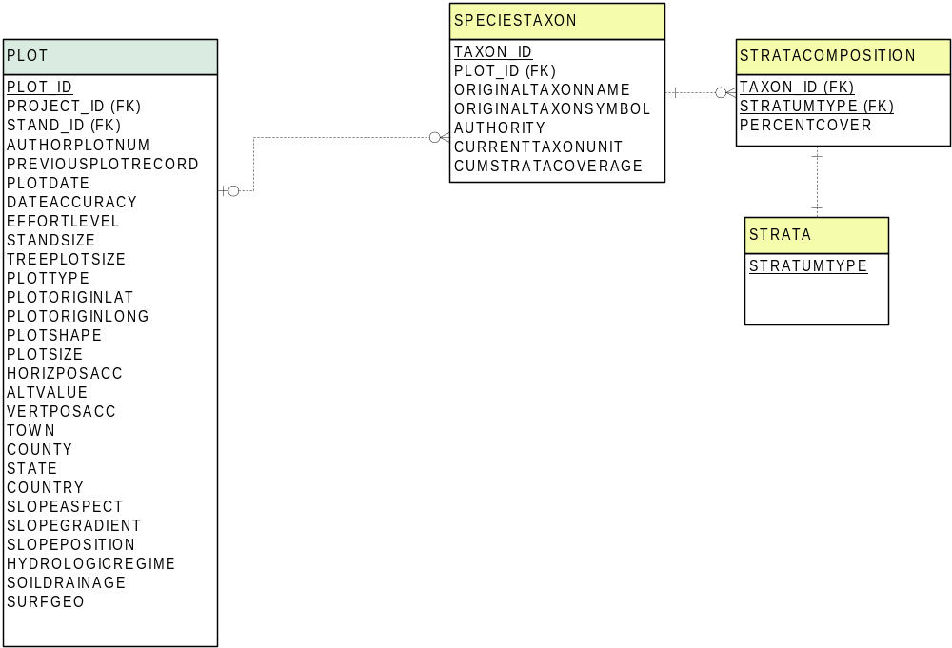
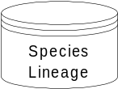
Not yet discussed
What if no ‘authority’?
(reject plot)
Current focus
Previously discussed
Moss
Field
Shrub
Sub-canopy tree
Tree

Slide 12
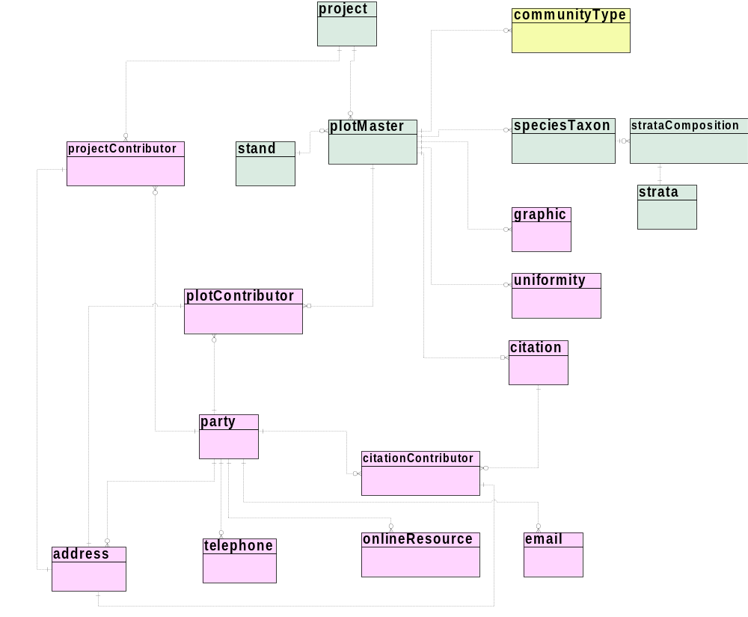
Not yet discussed
Current focus
Previously discussed

Slide 13
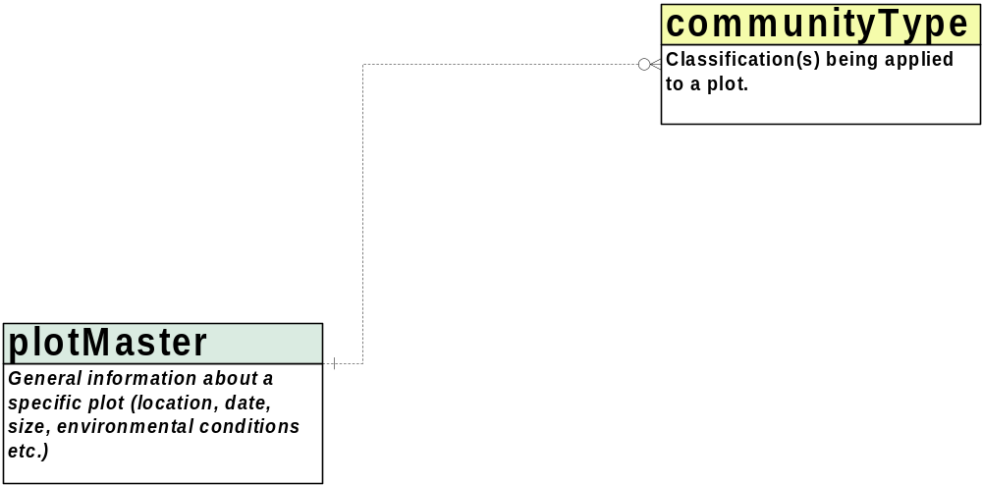
Not yet discussed
Current focus
Previously discussed

Slide 14
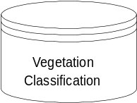
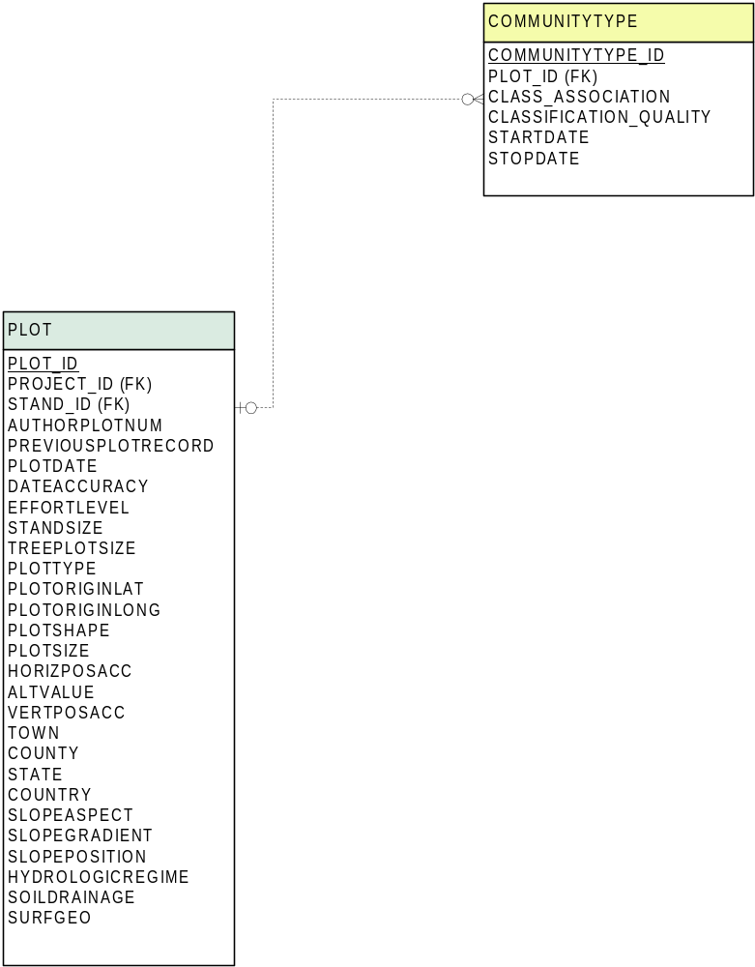
Not yet discussed
Current focus
Previously discussed
Does this belong?
Should we be storing information
about the party applying the classification
to the plot?

Slide 15
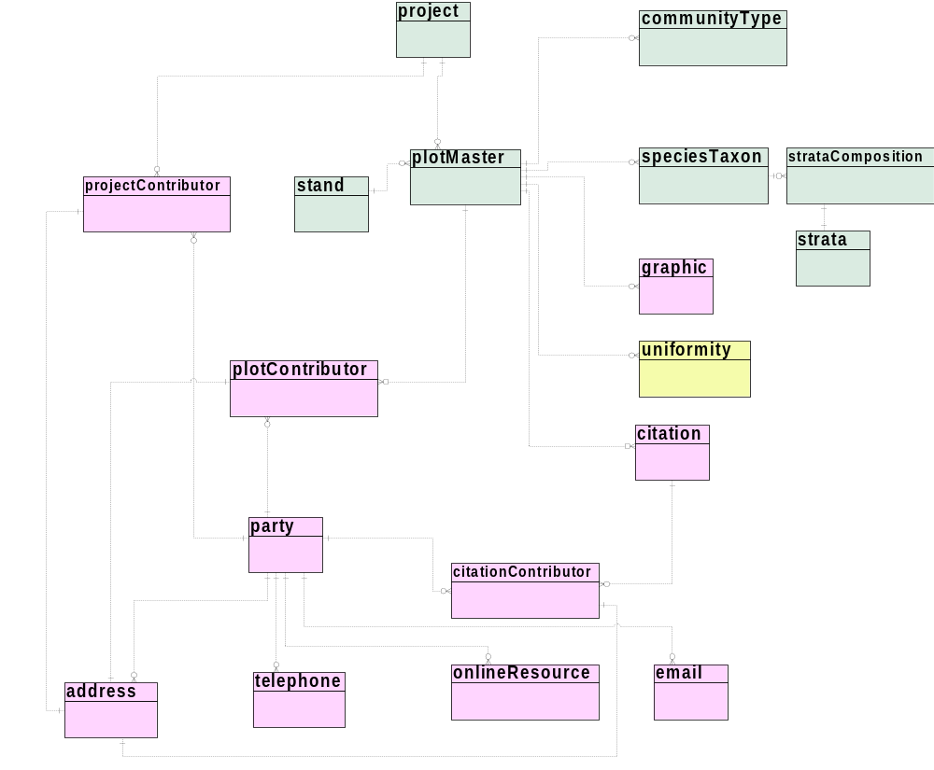
Not yet discussed
Current focus
Previously discussed

Slide 16
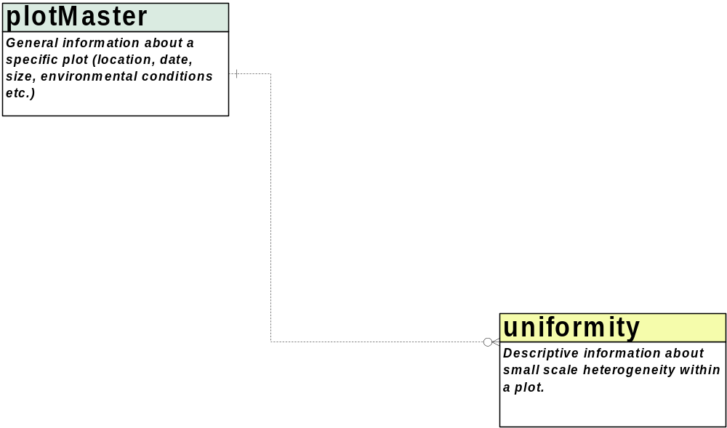
Not yet discussed
Current focus
Previously discussed

Slide 17
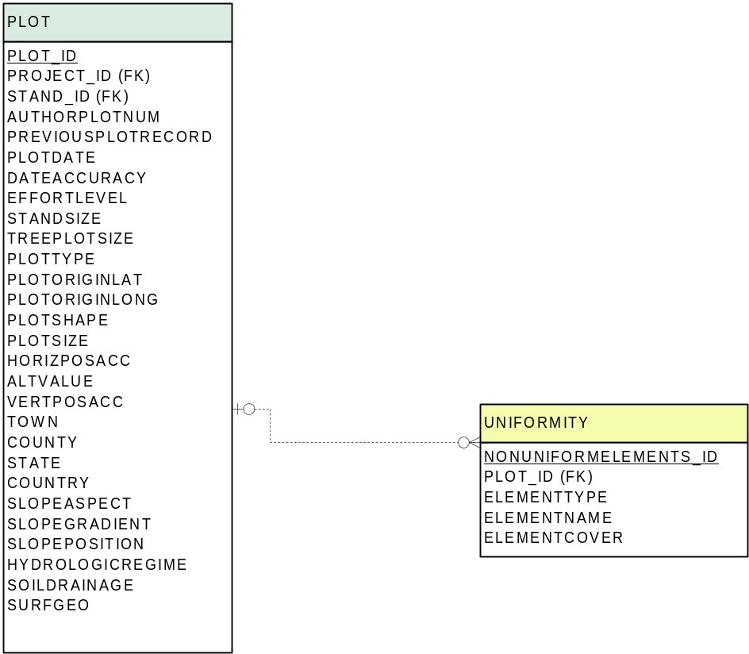
Not yet discussed
Current focus
Previously discussed
Scale dependent.

Slide 18
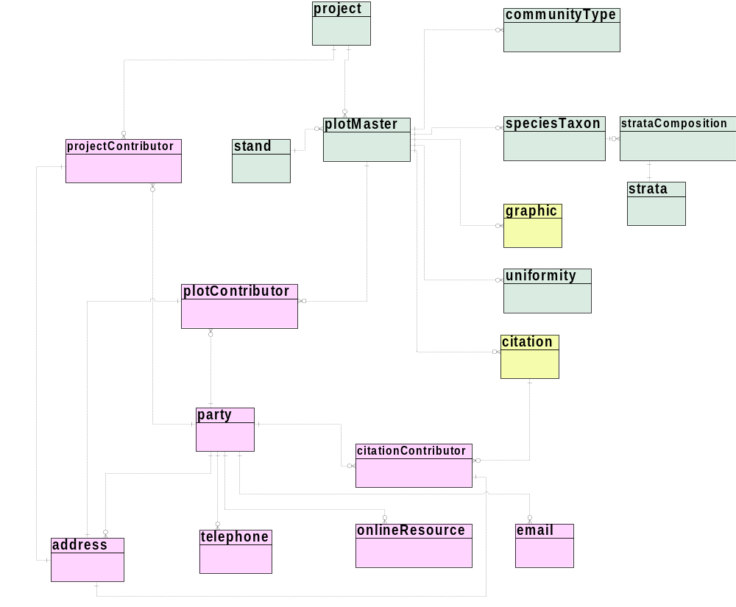
Not yet discussed
Current focus
Previously discussed

Slide 19
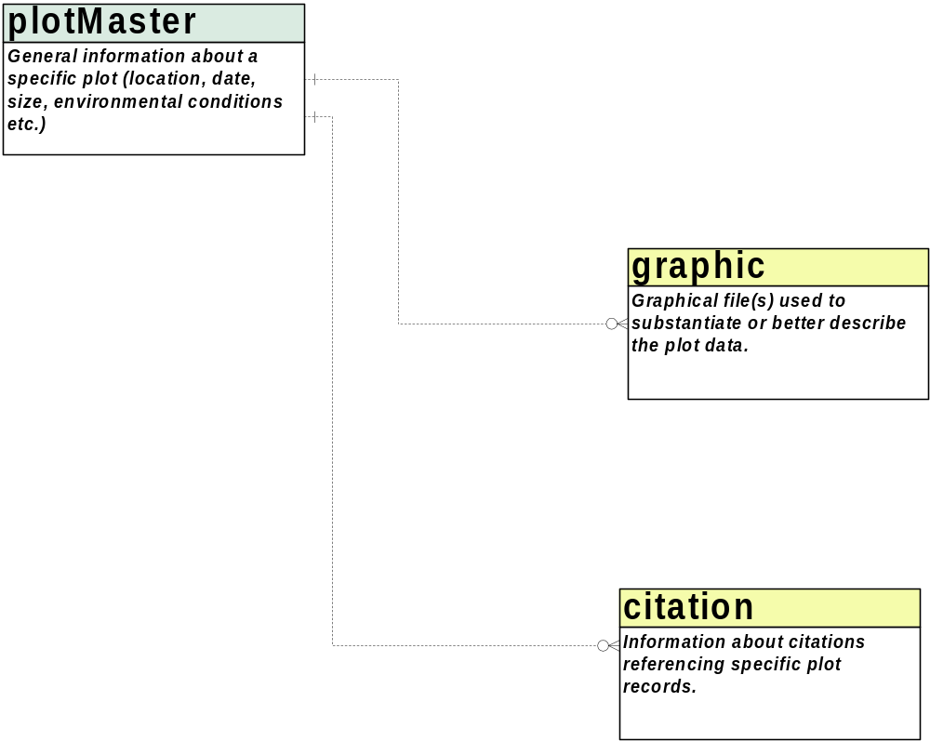
Not yet discussed
Current focus
Previously discussed

Slide 20
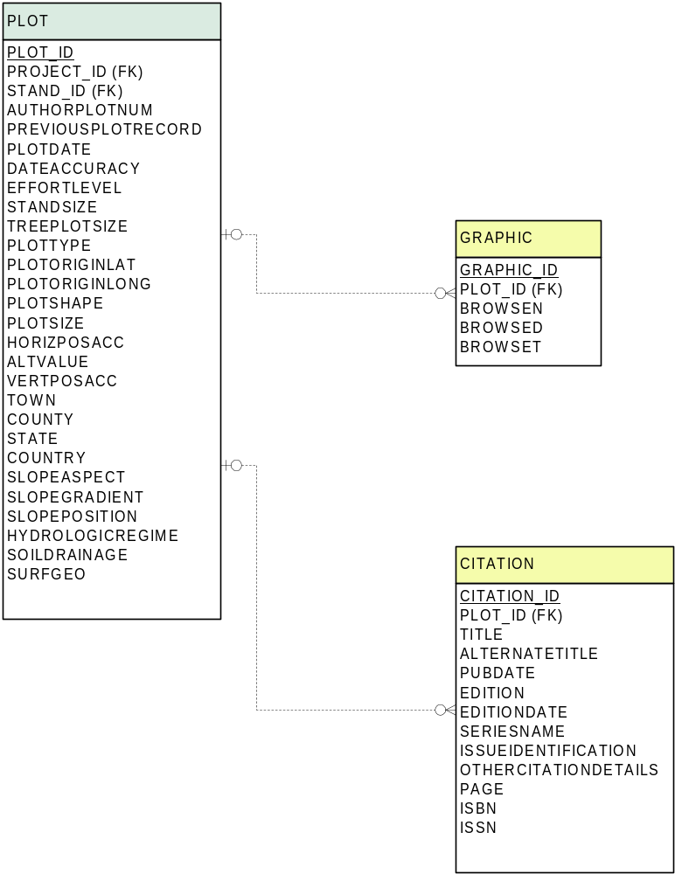
Not yet discussed
Current focus
Previously discussed
Browse files, do we need to
store other file types?
File types: tiff, gif, jpeg, cgm etc.

Slide 21
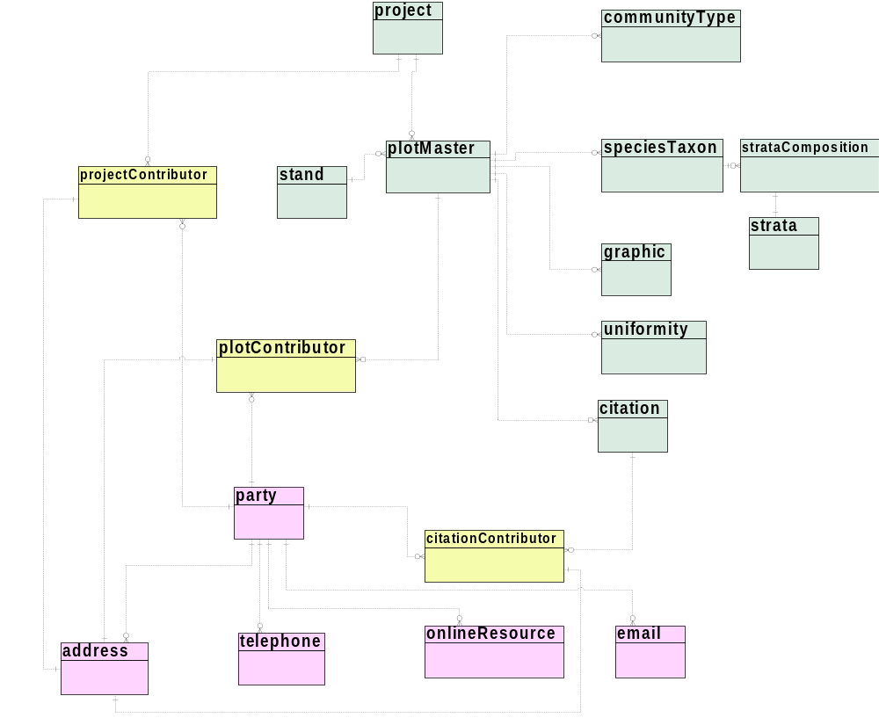
Not yet discussed
Current focus
Previously discussed

Slide 22
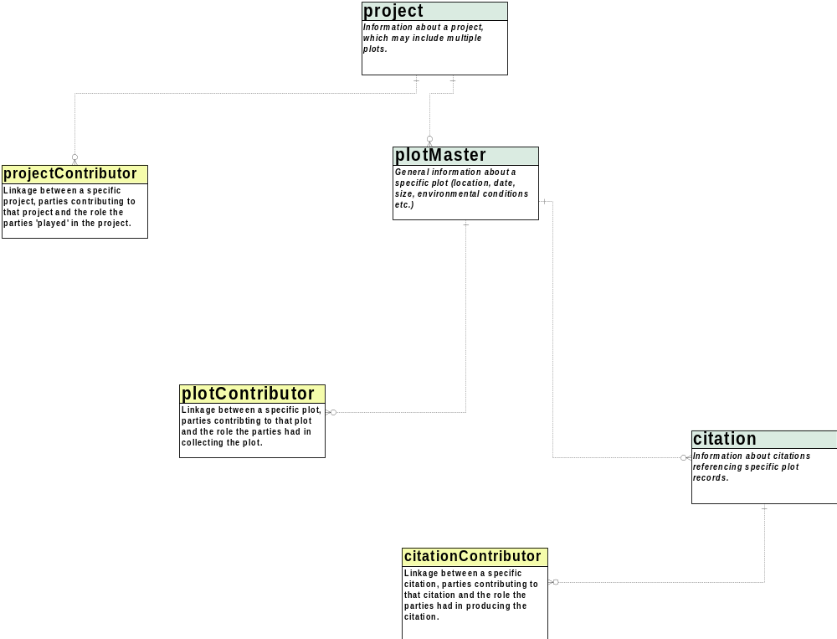
Not yet discussed
Current focus
Previously discussed

Slide 23
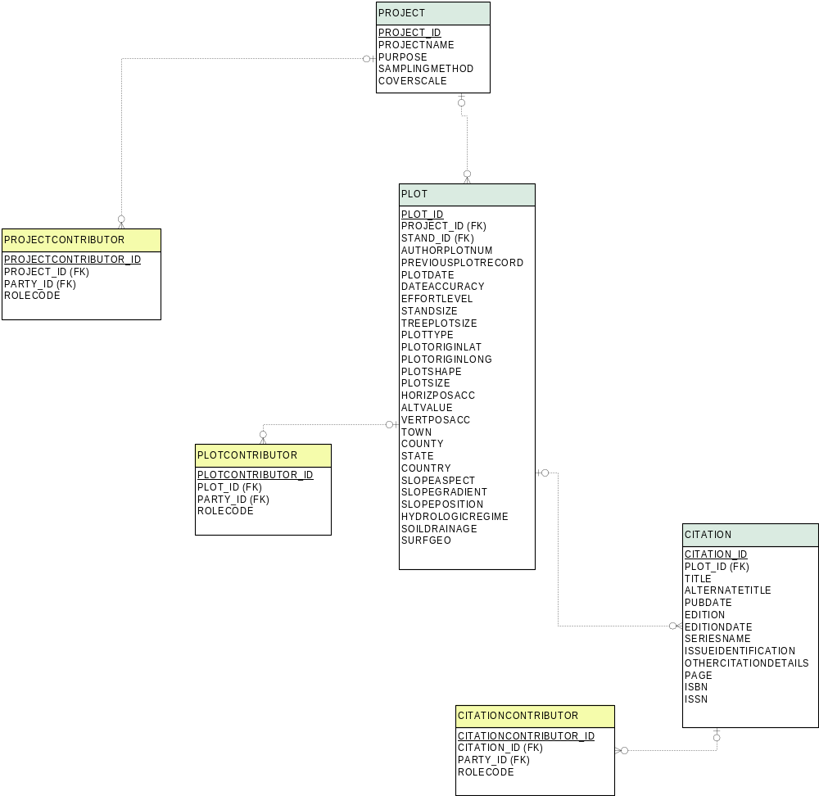
Not yet discussed
Current focus
Previously discussed
Contributor roles include:
Principal Investigator, owner,
publisher, editor, author, contact.

Slide 24
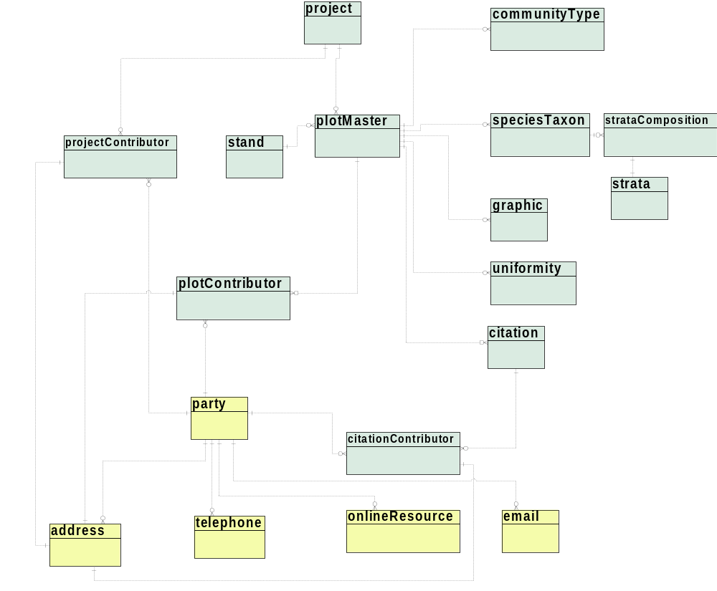
Not yet discussed
Current focus
Previously discussed

Slide 25
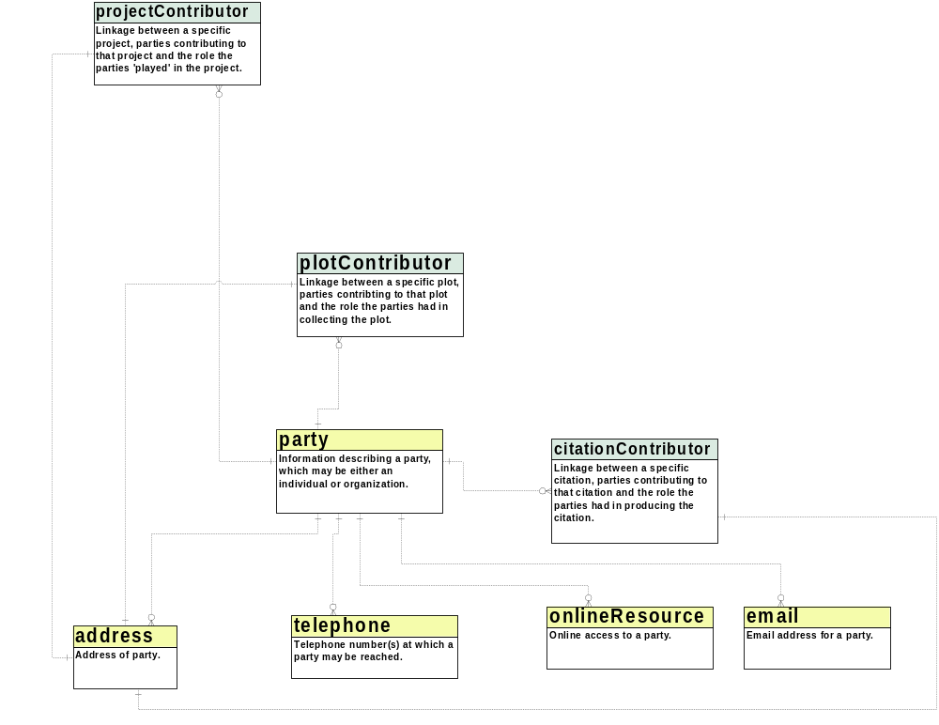
Not yet discussed
Current focus
Previously discussed

Slide 26
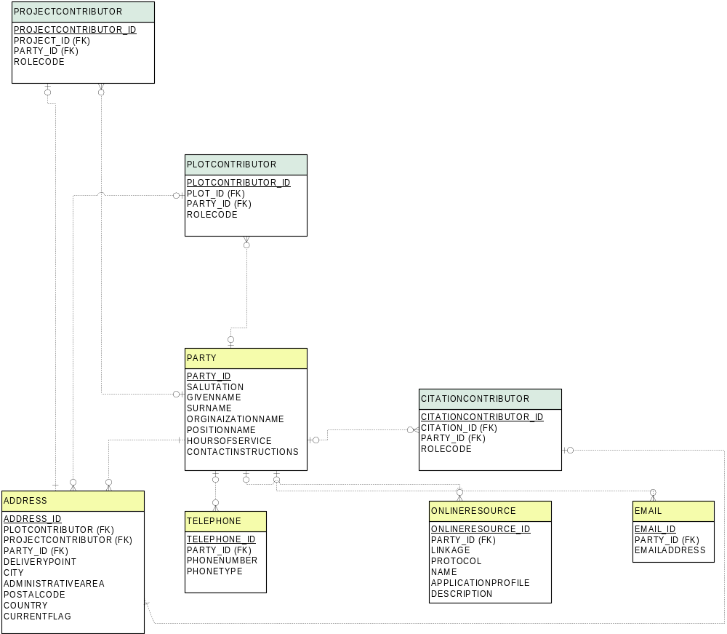
Not yet discussed
Current focus
Previously discussed
How carefully should
we store dates for
addresses?

Slide 27
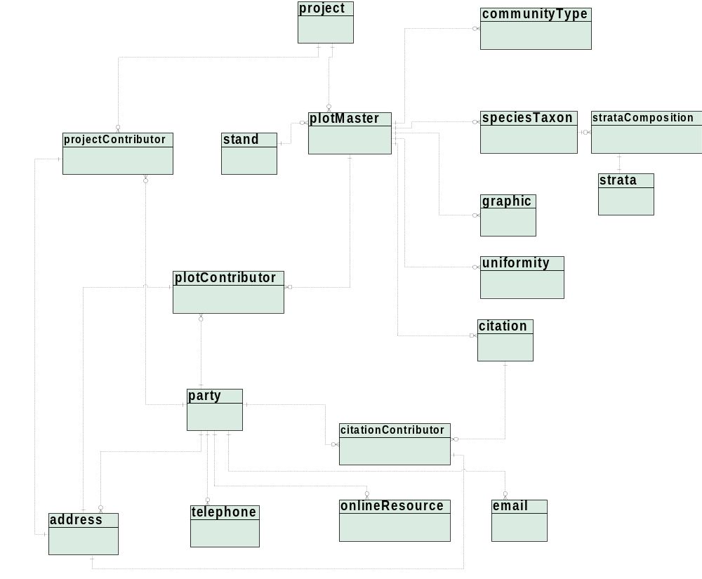
Not yet discussed
Current focus
Previously discussed

Slide 28
Remaining Issues
This material is based upon work supported by the National Science Foundation under Grant No(s). DEB99-80154, blah. Any opinions,
findings and conclusions or recomendations expressed in this material are those of the author(s) and do not necessarily reflect the views
of the National Science Foundation (NSF).

