Slide 1

Background topics
Overview goals and objectives
Overview agenda
…
Review database design
Taxonomy module
Veg. community classification module
Management scenarios
Community review and feedback
January 29, 2001
Notes:
Meeting goals and agenda - as developer what I hope to get out of the meeting, any significant changes to the agenda

Slide 2
Meeting goals
Understanding --
Overriding principles that are general to the
application development process methodologies.
Agreement --
Number and type of user interfaces for the plots database.
Functionality of these interfaces
Expectations for individual prototypes.
January 29, 2001
Notes:
List of functionality? - list the planned deliverables and what I will be doing with them as designer/developer

Slide 3
Agenda overview
BACKGROUND
DEVELOPMENT PLAN/TOOLS
GENERAL INTERFACE FUNCTIONALITY
DATABASE QUERIES
WEB INTERFACE FUNCTIONALITY
EXPLORE RELATED DESK TOP TOOLS
DESK TOP INTERFACE FUNCTIONALITY
INTERFACE LAYOUT
TAXONOMY MODULE
THE HENNEKENS CONNECTION
FUTURE PLANNING
MONDAY:
TUESDAY:
WEDNESDAY:
January 29, 2001
Notes:
List of functionality? - list the planned deliverables and what I will be doing with them as designer/developer

Slide 4
Agenda overview
MONDAY:
Software development
process
tools
?
Background
plots, plants,
communities
Interface Discussion
expectations
functionality
Database Queries
review
most complex case
?
January 29, 2001
Notes:
List of functionality? - list the planned deliverables and what I will be doing with them as designer/developer

Slide 5
Agenda departure
?
January 29, 2001
Notes:
List of functionality? - list the planned deliverables and what I will be doing with them as designer/developer

Slide 6
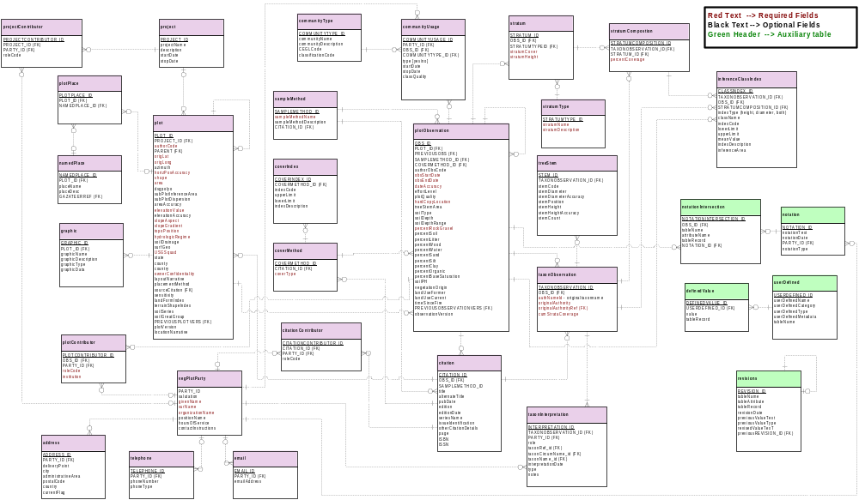

Plots Database Design Review

Slide 7
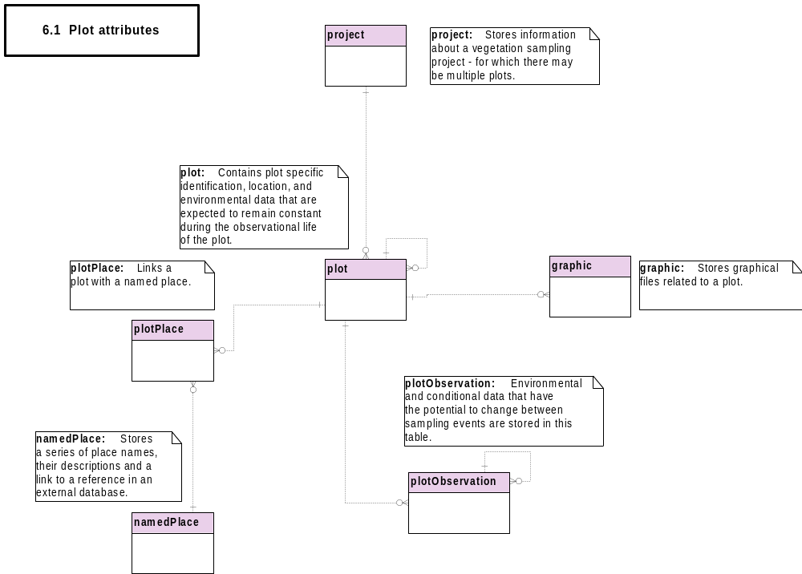

Slide 8
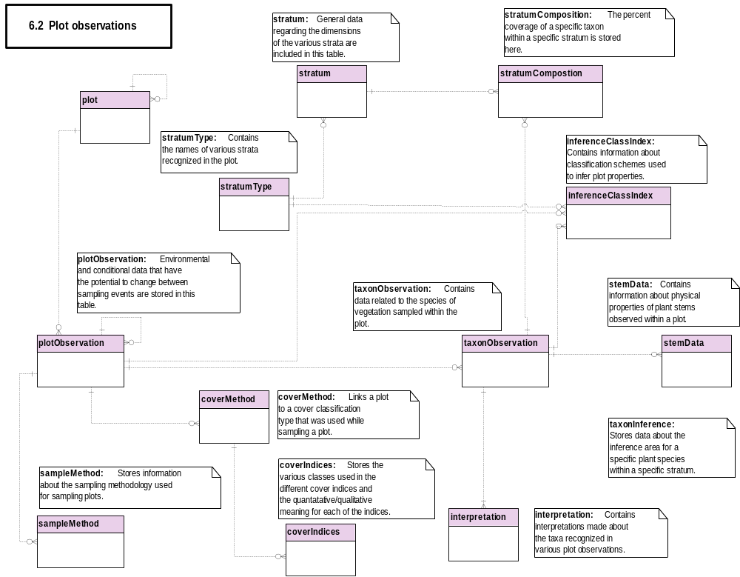

Slide 9
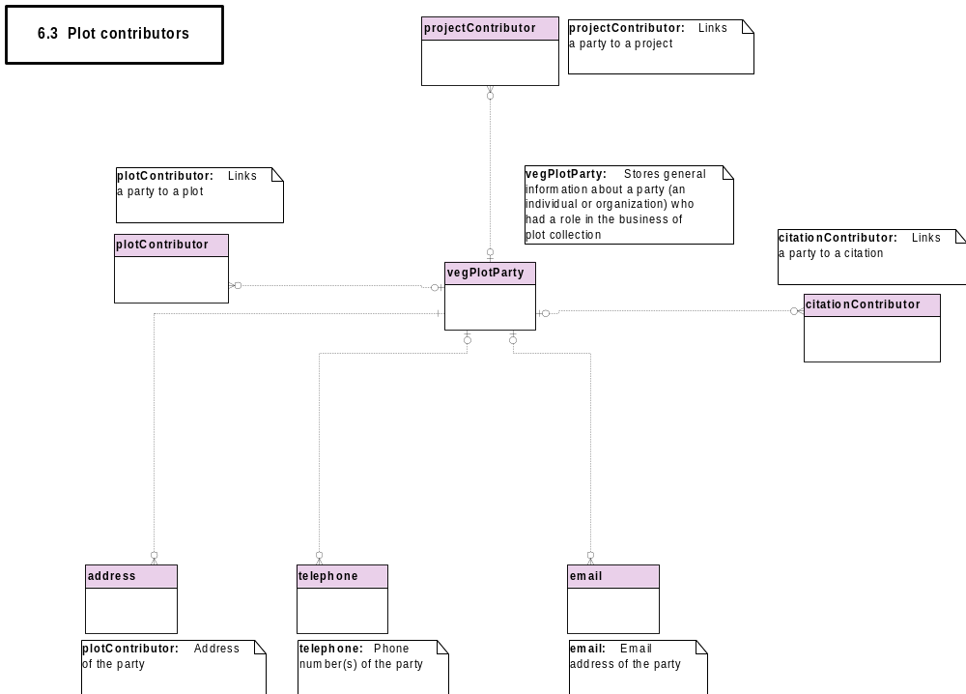

Slide 10
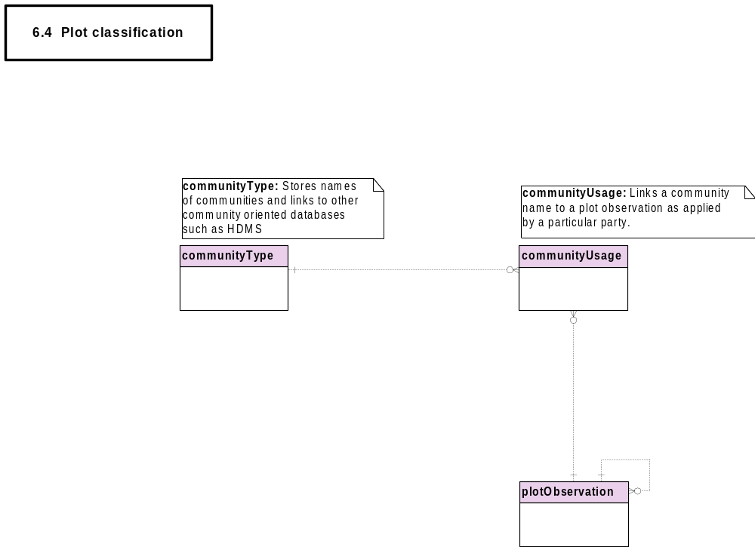

Slide 11
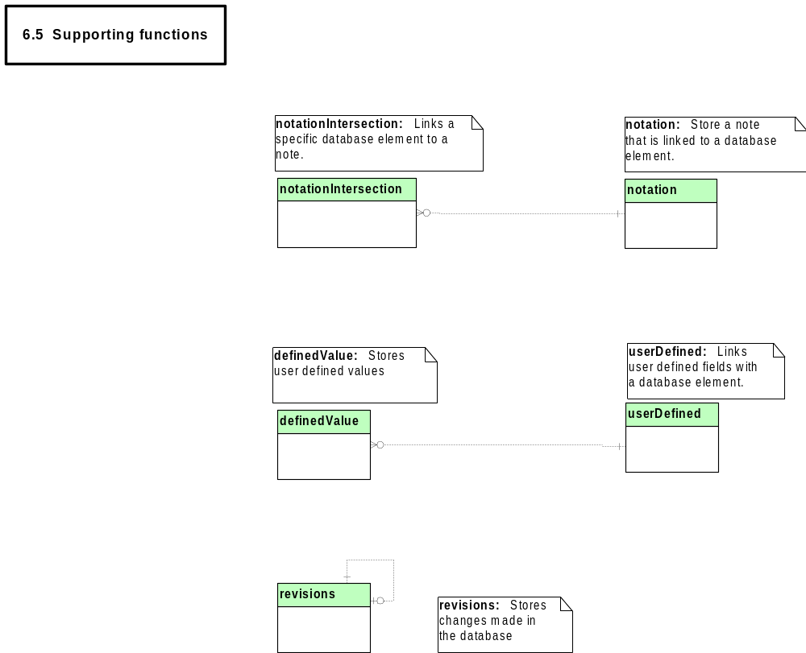

Slide 12
Remaining Issues -- plot model
authorCode to plotObservation
elevationAccuracy
Soil texture and composition
Soil analytical data
Environmental fields vs. user-defined fields
Vertical strata
Damman’s responsibilities
Annotation of plots
Required fields
Stand
    … plant taxonomy model:

Slide 13

Taxonomy Module
Smithsonian meeting:
  Peet-Taswell model vs Berendsohn model
FGDC Biological Nomenclature Working Group
Update on ABI & HDMS
Prospects for implementation
The difficult choice
….MODELS:

Slide 14
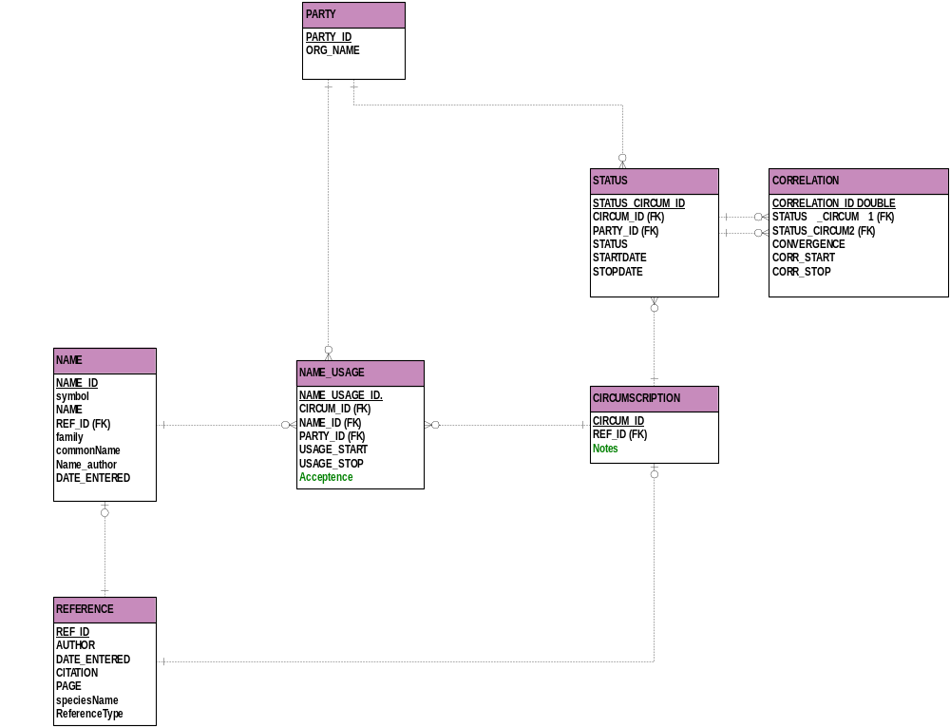

Slide 15
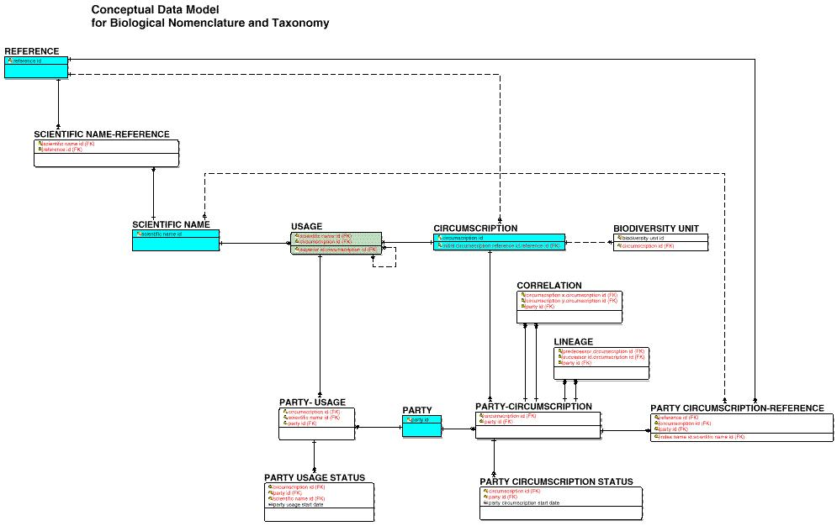

Slide 16

Community Module
Update on development of this module
Update on ABI & HDMS
Interface with HDMS or equivalent
….MODELS:

Slide 17
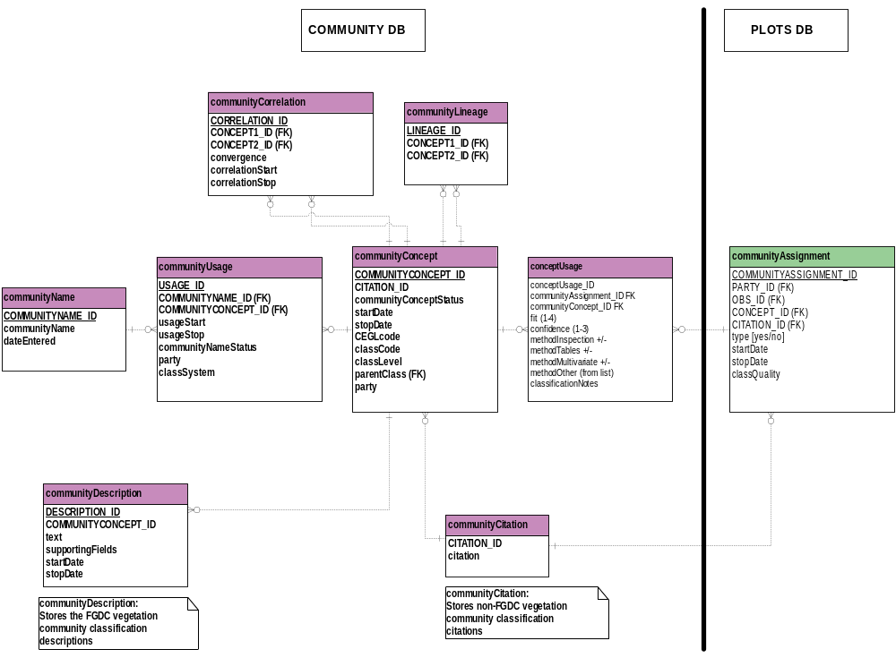

Slide 18
Data Management Scenarios
Who, why and how much review
for:
• submitted plot data
• non TNC vegetation classifications
• non standard indexing systems
NVC management
Similar national initiatives in other countries
Quality control of data submissions
“Peer review” of classification

Slide 19
Review and Feedback
How to best obtain community feedback
  on the database design.
Who in include in the process.

Slide 20
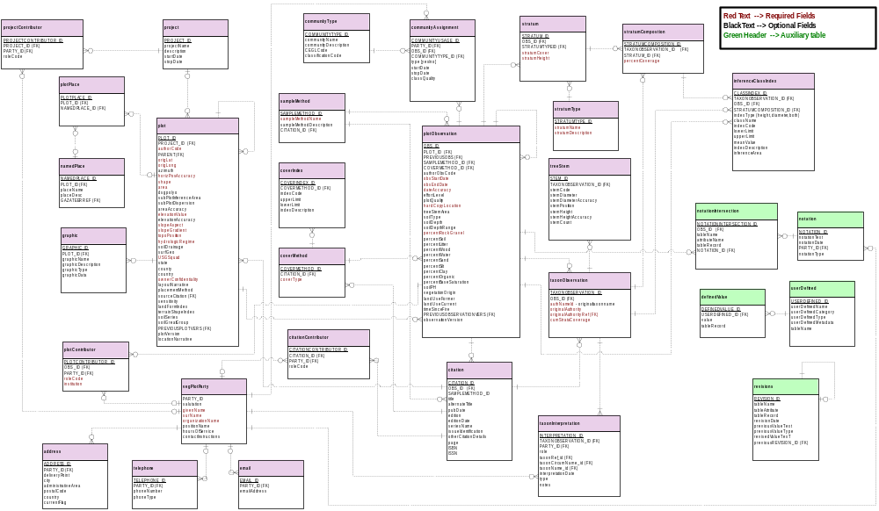
Plots database tables …

Slide 21
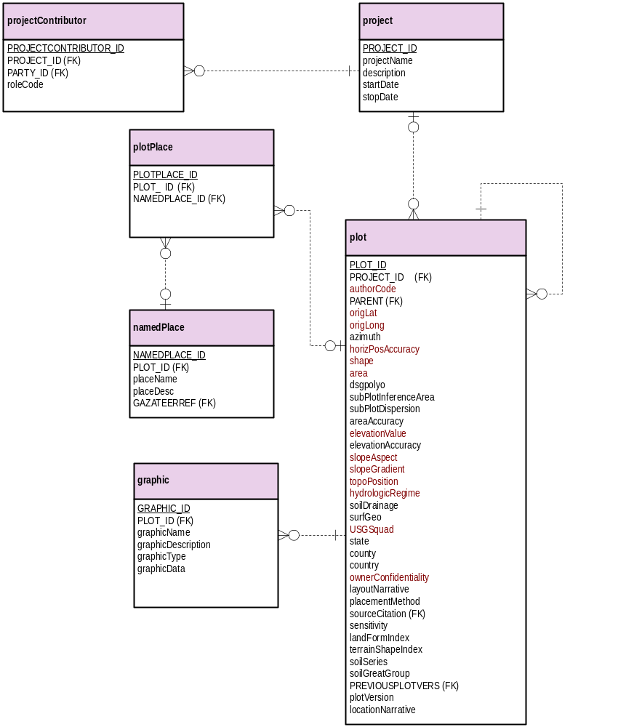
projectContributor
plotPlace
namedPlace
Graphic
Plot
project

Slide 22
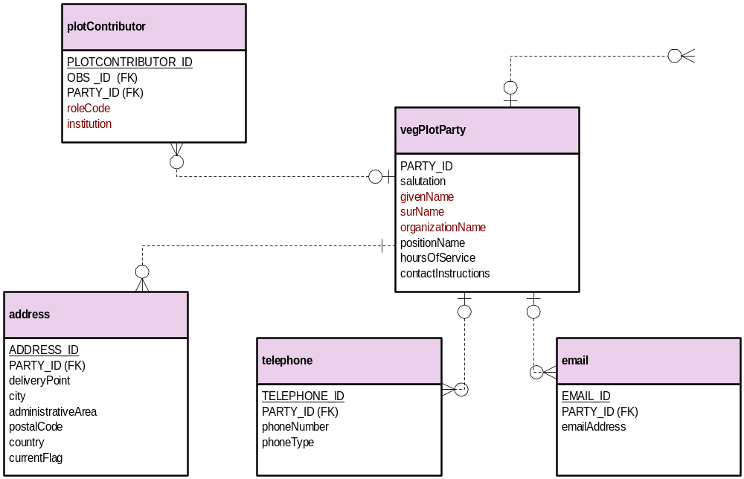
citationContributor
plotContributor
address
vegPlotParty
telephone
email

Slide 23
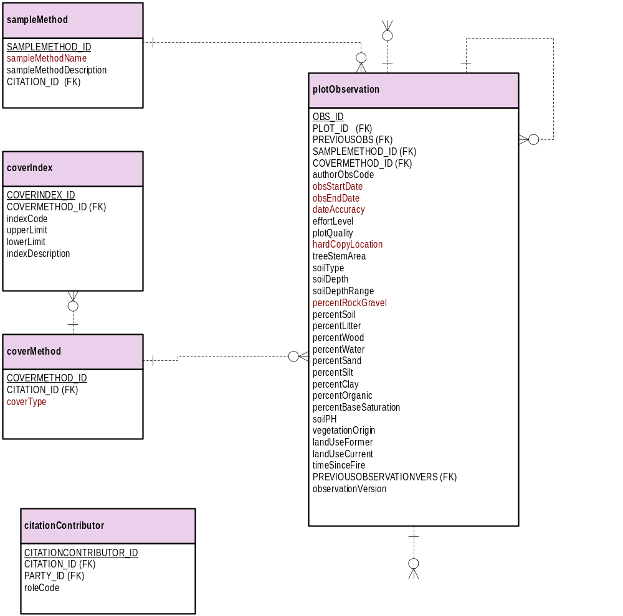
communityAssignment
sampleMethod
plotObservation
coverIndex
coverMethod
citationContributor
citation

Slide 24
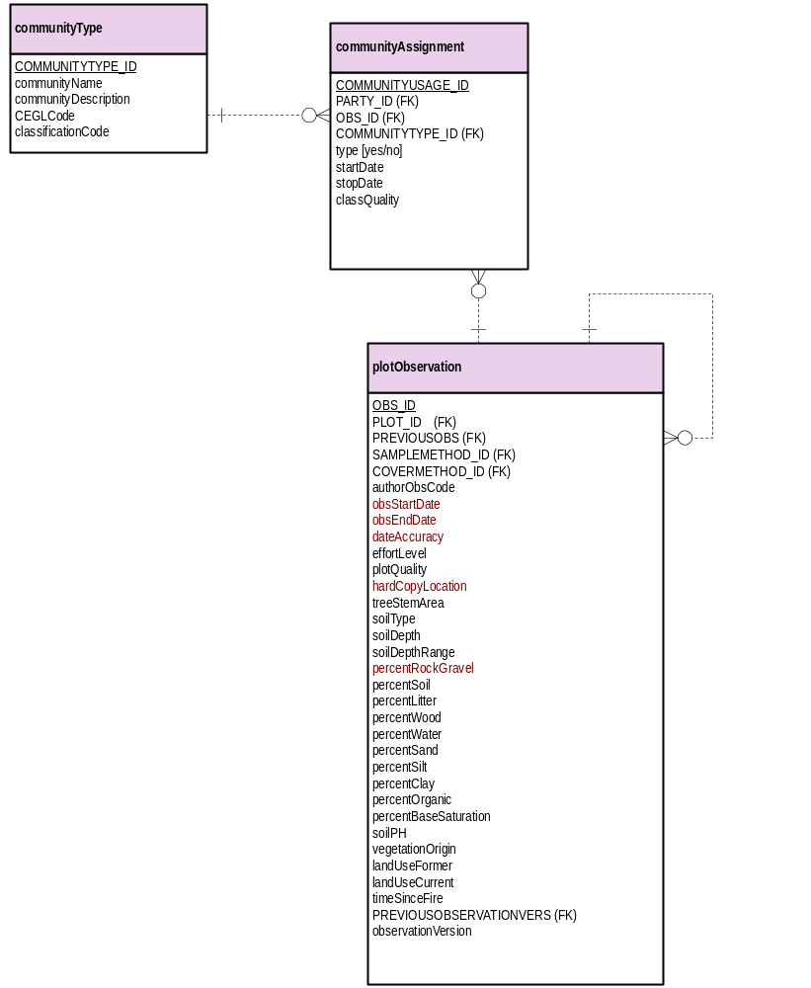
communityType
communityAssignment
plotObservation

Slide 25
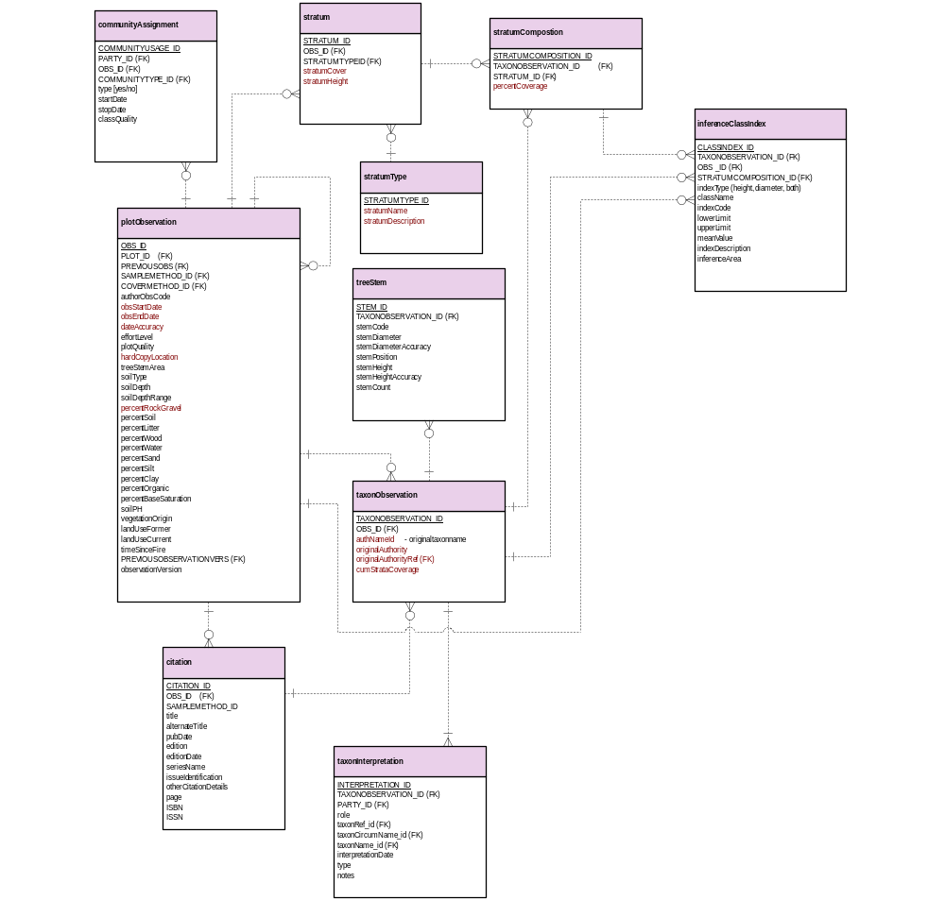
communityAssignment
plotObservation
stratum
stratumType
treeStem
taxonObservation
Citation
taxonInterpretation
stratumComposition
inferenceClassIndex

Slide 26
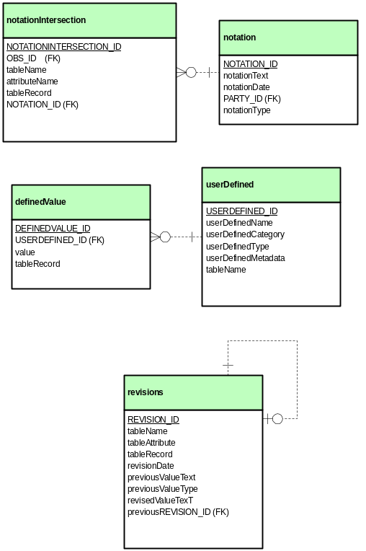
plotObservation
party
notationIntersection
notation
definedValue
userDefined
revisions

