Slide 1
The VegBank
taxonomic datamodel
Sponsored by:
  The Ecological Society of America - Vegetation Classification Panel
Produced at:
  The National Center for Ecological Analysis and Synthesis
Principal Investigators:
  Robert K. Peet, University of North Carolina
  John Harris, National Center for Ecological Analysis & Synthesis
  Steve Taswell, NatureServe (ret.)
  Larry Morse, NatureServe
  Janet Goman, ITIS

Slide 2
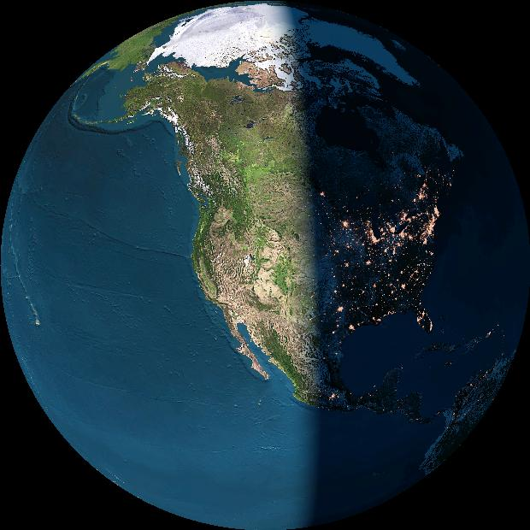
Biodiversity
data structure
SynTaxon
Community type databases
Locality
Observation/Collection
Event
Plot/Inventory databases
Object or specimen
Specimen databases
BioTaxon
Taxonomic databases

Slide 3
The Taxonomic database challenge:
Standardizing organisms and communities
The problem:
Integration of data potentially representing different times, places, investigators and taxonomic standards.
The traditional solution:
A standard list of organisms / communities.

Slide 4
Standard lists are available
Representative examples for higher plants include:
* North America / US
USDA Plants http://plants.usda.gov
ITIS http://www.itis.usda.gov
NatureServe http://www.natureserve.org
* World
IPNI International Plant Names Checklist
http://www.ipni.org/
IOPI Global Plant Checklist
http://www.bgbm.fu-berlin.de/IOPI/GPC/

Slide 5
Most standardized taxon lists fail to allow effective integration of datasets
The reasons include:
  The user cannot reconstruct the database as viewed at an arbitrary time in the past,
  Taxonomic concepts are not defined (just lists),
  Multiple party perspectives on taxonomic concepts and names cannot be supported or reconciled.

Slide 6
Three concepts of shagbark hickory
Splitting one species into two illustrates the ambiguity often associated with scientific names. If you encounter the name “Carya ovata (Miller) K. Koch” in a database, you cannot be sure which of two meanings applies.
Carya carolinae-sept.
(Ashe) Engler & Graebner
Carya ovata
(Miller)K. Koch
Carya ovata
(Miller)K. Koch
sec. Gleason 1952
sec. Radford et al. 1968

Slide 7
Multiple concepts of Rhynchospora plumosa s.l.
Elliot 1816
Gray
1834
Chapman
1860
Kral
1998
Peet
2002
R. plumosa
R. plumosa
v. plumosa
R. plumosa
R. sp. 1
1
R. plumosa
R plumosa
v. intermedia
R. intermedia
R. plumosa
v. plumosa
2
R. plumosa
v. interrupta
R. pineticola
R. plumosa
v. pineticola
3

Slide 8
An assertion represents a unique combination of a name and a reference
“Assertion” is equivalent to
“Potential taxon” & “taxonomic concept”
Name
Assertion
Reference

Slide 9
Six shagbark hickory assertions
Possible taxonomic synonyms are listed together
Names
Carya ovata
Carya carolinae-septentrionalis
Carya ovata v. ovata
Carya ovata v. australis
Assertions
(One shagbark)
C. ovata sec Gleason ’52
C. ovata sec FNA ‘97
(Southern shagbark)
C. carolinae-s. sec Radford ‘68
C. ovata v. australis sec FNA ‘97
(Northern shagbark)
C. ovata sec Radford ‘68
C. ovata (v. ovata) sec FNA ‘97
References
Gleason 1952 Britton & Brown
Radford et al. 1968 Flora Carolinas
Stone 1997 Flora North America

Slide 10
A usage represents a unique combination of an assertion and a name.
Usages can be used to track nomenclatural synonyms
Name
Usage
Assertion

Slide 11
A usage (name assignment) and assertion (taxon concept) can be combined in a single model
Name
Usage
Assertion
Reference

Slide 12
Names
ITIS Usage
Assertions
1. Carya ovata
2. C. carolinae
3. C. ovata var. ovata
3. C. ovata var. australis
1-F OK
2-D OK
3-F Syn
4-D Syn
ovata sec. Gleason
ovata sec. FNA
carolinae sec. Radford
ovata australis sec. FNA
ovata sec. Radford
ovata (ovata) sec. FNA
ITIS likely views the linkage of the assertion “Carya ovata var. australis sec. FNA 1997” with the name “Carya ovata var. australis” as a nomenclatural synonym.

Slide 13
Party Perspective
The Party Perspective on an Assertion includes:
  Status – Standard, Nonstandard, Undetermined
  Correlation with other assertions –
  Equal, Greater, Lesser, Overlap, Undetermined.
  Lineage – Predecessor and Successor assertions.
  Start & Stop dates.

Slide 14
Application of Party Perspective
Party
Assertion
ITIS
FNA Committee
NatureServe
USDA Plants
Carya ovata sec Gleason 1952
Carya ovata sec FNA 1997
Carya ovata sec Radford 1968
Carya carolinae sec Radford 1968
Carya ovata (ovata) sec FNA 1997
Carya ovata australis sec FNA 1997
Status
Party Assertion Status Start Name
ITIS ovata – G52 NS 1996
ITIS ovata – R68 St 1996 C. ovata
ITIS carolinae – R68 St 1996 C. carolinae-sept.
ITIS carolinae – R68 NS 2000
ITIS ovata aust – FNA St 2000 C. carolinae-sept.
ITIS ovata – R68 NS 2000
ITIS ovata ovata – FNA St 2000 C. ovata

Slide 15
Data relationships
VegBank taxonomic data model
Interpretation
Name
Assertion
Usage
Party
Status
Correlation
Lineage
Publication

Slide 16
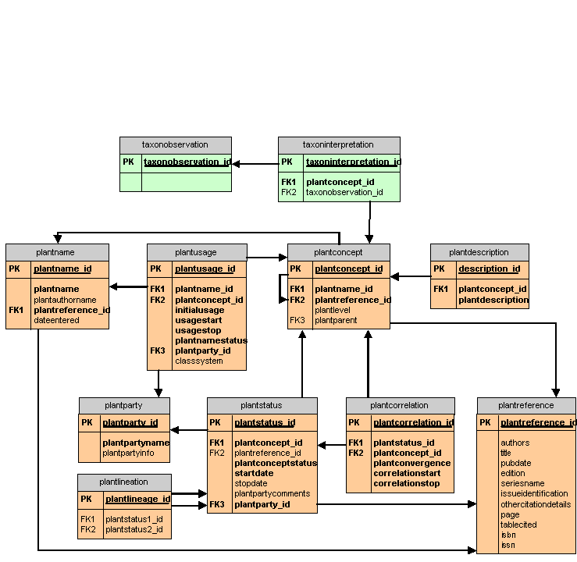

Slide 17
(Inter)National Taxonomic Database?
  An upgrade for ITIS & Species 2000?
  Concept-based
  Party-neutral
  Perfectly archived
  Synonymy and lineage tracking

