Slide 1
VegBank
A vegetation field plot archive
Sponsored by:
  The Ecological Society of America - Vegetation Classification Panel
Produced at:
  The National Center for Ecological Analysis and Synthesis
Principal Investigators:
  Robert K. Peet, University of North Carolina
  John Harris, National Center for Ecological Analysis & Synthesis
  Michael D. Jennings, U.S. Geological Survey
  Dennis Grossman, NatureServe
  Marilyn D. Walker, USDA Forest Service

Slide 2






VegBank is made possible
by the support and cooperation of:
Ecological Society of America
National Center for Ecological
Analysis and Synthesis
Federal Geographic Data Committee
Gap Analysis Program
National Biological Information Infrastructure
National Science Foundation

Slide 3
Background
The ESA Vegetation Classification Panel
was established in 1993 with a mandate to support the emerging U.S. Vegetation Classification

Slide 4
Partner Organizations
Ecological Society of America
Role: to develop and implement professional standards,
including peer review,
for documentation and classification of vegetation
NatureServe
Role: to develop, support & maintain
a standard vegetation classification
for conservation, inventory, and monitoring

Slide 5
Partner Organizations
U.S. Federal Geographic Data Committee
Vegetation Subcommittee
Role: to establish within the Federal community
standards for accuracy, documentation and quality of
vegetation data, and standards for vegetation classification
USGS – BRD / NBII
Role: to “make the NVC system, and its associated data
and information products, broadly accessible
by incorporating them in the NBII federation.”

Slide 6
Vegetation Panel Findings
A standardized, refereed, and widely-used vegetation classification for the United States is urgently needed for assessment, management, and inventory of the nation's ecosystems.
The classification must be based on standardized nomenclature, terminology, methods, and data management.
Without a set of nationwide standards, data from different sources cannot be integrated, compared, or evaluated.

Slide 7
A Federal Standard
In 1997 the Federal government adopted as its standard the “National Vegetation Classification.”
However, only the standards for the physiognomic levels of the hierarchy were adopted in detail.
A detailed floristic classification based on quantitative field data was adopted only in concept.

Slide 8
Physiognomic categories
Category Example
Class . . . . . . . . . . Woodlands
Subclass . . . . . . .Mainly Evergreen Woodlands
Group . . . . . . . . .Evergreen Needle‑leaved Woodlands
Subgroup . . . . . Natural/Seminatural
Formation . . . . Evergreen Coniferous Woodland with Rounded Crowns
Floristic categories
Alliance . . . . . . Juniperus occidentalis
Association . . . . Juniperus occidentalis /
Artemesia tridentata

Slide 9
Standards for Vegetation Classification
The Panel and its partners have been working to develop standards for the floristic levels of the classification covering:
Terminology
Plot data acquisition
Identification and documentation of vegetation types
Formal description and peer review of types
Information dissemination and management.
Version 1.0 due for release in spring 2002

Slide 10
The Missing Piece
The missing core component is the data infrastructure needed to manage the anticipated 10⁷plots and 10⁴plant associations, and to distribute this over the web in a continually revised, perfectly updated form.

Slide 11
Vegetation Plot Archive
The Plot Archive
- - -
Information Flow
Database management
Plot Data Submission
Raw Plot Data
Legend
Fieldwork
External Action
Internal Action
Real Vegetation
Entity

Slide 12
WWW Output
US-NVC
---
Proposed data flow
Extraction
Classification Database
Classification Mgt.
Digital Journal
US-NVC Panel
Peer Review
Proposal
Legend
External Action
Analysis & Synthesis
Internal Action
Vegetation Plot Archive
Entity

Slide 13
A vegetation plot archive?
There is currently no standard repository for plot data.
A repository is needed for:
  Plot storage and preservation
  Plot access and identification
  Plot documentation in literature/databases

Slide 14
VegBank
The ESA Vegetation Panel is currently developing a public archive for vegetation plots known as VegBank (www.vegbank.org).
VegBank is expected to function for vegetation
plot data in a manner analogous to GenBank.
Primary data will be deposited for reference,
novel synthesis, and reanalysis.

Slide 15
EcoInformatics ?
Massive plot data have the potential to create new disciplines and allow critical syntheses.
  Remote sensing. What is really on the ground?
  Theoretical community ecology. Who occurs together, and where, and following what rules?
  Monitoring. What changes are really taking
  place in the vegetation?
  Restoration. What should be our restoration targets?
  Vegetation & species modeling. Where should
  we expect species & communities to occur after environmental changes?

Slide 16
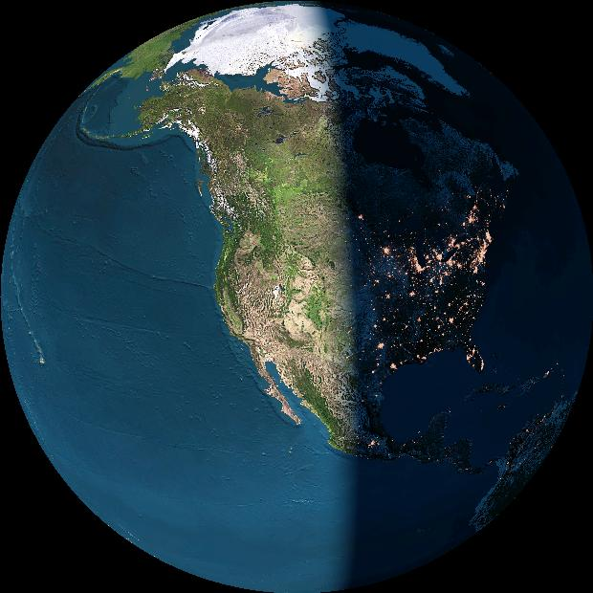
Biodiversity
data structure
SynTaxon
Community type databases
Locality
Observation/Collection
Event
Plot/Inventory databases
Object or specimen
Specimen databases
BioTaxon
Taxonomic databases

Slide 17
The Taxonomic database challenge:
Standardizing organisms and communities
The problem:
Integration of data potentially representing different times, places, investigators and taxonomic standards.
The traditional solution:
A standard list of organisms / communities.

Slide 18
Standard lists are available
Representative examples for higher plants include:
* North America / US
USDA Plants http://plants.usda.gov/
ITIS http://www.itis.usda.gov/
NatureServe http://www.natureserve.org
* World
IPNI International Plant Names Checklist
http://www.ipni.org/
IOPI Global Plant Checklist
http://www.bgbm.fu-berlin.de/IOPI/GPC/

Slide 19
Most standardized taxon lists fail to allow effective integration of datasets
The reasons include:
  The user cannot reconstruct the database as viewed at an arbitrary time in the past,
  Taxonomic concepts are not defined (just lists),
  Multiple party perspectives on taxonomic concepts and names cannot be supported or reconciled.

Slide 20
Three concepts of shagbark hickory
Splitting one species into two illustrates the ambiguity often associated with scientific names. If you encounter the name “Carya ovata (Miller) K. Koch” in a database, you cannot be sure which of two meanings applies.
Carya carolinae-sept.
(Ashe) Engler & Graebner
Carya ovata
(Miller)K. Koch
Carya ovata
(Miller)K. Koch
sec. Gleason 1952
sec. Radford et al. 1968

Slide 21
An assertion represents a unique combination of a name and a reference
“Assertion” is equivalent to
“Potential taxon” & “taxonomic concept”
Name
Assertion
Reference

Slide 22
Six shagbark hickory assertions
Possible taxonomic synonyms are listed together
Names
Carya ovata
Carya carolinae-septentrionalis
Carya ovata v. ovata
Carya ovata v. australis
Assertions
(One shagbark)
C. ovata sec Gleason ’52
C. ovata sec FNA ‘97
(Southern shagbark)
C. carolinae-s. sec Radford ‘68
C. ovata v. australis sec FNA ‘97
(Northern shagbark)
C. ovata sec Radford ‘68
C. ovata (v. ovata) sec FNA ‘97
References
Gleason 1952 Britton & Brown
Radford et al. 1968 Flora Carolinas
Stone 1997 Flora North America

Slide 23
(Inter)National Taxonomic Database?
  An upgrade for ITIS & Species 2000?
  Concept-based
  Party-neutral
  Synonymy and lineage tracking
  Perfectly archived

Slide 24
Where are we?
  Standards are being developed by various groups: FGDC, TDWG, IOPI, GBIF, etc.
  All organisms/specimens/communities in databases should be identified by linkage to an assertion = name and reference!

Slide 25
Core elements of VegBank
Project
Plot
Plot
Observation
Taxon
Observation
Taxon
Interpretation
Plot
Interpretation

Slide 26
ESA standards for plot data
Four levels of standards:
- Submission (geocoordinates, dominant taxa)
- Occurrence (area, interpretation)
- Classification (cover values for all taxa)
- Best practice (cover values in strata)
Pick lists (48 and counting)
Conversion to common units
Method protocols
Concept-based interpretations
“Painless” metadata

Slide 27
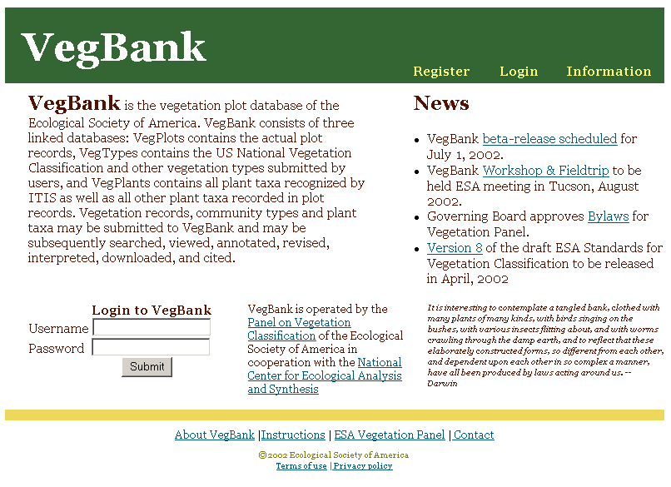

Slide 28
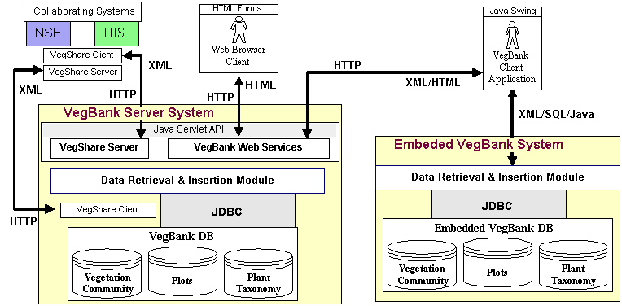
Parallel Server and Client systems

Slide 29
VegBank Client Interface Tools
Desktop client for data preparation and local use.
Flexible data import, including XML.
Tools for linking taxonomic and community concepts.
Standard query, flexible query, SQL query.
Flexible data export, including XML.
Easy web access to central archive

Slide 30
Conclusions
A public archive is needed for vegetation plot data
Design for reobservation. Separate permanent from transient attributes.
Records of organisms should always contain
a scientific name and a reference.
Design for future annotation of organism and community concepts.
Archival databases should provide time-specific views.

