Slide 1
Overview of
VegBank

Slide 2

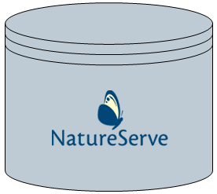
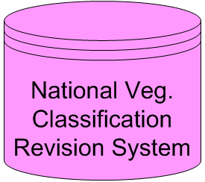
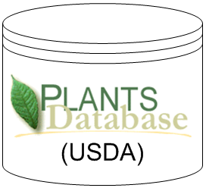
Overview of Online Ecological Info
vegbank.org
natureserve.org
Stores Plots and makes them publicly accessible
Stores Current Communities in the NVC
TBA
plants.usda.gov
Allows people to change and update NVC and plants
Stores Current Plant taxonomy

Slide 3

VegBank data sources
vegbank.org
natureserve.org
communities
plots
plants
plants.usda.gov
VegBank
Community of Users

Slide 4
Search for data in VegBank
vegbank.org
plots
plants
communities
Interpretation
&
Annotation:
Adding information to data already in VegBank
(i.e. interpreting a plant on a plot, assigning a plot to a community, notes)
VegBank
Community of Users

Slide 5
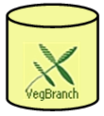
Adding plots to VegBank
vegbank.org
VegBranch: A MS Access Database on your own computer that allows you to interact with VegBank on the web
Load data to VegBank
Download data from VegBank
VegBank
Community of Users
import
plots
enter
plots

Slide 6
Downloading plots from VegBank
vegbank.org
Query plots from VegBank,
Then download to VegBranch
Query
Download
VegBank
Community of Users

Slide 7

Analysis of plot data
vegbank.org
VegBank&VegBranch have no analysis tools.
Other software and organizations can provide these tools, e.g. PC-ORD
We do provide data downloads that can be used for analysis.
Query plots from VegBank
query
spreadsheets
Then download to spreadsheet text files.
(limited data)
VegBank
Community of Users
Or download to VegBranch
Advanced users can also download our XML files to manipulate data
Analysis in PC-Ord or similar program

Slide 8

The future: Adding peer-reviewed communities & plant concepts
vegbank.org
natureserve.org
List of typal plots for new & existing
communities and new plant concepts
- new plant concepts
- new and revised communities
TBA
plants.usda.gov
new plant concepts
New Communities
or plants
submit
peer review

