Slide 1

Wednesday Wrap-up
Prioritization for Prototypes
General expectations for prototype
Prioritize the functions
Prototype review periods
Remaining Issues -- from Tuesday
authentication - plot Interpretation
HDMS linkage
Other issues
Taxonomy module
Stephen Hennekens
Future Planning
January 31, 2001

Slide 2
Interface design evaluation
Preliminary
design
Here today
Build
prototype #1
interface
Build
prototype #n
interface
April 1st
June 1st
August 1st
October 1st
Design
modification
are made
User
evaluates
interface
Evaluation
studied by
designer
ESA Prototype
Minimum Requirements?
Notes:
As per Curt Monash

Slide 3
Functionality prioritization
data downloader
-module to isolate the particular attributes -- Customizable downloads
-formats
XML (local database), flat-ASCII, Access (TNC Plots),
TurboVeg, Terra, Canoco, PC-ORD, & Decoda
-compression
-module to email the user in the case of a very large amount of time
to run the query
-resolving plots with different taxa resolution to a user specific
resolution -- this module would only be used for outputting
-Shopping cart scenario
-Manipulate the cover classes to a user
defined standard cover classification
data summary/visualization -- analytical tools
-histogram
-live update every quarter
-geographic distributions
Multi-plot Summary Tools
species richness -- summarize by entire result set multiple levels
histogram -- specific variables
community type summary table
summarize the degree of conformance for taxonomic
personalization -- allow the user to identify those attributes in
the collective summary page
Single-plot Summary Tools
-Data quality/completeness -- proxy for the coverage in the plot obs table
-view the entire species list
backend
flexible query engine
implement entire full schema
authentication module
download/query recorder
provisional name -- add to the data model (communityUsage)
other things:
-- look into leveraging turboVeg, TNC plots.
interface
general data loading
-preprocessor / error checker - desk top
logic checking (ie. azimuth 0-360, percentages sum to 100 ...)
newdata loader
-site information - desk top
-species information - desk top
-data quality summary
-data ingestion notification
-define authority
-segregate the state specific species data to increase app reponse
-automatic species picker (like url in netscape) - multiple standards?
-allow the user the option to identify the species infor by strata
or by species
-ability to type in USDA codes -- and have the app do the match-up
-Kartez (ABI), USDA plants, ITIS
-customizable codes
-make assumptions - always use the same user defined fields & codes
-request type for projection - conversion to lat/long from
field coordinates using on the fly conversion
-popup the USGS quad based on the lat/long
-read excel files
-map directly to the database attribute
-basic stats: min, max, mean, number of nulls, graphical histogram
-editor to correct the data problems
-handle user defined: description, category, name
-user defined validation ie. Enter the min max for a given attribute
-spell checking
-Strata mapping:
automatically attempt to map the user’s strata
levels into a standard mapping
-Inputting of nonstandard species (grass#1, 2 …n) user defined
-Compose a module that will allow a user to identify a species that
is a combination of multiple other species

Slide 4
Data prep - input
vegPlot prioritization
1 – needed to make the model prototype run with minimal functionality
2 – essential to the project / product
3 – Needed but not immediate
4 – Needed but less immediate than #3
interface
2 -preprocessor / error checker - desk top
logic checking (ie. azimuth 0-360, percentages sum to 100 ...)
2-3 -data quality text summary pre-load
2 data ingestion into the database notification
2 -define authority
3 -segregate the state specific species data to increase app response
3 -automatic species picker (like url in Netscape) - multiple standards?
3 -allow the user the option to identify the species information by strata
or by species
3 -ability to type in USDA codes -- and have the app do the match-up
2 -Kartez (ABI), USDA plants, IT IS -- concept-based taxonomy
3-4 -customizable codes
3 -make assumptions - always use the same user defined fields & codes
2 -request type for projection - conversion to lat/long from
field coordinates using on the fly conversion
4 -popup the USGS quad based on the lat/long

Slide 5
Data prep – input … cont.
2-ability for user to define new cover classes
3.5-Strata mapping:
automatically attempt to map the user’s strata
levels into a standard mapping
1.5-Inputting of nonstandard species (grass#1, 2 …n) user defined
4-Compose a module that will allow a user to identify a species that is a combination of multiple other species
3 - Capability of linking a user defined taxa to a user defined taxa category;
3 - ability to recognize a subspecies as a member of a specific species
2 - interface/form to edit or enter data into the vegPlotParty
2 - form to annotate/reinterpret a plot as a to which community type it belongs to
2 - form for entering a taxon interpretation
3 - upload a series of taxon interpretations
3 - implementing the notes/memos etc.
2 - implementing the user defined fields
4 - add a citation to a plot
1-read ascii files
1.5-GUI - map which allows user to directly map the
database attribute
*possibly allow user a selected sub-set of the
database attributes
1-command-line - map which allows user to directly
map the database attribute
*this is the ascii dataset with a external header file
4-basic stats: min, max, mean, number of nulls
4-editor to correct the data problems
2-editor to edit the header info.
3-handle user defined: description, category, name
4-user defined validation ie. Enter the min
max for a given attribute
3-spell checking
2-ability for user to define new strata definitions

Slide 6
Data analysis
data summary/visualization -- analytical tools
4-histogram
4-geographic distributions
Multi-plot Summary Tools
4-species richness -- summarize by entire result set multiple levels
4-community type summary table
4-summarize the degree of conformance for taxonomy
3-generic summary page (plotAuthor, location, plotName, top species,
sample method, community)
4-personalization -- allow the user to identify those attributes in
the collective summary page
Single-plot Summary Tools
4-Data quality/completeness -- proxy for the coverage in the plot obs table
3-view the entire species list

Slide 7
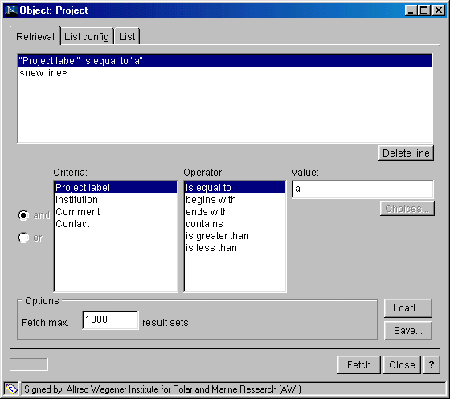
Queries
1] Simple query form interface allowing query by:
species list, state, community, elevation, surface geology,
whether the plot has multiple observations
3] More flexible query interface with the option to choose
query elements, Boolean operators and values
3] SQL interface via the web/desk top client

Slide 8
Queries 1
queryElements - used in the second query engine
2- species
2- locations (based on named places … state)
2- species abundance
2- data collection method:
plot quality sampling method, plot size
2-site factors: slope, ph soil texture
2- physiognomy strata type
2- community classification - confidence
2- party - roles, individuals
2- data availability
2- species taxonomy method -
2-does plot use a standard taxonomy
2-eco regions
2-community alliance/association
2-pass nvc classification requirements
2-data completeness
2-available data ie. any plots with soil calcium
3-select area from maps
4-eco region based on map selection
-query the module that stores information on the:
4- owner of plot to query number of downloads and
the person who downloaded the file
authenticated users
queries sent to the database
4-ability to save queries and or retrive queries for the
client machine for running in the middle layer
query engine and the SQL-like query engine

Slide 9
Remaining Backend work
backend
flexible query engine
implement entire full schema
authentication module
download/query recorder
provisional name -- add to the data model (communityUsage)
other things:
-- look into leveraging turboVeg, TNC plots.

Slide 10
Data export
2-module to isolate the particular attributes -- Customizable downloads
-formats
(1)XML (local database), (1) flat-ASCII, Access (TNC Plots),
(3)TurboVeg, (4)Canoco, ()PC-ORD, & ()Decoda
1 -compression
3.5 -module to email the user in the case of a very large amount of time
to run the query
3-resolving plots with different taxa resolution to a user specific
resolution -- this module would only be used for outputting
2.5-Shopping cart scenario
2.5-Manipulate cove to raw percentages
3-Manipulate the cover classes to a user
defined standard cover classification

Slide 11
Authentication
Tightly related topics:
Data security/sensitivity
Define extent of user levels
Access restrictions
Cookies
Session identification
Blow open for local DB?
Continue function list..

Slide 12
Interpretive data submittal
How does it work?
User access
Submittal forms
Continue function list..

