Slide 1

Interface Functionality
Introduction
Design model and considerations
System overview - database communication
Requirements Analysis
Information cleansing/preparation tools
Query tools
Analytical tools
Retrieval mechanisms
Authentication
Interpretation
Prioritization
January 29, 2001

Slide 2
Model design methods
Requirements
Determine the requirements for the application
Conceptual Design
Model the underlying business that the application will support
Logical Design
Design in general terms how the application will operate
Physical Design
Design in specific terms how the application will be constructed
Construction
Construct the application
Usability Testing
Test the usability of the user interface

Slide 3
Interface design evaluation
Preliminary
design
Cycle time for Prototype
60-90 days
Build
prototype #1
interface
Build
prototype #n
interface
Design
modification
are made
User
evaluates
interface
Evaluation
studied by
designer
Notes:
As per Curt Monash

Slide 4
Why an Interface
Access to Data
Analysis
Data cleansing
Data formatting
… Brainstorming
Notes:
Basically the only reason we need an interface is to access the data other possibilities may include:
Statistical analysis
Data organization
other

Slide 5
Brainstorming tools
Use case scenarios.
Related software.
…Interface – database communication
Notes:
Use case scenarios: everyone describes the processes that are hoping to do with the software system.
I will start the discussion by suggesting one of the scenarios that I would like to use the system for
Hypothesis: In the Sierra Nevada, I suspect that the species Acer rubrum coverage is related to three variables
1] The soil ph,
2] elevation
3] surficial geology

Slide 6
Interface Database Communication
Should interface(s) communicate
with:
Central database
Embedded database
Both
…Flexible current design
Notes:
Assume that the servlets will access with the central database
the stand alone tools will access the local database and the central database

Slide 7
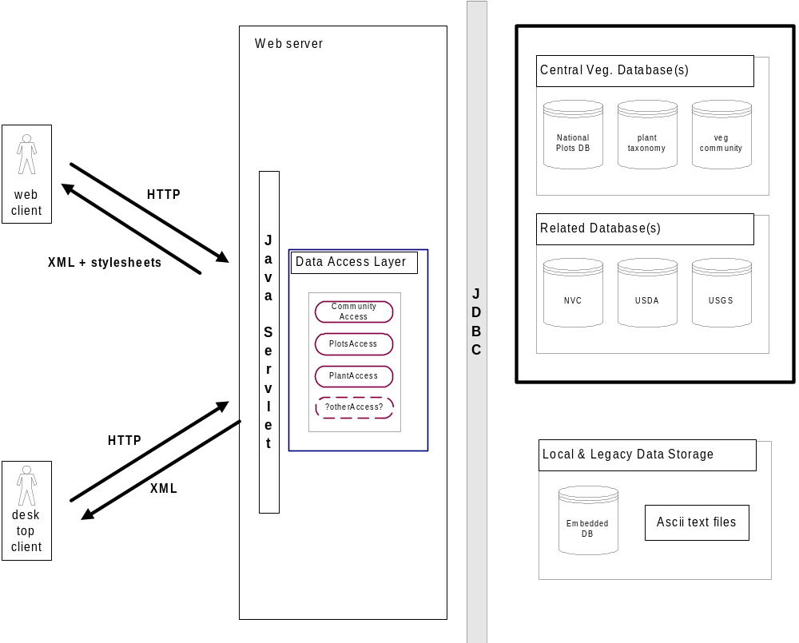
Vegetation plot database system
Web Interface
Desk-top Interface
Designed to access
Central db and/or local data
Notes:
Bulk of work to date has been on the ‘back-end’ and that have been waiting for the meeting to discuss the ‘front-end’ or interface issues
Maybe this should only be the backend discussion?
Conceptual diagrams showing client server relationships
show the architectural/system diagrams - servlet
information
question the importance of a standalone system and
discuss the use of morpho and beans
pinpoint the integration of the chosen tools to the system
that already has been designed

Slide 8
Data preparation/input
Formatting
tools to directly enter data
support various legacy data formats
(flexibility).
Error and consistency checking
Data quality summary
Notification on ingestion
      Start function list..

Slide 9
Data preparation/input
Data input
logic checker -- azimuth < 360,
percent not greater than 100
New data input:
1) define authority
1b) state specific
2) automatic species picker (like url in Netscape) - multiple standards?
-by strata and total
-ability to type in USDA codes
-Kartez (ABI), USDA plants, ITIS
-live update every quarter
-customizable codes
3) always the same user defined fields & codes
4) request type for projection - conversion to lat/long
-field coordinates
-on the fly conversion
5) provisional name -- and to the data model (communityUsage)
6) popup the USGS quad based on the lat/long
-- look into leveraging turboVeg, TNC plots.

Slide 10
Legacy data format: -- generic ASCII interface and small set of custom loaders
1) summary report
2) turboVeg
3) TNC plots
4) CCF - Cornell Condensed Format
5) legacy preprocessor to convert the taxonomy into species concept codes
Data loading use cases:
1] new field data in a field notebook
-need the field notebook
-element codes from USDA
2] legacy data with 1200 plots in a single dataset
3] Jim Drake provides DBA with 200,000 plots in a single ascii
file.

Slide 11
Header {
plotname, string
surface_geology, string
name, string
email address, string
role, string
}
plot1|sandstone|Bob Peet|peet@unc.edu|leader
plot1|sandstone|Bob Peet|peet@unc.edu|leader
plot1|sandstone|Bob Peet|peet@unc.edu|collector

Slide 12
Header {
plotname, string
name, string
name2, string
name3, string
endOfFile char = -999.25
}
plot1, sandstone, Bob Peet, John Harris, Dave Roberts, -999.25

Slide 13
Requirements for the general ascii loader:
read excel files
map directly to the database attribute
basic stats: min, max, mean, number of nulls, graphical histogram
editor to correct the data problems
handle user defined: description, category, name
user defined validation ie. Enter the min max for a given attribute
Species -- this should be modular so that can be used in the data preprocessor
as well in this module
read species name or code
spell checking
frequency of species
specify the species by state and adjoining states
if user has not used USDA, get the codes and matching species for matching
authority that the plot author’s usage
require user to identify a standard (USDA, FNA)
summary to include the element-species mapping -- use synonymies
ie. If user enters Abies lasiocarpa then prompt the user: all varieties
Abies lasiocarpa var lasiocarpa
Abies bifolia [] - the user defines the authority in this case
Abies lasiocarpa var. arizonica
Abies lasiocarpa
ie. If user enters Abies bifolia then map to the following
Abies lasiocarpa var lasiocarpa
"ABAR2","Abies arizonica Merriam","=Abies lasiocarpa var. arizonica","Pinaceae"
"ABBAL","Abies balsamea (L.) P. Mill. ssp. lasiocarpa (Hook.) Boivin","=Abies lasiocarpa var. lasiocarpa","Pinaceae"
"ABBAF","Abies balsamea (L.) P. Mill. var. fallax (Engelm.) Boivin","=Abies lasiocarpa var. lasiocarpa","Pinaceae"
"ABBI3","Abies bifolia A. Murr.","=Abies lasiocarpa var. lasiocarpa","Pinaceae"
"ABLAA","Abies lasiocarpa (Hook.) Nutt. var. arizonica (Merriam) Lemmon","corkbark fir","Pinaceae"
"ABLAL","Abies lasiocarpa (Hook.) Nutt. var. lasiocarpa","subalpine fir","Pinaceae"
"ABLA","Abies lasiocarpa (Hook.) Nutt.","subalpine fir","Pinaceae"
"ABSU","Abies subalpina Engelmann","=Abies lasiocarpa var. lasiocarpa","Pinaceae”a

Slide 14
Requirements for the general ascii loader:
Species -- this should be modular so that can be used in the data preprocessor
as well in this module
read species name or code
spell checking
frequency of species
specify the species by state and adjoining states
if user has not used USDA, get the codes and matching species for matching
authority that the plot author’s usage
require user to identify a standard (USDA, FNA)
summary to include the element-species mapping -- use synonymies
ie. If user enters Abies lasiocarpa then prompt the user: all varieties
Abies lasiocarpa var lasiocarpa
Abies bifolia [] - the user defines the authority in this case
Abies lasiocarpa var. arizonica
Abies lasiocarpa
ie. If user enters Abies bifolia then map to the following
Abies lasiocarpa var lasiocarpa
"ABAR2","Abies arizonica Merriam","=Abies lasiocarpa var. arizonica","Pinaceae"
"ABBAL","Abies balsamea (L.) P. Mill. ssp. lasiocarpa (Hook.) Boivin","=Abies lasiocarpa var. lasiocarpa","Pinaceae"
"ABBAF","Abies balsamea (L.) P. Mill. var. fallax (Engelm.) Boivin","=Abies lasiocarpa var. lasiocarpa","Pinaceae"
"ABBI3","Abies bifolia A. Murr.","=Abies lasiocarpa var. lasiocarpa","Pinaceae"
"ABLAA","Abies lasiocarpa (Hook.) Nutt. var. arizonica (Merriam) Lemmon","corkbark fir","Pinaceae"
"ABLAL","Abies lasiocarpa (Hook.) Nutt. var. lasiocarpa","subalpine fir","Pinaceae"
"ABLA","Abies lasiocarpa (Hook.) Nutt.","subalpine fir","Pinaceae"
"ABSU","Abies subalpina Engelmann","=Abies lasiocarpa var. lasiocarpa","Pinaceae”a

Slide 15
Requirements for the general ascii loader:
Strata mapping:
automatically attempt to map the user’s strata
levels into a standard mapping
Inputting of nonstandard species (grass#1, 2 …n) user defined
Compose a module that will allow a user to identify a species that
is a combination of multiple other species
resolving plots with different taxa resolution to a user specific
resolution -- this module would only be used for outputting

Slide 16
Query tools
Current design considerations:
1] Simple query device - occasional user
2] Expanded customizable search tool
3] SQL-like interface with schema-education
layer
Continue function list..

Slide 17
Analytical tools
Summary text viewer
?
Multidimensional analysis

Slide 18
Multi-plot Summary Tools
species richness -- summarize by entire result set multiple levels
histogram -- specific variables
community type summary table
summarize the degree of conformance for taxonomic
personalization
USE CASE:
query plots, visualize the distribution or view individual plot
summaries, redo the queries depending on these analysis, download
or remove from the download list
Single-plot Summary Tools
Data quality/completeness -- proxy for the coverage in the plot obs table
view the entire species list

Slide 19
Expanded tools list
1) species distribution modeling:
1.1) gaussian regression
1.2) logistic regression
1.3) beta function models
1.4) GLM models (generalized linear models)
1.5) GAM models (generalized additive models)
1.6) CART (classification and regression trees)
2) diversity analysis
2.1) dominance diversity curves
2.2) productivity/diversity analyses
2.3) diversity/? whatever analyses
3) cluster analysis
3.1) traditional hierarchical agglomerative
3.2) two-way-indicator species analysis (TWINSPAN)
3.3) fuzzy cluster analysis
4) multivariate analyses
4.1) PCA (principal components analysis)
4.2) RA/CA (reciprocal averaging\correspondence analysis)
4.3) NMDS (non-metric multidimensional scaling)
4.4) fuzzy set ordination
5) hybird or constrained ordination
5.1) canonical correlation analysis
5.2) canonical correspondence analysis (CANOCO)
fuzphy provides:
1) fuzzy set ordination (see 4.4 above)
2) fuzzy clustering (see 3.3 above)
3) maximal cliques analysis (full-dimensional permutation stats)
4) similar pairs analysis (full-dimensional permutation stats)
5) maximally compact sets analysis (full-dimensional stats)
6) some other weird stuff and basic database functions

Slide 20
Data export mechanism
Format -- XML, flat-ASCII, TurboVeg, TNC Plots,
Terra, Canoco, PC-ORD, & Decoda.
Compression -- multiple individual plot files, single
combined dataset, gzip, zip
Attribute selection – How flexible should the output
be; should the user be able to select individual
attributes for download?
Continue function list..

Slide 21
Data export options:
refresh data from central server
Formatting:
to local database, XML, flat-ASCII, Access (TNC Plots),
TurboVeg, Terra, Canoco, PC-ORD, & Decoda.
Possibly email the user if the query/download process is going to take a long time
Customizable downloads -
Shopping cart scenario
Resolve taxonomic disparities
Manipulate the cover classes to a user
defined standard cover classification

Slide 22
method for resolving taxonomic disparities
- Abies biofolia example for entire result set - which

Slide 23
Authentication
Tightly related topics:
Data security/sensitivity
Define extent of user levels
Access restrictions
Cookies
Session identification
Blow open for local DB?
Continue function list..

Slide 24
Interpretive data submittal
How does it work?
User access
Submittal forms
Continue function list..

Slide 25
Functionality prioritization
Start to prioritize the functionality:
Top-down vs. bottom-up approach
Prioritize function list..

