Slide 1


Impending Software Development
Importance to ecologists
Development Process
Development Tools
Work to Progress
January 29, 2001
Notes:
structure the process

Slide 2
Importance of understanding process and tools
Expectations
Unity
Efficiency
Notes:
Analogy to building a house
Expectations: -- what kind of applications can be built with chosen tools
Unity: Recognizing which periods of the process model are for collaboration will lead to better communication and agreement, also the understanding of how to use the process tools/timeline will lead to improved communication
Efficiency: -- If everyone understands the process and tools and uses them correctly the project will move along at an efficient rate
40% of all software projects fail

Slide 3
Development Process
Prototyping model
• Carefully designed prototypes
• Multiple prototypes
• Tight integration between developers
and ecologists
Plan to throw one away, you will anyway

Slide 4
Prototyping model
Critique
prototype
Analyze
requirements
behavior spec
Build
prototype
Design
component spec
Implement
code
application, certification
Test
Operate
Notes:
As per Curt Monash

Slide 5
Prototyping model
Critique
prototype
Analyze
requirements
behavior spec
Build
prototype
Design
component spec
Implement
code
application, certification
Test
Operate
Notes:
As per Curt Monash

Slide 6
Analyze
requirements
~ Determine the requirements for the application
Assemble the design team
Identify all stakeholders
Select the design team (there will be a significant time commitment involved)
Gather Requirements:
Interview as many stakeholders as is practical to determine:
What the underlying business problems are that this application should address
What benefits the application should provide
What the critical success factors are
Define the scope of the project
Review the requirements that have been gathered
Make decisions about what will be included and what will not
If the scope of the project gets too big, consider breaking it down into stages.
Notes:
As per Curt Monash

Slide 7
Prototyping model
Critique
prototype
Analyze
requirements
behavior spec
Build
prototype
Design
component spec
Implement
code
application, certification
Test
Operate
Notes:
As per Curt Monash

Slide 8
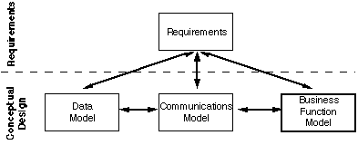
Design
Conceptual - Model the underlying business that the
application will support
Logical - Design in general terms how the application
will operate
Physical - Design in specific terms how the application
will be constructed
Notes:
As per Curt Monash

Slide 9
Benefits
Multiple design phases
Refinement of design
Tight integration between developers and users
Incremental improvement
Notes:
Multiple design - phases room for change – leading to:
tight integration between developers and users
incremental improvement
The prototype serves as a mechanism for identifying software requirements
Mention that at times there may be drawbacks to the haste
Mention other development process like linear and hacking

Slide 10
Remaining issues with process
Number of iterations
Planning for re-design
Software testing
Notes:
Number of iterations should be discussed but should probably wait until finish listing the functionality
Commitment for the working group will get back to me after release or prototype with redisign specs, should the number of testers
Should be greater than the number of the working group.

Slide 11
Development Tools
Representative tools reflect the desire to have the following features:
High performance
Robust
Open architecture
Platform neutral
Scaleable
Notes:
Recognition that tools will have to be flexible/scaleable to act as central server and a desktop client
minimum hardware requirements
this is not locked because the interface design may impact the use of some of these tools

Slide 12
Features
Java - Write once run any where
Java Servlet - Dynamic html generation
JDBC - Connect to any Database
Swing - Classy interface tools
Beans - Reusable components
Notes:
Servlets: dynamic html generation including media generated from:
database query results
logic
calculations etc..

Slide 13
Features .. 2
XML: is the format for structured data on the Web.
It preserves the unique blend of simplicity and openness of the Web compared to conventional distributed object technologies.
It doesn't require a big commitment to deploy services which export an XML interface. It has minimal impact on how Web applications are structured.
It is straightforward to write generic tools which export parts of a relational database as XML encoded data, or even to write generic code that serializes Java (or other) objects as XML data structures.
Notes:
Recognition that tools will have to be flexible/scaleable to act as central server and a desktop client

Slide 14
Features .. 3
Databases:
Oracle 8i:
Embedded Database Solutions
InstantDB
SleepyCat
Mysql
PostgreSQL
cloudScape
informix
Notes:
Recognition that tools will have to be flexible/scaleable to act as central server and a desktop client

Slide 15
Design Work to Date
Nature of the work -- primarily back end
Assumptions made by the developers
System model abstractions
Notes:
Bulk of work to date has been on the ‘back-end’ and that have been waiting for the meeting to discuss the ‘front-end’ or interface issues
Maybe this should only be the backend discussion?
Conceptual diagrams showing client server relationships
show the architectural/system diagrams - servlet
information
question the importance of a standalone system and
discuss the use of morpho and beans
pinpoint the integration of the chosen tools to the system
that already has been designed

Slide 16
Requirements
Flexible enough to encompass all potential queries
Must support a high frequency of operations
Have large numbers of users
Must support a high frequency of operations, typically
involving updates to data
Involve multiple, heterogeneous sources of data
(e.g. multiple relational database)
Intercommunication with both stand alone
applications and web-interface
Notes:
Bulk of work to date has been on the ‘back-end’ and that have been waiting for the meeting to discuss the ‘front-end’ or interface issues
Maybe this should only be the backend discussion?
Conceptual diagrams showing client server relationships
show the architectural/system diagrams - servlet
information
question the importance of a standalone system and
discuss the use of morpho and beans
pinpoint the integration of the chosen tools to the system
that already has been designed

Slide 17
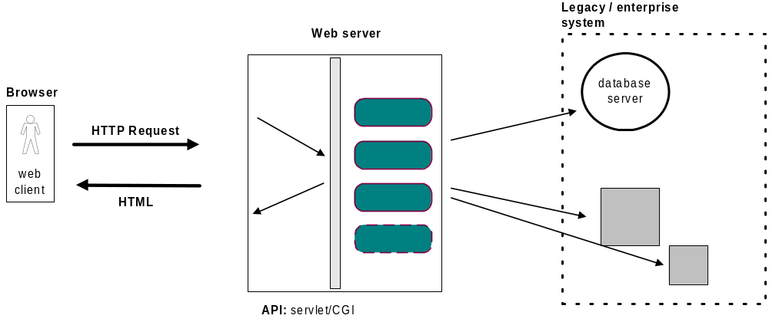
3 tiered web application system
Notes:
Bulk of work to date has been on the ‘back-end’ and that have been waiting for the meeting to discuss the ‘front-end’ or interface issues
Maybe this should only be the backend discussion?
Conceptual diagrams showing client server relationships
show the architectural/system diagrams - servlet
information
question the importance of a standalone system and
discuss the use of morpho and beans
pinpoint the integration of the chosen tools to the system
that already has been designed

Slide 18
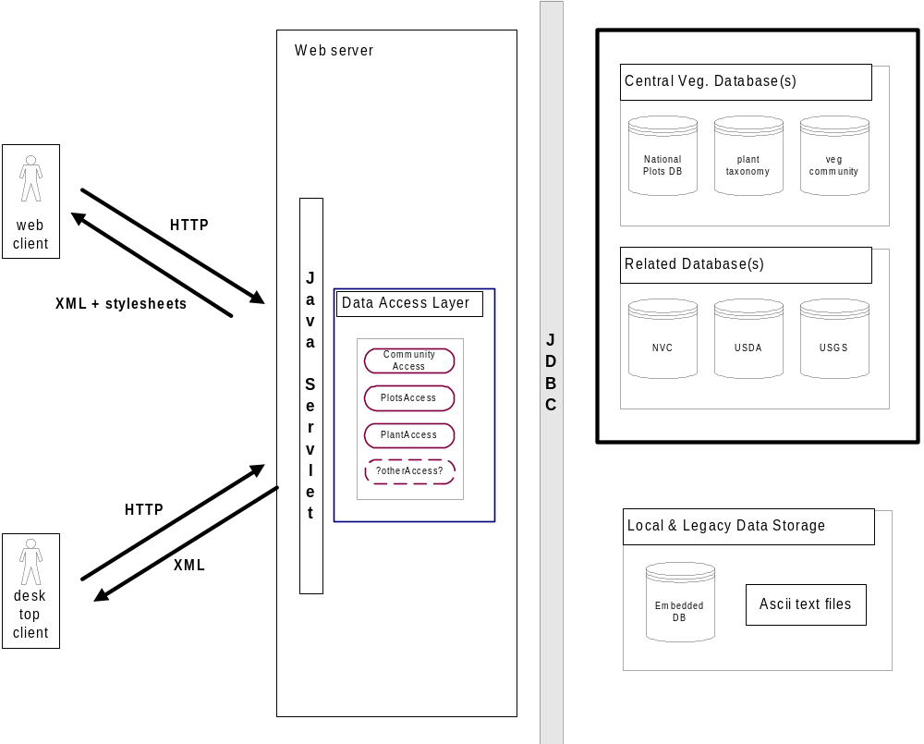
Vegetation plot database system
change to show separation of dataset
Notes:
Bulk of work to date has been on the ‘back-end’ and that have been waiting for the meeting to discuss the ‘front-end’ or interface issues
Maybe this should only be the backend discussion?
Conceptual diagrams showing client server relationships
show the architectural/system diagrams - servlet
information
question the importance of a standalone system and
discuss the use of morpho and beans
pinpoint the integration of the chosen tools to the system
that already has been designed

Slide 19
Physical Design
Nature of the work -- primarily back end
Assumptions made by the developers
System model abstractions
Notes:
Bulk of work to date has been on the ‘back-end’ and that have been waiting for the meeting to discuss the ‘front-end’ or interface issues
Maybe this should only be the backend discussion?
Conceptual diagrams showing client server relationships
show the architectural/system diagrams - servlet
information
question the importance of a standalone system and
discuss the use of morpho and beans
pinpoint the integration of the chosen tools to the system
that already has been designed

Slide 20
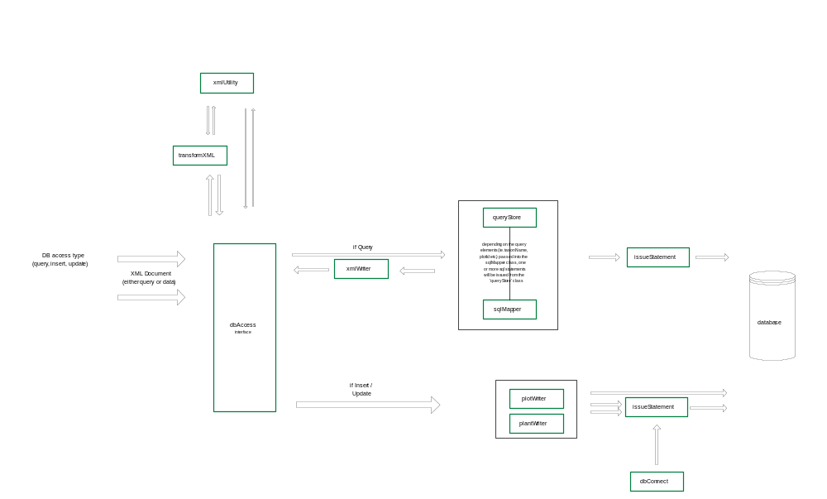
Notes:
Bulk of work to date has been on the ‘back-end’ and that have been waiting for the meeting to discuss the ‘front-end’ or interface issues
Maybe this should only be the backend discussion?
Conceptual diagrams showing client server relationships
show the architectural/system diagrams - servlet
information
question the importance of a standalone system and
discuss the use of morpho and beans
pinpoint the integration of the chosen tools to the system
that already has been designed

Slide 21
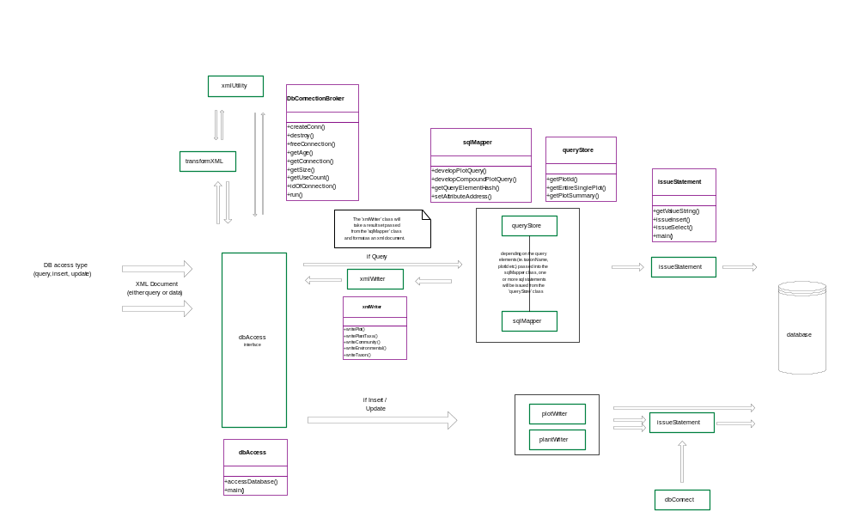
Notes:
Bulk of work to date has been on the ‘back-end’ and that have been waiting for the meeting to discuss the ‘front-end’ or interface issues
Maybe this should only be the backend discussion?
Conceptual diagrams showing client server relationships
show the architectural/system diagrams - servlet
information
question the importance of a standalone system and
discuss the use of morpho and beans
pinpoint the integration of the chosen tools to the system
that already has been designed

Slide 22
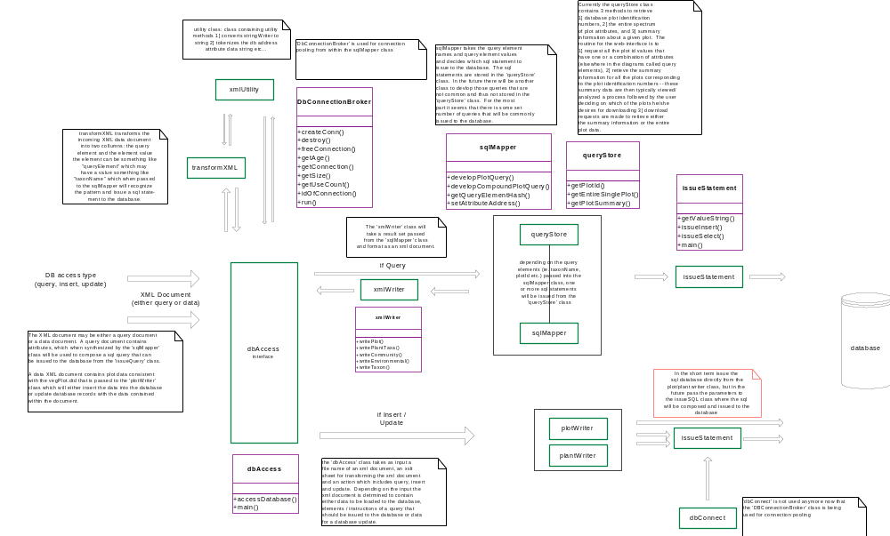
Notes:
Bulk of work to date has been on the ‘back-end’ and that have been waiting for the meeting to discuss the ‘front-end’ or interface issues
Maybe this should only be the backend discussion?
Conceptual diagrams showing client server relationships
show the architectural/system diagrams - servlet
information
question the importance of a standalone system and
discuss the use of morpho and beans
pinpoint the integration of the chosen tools to the system
that already has been designed

Slide 23
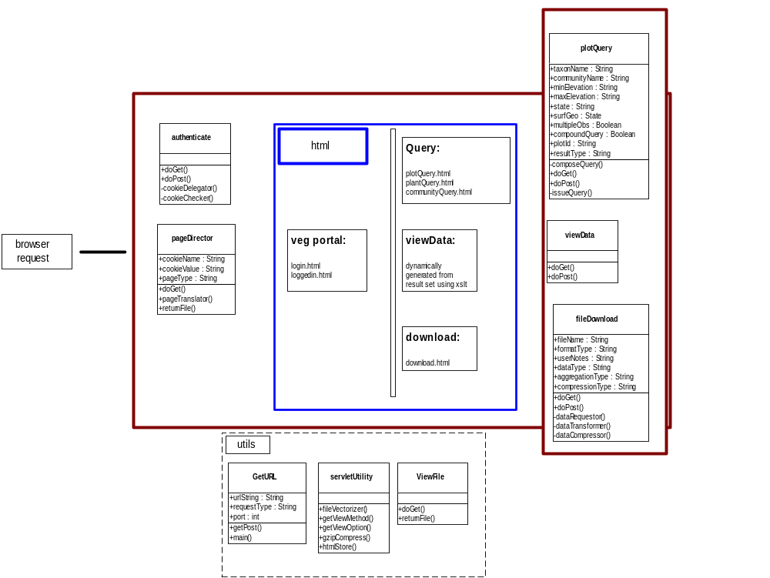
Notes:
Bulk of work to date has been on the ‘back-end’ and that have been waiting for the meeting to discuss the ‘front-end’ or interface issues
Maybe this should only be the backend discussion?
Conceptual diagrams showing client server relationships
show the architectural/system diagrams - servlet
information
question the importance of a standalone system and
discuss the use of morpho and beans
pinpoint the integration of the chosen tools to the system
that already has been designed

Slide 24
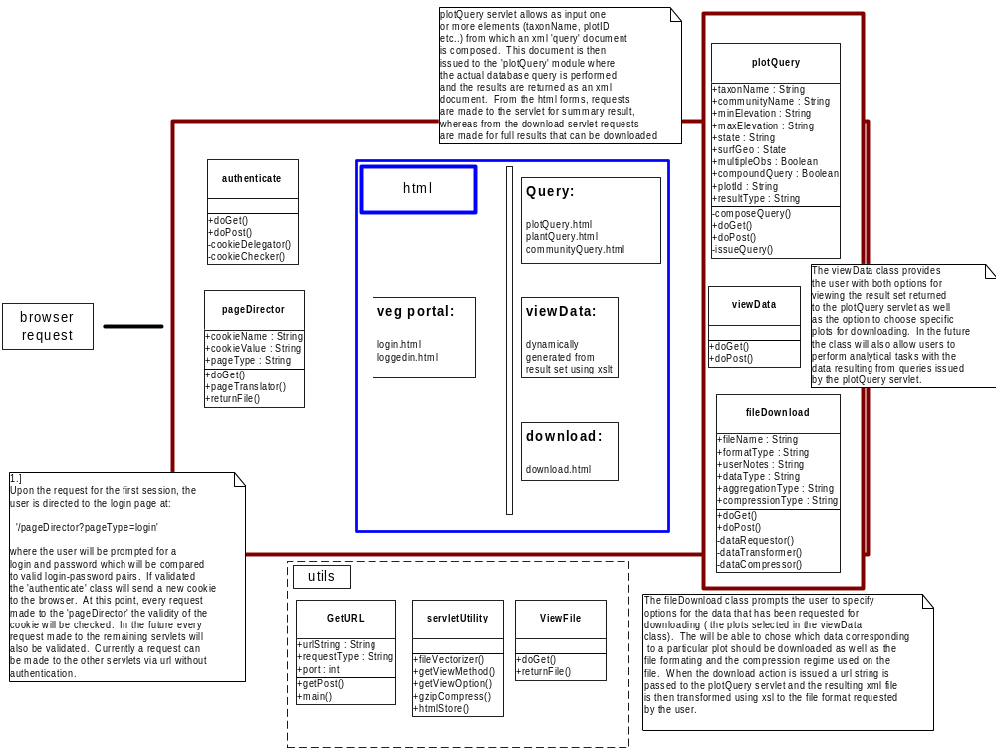
Notes:
Bulk of work to date has been on the ‘back-end’ and that have been waiting for the meeting to discuss the ‘front-end’ or interface issues
Maybe this should only be the backend discussion?
Conceptual diagrams showing client server relationships
show the architectural/system diagrams - servlet
information
question the importance of a standalone system and
discuss the use of morpho and beans
pinpoint the integration of the chosen tools to the system
that already has been designed

Slide 25
Notes:
Bulk of work to date has been on the ‘back-end’ and that have been waiting for the meeting to discuss the ‘front-end’ or interface issues
Maybe this should only be the backend discussion?
Conceptual diagrams showing client server relationships
show the architectural/system diagrams - servlet
information
question the importance of a standalone system and
discuss the use of morpho and beans
pinpoint the integration of the chosen tools to the system
that already has been designed

Slide 26
Development Work to Date
Nature of the work -- primarily back end
Assumptions made by the developers
System model abstractions
Notes:
Bulk of work to date has been on the ‘back-end’ and that have been waiting for the meeting to discuss the ‘front-end’ or interface issues
Maybe this should only be the backend discussion?
Conceptual diagrams showing client server relationships
show the architectural/system diagrams - servlet
information
question the importance of a standalone system and
discuss the use of morpho and beans
pinpoint the integration of the chosen tools to the system
that already has been designed

Slide 27
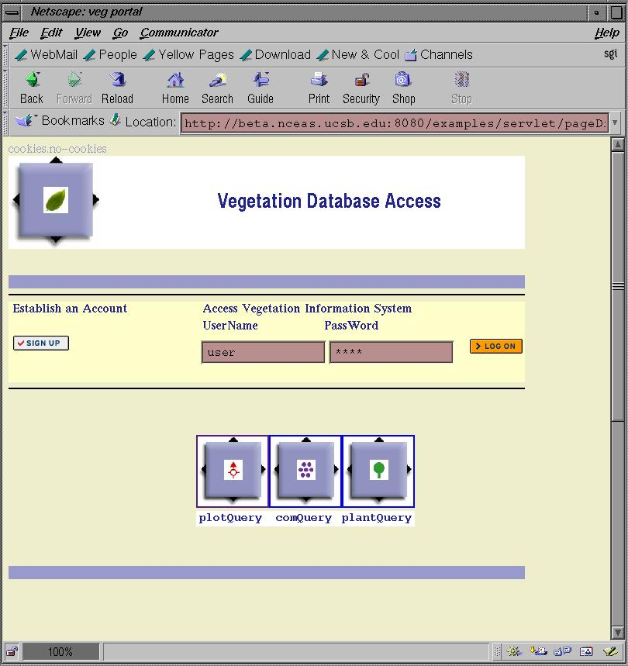
Notes:
Bulk of work to date has been on the ‘back-end’ and that have been waiting for the meeting to discuss the ‘front-end’ or interface issues
Maybe this should only be the backend discussion?
Conceptual diagrams showing client server relationships
show the architectural/system diagrams - servlet
information
question the importance of a standalone system and
discuss the use of morpho and beans
pinpoint the integration of the chosen tools to the system
that already has been designed

Slide 28
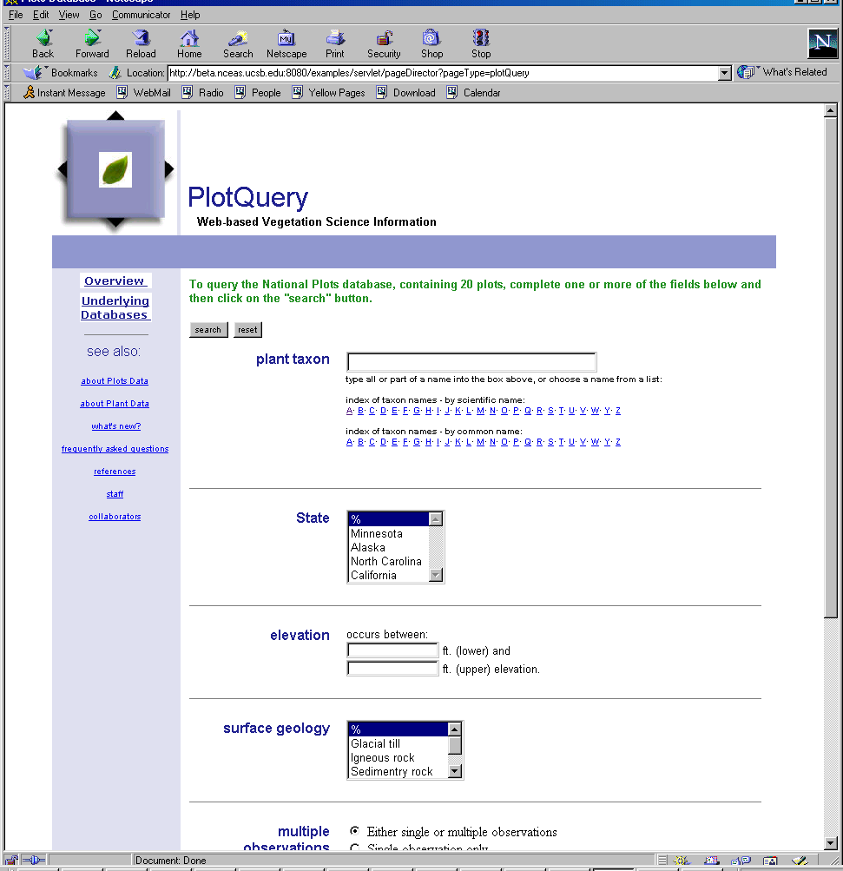
Notes:
Bulk of work to date has been on the ‘back-end’ and that have been waiting for the meeting to discuss the ‘front-end’ or interface issues
Maybe this should only be the backend discussion?
Conceptual diagrams showing client server relationships
show the architectural/system diagrams - servlet
information
question the importance of a standalone system and
discuss the use of morpho and beans
pinpoint the integration of the chosen tools to the system
that already has been designed

Slide 29
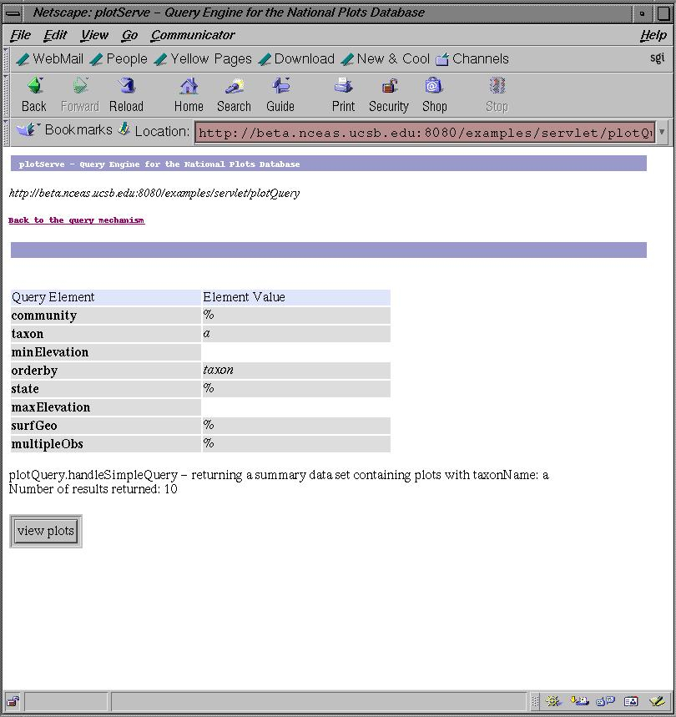
Notes:
Bulk of work to date has been on the ‘back-end’ and that have been waiting for the meeting to discuss the ‘front-end’ or interface issues
Maybe this should only be the backend discussion?
Conceptual diagrams showing client server relationships
show the architectural/system diagrams - servlet
information
question the importance of a standalone system and
discuss the use of morpho and beans
pinpoint the integration of the chosen tools to the system
that already has been designed

Slide 30
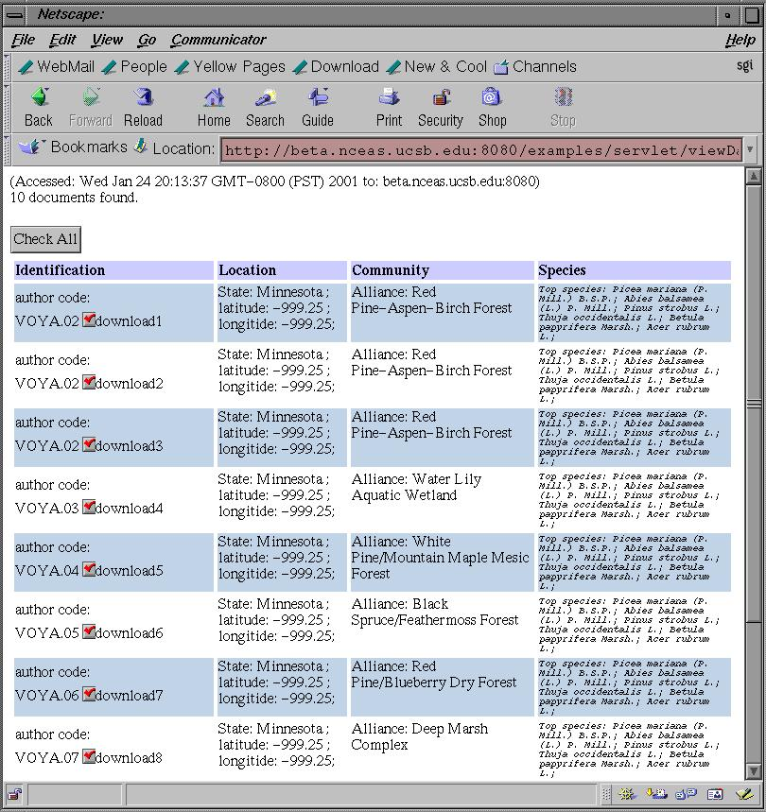
Notes:
Bulk of work to date has been on the ‘back-end’ and that have been waiting for the meeting to discuss the ‘front-end’ or interface issues
Maybe this should only be the backend discussion?
Conceptual diagrams showing client server relationships
show the architectural/system diagrams - servlet
information
question the importance of a standalone system and
discuss the use of morpho and beans
pinpoint the integration of the chosen tools to the system
that already has been designed

Slide 31
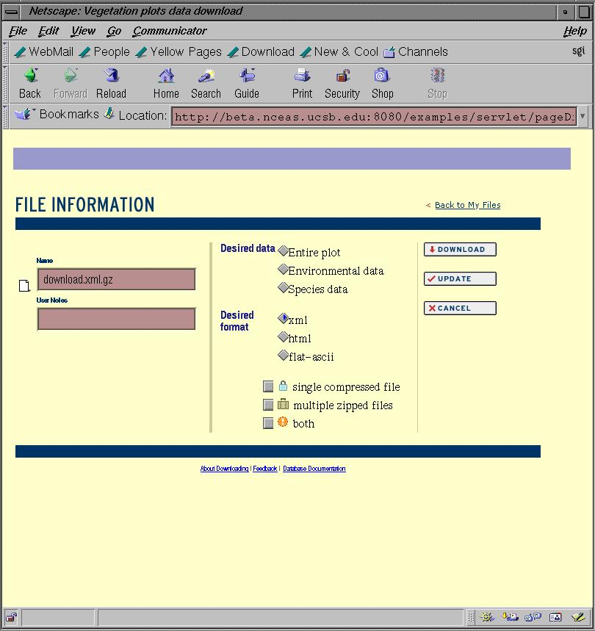
Notes:
Bulk of work to date has been on the ‘back-end’ and that have been waiting for the meeting to discuss the ‘front-end’ or interface issues
Maybe this should only be the backend discussion?
Conceptual diagrams showing client server relationships
show the architectural/system diagrams - servlet
information
question the importance of a standalone system and
discuss the use of morpho and beans
pinpoint the integration of the chosen tools to the system
that already has been designed

