Slide 1


OVERVIEW OF DATA FLOW IN NVC PROCESS
Field sheets
NVC
Proceedings

Slide 2
VegBank and the NVC
Ecologists have long recognized need to communicate about "community type" or "vegetation type" as a unit of vegetation.
Vegetation types can be understood as segments along gradients of vegetation composition – more-or-less continuous.
Conceptualization of vegetation types is derived from analyses of vegetation samples (plots, transects, relevés etc.), and these samples provide the fundamental records for describing vegetation.
Both basic and practical needs for classifying vegetation have led to substantial unification in approaches to vegetation classification – the NVC is one such expression.
Convergence of basic concepts that underlie establishment and recognition of associations and alliances.

Slide 3
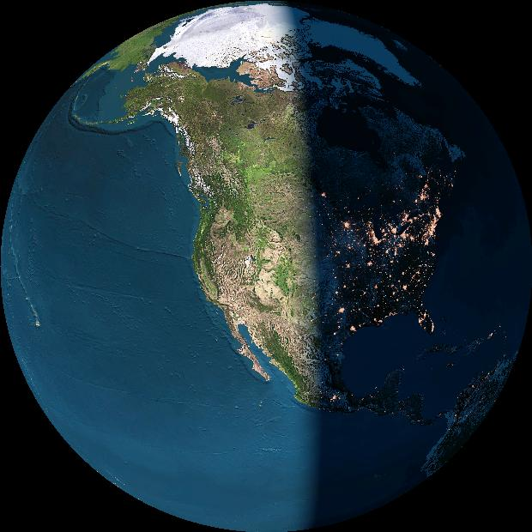
Biodiversity
data structure
Vegetation Type
Locality
Vegetation classification databases
Plot Observation/
Collection Event
Plot/Archive databases
Specimen or Object
Specimen databases
Bio-Taxon
Taxonomic databases

Slide 4
WWW Output
US-NVC
---
Proposed data flow
Extraction
Classification Database
Classification Mgmt.
Digital NVC Proceedings
US-NVC Panel
Peer Review
Proposal
Legend
External Action
Analysis & Synthesis
Internal Action
Vegetation Plot Archive
Database

Slide 5
Vegetation Plot Archive: A Missing Piece of the Puzzle
The missing core component is the data infrastructure needed to manage the anticipated 10⁷ plots and 10⁴ plant associations, and to distribute this over the web in a continually revised, perfectly updated form.
But how were we getting by before?

Slide 6
Before
Plot Archive
After Plot Archive
Field Survey notes
Type 1
Type 4
USFS type
Journal type
NHP type
Type 2
Type 3

Slide 7
Database Solutions to Plot Archives and
Other Databases for NVC
Plot data form the quantitative basis for refining the NVC/IVC classification – but they depend on other data and databases.
Plot Data require 3 key databases:
Classification Databases
  Biotics, NatureServe Explorer
Taxonomic Databases
  ITIS, others
Vegetation Plot Databases
  VegBank, VegBranch, others?

Slide 8
Other Pieces Needed for NVC
But processing of plot data for IVC/NVC also needs another set of processes for interpretation of vegetation types based on plots.
Consistent Type Description
Peer Review Process
NVC Digital Proceedings connecting Type descriptions to Plot database.

Slide 9
VegBank – the Plot Archive Solution
The ESA Vegetation Panel is currently developing a public vegetation plot archive known as VegBank (www.vegbank.org).
VegBank is expected to function for vegetation
plot data in a manner analogous to GenBank.
Primary data will be deposited for reference,
novel synthesis, and reanalysis, particularly for classification.
The database architecture can be generalized to most types of species co-occurrence data.

Slide 10
VegBank
A vegetation field plot archive
Sponsored by:
  The Ecological Society of America - Vegetation Classification Panel
Produced at:
  The National Center for Ecological Analysis and Synthesis (NCEAS)
Principal Investigators:
  Robert K. Peet, University of North Carolina
  Michael D. Jennings, U.S. Geological Survey
  Dennis Grossman, NatureServe
  Marilyn D. Walker, USDA Forest Service
Staff:
  P. Mark Anderson, NCEAS
  Michael Lee, University of North Carolina

Slide 11






VegBank is made possible
by the support and cooperation of:
Ecological Society of America
National Center for Ecological
Analysis and Synthesis
Federal Geographic Data Committee
Gap Analysis Program
National Biological Information Infrastructure
National Science Foundation

Slide 12
Core elements of VegBank
Project
Plot data
Species taxonomy
Vegetation classification
Plot
Plot
Observation
Taxon
Observation
Taxon
Interpretation
Plot
Interpretation
(Community Type)

Slide 13
The Taxonomic Database Challenge:
Standardizing organisms and communities
The problem:
Integration of data potentially representing different times, places, investigators and taxonomic standards.
The traditional solution:
A standard list of organisms / communities.

Slide 14
Taxon: Standard Lists are Available
Representative examples for higher plants include:
* North America / US
USDA Plants http://plants.usda.gov/
ITIS http://www.itis.usda.gov/
NatureServe http://www.natureserve.org
* World
IPNI International Plant Names Checklist
http://www.ipni.org/
IOPI Global Plant Checklist
http://www.bgbm.fu-berlin.de/IOPI/GPC/

Slide 15
Most standardized taxon lists fail to allow effective integration of datasets
The reasons include:
  Taxonomic concepts are not defined (just lists),
  Multiple party perspectives on taxonomic concepts and names cannot be supported or reconciled,
  The user cannot reconstruct the database as viewed at an arbitrary time in the past.

Slide 16
Why current taxon lists fail: Three concepts of shagbark hickory
Splitting one species into two illustrates the ambiguity often associated with scientific names. If you encounter the name “Carya ovata (Miller) K. Koch” in a database, you cannot be sure which of two meanings applies.
Carya carolinae-sept.
(Ashe) Engler & Graebner
Carya ovata
(Miller)K. Koch
Carya ovata
(Miller)K. Koch
sec. Gleason 1952
sec. Radford et al. 1968

Slide 17
A concept represents a unique combination of a name and a reference
“Taxon Concept” is equivalent to
“Potential taxon” & “Assertion”
Name
Concept
Reference

Slide 18
What we wished was available: (Inter)National Taxonomic Database
  An upgrade for ITIS etc.?
  Concept-based
  Party-neutral
  Synonymy and lineage tracking
  Perfectly archived

Slide 19
Plot Database Conclusions
A public archive is needed for vegetation plot data.
Design for re-observation of plots:
separate permanent from transient attributes.
Records of species should always contain
a scientific name and a reference (concept-based).
Design for future annotation of species and community concepts.
Archival databases should provide time-specific views.

Slide 20
Guidelines for Vegetation Classification
The ESA Vegetation Panel and its partners have been working to develop guidelines for the floristic levels of the classification covering:
Terminology
Plot data acquisition
Identification and documentation of vegetation types
Formal description and peer review of types
Information dissemination and management.
Version 2.0 released in May 2003
Version 3.0 under review by FGDC as federal standard

Slide 21
ESA standards for plot data
Four levels of standards:
- Submission (geo-coordinates, dominant taxa)
- Occurrence (area, interpretation)
- Classification (cover values for all taxa)
- Best practice (cover values for all taxa by strata)
Pick lists (48 and counting)
Conversion to common units
Method protocols
Concept-based interpretations of taxa & communities
“Painless” metadata

Slide 22
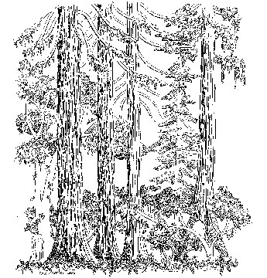
Vegetation Description
Pseudotsuga menziesii – Tsuga heterophylla Forest Alliance
Douglas Fir – Western Hemlock
CANOPY SPECIES
Pseudotsuga menziesii 37.5%
Abies grandis 37.5%
Tsuga heterophylla 37.5%
Thuja plicata 12.5%
Olympic National Park, Mt. Olympus

Slide 23
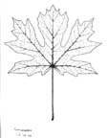
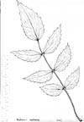

Vegetation Description: structure & floristics
T – TREE LAYER (100%)
  T1 (main canopy layer; 100%):
    Pseudotsuga menziesii 37.5%,
    Abies grandis 37.5%,
    Tsuga heterophylla 37.5%,
    Thuja plicata 12.5%;
  T2 (sub canopy layer; 70%):
    Tsuga heterophylla 12.5%
    Acer circinatum 62.5%,
    Rhamnus purshiana 3%;
S – SHRUB LAYER (20%)
  S1 (tall shrub layer; 15%):
    Taxus brevifolia 0.5%,
    Oplopanax horridus 7.5%,
  S2 (low shrub layer; 20%):
    Mahonia nervosa 3%,
    Gaultheria shallon 12.5%, etc.
H - HERB LAYER (50%):
M - MOSS LAYER (70%).

Slide 24
VEGETATION FIELD PLOTS
(Guidelines, Chapter 5)
1. Stand selection and plot design: How plots/stands were selected and designed.
2. Physiognomy: (Optimally), recognize the following strata when present: tree, shrub, herb, and moss (moss, lichen, liverwort, alga), and in aquatic habitats, floating, and submerged
3. Species composition:
  Sampling should detect complete species assemblage (one time sampling)
  A plant name and plant reference
  Taxon cover (or taxon stratum cover); cover estimated to at least Braun-Blanquet scale.

Slide 25
VEGETATION FIELD PLOTS
(Guidelines, Chapter 5)
4. Site data: Elevation, slope aspect, slope gradient. (minimal).
5. Geographic Data:
  Latitude and longitude, decimal degrees and WGS 84 (NAD83) datum,
  Field coordinates and the datum used.
6. Metadata: Project name/description, methodology for selecting and laying out plots, effort in gathering floristic data, cover scale and strata types, and name/ contact information of lead field investigators.

Slide 26
DESCRIPTION OF FLORISTIC UNITS (Guidelines, Chapter 6)
Names of natural and semi-natural types (nomenclatural rules).
Floristic unit. Indicate level of unit described: “Association,” Alliance,” “Planted/Cultivated.”
Placement in the hierarchy
Classification comments.
Rationale for choosing the nominal taxa (the species by which the type is named).
Brief description. Provide a brief (1-2 paragraph) summary.
Physiognomy.
8. Floristics. Species composition and average cover for all species (preferably by stratum)
  a. Stand table of floristic composition (preferably by stratum)
  b. Summary of diagnostic species.
  c. Taxonomic usage in floristic tables with reference.

Slide 27
DESCRIPTION OF FLORISTIC UNITS (Guidelines, Chapter 6)
9. Dynamics
10. Environmental description.
11. Description of the range
12. Identify field plots.
13. Evaluate plot data
14. The number and size of plots. Justify the number of and sizes of plots.
15. Methods used to analyze field data.
16. Overall confidence level for the type (High, Moderate, Low).
17. Citations.
18. Synonymy.

Slide 28
GUIDELINES FOR PEER REVIEW (Guidelines, Chapter 7)
1. Peer-review process administered by the ESA Vegetation Panel and appointees.
2. Reviewers should have sufficient regional expertise.
3. Each type will be assigned a confidence level (High, Moderate, Low).
4. Investigators participating in NVC use a defined template for type descriptions.
5. Investigators must place their proposed types within context of existing NVC types – decide if proposed type is distinct, or will refine or upgrade existing type(s) on list.

Slide 29
GUIDELINES FOR PEER REVIEW (Guidelines, Chapter 7)
6. Two kinds of peer review are available.
  a. Types with information sufficient for High or Moderate confidence level, full peer-review process required.
  b. Types with less information, but investigator is convinced type is new to NVC, s/he submits as Low confidence, expedited peer-review process.
7. Full descriptions of types constitutes the NVC primary literature, published in a public digital Proceedings of the NVC.

Slide 30
DATA MANAGEMENT
(Guidelines, Chapter 8)
1. Vegetation Classification Database viewable and searchable over the web. Primary access - NatureServe Explorer (http://www.natureserve.org/explorer/).
2. Users of NVC should cite the website and the explicit version observed.
3. Maintenance of NVC data files by NVC management team. However, definition, redefinition, or change in the confidence level of a vegetation type requires approval of the peer-review team.
4. Plot data for NVC must be archived in VegBank or other public database.

Slide 31
DATA MANAGEMENT
(Guidelines, Chapter 8)
5. Plot data for NVC types must be linked by accession number to types in the Vegetation Classification Database and should be publicly available.
6. If non-VegBank database used, that archive must ensure data permanency and exportability.
7. Proposals for revisions to NVC submitted in digital format using standard templates.
8. Successful proposals posted on the web as Proceedings of the NVC.
9. Each taxon must be reported as a name and publication couplet. Unknown or irregular taxa should also be reported.

Slide 32
WWW Output
US-NVC
---
Proposed data flow
Extraction
Classification Database
Classification Mgmt.
Digital NVC Proceedings
US-NVC Panel
Peer Review
Proposal
Analysis & Synthesis
Vegetation Plot Archive
Plot Data

Slide 33
Core elements of VegBank
Project
Plot data
Species taxonomy
Vegetation classification
Plot
Plot
Observation
Taxon
Observation
Taxon
Interpretation
Plot
Interpretation
(Community Type)

Slide 34
Plot Data –
Data Entry & Management
Multiple Options:
  Excel spreadsheets – VegBranch
  Access database - VegBranch
  NPS PLOTS database
  VegBranch
  Other Databases – XML links

Slide 35
DATA UPLOAD & DOWNLOAD
VegBranch → XML → VegBank
VegBank → SQL file → VegBranch
3. Other Databases ← → XML ← → VegBank

Slide 36
VegBank Client Interface Tools
Desktop client for data preparation (VegBranch),
Flexible data import,
Standard query, flexible query, SQL query,
Flexible data export,
Tools for linking taxonomic and community concepts,
Easy web access to central archive.

Slide 37
Connectivity of Databases
CE = Community Element Record
SP# = Species Record
= One Way Data Flow
= Deep Link
Kartesz Data Tool
B?
CE 3000
Sp300
Sp300
A
Sp200
CE 2000
Sp200
C
CE1000
Sp100
Sp100
D
BIOTICS Community Element Data
Community ID - 1000
Name – Abies lasiocarpa- Vaccinium scopariuma Forest
Descriptive fields
Component SP
SP IDName etc
1blah
2etc.
3
Plot Table
Asc#TypeDateetc
1Typalxxx
2nontype
NS Explorer
Community ID 1000
Name – Abies lasiocarpa- Vaccinium scopariuma Forest
Descriptive fields
Component SP
SP IDName etc
1blah
2etc.
3
Plot Table
Asc#TypeDateetc
1Typalxxx
2non typal
VEG BANK – Plots
Accesion # 1
Community ID - 1000
Name Abies lasiocarpa- Vaccinium scopariuma Forest
Plant List
SP ID Name cover etc.
100
200
300
400
G
VEG
Acce2
Com
Vacc
Plant
SP ID
200
300
400
2000
2000
E
= Deep Link
H
F

Slide 38
Building Vegetation Datasets with VegBank
How will ecologists in universities, heritage programs, federal agencies, etc. be able to move their data into VegBank?
  Why do it?
  How to do it?
  When to do it?

Slide 39
OTHER APPLICATIONS
Massive plot data have the potential to create new disciplines and allow critical syntheses.
  Remote sensing. What is really on the ground?
  Theoretical community ecology. Who occurs together, and where, and following what rules?
  Monitoring. What changes are really taking
  place in the vegetation?
  Restoration. What should be our restoration targets?
  Vegetation & species modeling. Where should
  we expect species & communities to occur after environmental changes?

Slide 40
LONG TERM USE &
DATA MIGRATION PLANS
1. Sustainable Support for VegBank
2. Partnership among supporters of NVC based on plot data and NVC process
3. Compiling Data Sets

