Slide 1
The VegBank Data Model

Slide 2
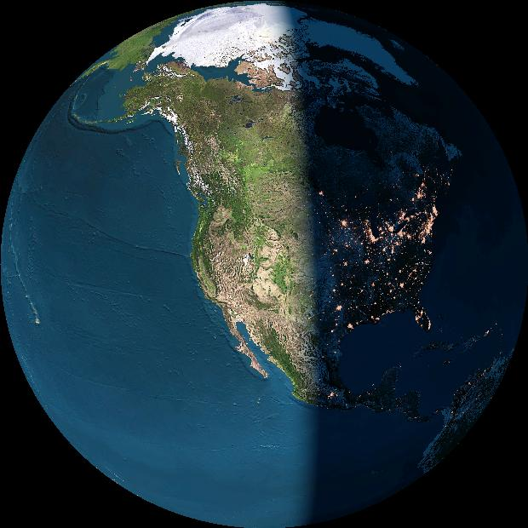
Biodiversity
data structure
Vegetation Type
Vegetation type database
Locality
Plot Observation/
Collection Event
Plot/Inventory database
Specimen or Object
Occurrence database
Bio-Taxon
Taxonomic database

Slide 3
Plot
Core elements
of VegBank
Plot
Observation
Taxon
Observation
Plot
Interpretation
Taxon
Interpretation
Plot
Assignment
Taxon
Assignment

Slide 4
VegBank consists of three integrated databases
The Plot Database
The Plant Database
The Community Database

Slide 5
Taxonomic database challenge:
Standardizing organisms and communities
The problem:
Integration of data potentially representing different times, places, investigators and taxonomic standards.
The traditional solution:
A standard checklists of organisms.

Slide 6
Standard checklists for Taxa
Representative examples for higher plants in North America / US
USDA Plants http://plants.usda.gov
ITIS http://www.itis.usda.gov
NatureServe http://www.natureserve.org
BONAP http://www.bonap.org/
Flora North America http://hua.huh.harvard.edu/FNA/
These are intended to be checklists wherein the taxa recognized perfectly partition all plants. The lists can be dynamic.

Slide 7
Most taxon checklists fail to allow effective dataset integration
The reasons include:
The user cannot reconstruct the database as viewed at an arbitrary time in the past,
Taxonomic concepts are not defined (just lists),
Multiple party perspectives on taxonomic concepts and names cannot be supported or reconciled.

Slide 8
Multiple concepts of
Rhynchospora plumosa s.l.
Elliot 1816
Gray
1834
Chapman
1860
Kral
2003
Peet
2004?
R. plumosa
R. plumosa
v. plumosa
R. plumosa
R. sp. 1
1
R. plumosa
R plumosa
v. intermedia
R. intermedia
R. plumosa
v. plumosa
2
R. plumosa
v. interrupta
R. pineticola
R. plumosa
v. pineticola
3

Slide 9
Taxonomic theory
A taxon concept represents a unique combination of a name and a reference
“Taxon concept” roughly equivalent to
“Potential taxon” & “assertion”
Name
Concept
Reference

Slide 10
A usage represents an association of a concept with a name.
Name
Usage
Concept
Usage does not appear in the IOPI model, but instead is a special case of concept
Usage can be used to apply multiple name systems to a concept
Desirable for stability in recognized concepts

Slide 11
Three concepts of shagbark hickory
Splitting one species into two illustrates the ambiguity often associated with scientific names.
Carya carolinae-septentrionalis
(Ashe) Engler & Graebner
Carya ovata
(Miller) K. Koch
Carya ovata
(Miller) K. Koch
sec. Gleason 1952
sec. Radford et al. 1968

Slide 12
Six shagbark hickory concepts
Possible synonyms are listed together
Names
Carya ovata
Carya carolinae-septentrionalis
Carya ovata v. ovata
Carya ovata v. australis
Concepts
(One shagbark)
C. ovata sec Gleason ’52
C. ovata sec FNA ‘97
(Southern shagbark)
C. carolinae-s. sec Radford ‘68
C. ovata v. australis sec FNA ‘97
(Northern shagbark)
C. ovata sec Radford ‘68
C. ovata (v. ovata) sec FNA ‘97
References
Gleason 1952. Britton & Brown
Radford et al. 1968. Flora Carolinas
Stone 1997. Flora North America

Slide 13
Data relationships
VegBank taxonomic data model
Name
Concept
Start, Stop
ConceptStatus
Level, Parent
Usage
Start, Stop
NameStatus
Name system
Reference
Single party, dynamic perspective

Slide 14
Party Perspective
The Party Perspective on a concept includes:
  Status – Standard, Nonstandard, Undetermined
  Correlation with other concepts –
  Equal, Greater, Lesser, Overlap, Undetermined.
  Lineage – Predecessor and Successor concepts.
  Start & Stop dates for tracking changes

Slide 15
Application of Party Perspective
Party
Concept
ITIS
FNA Committee
NatureServe
Carya ovata sec Gleason 1952
Carya ovata sec FNA 1997
Carya ovata sec Radford 1968
Carya carolinae sec Radford 1968
Carya ovata (ovata) sec FNA 1997
Carya ovata australis sec FNA 1997
Status and usage
Party Concept Status Start Usage:SciName
ITIS ovata –G52 NS 1996
ITIS ovata –R68 St 1996 C. ovata
ITIS carolinae-s –R68 St 1996 C. carolinae-sept.
ITIS carolinae-s –R68 NS 2000
ITIS ovata aust –FNA St 2000 C. carolinae-sept.
ITIS ovata – R68 NS 2000
ITIS ovata ovata –FNA St 2000 C. ovata

Slide 16
Data relationships
VegBank taxonomic data model
Name
Concept
Usage
Start, Stop
NameStatus
Name system
Status
Start, Stop
ConceptStatus
Level, Parent
Party
Reference
Multiple parties, dynamic perspectives

Slide 17
Data relationships
VegBank taxonomic data model
Name
Concept
Usage
Start, Stop
NameStatus
Name system
Correlation
Party
Status
Start, Stop
ConceptStatus
Level, Parent
Lineage
Reference
With party correlations and lineages

Slide 18
Intended functionality
Organisms are labeled by reference to concept (name-reference combination),
Party perspectives on concepts and names can be dynamic, but remain perfectly archived,
User can select which party perspective to follow,
Different names systems are supported,
Enhanced stability in recognized concepts by separating name assignment and rank from concept.

Slide 19
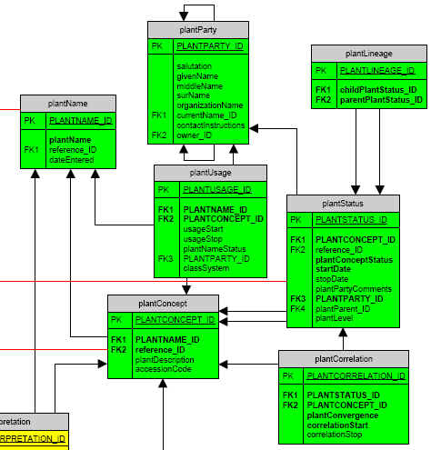
Plant Taxa
Name
(Reference)
Concept
Status
Correlation
Lineage
Usage
Party

Slide 20
State of Taxon Concept Development
TDWG, IOPI, & SEEK
VegBank
3. Collaborators
NatureServe Biotics4
USDA PLANTS & ITIS

Slide 21
VegBank taxon data content
Prototype populated with USDA PLANTS lists and synonyms = weak concepts.
Contract with NatureServe and John Kartesz
Develop reference-based concepts for 14000 by July 2004 of the ~32000 vascular plant taxa at species level and below
List of unambiguous taxa (~6000?)
Treatment of most ambiguous taxa
Demonstration mapping to FNA
A few demosntration groups in depth

Slide 22
Concept workbench
Concept workbench for both plant concepts and community concepts is planned.

Slide 23
The VegBank ERD
Available at http://vegbank.org
Click tables for data dictionary and constrained vocabulary

Slide 24
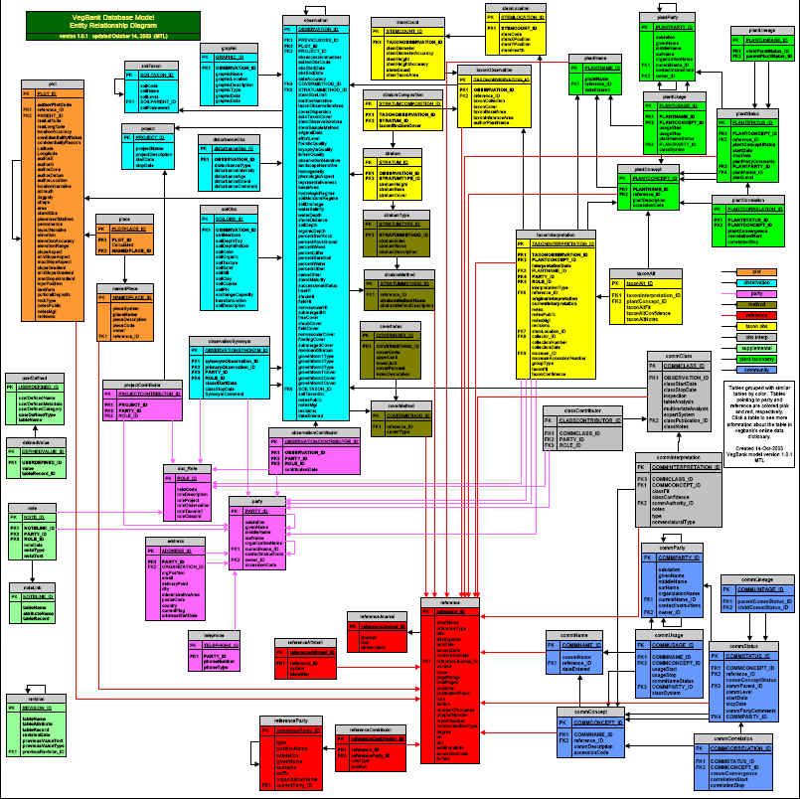

Slide 25
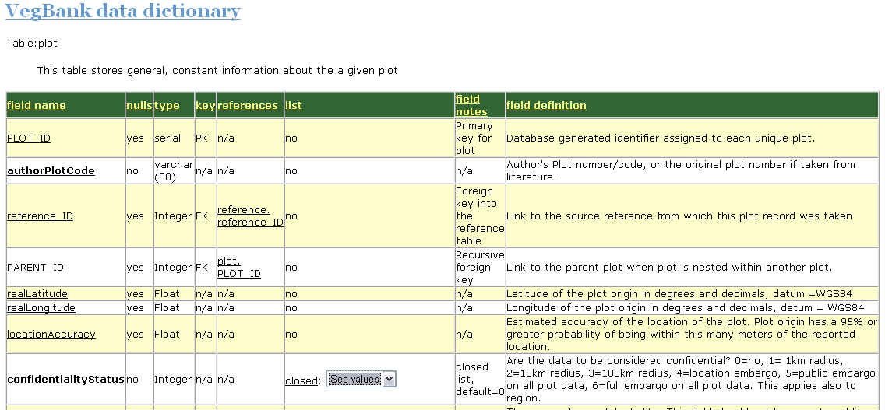
The data dictionary provides critical information such as field types, field definitions, and constrained vocabularies.

Slide 26
Example plot metadata
Project attributes
Plot parties
Observation date
Cover & stratum methods
Plot selection
Plot layout
Site data
Geographic data

Slide 27
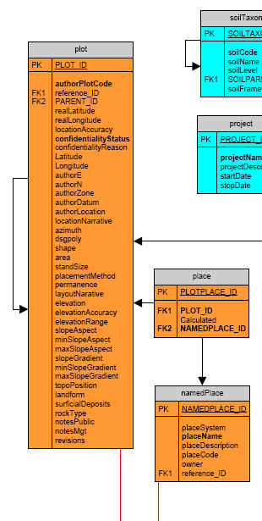
Plot
Place
Named Place

Slide 28
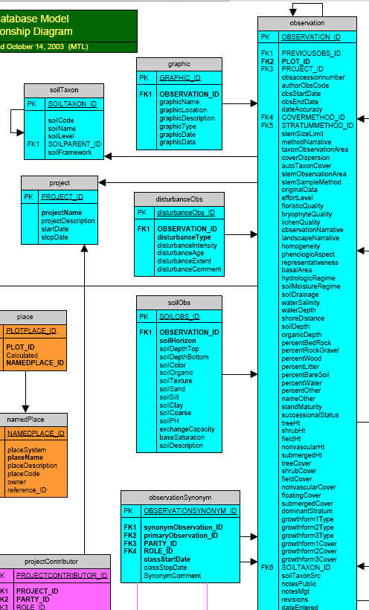
Observation
Project
Disturbance Obs
Soil Obs
Graphic
Observation Synonym
Cover method

Slide 29
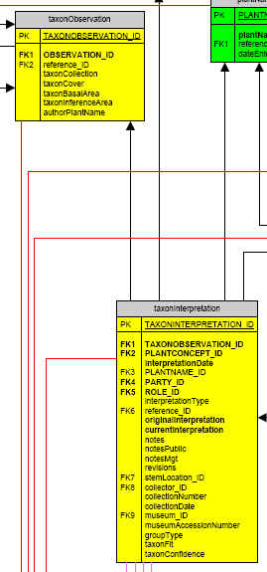
Taxon Observation
Importance values
Author name
Taxon Interpretation
Which taxon
Who decided and why
Stem or collective
Voucher information

Slide 30
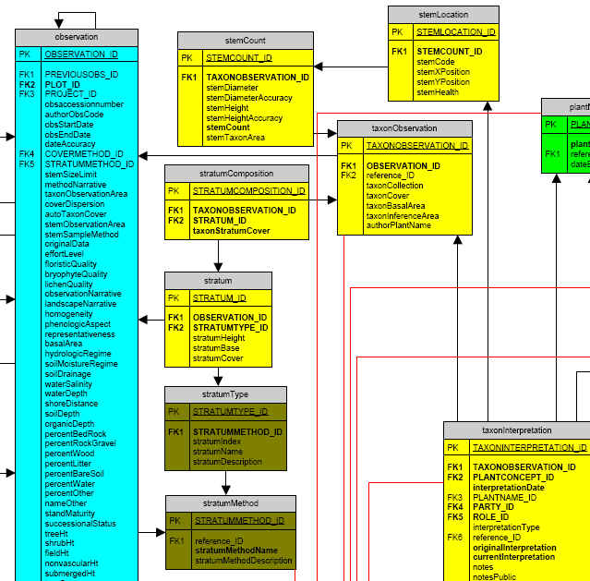
Stems & Strata
Stratum method
Stratum type
Stratum
Stratum comp.
Taxon observ.
Stem count
Stem location

Slide 31
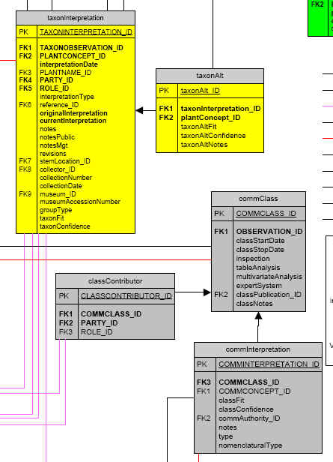
Interpretation
continued
Plants
Taxon Interpretation
Taxon Alt
Communities
Class
Interpretation

Slide 32
Problematic taxa of ecological datasets
Carex sp.
Crustose lichen
Hairy sedge #6.
Sporobolus sp. #1
Picea glauca – engelmannii complex
Potentilla simplex or P. canadensis
Carya ovata sec. Gleason 1952

Slide 33
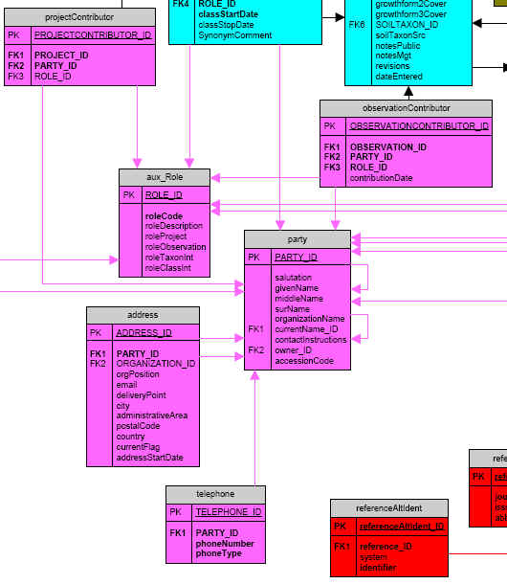
Party
Project Contr.
Obs Contr.
Role
Address
Telephone

Slide 34
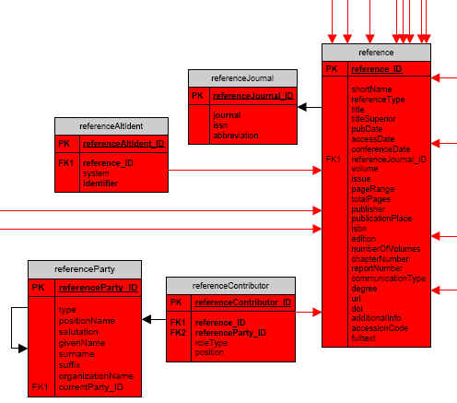
References

Slide 35
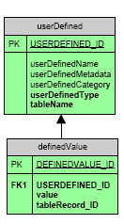
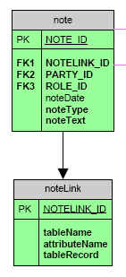
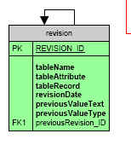
Utilities
User defined
Notes
Revisions

Slide 36
Intellectual Property issues
Rare species
Private lands
Working datasets – not yet complete
Ongoing research
Citation
Annotation

Slide 37
Connectivity & Collaboration
Loaders for popular plot databases
Data exchange standards for plots
Data exchange standards for taxa
Refresh activities among VegBank, Biotics, and ITIS/PLANTS.
Distributed VegBank systems
Deep links into VegBank

Slide 38
Possible VegBank nodes
US – ESA
New Zealand
Canada
Amazon collaboration
Europe
South Africa

Slide 39
Tools for semantic mediation & data discovery: Science Environment for Ecological Knowledge
To improve how researchers can
gain global access to ecological data and information,
2) rapidly locate and utilize distributed computational services, and
3) capture, reproduce, and extend the analysis process itself.

Slide 40
The SEEK project
Standard data structures.
Public data archives (deposit, withdraw, cite).
Standard exchange formats.
Standard protocols.
Tools for semantic mediation & data discovery.

